Slide 1
Uniform Cost Search (UCS)
Lecture 4

Slide 2
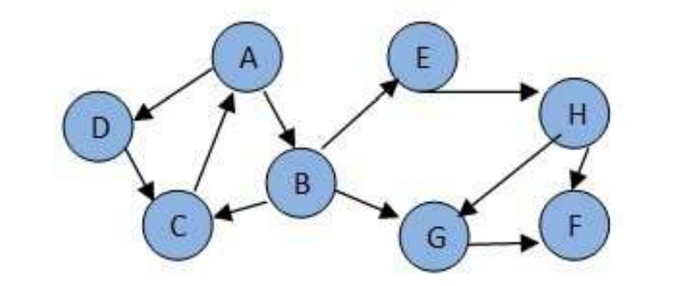
Quiz
Use DFS (alphabetically) to find the path between A and F for the following search space:

Slide 3
Uniform Cost Search (UCS)
UCS is uninformed (blind) search algorithm.
UCS algorithm uses the lowest cumulative cost to find a path between the start (source) node and the goal (distination) node.
The UCS is implemented using a priority queue.

Slide 4
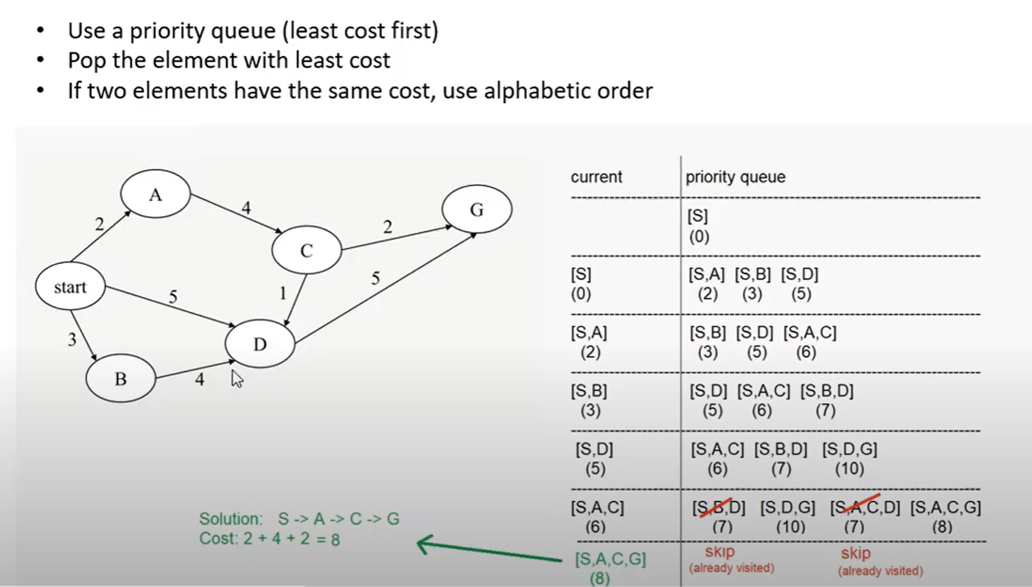
Example 1:

Slide 5
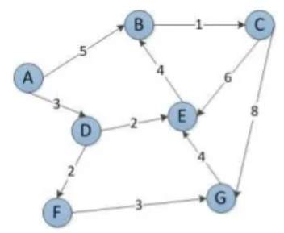
Example 2:
Use Uniform Cost Search (alphabetically) to find the path between A and G for the following search space:

Slide 6
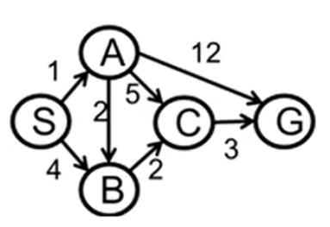
Example 3:
Use Uniform Cost Search (alphabetically) to find the path between S and G for the following search space:

