Slide 1
Python Programming Language Lecture 1

Slide 2
History of Python
Python was developed by Guido van Rossum in the late eighties and early nineties at the National Research Institute for Mathematics and Computer Science in the Netherlands.
Python is derived from many other languages, including ABC, Modula-3, C, C++, Algol-68, SmallTalk, and Unix shell and other scripting languages.
Python is copyrighted. Like Perl, Python source code is now available under the GNU General Public License (GPL).
- Python is now maintained by a core development team at the institute, although Guido van Rossum still holds a vital role in directing its progress.

Slide 3
Features of Python
Interpreted − Python is processed at runtime by the interpreter. You do not need to compile your program before executing it. This is similar to PERL and PHP.
Interactive − You can actually sit at a Python prompt and interact with the interpreter directly to write your programs.
Object-Oriented − Python supports Object-Oriented style or technique of programming that encapsulates code within objects.
Python is a Beginner's Language − Python is a great language for the beginner-level programmers and supports the development of a wide range of applications from simple text processing to WWW browsers to games.

Slide 4
Features of Python
Easy-to-learn − Python has few keywords, simple structure, and a clearly defined syntax. This allows the student to pick up the language quickly.
Easy-to-read − Python code is more clearly defined and visible to the eyes.
Easy-to-maintain − Python's source code is fairly easy-to-maintain.
A broad standard library − Python's bulk of the library is very portable and cross-platform compatible on UNIX, Windows, and Macintosh.

Slide 5
Features of Python
Portable − Python can run on a wide variety of hardware platforms and has the same interface on all platforms.
Extendable − You can add low-level modules to the Python interpreter. These modules enable programmers to add to or customize their tools to be more efficient.
Databases − Python provides interfaces to all major commercial
databases.
GUI Programming − Python supports GUI applications that can be created and ported to many system calls, libraries and windows systems, such as Windows MFC, Macintosh, and the X Window system of Unix

Slide 6
Examples of projects using Python
Google
Youtube
Instgram

Slide 7
Variable Types
As in every language, a variable is the name of a memory location.
Python is weakly typed That is, you don’t declare variables to be a specific type.
A variable has the type that corresponds to the value you assign to it.
Variable names begin with a letter or an underscore and can contain letters, numbers, and underscores.
Python has reserved words that you can’t use as variable names.

Slide 8
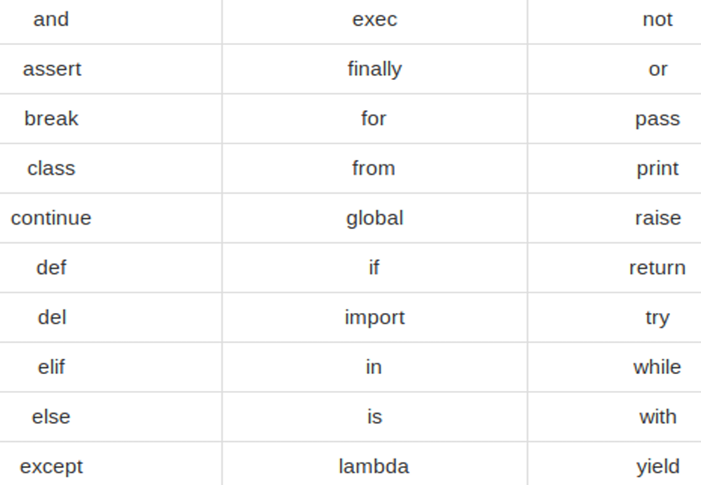
Python Reserved Words

Slide 9
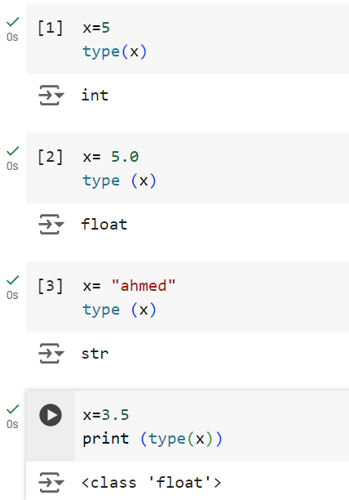
Examples

Slide 10
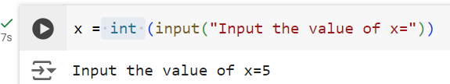
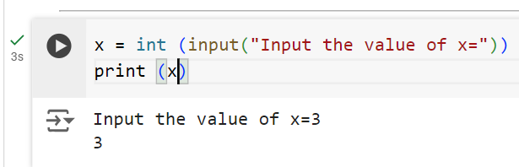
Input and Print
Input take the values from the user as shown in the example:
Important Note: 1- We must determine the type of the value we want to read it.
2- Variable x different from variable X.

Slide 11
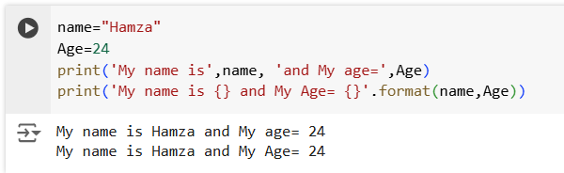
Using Format with Print

Slide 12
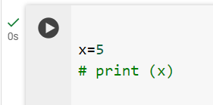
Comments
In python, a line begins with # consider comment
Example:

Slide 13
Exercise
Write a python program which accept the length side of a square from a user and compute the area.
Write a python program which accept the radius of a circle from a user and compute the area.

Slide 14
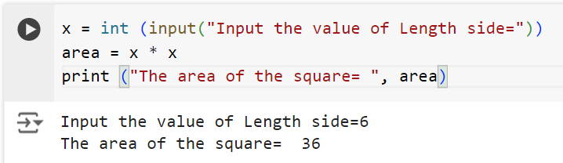
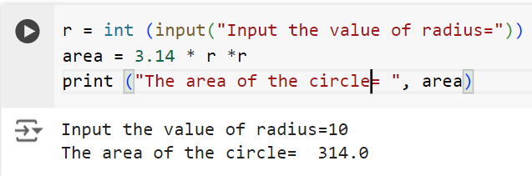
Solutions

Slide 15
Operators
Types of Operators
1- Arithmetic
2- Relational
3- Logical

Slide 16
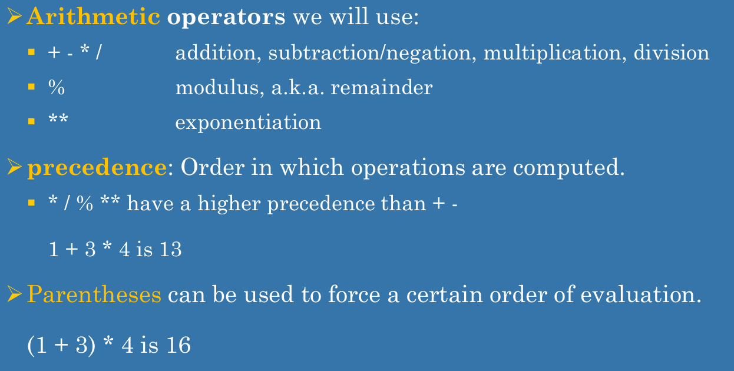
Arithmetic Operators

Slide 17
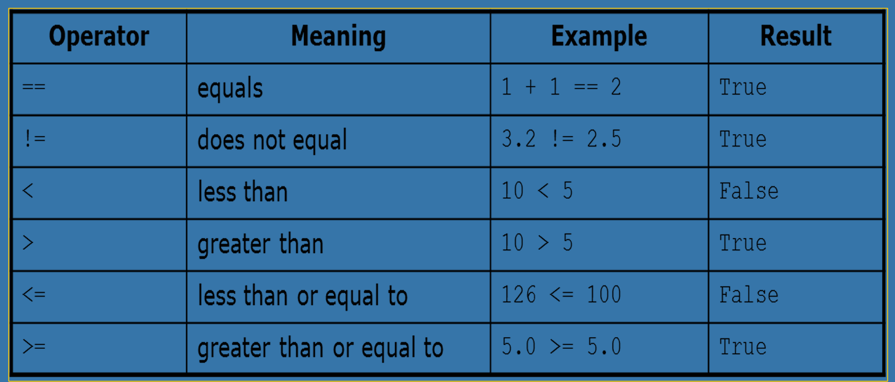
Relational Operators

Slide 18
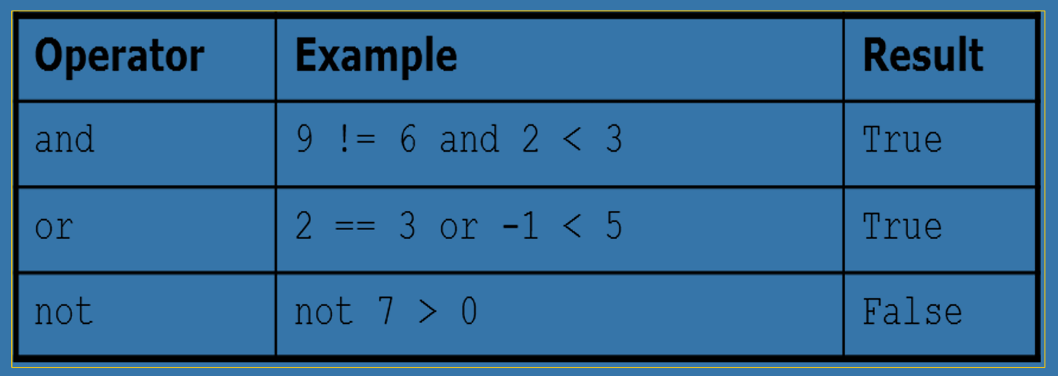
Logical Operators

Slide 19
Indentation
Python provides no braces to indicate blocks of code for class and function definitions or flow control. Blocks of code are denoted by line indentation, which is rigidly enforced.
The number of spaces in the indentation is variable, but all statements within the block must be indented the same amount.

Slide 20
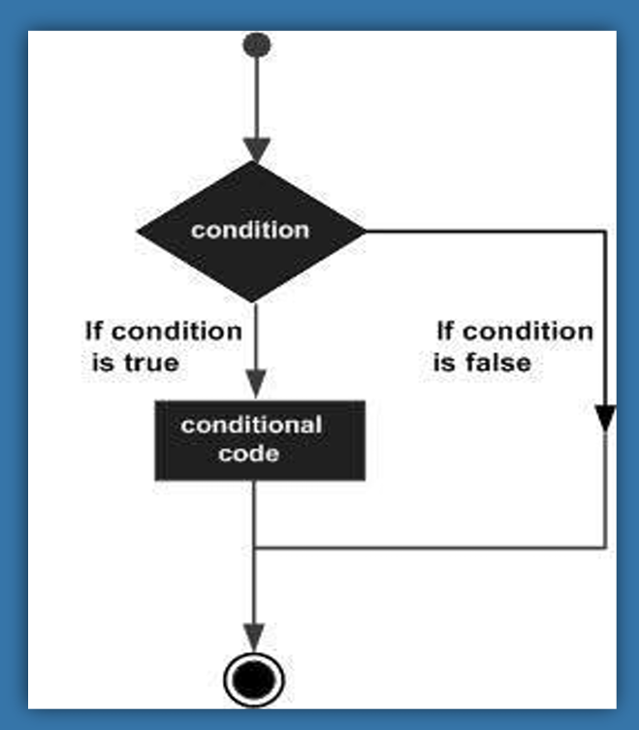
Decision Making (The if statement)

Slide 21
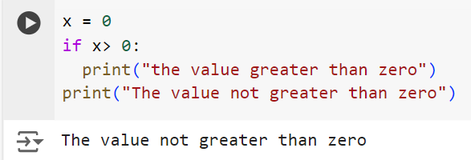
Example

Slide 22
If-else statement
if <condition>:
<statements>
else:
<statements>
Note the colon following the else

Slide 23
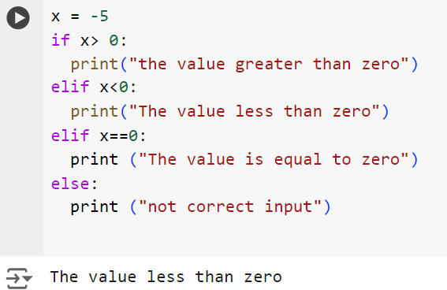
Elif statement

Slide 24
Exercises
Write a Python program to find whether a given number (accept from the user) is even or odd, print out an appropriate message to the user.
Write a Python program to sum of three given integers. However, if two values are equal sum will be zero.

Slide 25
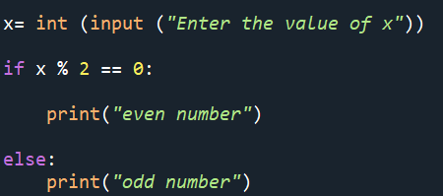
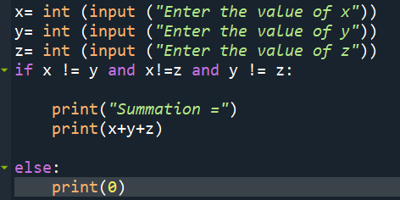
Solutions

