Slide 1
Artificial Intelligence
Lecture 11

Slide 2
Data, Information and Knowledge
Data are raw alphanumeric values.
Information is essentially processed data.
Knowledge is what we know. Knowledge is unique to each individual and is the accumulation of past experience and insight that shapes the lens by which we interpret and assign meaning to information.

Slide 3
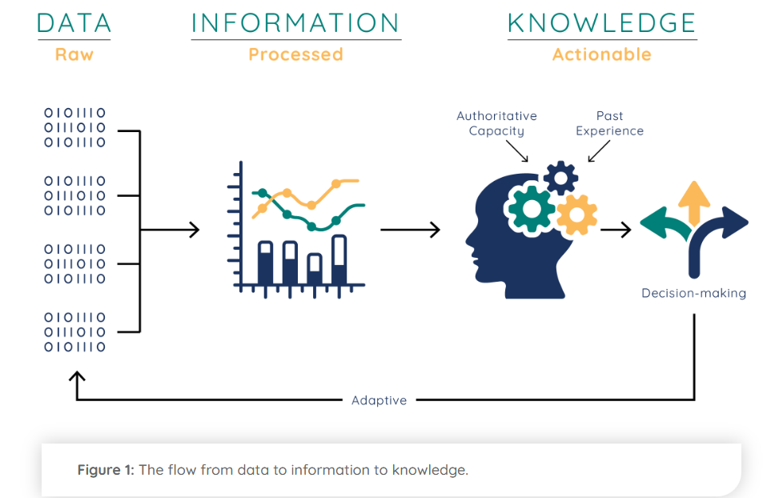

Slide 4
Knowledge Representation
Knowledge representation: refers to the techniques used to represent information about the world in a form that a computer system can utilize to solve complex tasks such as diagnosing a problem, understanding natural language, or planning actions.
There are many methods can be used for knowledge representation and they can be described as follows:-
1. Propositional Logic
2. Predicate Logic
3. Semantic Network
4. Conceptual Graph
5. Frame Representation
6. Script Representation

Slide 5
1. Propositional Logic (calculus)
• Truth symbols: true, false
• Propositional symbols: P, Q, S, ...
• Wrapping parentheses: ( … )
• Sentences are combined by connectives:
 ...and [conjunction]
 ...or [disjunction]
⇒ ...implies [implication / conditional]
 .is equivalent [biconditional]
➢ ...not [negation]

Slide 6
Examples
It is hot (Fact)
P
It is not hot (Fact)
ךP
If it is raining, then will not go to mountain (Rule)
P → ךQ
The food is good and the service is good (Fact)
X ∧ Y

Slide 7
If the food is good and the service is good then the restaurant is good (Rule)
X ∧ Y → Z
Note: The result depend on the type of relation.
X | Y | Z
T | T | T
T | F | F
F | T | F
F | F | F

Slide 8
Examples
Represent the following knowledge using the propositional logic method.
“If it is sunny today, then the sun shines on the screen. If the sunshines on the screen, the blinds are brought down. The blinds are not down. Is it sunny today?”
Answer: P= It is sunny today. Q= the sun shines on the screen.
R= the blinds are brought down. ךR= The blinds are not down.
P?=Is it sunny today?

Slide 9
2. Predicate Logic
Predicate logic provides formalism for performing the analysis of prepositions and additional methods for reasoning with quantified expressions.
Well formed formula (WFF): It is a well-formulated sentence that we will deal with.
Examples
All basketball players are tall.
∀X play(X, basketball) →tall(X)
John likes anyone who likes books.
like(X,book) →like(john,X)
Nobody likes taxes
ך∃X like(X,taxes)
John did not study but he is lucky
ךstudy(john)∧luky(john)
All cats and dogs are animals
∀X∀Y cats(X) ∧dogs(Y) →animals(X)∧animals(Y)

Slide 10
Examples
Represent the following knowledge using the predicate logic method.
1- Ahmed is a boy.
boy(ahmed)
2- She has a story
has(she, story)
3- Ali is a clever student
clever(ali, student) or clever(ali) ∧ student (ali)
4- Yassir has a white car
has (yassir,car) ∧ color(car, white)

Slide 11
Examples
5- Today is sunny day.
sunny(today)
6- Esraa has 5 books.
has(esraa, book) ∧ number(book, 5)
7- Ayman is going to school now.
go(ayman, school) ∧ time(now)
8- I have one or two books.
have(i,book)∧ (number(book, one)V number(book, two))

Slide 12



Examples
9- Marcus tried to assassinate Caesar.
assassinate(marcus, caesar).
10- There is a person who wrote computer chess.
: write(X, computer chess)
11- All Romans were either loyal to Caesar or hated him.
:Roman(X) loaylto(X, caesar) V hate(X, caesar).
12- Everyone is loyal to someone.
loyalto(X,Y)

Slide 13
Example
13- When I’m scick, I will go to the doctor.
scick(i) go(i, doctor)
14- If student will read well, he will pass.
read(X,well) pass(X)
15- John playing well therefore he will win the game.
play(john,well) win(john,game)

