Slide 1
Python Programming Language Lecture 6
Implementation (Code) for BFS, DFS and UCS

Slide 2
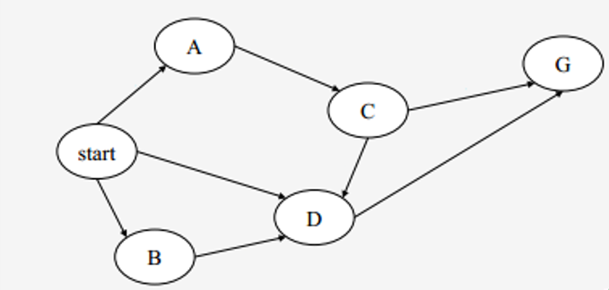
We use the Graph below as an example for BFS and DFS

Slide 3
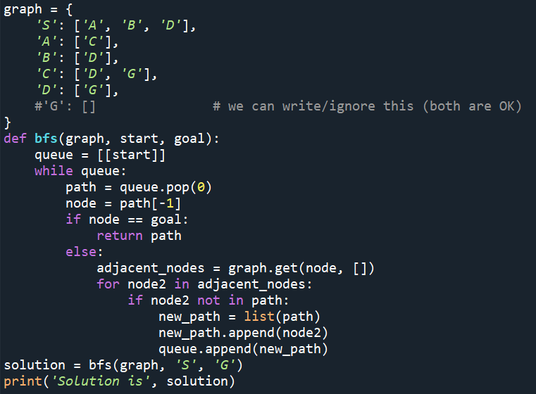
Breadth-First Search (BFS)

Slide 4

Depth-First Search (DFS)

Slide 5
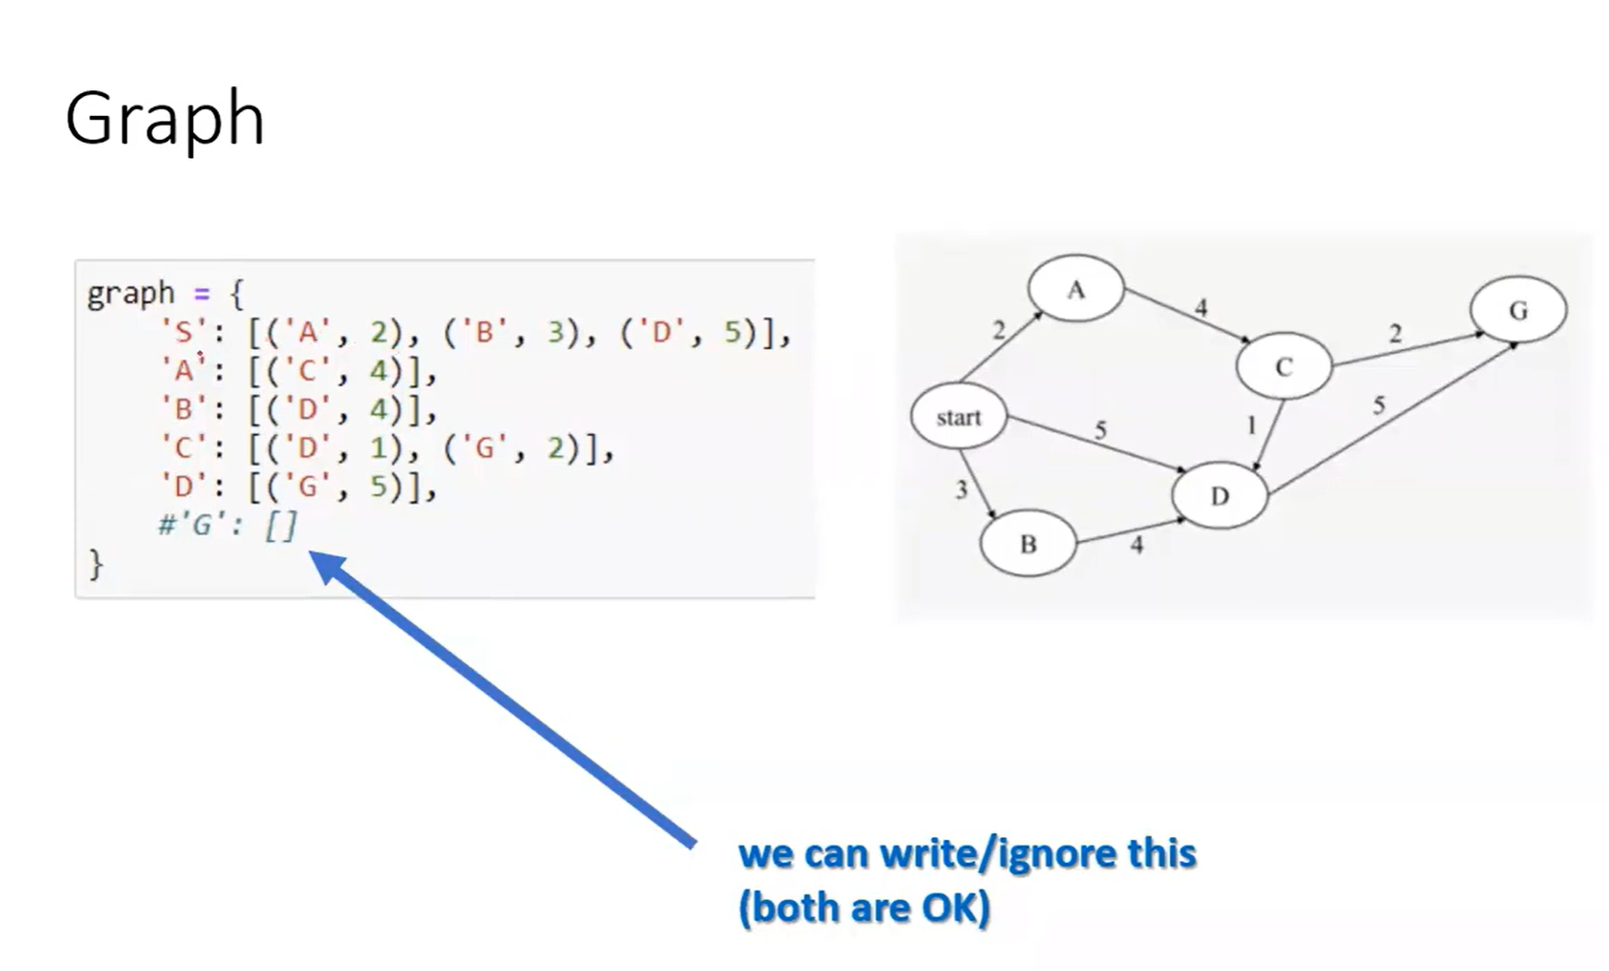
Implementation code of Uniform Cost Search

Slide 6
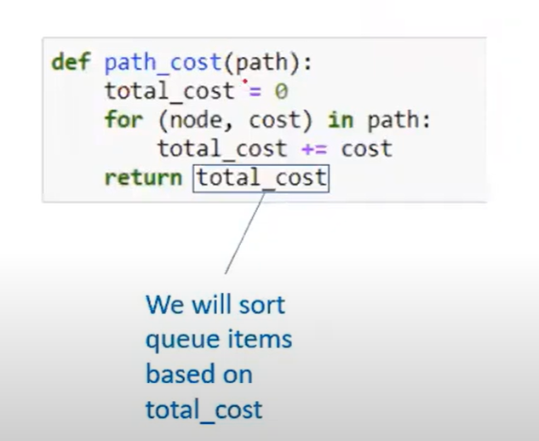

Slide 7
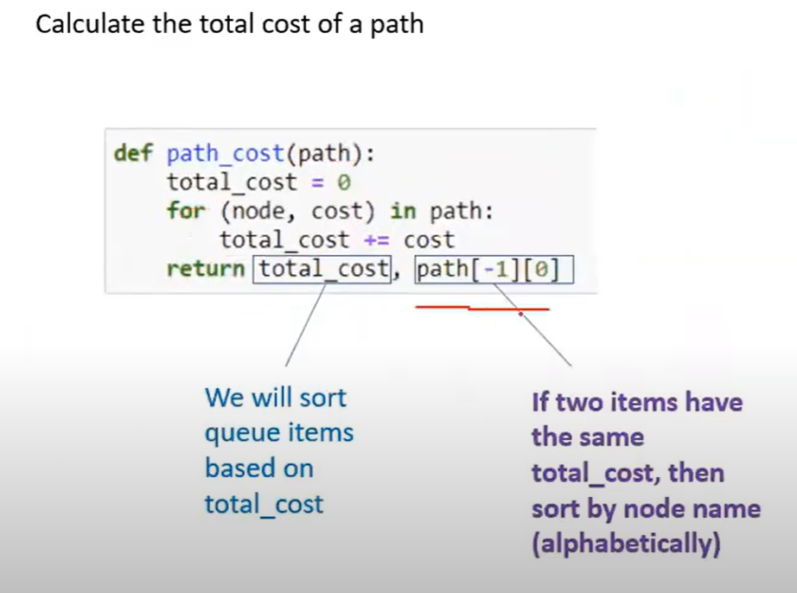

Slide 8
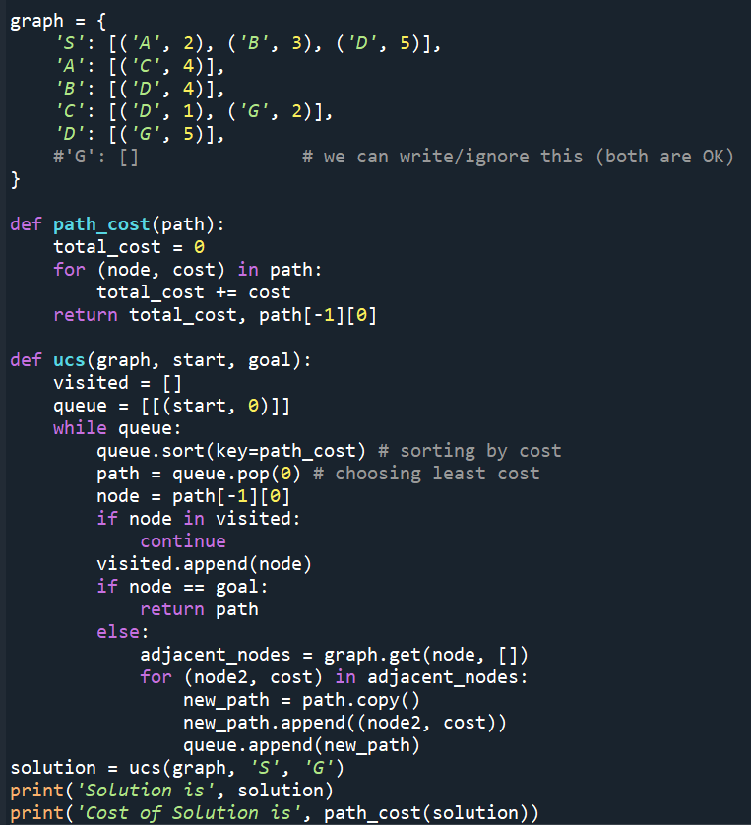
Uniform-Cost Search (UCS)

Slide 9
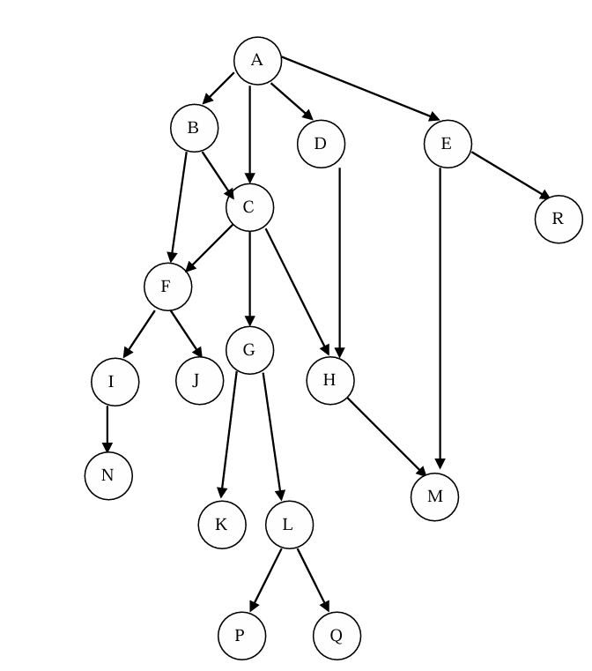
Quiz
Apply BFS and DFS to this Gragh
considering G is the Goal, using
the alaphabitical way.

Slide 10
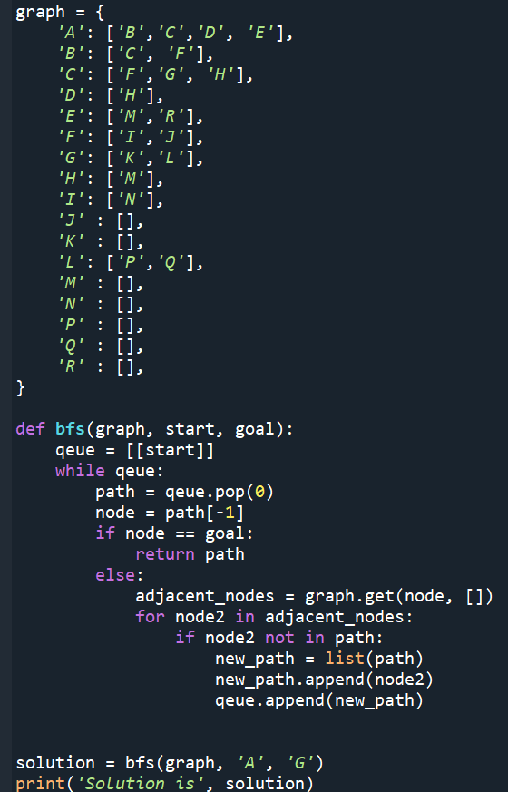
Solution of BFS (Alphabitically)

Slide 11
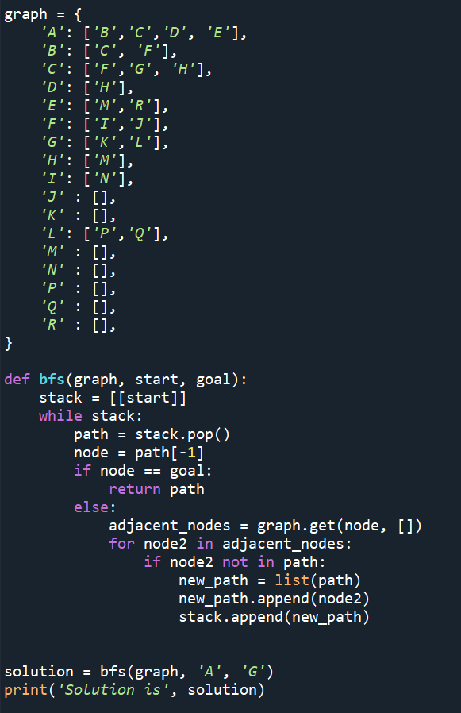

Solution of DFS (Alphabitically)

