Slide 1
Python Programming Language Lecture 3

Slide 2
Lists
The list is a most datatype available in Python which can be written as a list of comma-separated values (items) between square brackets. Important thing about a list is that items in a list need not be of the same type.
➢list1 = ['physics', 'chemistry', 1997, 2000]
➢list2 = [1, 2, 3, 4, 5]

Slide 3
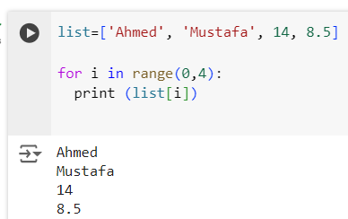
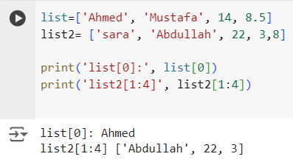
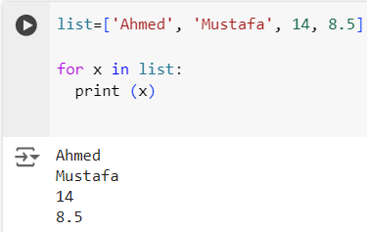
Example

Slide 4
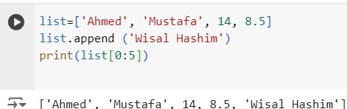

Append() and Insert()
Append() takes one argument and insert element to the end of list, While Insert() takes two arguments, the first used to determine the plae of element and the second for element itself.
Example

Slide 5
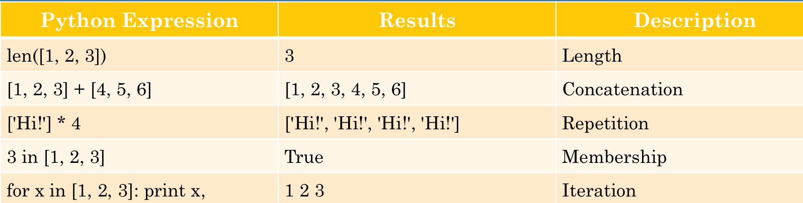
Basic List Operations

Slide 6
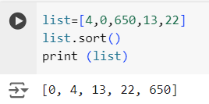
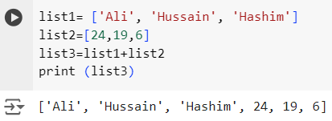
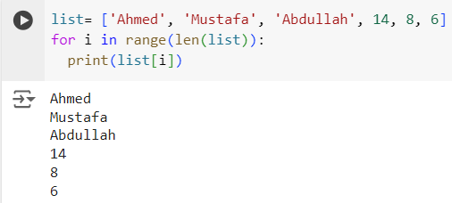
Examples

Slide 7
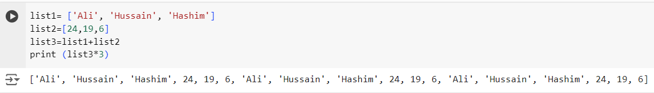
Examples

Slide 8
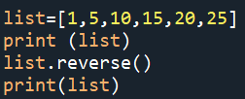



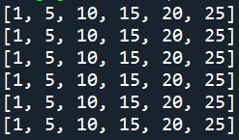
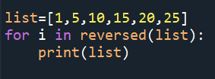
Reverse (), Reversed()
Note: See the difference

Slide 9
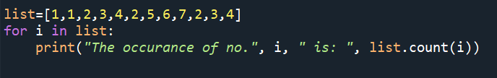
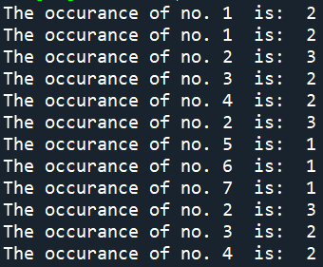
count()
To count the number of appearance of elements in the list we used count() function as shown below:

Slide 10
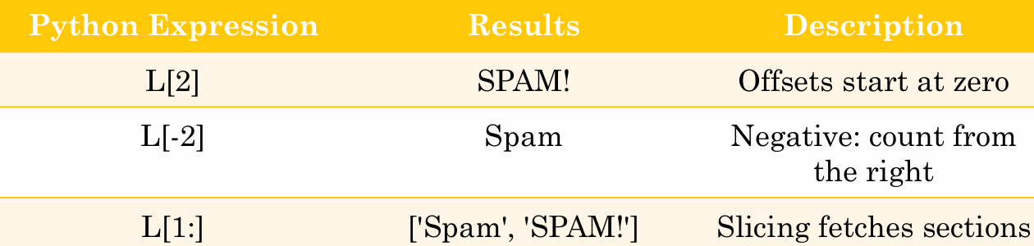
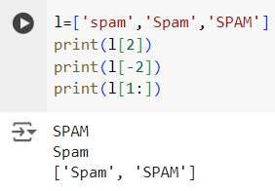
L = ['spam', 'Spam', 'SPAM!’]

Slide 11
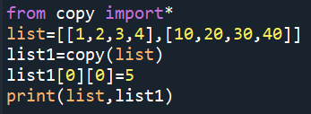
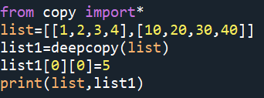
Copy() and deepcopy() with list

Slide 12
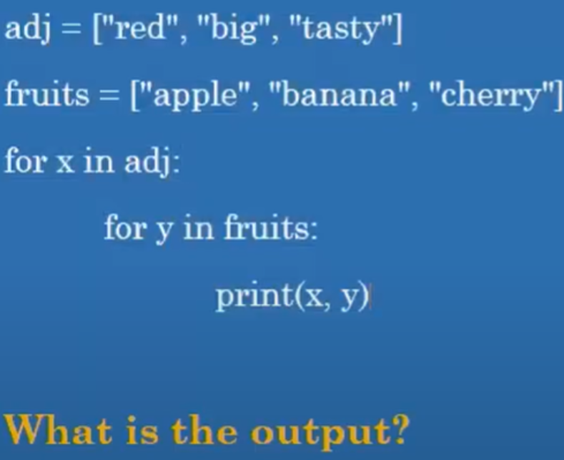
Nested Loop with Lists (Small Quiz)

Slide 13
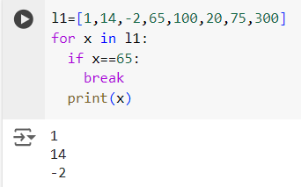
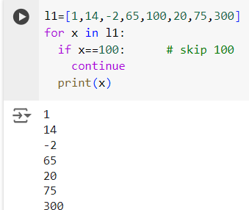
braek, continue

Slide 14
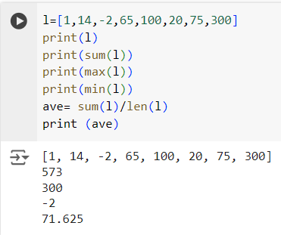
Exercise
Write a Python program to first print all elements in a given list of integers then print the sum of its element and print maximum, minimum and average value in this list.

Slide 15
Tuples
A tuple is a sequence of immutable Python objects. Tuples are sequences, just like lists. The differences between tuples and lists are, the tuples cannot be changed unlike lists and tuples use parentheses, whereas lists use square brackets.
Tuples are immutable which means you cannot update or change the values of tuple elements. You are able to take portions of existing tuples to create new tuples.
Removing individual tuple elements is not possible.

Slide 16
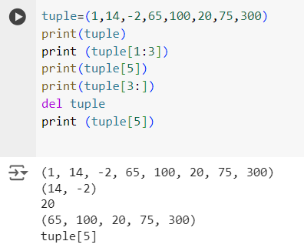
Example

Slide 17

Basic Tuples Operations

Slide 18
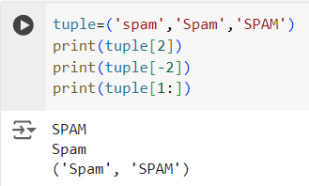
Example

