Slide 1
Python Programming Language
Lecture 10

Slide 2
Pandas Library
Pandas is a Python library used for working with data sets.
It has functions for analyzing, cleaning, exploring, and manipulating data.
The name "Pandas" has a reference to both "Panel Data", and "Python Data Analysis" and was created by Wes McKinney in 2008.
Pandas gives you an important answers about the data such as:
Is there a correlation between two or more columns?

Slide 3
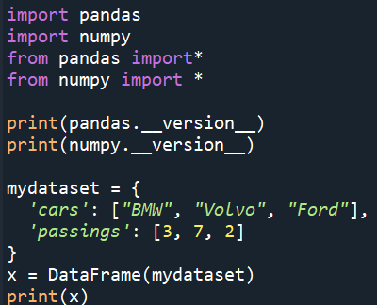
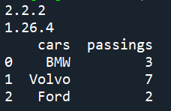
Checking Pandas and numpy Version
The version string is stored under __version__ attribute.
Pandas DataFrame
A Pandas DataFrame is a 2 dimensional data structure, like a 2 dimensional array, or a table with rows and columns.
Example:

Slide 4
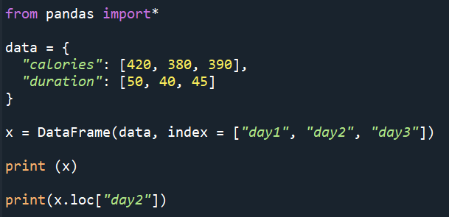
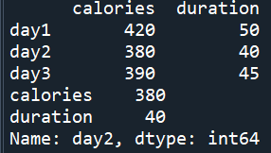
Locate Named Indexes
Use the named index in the loc attribute to return the specified row(s).
Example:

Slide 5
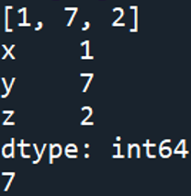
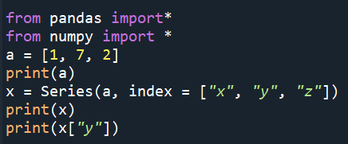
Pandas Series and index
A Pandas Series is like a column in a table. It is a one-dimensional array holding data of any type.
With the index argument, you can name your own labels, which mean you can access an item by referring to the label.
Example:

Slide 6
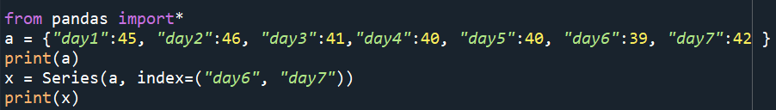
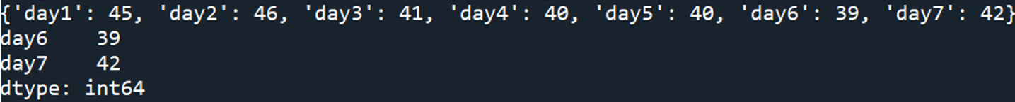
Create a Series with a spesific data

Slide 7
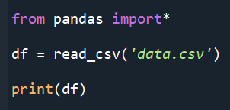
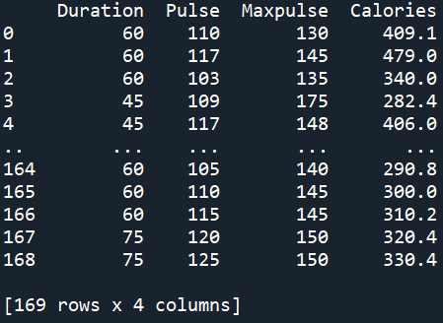
Load Files Into a DataFrame
Note: 1- When we use read () function, the first 5 rows and last 5 rows only appears.
2- If we want to see all the rows in a dataset, we use print(df.to_string())

Slide 8


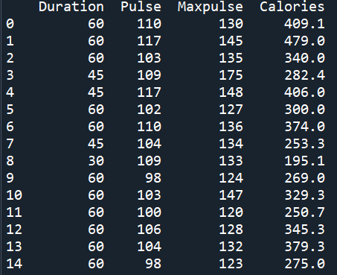
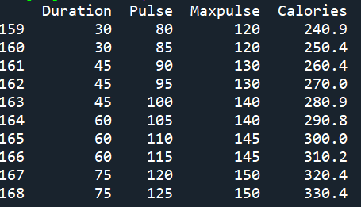
head () and tail () functions
- To print a specific number of rows from the top of a data set we use: head() function as shown in the example below.
- To print a specific number of rows from the bottom of a data set we
use: tail() function.

Slide 9
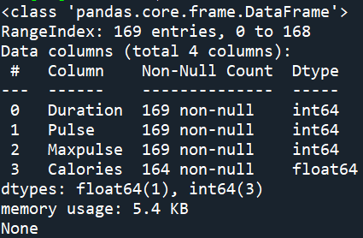
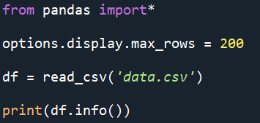
Information About the Data
The DataFrames object has a method called info(), that gives you more information about the data set.
Empty values, or Null values, can be bad when analyzing data, and you should consider removing rows with empty values. This is a step towards what is called cleaning data.

Slide 10
Data Cleaning
- Data cleaning means fixing bad data in your data set.
- Bad data could be:
Empty cells
Data in wrong format
Wrong data
Duplicates

Slide 11
Empty cells
Empty cells can potentially give you a wrong result when you analyze data. Different ways can use to deal with these cells:
1- Remove Rows: One way to deal with empty cells is to remove rows that contain empty cells. This is usually OK, since data sets can be very big, and removing a few rows will not have a big impact on the result.
2- Replace Empty Values: This way you do not have to delete entire rows just because of some empty cells. The fillna() method allows us to replace empty cells with a value.
3- Replace Only For Specified Columns: The example above replaces all empty cells in the whole Data Frame. To only replace empty values for one column, specify the column name for the DataFrame.

Slide 12
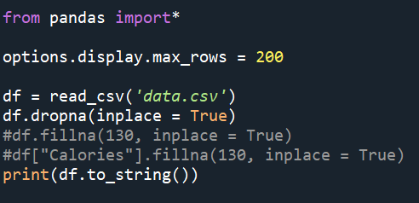
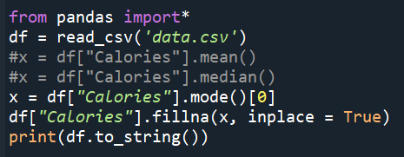
4- Replace Using Mean, Median, or Mode: A common way to replace empty cells, is to calculate the mean, median or mode value of the column.
Pandas uses the mean() median() and mode() methods to calculate the respective values for a specified column.
Examples:

Slide 13
Cleaning Data of Wrong Format
Cells with data of wrong format can make it difficult, or even impossible, to analyze data. To fix it, you have two options:
1- remove the rows.
2- convert all cells in the columns into the same format.
3- For small data sets you might be able to replace the wrong data one by one, but not for big data sets using: df.loc[row_no.,'coloumn_name'] = new value
Example
df.loc[7,'Duration'] = 45

Slide 14
Removing Duplicates
Duplicate rows are rows that have been registered more than one time.
To discover duplicates, we can use the duplicated() method.
The duplicated() method returns a Boolean values for each row, where:
True for every row that is a duplicate, otherwise False.
To remove duplicates, use the drop_duplicates(inplace = True) method.
Note: The (inplace = True) will make sure that the method does NOT return a new DataFrame, but it will remove all duplicates from the original DataFrame.

Slide 15
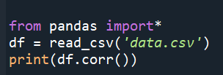
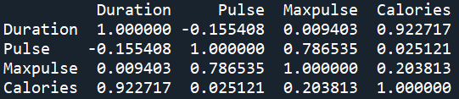
Data Correlations
A great aspect of the Pandas module is the corr() method, that calculates the relationship between each column in your data set.
Example:

Slide 16
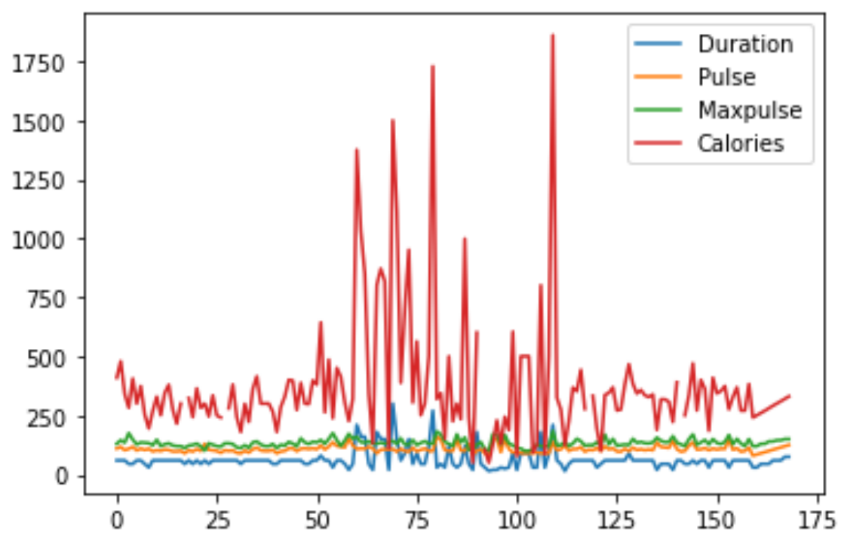
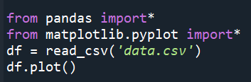
Plotting
Pandas uses the plot() method to create diagrams.
We can use Pyplot, a submodule of the Matplotlib library to visualize the diagram on the screen.
Example:

Slide 17
Scatter Plot
Specify that you want a scatter plot with the kind argument:
kind = 'scatter'
A scatter plot needs an x- and a y-axis.
In the example below we will use "Duration" for the x-axis and "Calories" for the y-axis.
Include the x and y arguments like this:
x = 'Duration', y = 'Calories'

Slide 18
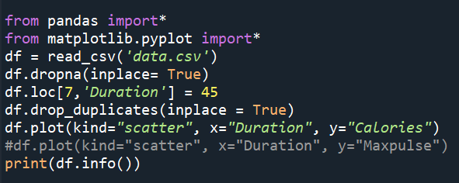
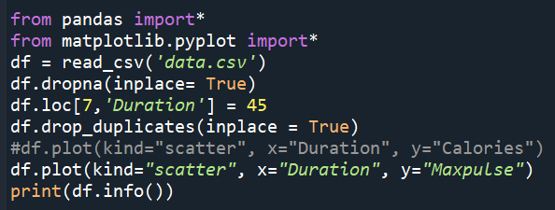
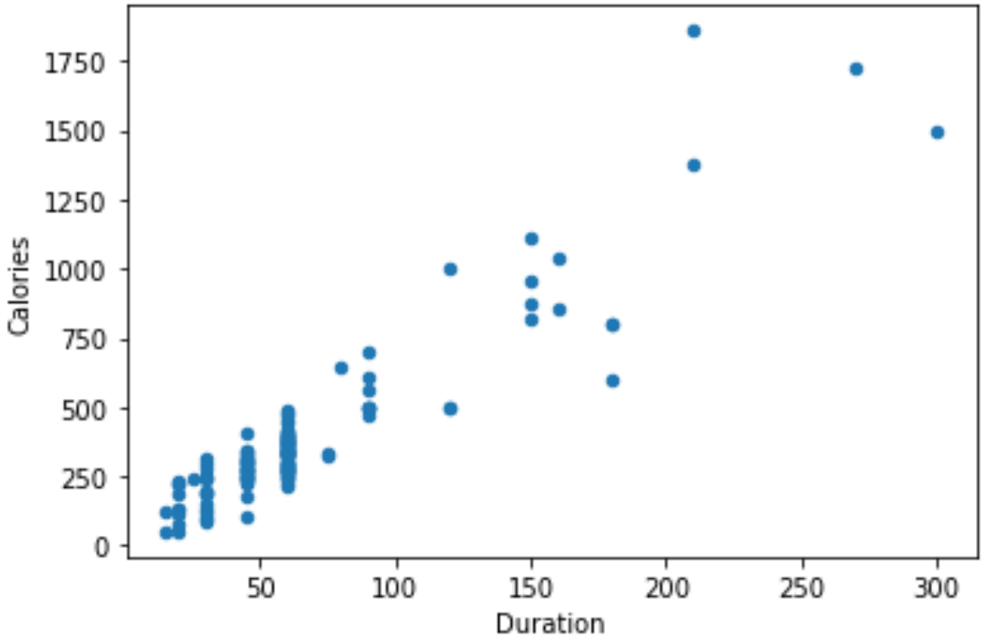
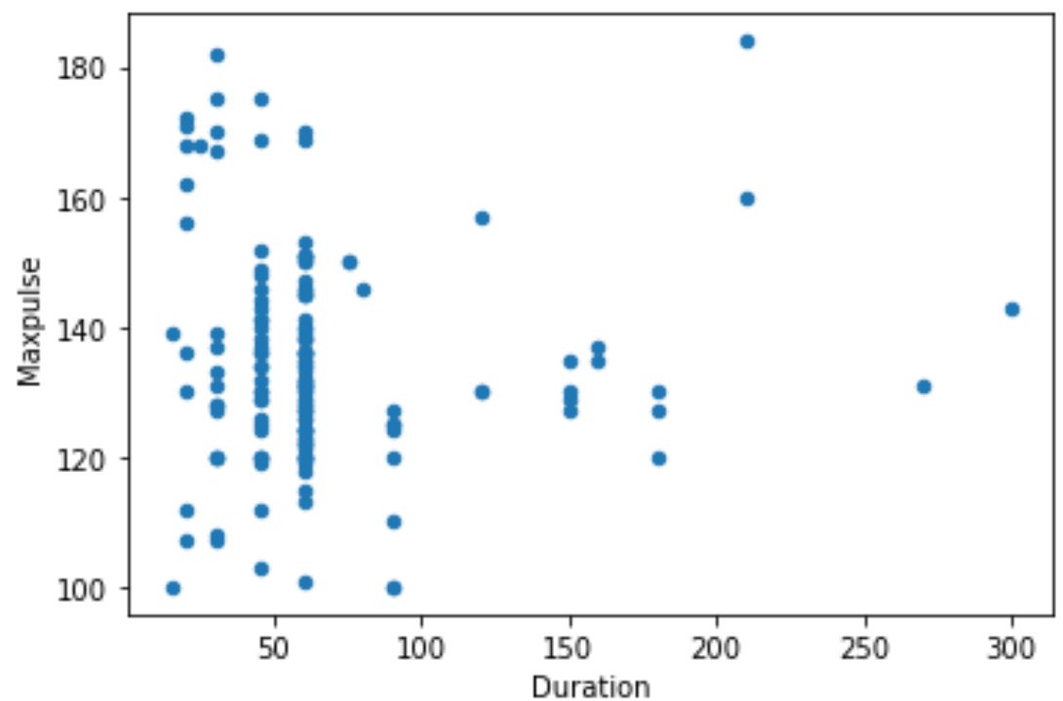
Example

Slide 19
Histogram
Use the kind argument to specify that you want a histogram:
kind = 'hist'
A histogram needs only one column.
A histogram shows us the frequency of each interval. We will use the "Calories" column to create the histogram.

Slide 20
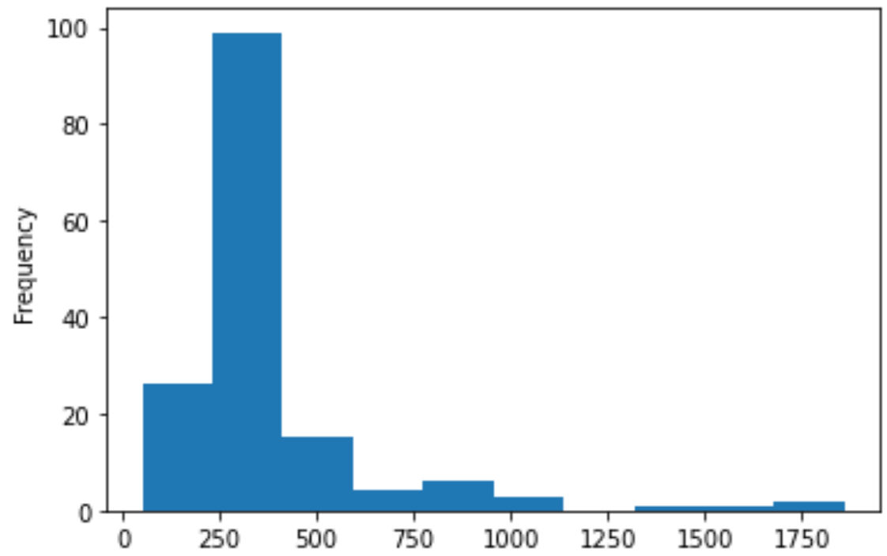
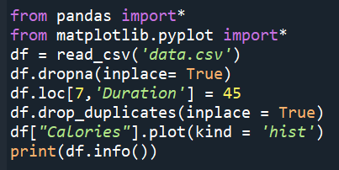
Example

