Slide 1
Python Programming Language
Lecture 5

Slide 2
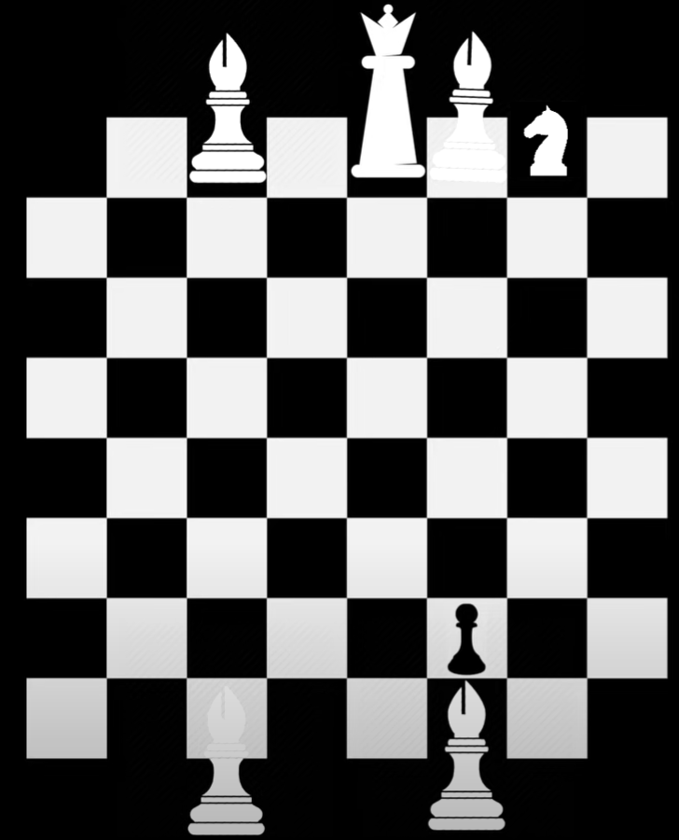
Data Types
Int , float, double, char, Boolean, Byte
Each one of the above data values can store only one value inside it.
What if we need a group of data types?
Assume we have: each piece need to determine different values such as position, Boolean, color?
Who we can solve the above problem?

Slide 3
Classes and Objects
Object: is an instance of class.
Class: is a template of the object.

Slide 4
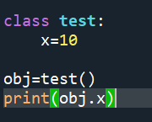
Create Class
- To create a new class, we write:
class ClassName:
For example:

Slide 5
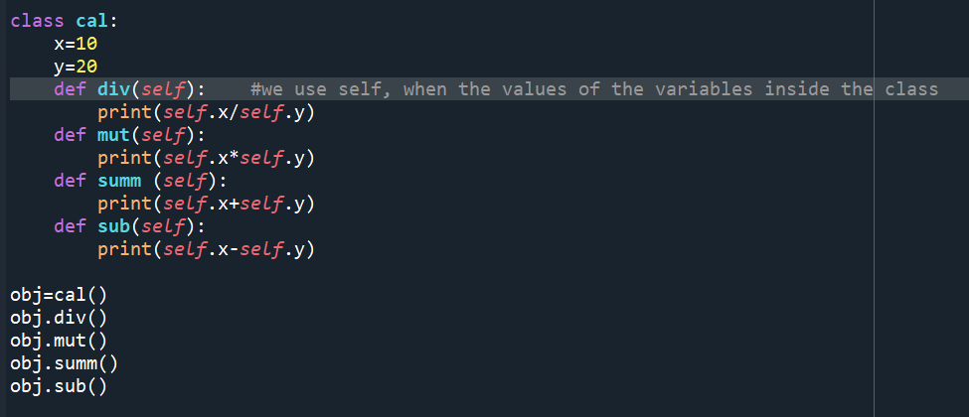
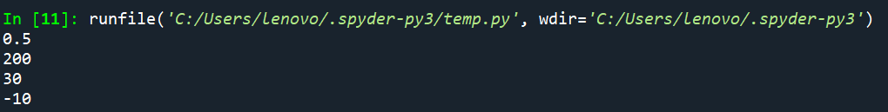
The self parameter is a reference to the current instance of the class, and is used to access variables that belongs to the class.
It does not have to be named self , you can call it whatever you like, but it has to be the first parameter of any function in the class
For Example:

Slide 6
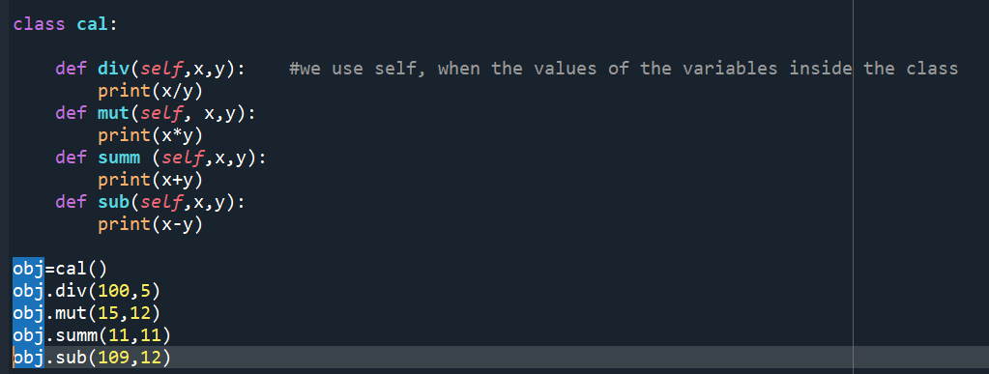
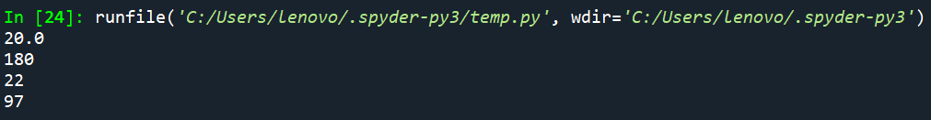
Example

Slide 7
All classes have a function called __init__(), which is always executed when the class is being initiated.
Use the __init__() function to assign values to object properties, or other operations that are necessary to do when the object is being created

Slide 8
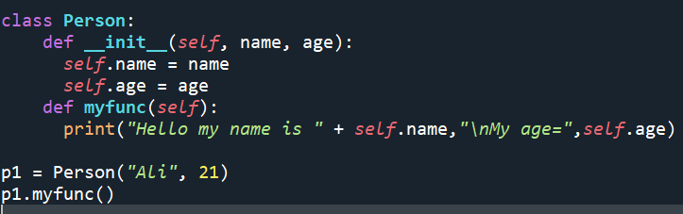
Example

Slide 9
Destroying Objects and class
You can delete only the object
del obj_name
To delete the class, you have to define destructor
def __del__(self):

Slide 10
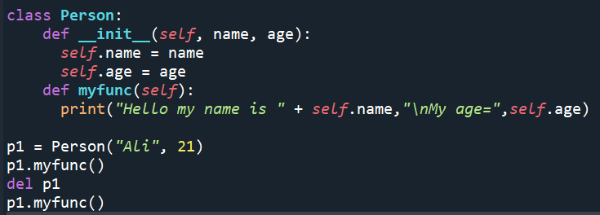
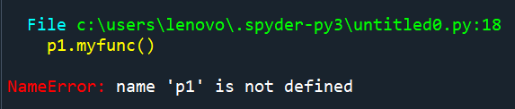
Example (Delete an object)

Slide 11
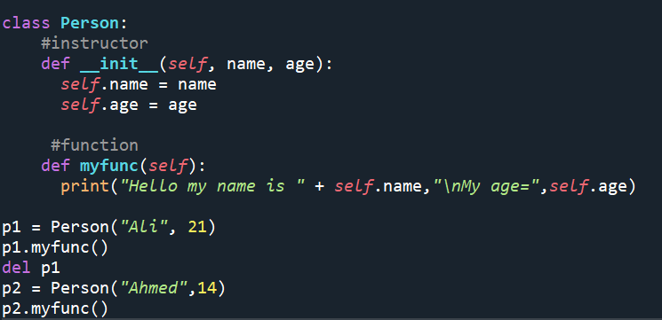
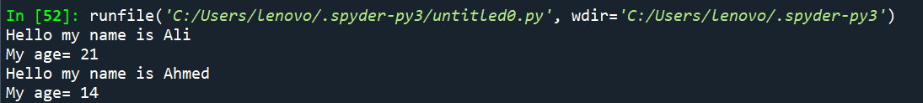

Slide 12
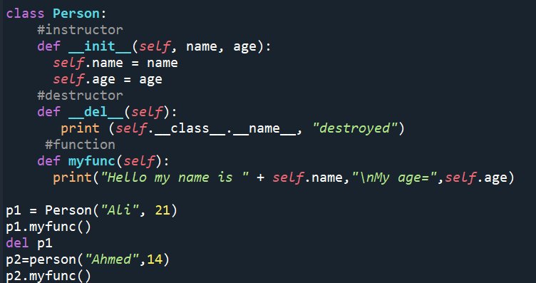
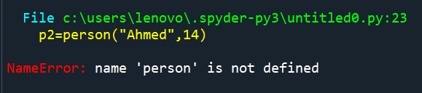
Example (Delete a class)

Slide 13
Class Inheritance
Instead of starting from scratch, you can create a class by deriving it from a preexisting class by listing the parent class in parentheses after the new class name.
The child class inherits the attributes of its parent class, and you can use those attributes as if they were defined in the child class. A child class can also override data members and methods from the parent.

Slide 14
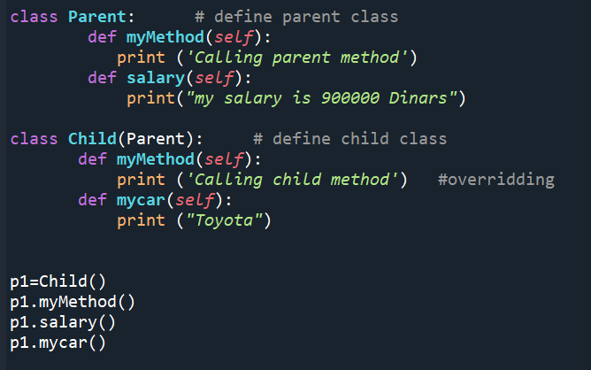
You can always override your parent class methods. One reason for overriding parent's methods is because you may want special or different functionality in your subclass.
For example:

