Slide 1
Artificial Intelligence
Lecture 16

Slide 2
Machine Learning
Machine Learning is making the computer learn from studying data and statistics.
Machine Learning is a step into the direction of artificial intelligence (AI).
Machine Learning is a program that analyses data and learns to predict the outcome.

Slide 3
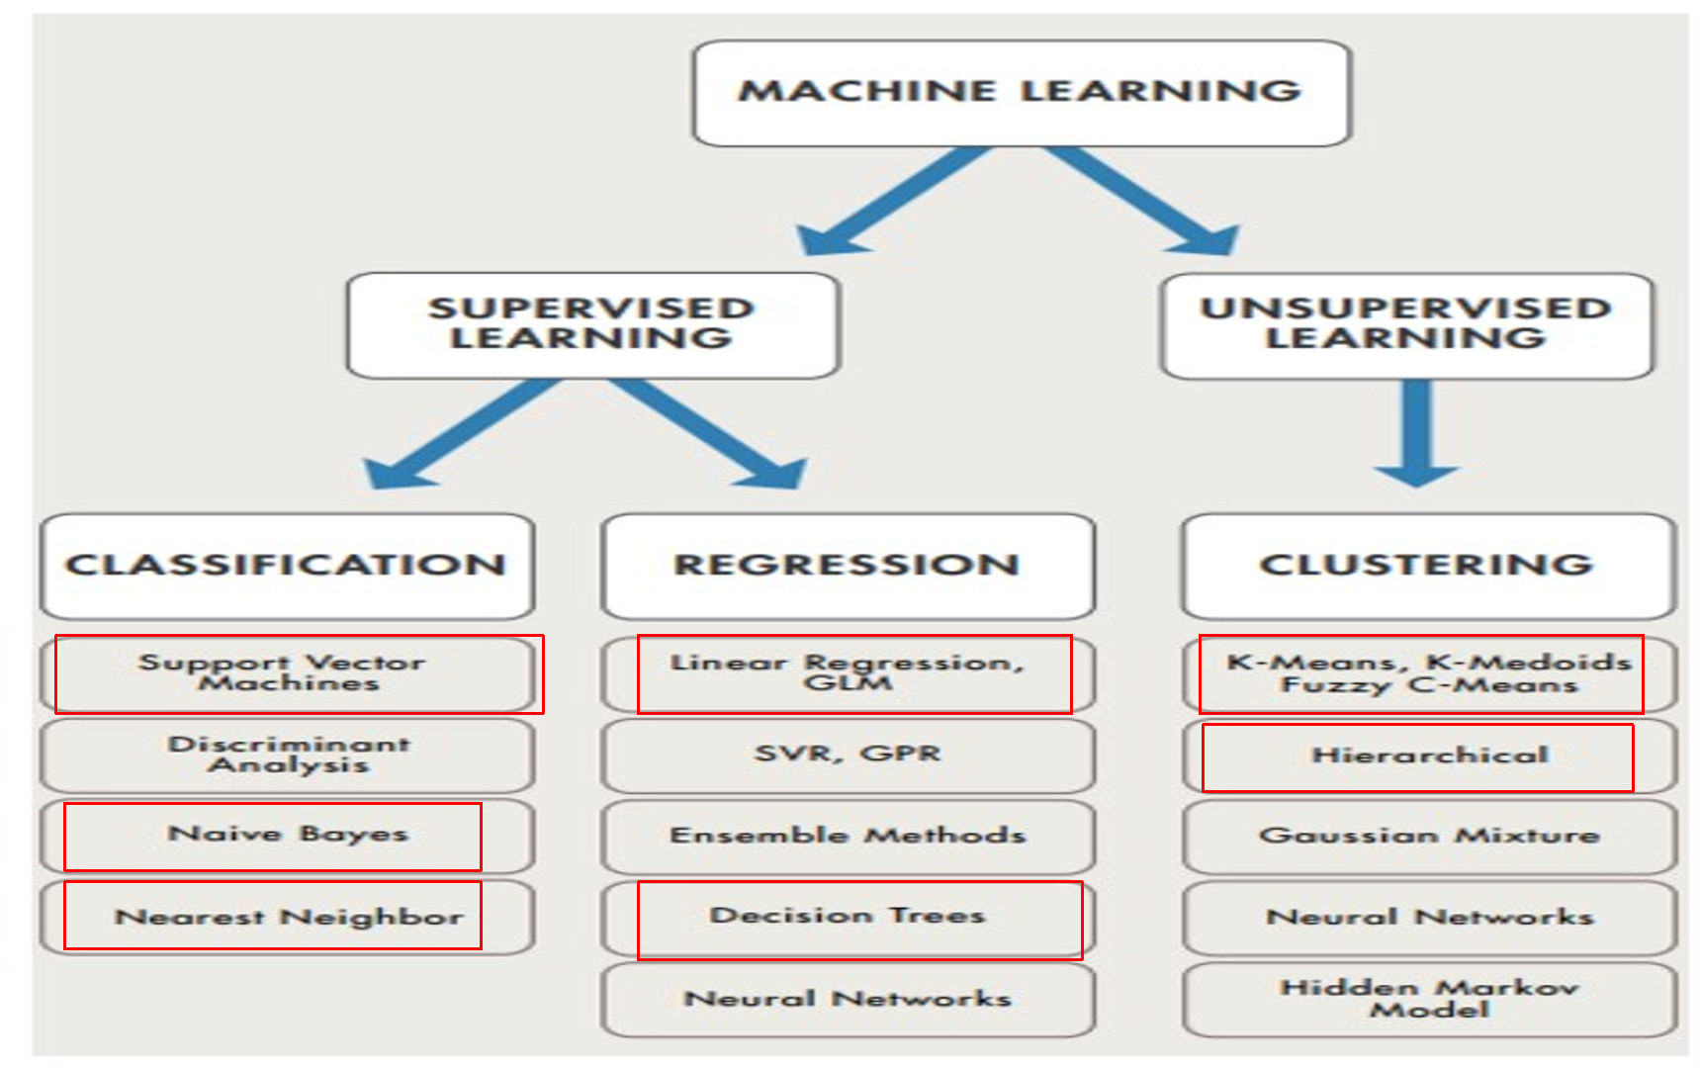

Slide 4
Supervised Learning
In supervised learning, we are given a data set and already know what our correct output should look like, having the idea that there is a relationship between the input and the output.
Supervised learning problems are categorized into "regression" and "classification" problems.
In a regression problem, we are trying to predict results within a continuous output, meaning that we are trying to map input variables to some continuous function.
In a classification problem, we are instead trying to predict results in a discrete output. In other words, we are trying to map input variables into discrete categories.

Slide 5
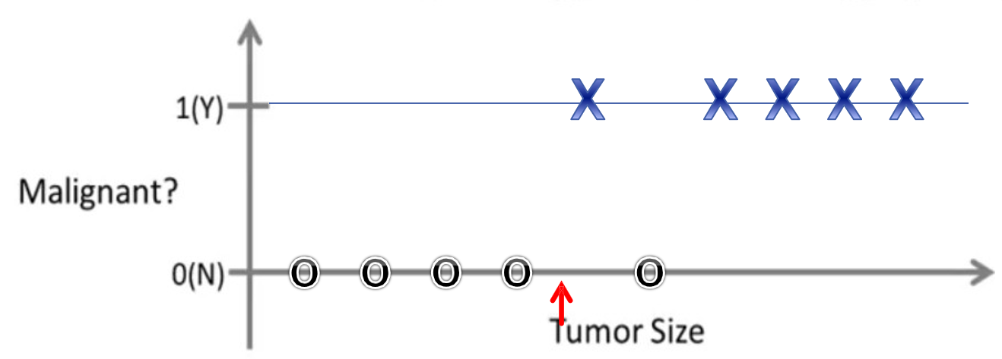
Example
Lung Cancer (Malignant or benging) is an exaple of a classification problem.
Classification
Discrete valued output (0 or 1)

Slide 6
Unsupervised Learning
Unsupervised learning is where you only have input data and no corresponding output variables.
We can derive structure from data where we don't necessarily know the effect of the variables.
We can derive this structure by clustering the data based on the relationships among the variables in the data.
With unsupervised learning there is no feedback based on the prediction results, i.e., there is no teacher to correct you.

Slide 7
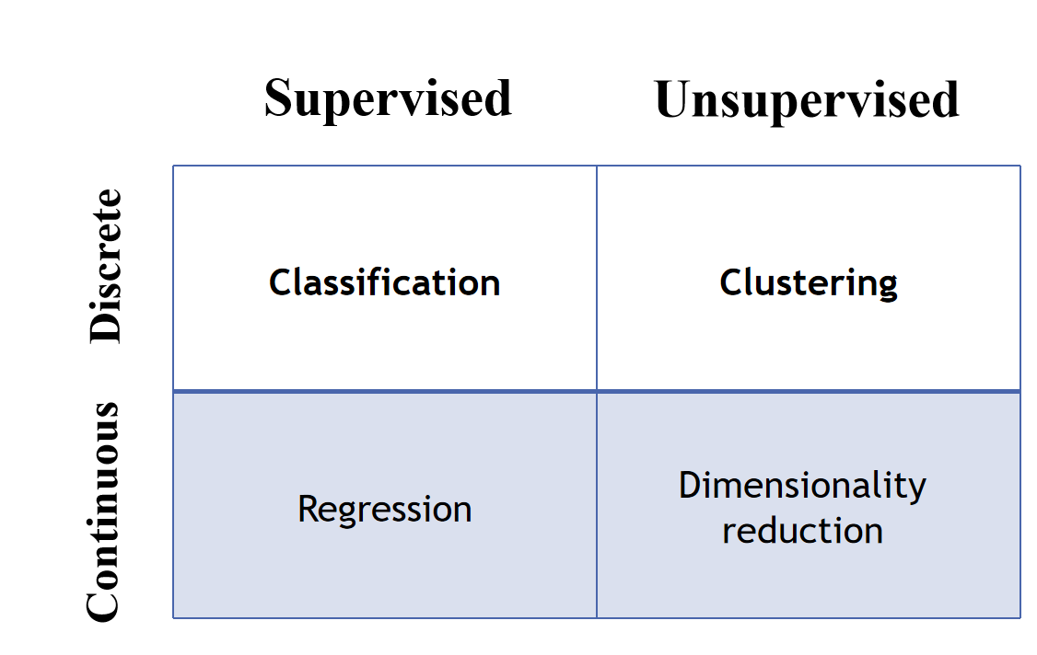
Learning Types

Slide 8
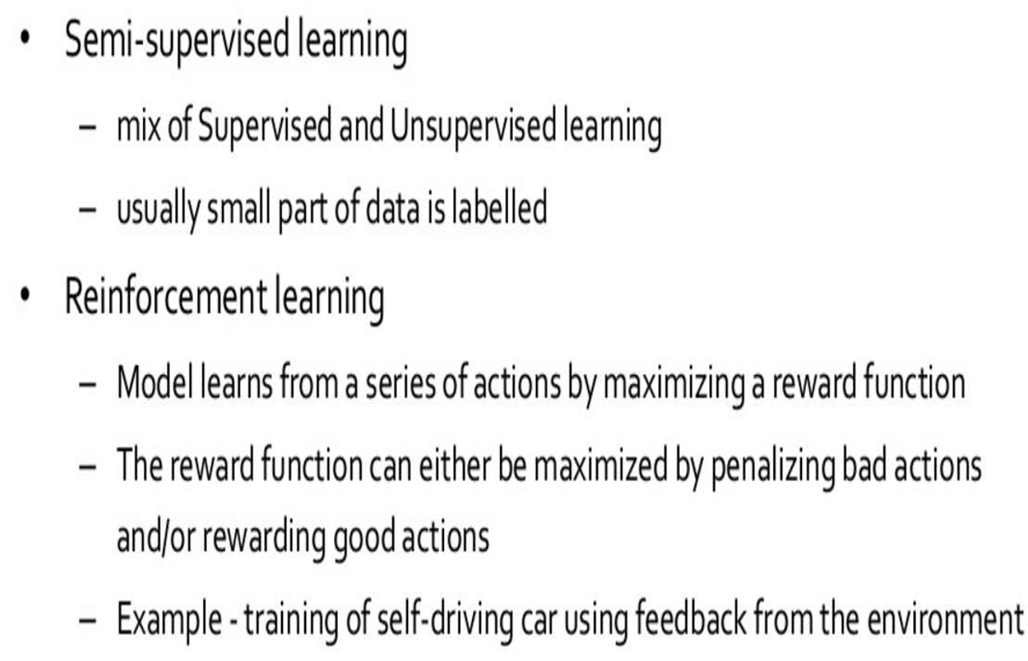
Machine Learning more types

Slide 9
Data Types
To analyze data, it is important to know what type of data we are dealing with. We can split the data types into three main categories:
Numerical
Categorical
Ordinal
1) Numerical data are numbers, and can be split into two numerical categories:
Discrete Data: counted data that are limited to integers. Example: The number of cars passing by.
Continuous Data: measured data that can be any number. Example: The price of an item, or the size of an item.
2) Categorical data are values that cannot be measured up against each other. Example: a color value, or any yes/no values.
3) Ordinal data are like categorical data, but can be measured up against each other. Example: school grades where A is better than B and so on.
By knowing the data type of your data source, you will be able to know what technique to use when analyzing them.

Slide 10
Mean, Median and Mode
In Machine Learning (and in mathematics) there are often three values that interests us:
Mean - The average value
Median - The mid point value
Mode - The most common value

Slide 11
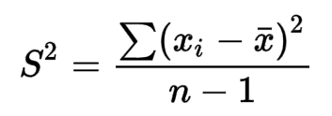
Variance
Variance is a number that indicates how spread out the values are. Variance is often represented by the symbol Sigma Squared: σ²
Variance Equation:

Slide 12
Standard Deviation
Standard deviation is the degree of dispersion or the scatter of the data points relative to its mean, in descriptive statistics. It is one of the basic methods of statistical analysis. Standard Deviation is commonly abbreviated as SD and denoted by the symbol Sigma: 'σ’.
Standard deviation is the positive square root of the variance.
If we get a low standard deviation then it means that the values tend to be close to the mean whereas a high standard deviation tells us that the values are far from the mean value.

Slide 13
Example
Let have the following data points: 32,111,138,28,59,77,97
To calculate the variance you have to do as follows:
1. Find the mean: (32+111+138+28+59+77+97) / 7 = 77.4
2. For each value, find the difference from the mean:
32 - 77.4 = -45.4
111 - 77.4 = 33.6
138 - 77.4 = 60.6
28 - 77.4 = -49.4
59 - 77.4 = -18.4
77 - 77.4 = - 0.4
97 - 77.4 = 19.6

Slide 14
3. For each difference, find the square value:
(-45.4)² = 2061.16
(33.6)² = 1128.96
(60.6)² = 3672.36
(-49.4)² = 2440.36
(-18.4)² = 338.56
(- 0.4)² = 0.16
(19.6)² = 384.16
4. The variance is the average number of these squared differences:
(2061.16+1128.96+3672.36+2440.36+338.56+0.16+384.16) / 7 = 1432.2
5- The standard deviation is: 37.85

Slide 15
Data Distribution
To create big data sets for testing, we use the Python module NumPy, which comes with a number of methods to create random data sets, of any size.
To visualize the data set we can draw a histogram with the data we collected. We will use the Python module Matplotlib to draw a histogram.

Slide 16
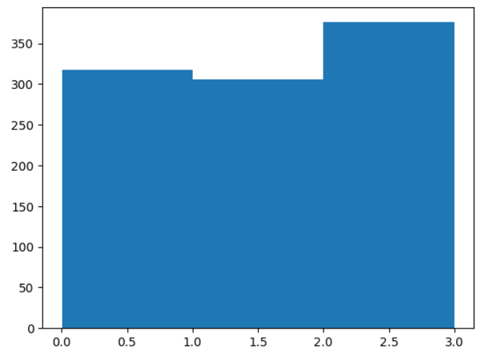
Example
import numpy
import matplotlib.pyplot as plt
x = numpy.random.uniform(0.0, 3.0, 1000)
print(x)
plt.hist(x, 3)
plt.show()

Slide 17
Normal Data Distribution
In probability theory, the normal data distribution is also known as the Gaussian data distribution.
Uniformly distributed random numbers on an interval have equal probability of being selected or happening. Normally distributed random numbers on an interval have probabilities that follow the normal distribution bell curve, so numbers closer to the mean are more likely to be selected or to happen.

Slide 18
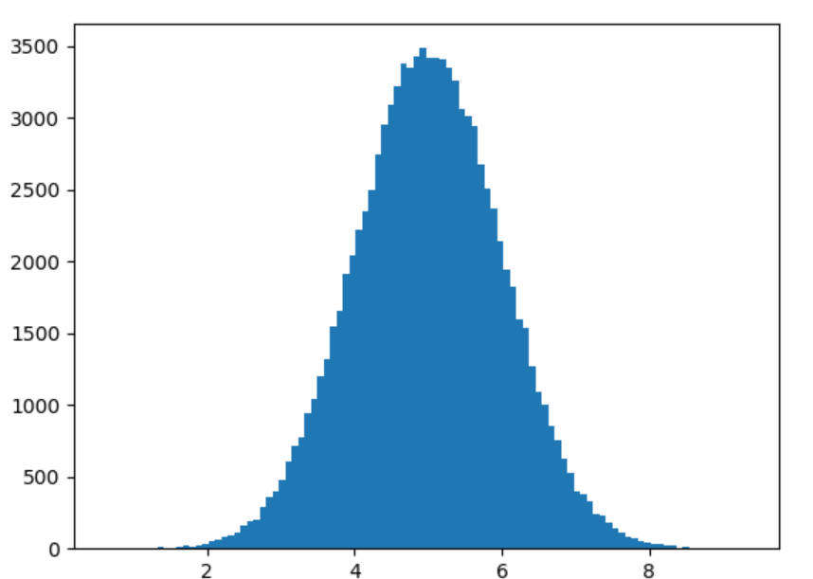
Example
import numpy
import matplotlib.pyplot as plt
x = numpy.random.normal(5.0, 1.0, 100000)
plt.hist(x, 100)
plt.show()

