Slide 1
Artificial Intelligence
Lecture 17

Slide 2
Machine Learning Model
The core objective of ML is:
1- Learning
2- Inference

Slide 3
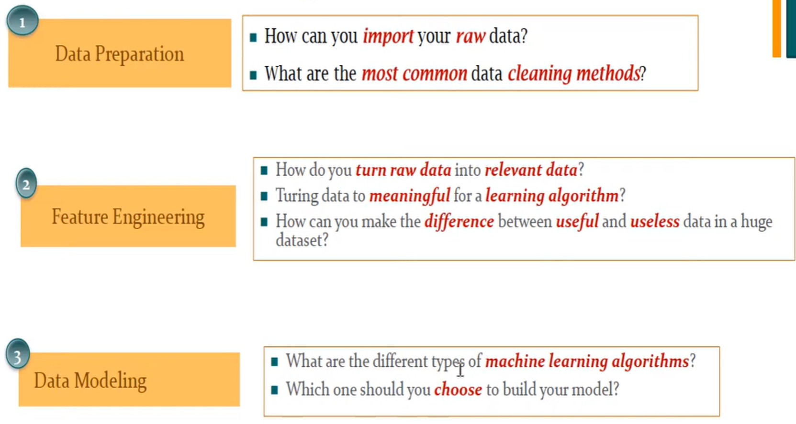
Machine Learning Main Steps:

Slide 4
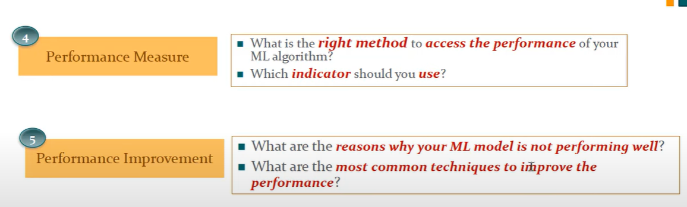

Slide 5
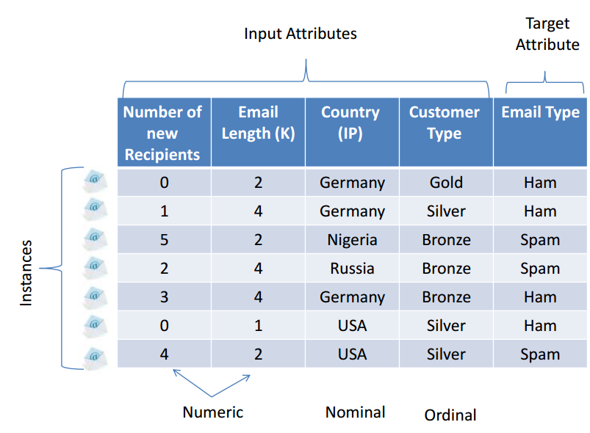
Data set
1. Import libraries
2. Read data (dataset)

Slide 6
1. Import Libraries
As main libraries, in Python Pandas, NumPy and time;
Pandas: Use for data manipulation and data analysis.
NumPy: a fundamental package for scientific computing with Python.
As for the visualization: Matplotlib and Seaborn.
For the data preprocessing techniques and algorithms: Scikit-learn libraries.

Slide 7
Data Preprocessing
It is a data mining technique that transforms raw data into an understandable format. Raw data(real world data) is always incomplete, in wrong format, duplicate, or contains outliers and that data cannot be sent through a model. That would cause certain errors. That is why we need to preprocess data before sending through a model.

Slide 8
Steps in Data Preprocessing
1. Checking for missing values
2. Checking for Wrong format
3. Checking for duplicate
4. Checking for outliers
5. Remove Inconsistencies
6. Checking for categorical data
7. Checking the data distribution
8. Standardize the data
9. Dimensionality Reduction
10. Data splitting

Slide 9
1. Checking for Missing Values
If there are no missing values found in the dataset, there is no need to use any missing values handling techniques.
If there are missing values then: (review Python_Lecture10)
1- Remove Rows: One way to deal with empty cells is to remove rows that contain empty cells. This is usually OK, since data sets can be very big, and removing a few rows will not have a big impact on the result.
2- Replace Empty Values: This way you do not have to delete entire rows just because of some empty cells. The fillna() method allows us to replace empty cells with a value.
3- Replace Only For Specified Columns: The example above replaces all empty cells in the whole Data Frame. To only replace empty values for one column, specify the column name for the DataFrame.

Slide 10
4. Replace Using Mean, Median, or Mode: A common way to replace empty cells, is to calculate the mean, median or mode value of the column.
Pandas uses the mean() median() and mode() methods to calculate the respective values for a specified column.

Slide 11
2. Checking for Wrong Format
Cells with data of wrong format can make it difficult, or even impossible, to analyze data. To fix it, you have two options:
1- Remove the rows.
2- Convert all cells in the columns into the same format.
3- For small data sets you might be able to replace the wrong data one by one, but not for big data sets using: df.loc[row_no.,'coloumn_name'] = new value

Slide 12
3. Checking for duplicate
Duplicate rows: are rows that have been registered more than one time.
To discover duplicates, we can use the duplicated() method.
The duplicated() method returns a Boolean values for each row, where:
True for every row that is a duplicate, otherwise False.
To remove duplicates, use the drop_duplicates(inplace = True) method.
Note: The (inplace = True) will make sure that the method does NOT return a new DataFrame, but it will remove all duplicates from the original DataFrame.

Slide 13

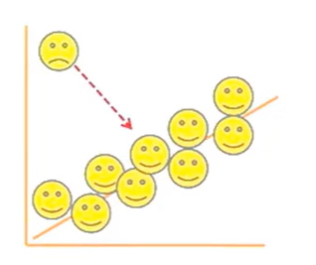
4- Checking for Outliers
Outlier detection is essential in data preprocessing to identify and handle anomalies in the data that may affect the model's performance. There are many outlier detection techniques such as: 1- Z-Score 2- Interquartile Range (IQR) 3- Isolation Forest
4- Local Outlier Factor (LOF) 5- Elliptic Envelope.

Slide 14
5. Remove Inconsistencies
just like missing values, real-world data also has multiple inconsistencies like incorrect spellings, incorrectly populated columns and rows (eg.: salary populated in birthday column). Sometimes, these inconsistencies can be treated through automation, but most often they need a manual check-up.

Slide 15
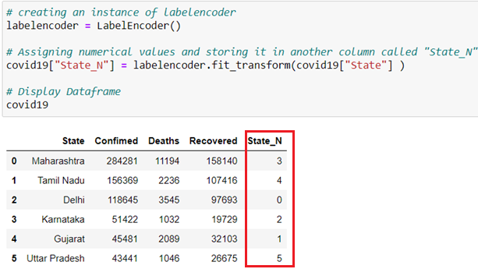
6. Checking for categorical data
If there is any categorical data we should convert it to numerical ones
7. Checking the data distribution
Check it through plotting onto Seaborn library

Slide 16
8. Standardizing the data
Ensure all cells in a coloumn share the same format to facilitate accurate analysis and prevent errors.
9. Dimensionality Reduction
Reducing the number of features while preserving information is essential to streamlining data for analysis.
10. Data splitting
Properly dividing datasets into training and testing subsets ensures the robustness of the machine learning model.
Use SKlearn train test split (20,80 or 25,75 or 30, 70).

