Slide 1
A* Search
Lecture 5

Slide 2
A* Search
A* algorithm is considered a heuristic search algorithm because it uses a heuristic function to guide its search toward the goal efficiently.
The A* algorithm is classified as an informed search method, relying on a heuristic function h(n) to estimate the cost from a given node n to the goal.

Slide 3
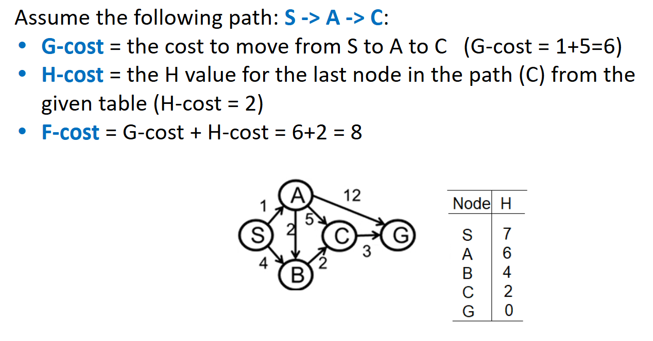
Difinitions

Slide 4
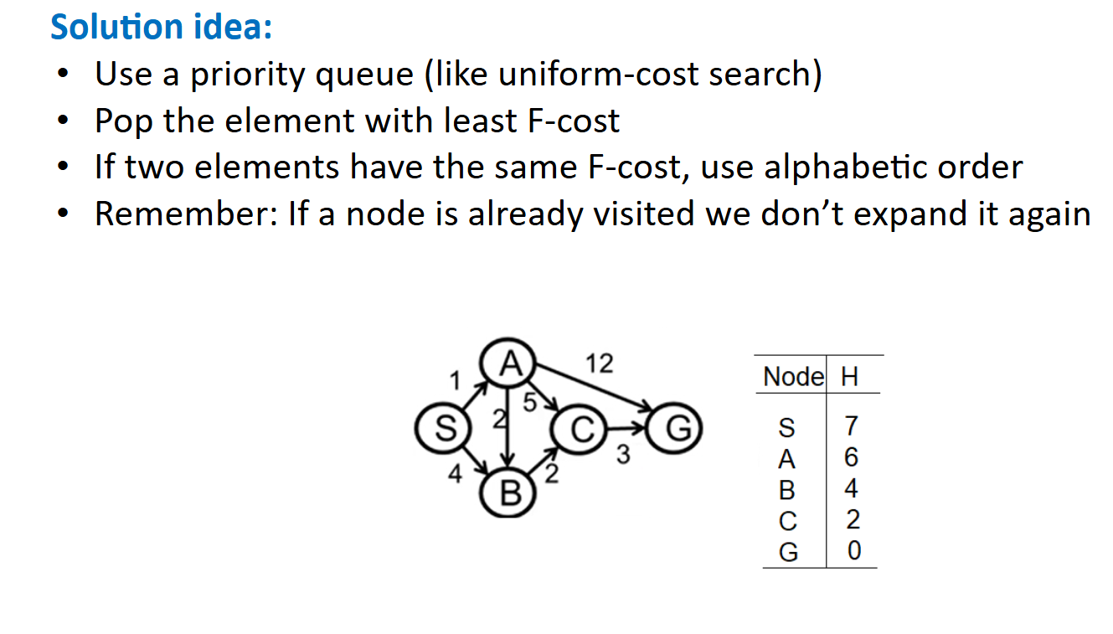
A* Search

Slide 5
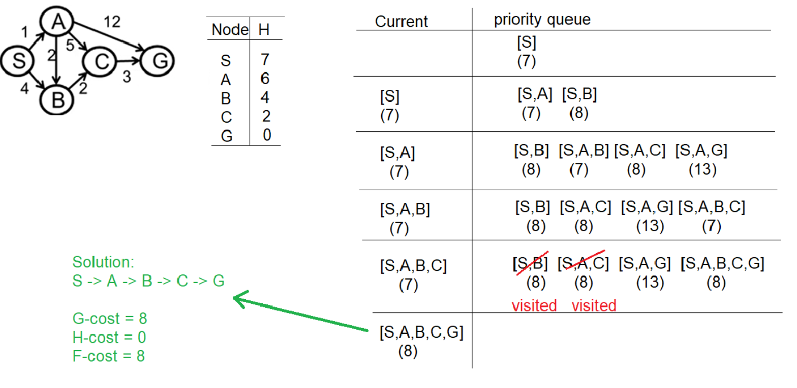
Example 1:

Slide 6
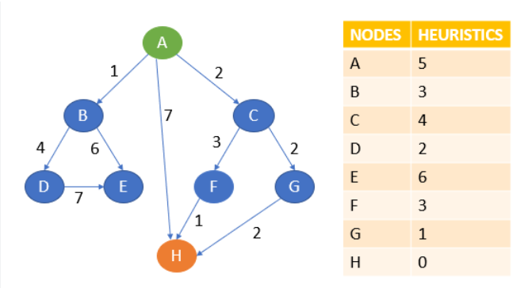
Example 2:
Use A* Search (alphabetically) to find the path between A and H for the following search space and Heuristics_cost:

Slide 7
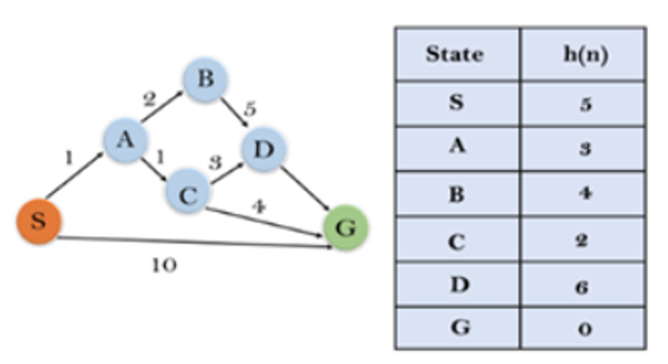
Example 3:
Use A* Search (alphabetically) to find the path between S and G for the following search space and Heuristics_cost:

