Slide 1
Python Programming Language
Lecture 9

Slide 2
Matplotlib Library
Matplotlib is a low level graph plotting library in python that serves as a visualization utility.
To import this library and checking Matplotlib version, we used:
import matplotlib
print(matplotlib.__version__)
Most of the Matplotlib utilities lies under the pyplot submodule, and we calling these utilities using:
from matplotlib.pyplot import*

Slide 3
Plot function
The plot() function is used to draw points (markers) in a diagram.
By default, the plot() function draws a line from point to point.
The function takes parameters for specifying points in the diagram.
Parameter 1 is an array containing the points on the x-axis.
Parameter 2 is an array containing the points on the y-axis.
If we need to plot a line from (1, 3) to (8, 10), we have to pass two arrays [1, 8] and [3, 10] to the plot function.

Slide 4
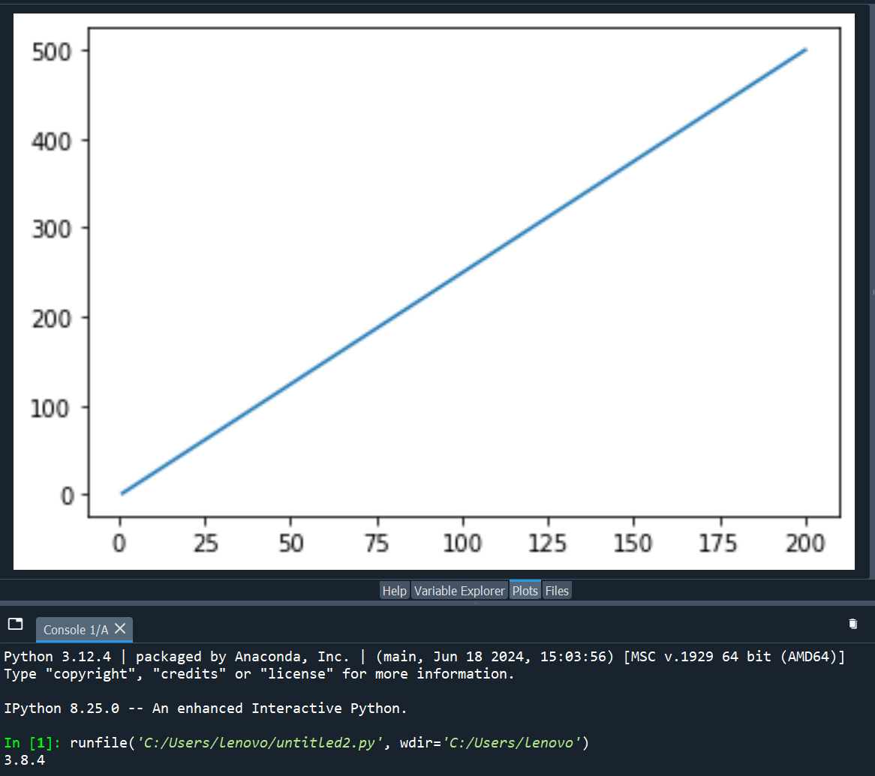
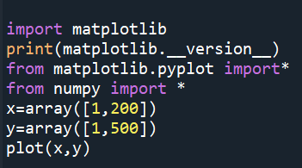
Example

Slide 5
Plotting Without Line
To plot only the markers, you can use shortcut string notation parameter 'o', which means 'rings', or you can use any parameter you want such as *,+,.... using:
plot(x,y,'*')
You can plot as many points as you like, just make sure you have the same number of points in both axis.
Note: If we do not specify the points on the x-axis, they will get the default values 0, 1, 2, 3 etc., depending on the length of the y-points.

Slide 6
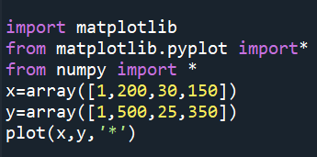
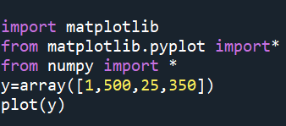
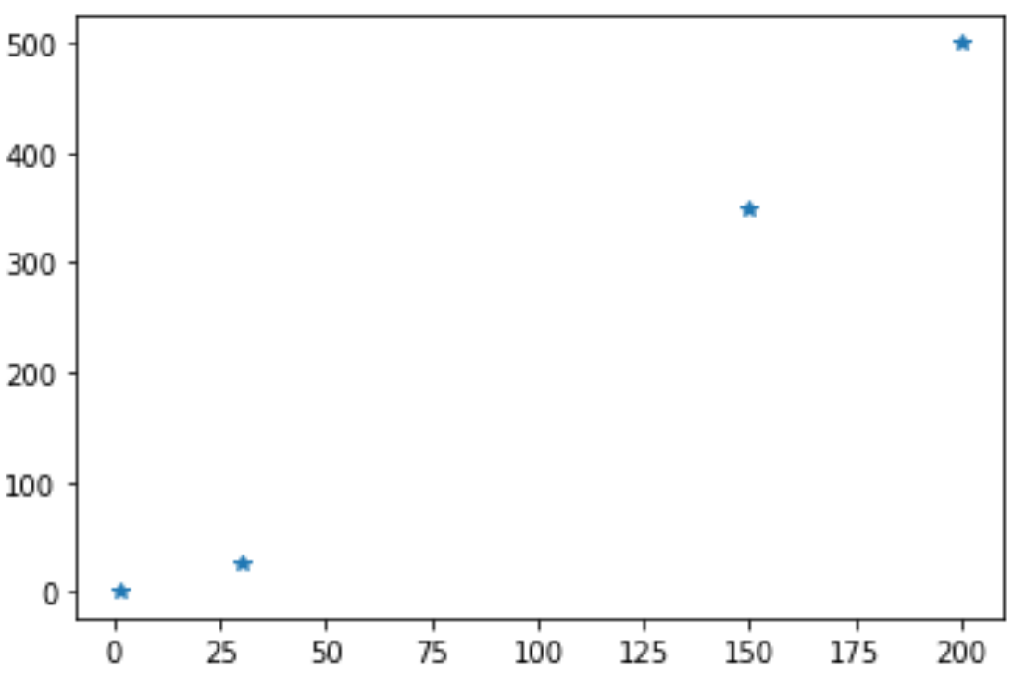
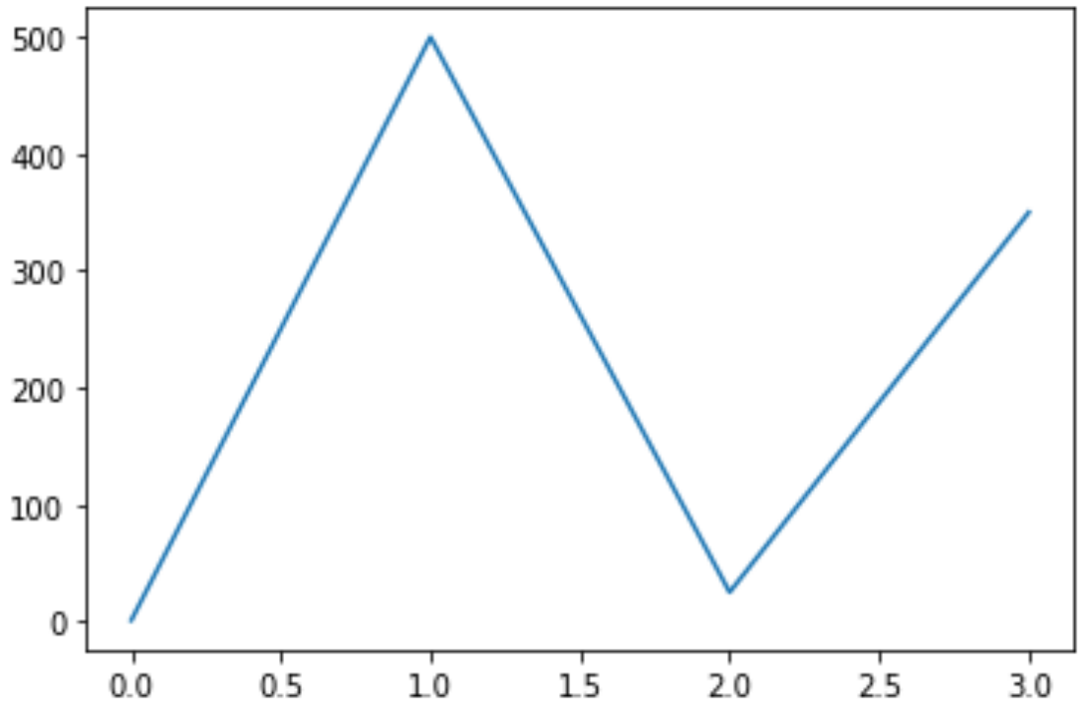
Example

Slide 7
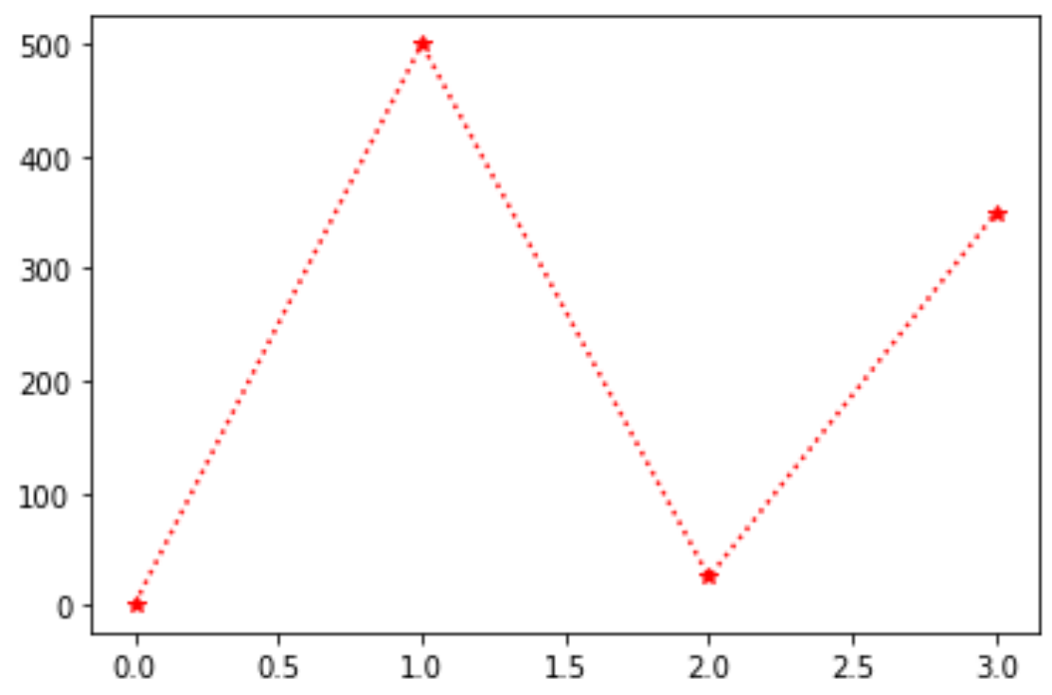
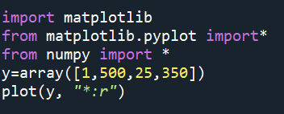
Markers
You can use the keyword argument marker to emphasize each point with a specified marker.
You can also use a color with marker, such as ‘*:r’, where r is for red color
Example:

Slide 8
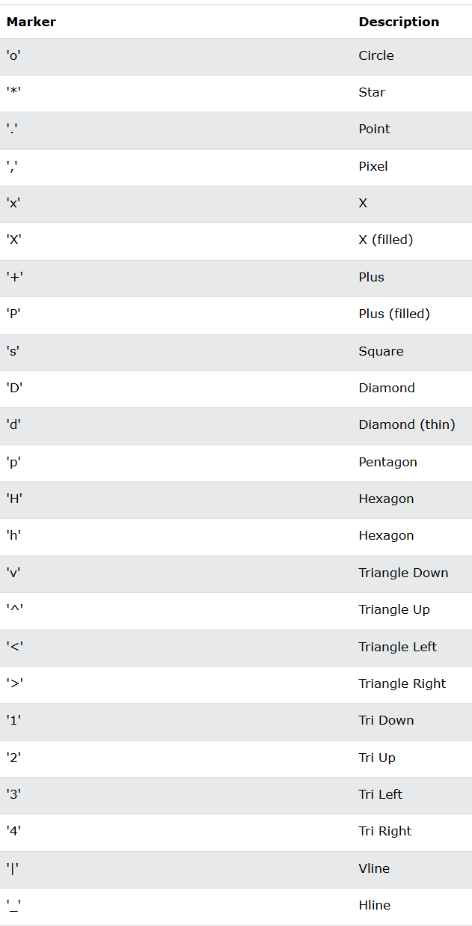

Slide 9
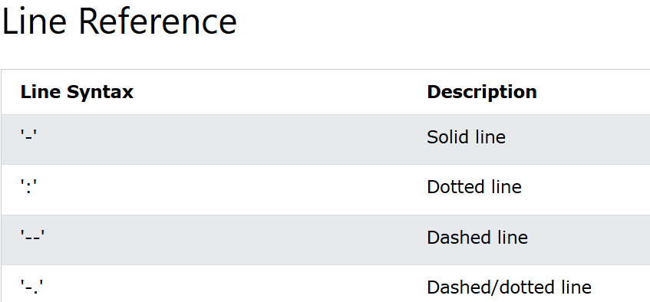
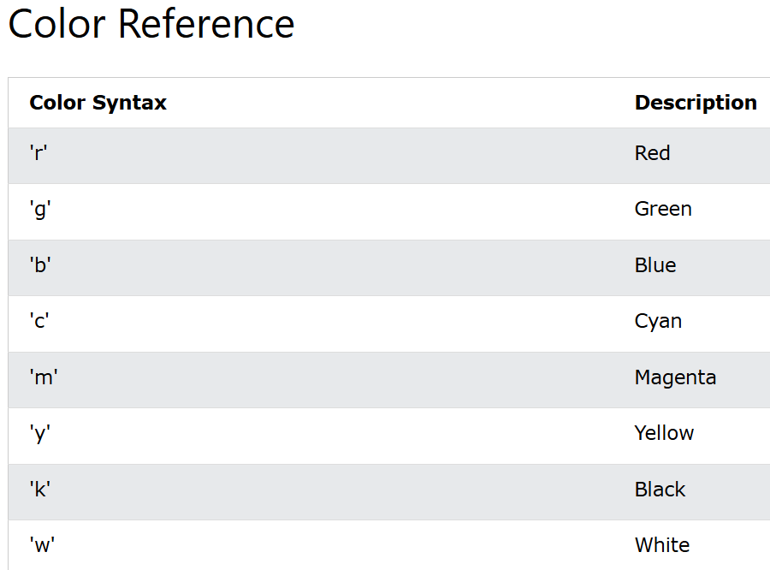
You can use the keyword argument markersize or the shorter version, ms to set the size of the markers.
You can use the keyword argument markeredgecolor or the shorter mec to set the color of the edge of the markers.
You can use the keyword argument markerfacecolor or the shorter mfc to set the color inside the edge of the markers.
You can use the keyword argument linewidth or the shorter lw to change the width of the line.

Slide 10
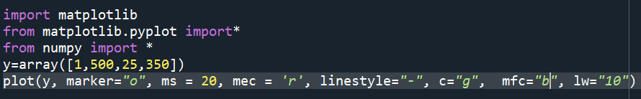
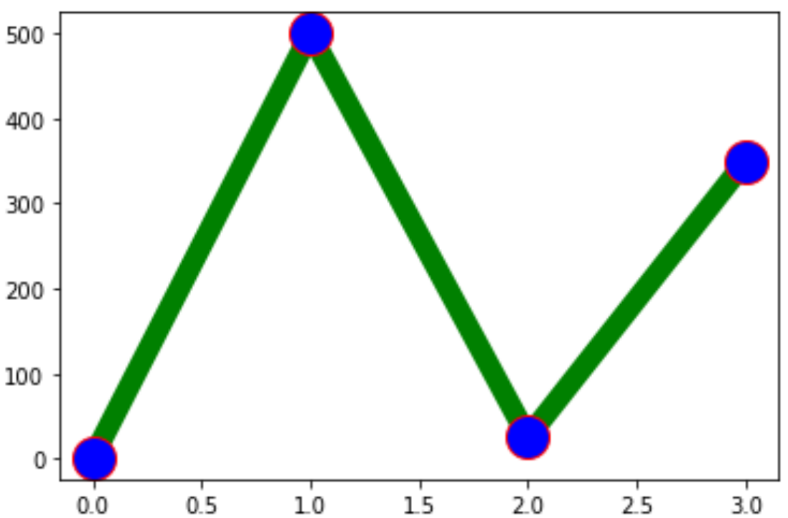
Example

Slide 11
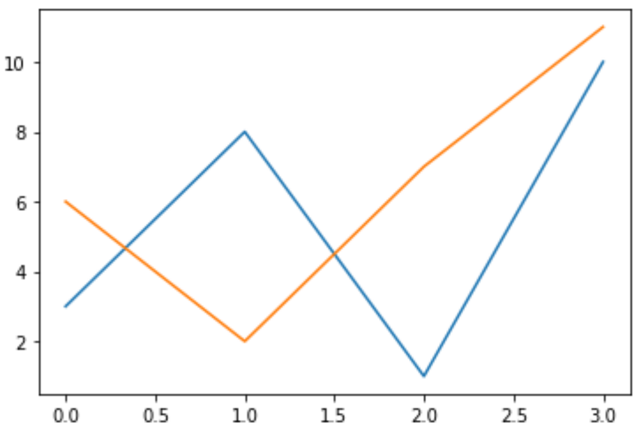
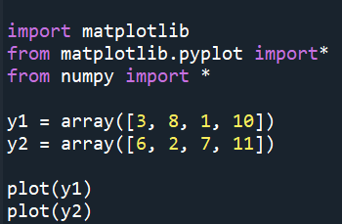
Multiple Lines
You can plot as many lines as you like by simply adding more plot() functions.

Slide 12
Labels and Title
You can use the xlabel() and ylabel() functions to set a label for the x- and y-axis.
You can use the title() function to set a title for the plot.
You can use the loc parameter in title() to position the title.
Legal values are: 'left', 'right', and 'center'. Default value is 'center'.

Slide 13
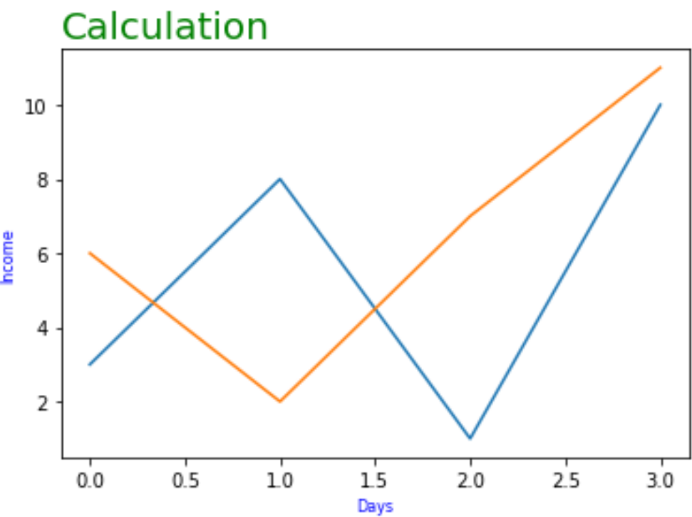
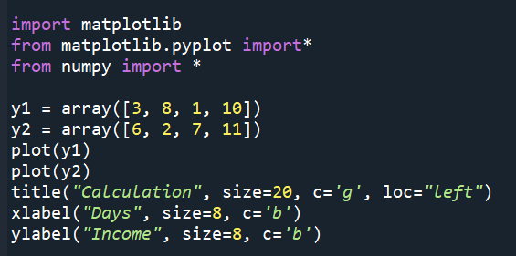
Example

Slide 14
Adding Grid Lines
You can use the grid() function to add grid lines to the plot.
You can use the axis parameter in the grid() function to specify which grid lines to display.
Legal values are: 'x', 'y', and 'both'. Default value is 'both'.
You can also set the line properties of the grid, like this: grid(color = 'color', linestyle = 'linestyle', linewidth = number)

Slide 15
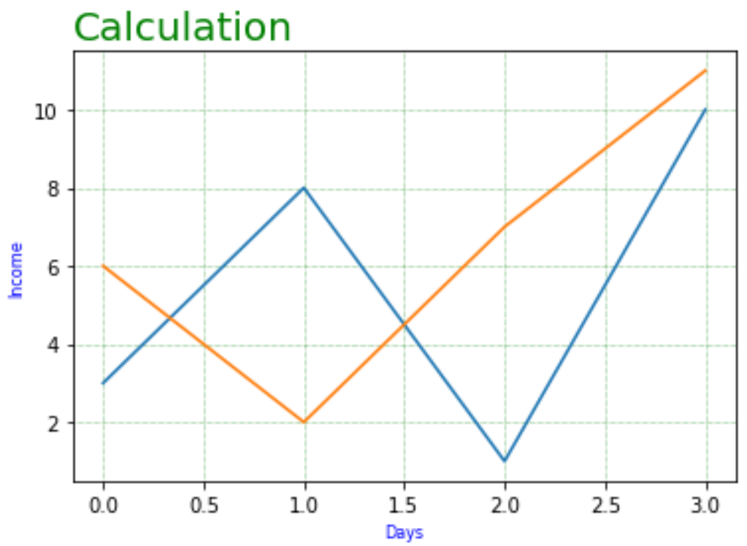
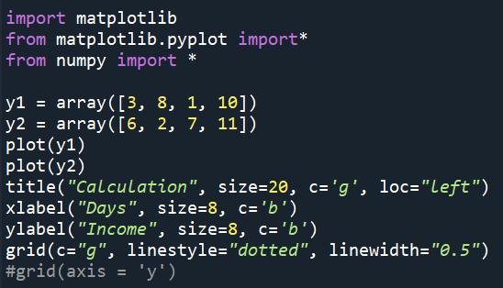
Example

Slide 16
Display Multiple Plots
With the subplot() function you can draw multiple plots in one figure
This function takes three arguments that describes the layout of the figure.
The layout is organized in rows and columns, which are represented by the first and second argument.
The third argument represents the index of the current plot.
You can draw as many plots you like on one figure, just descibe the number of rows, columns, and the index of the plot.
You can add a title to each plot with the title() function.
You can add a title to the entire figure with the suptitle() function.

Slide 17
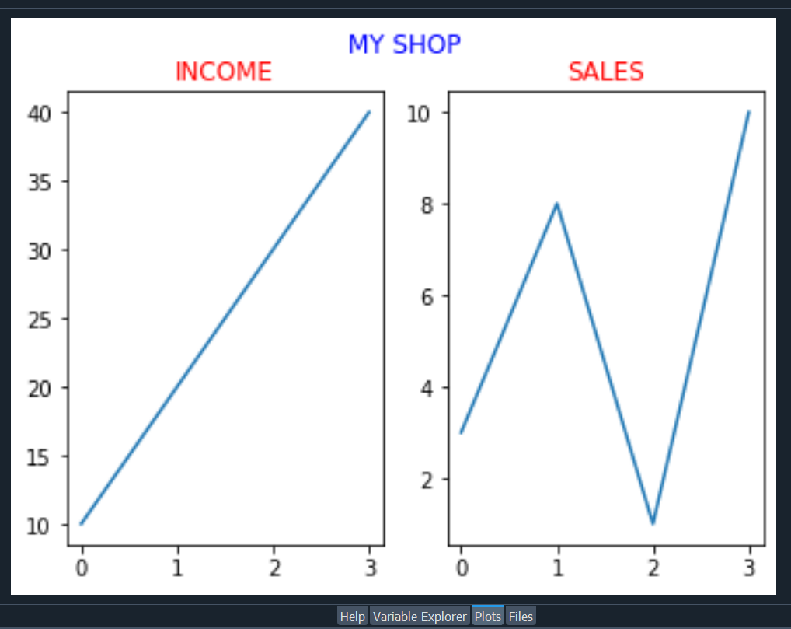
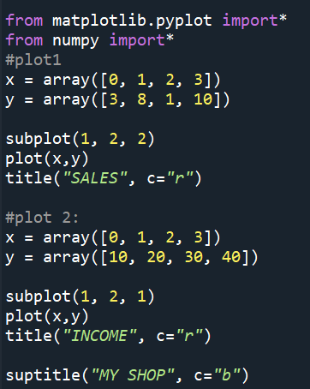
Example

Slide 18
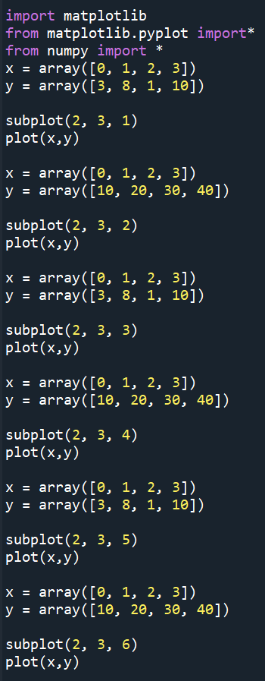
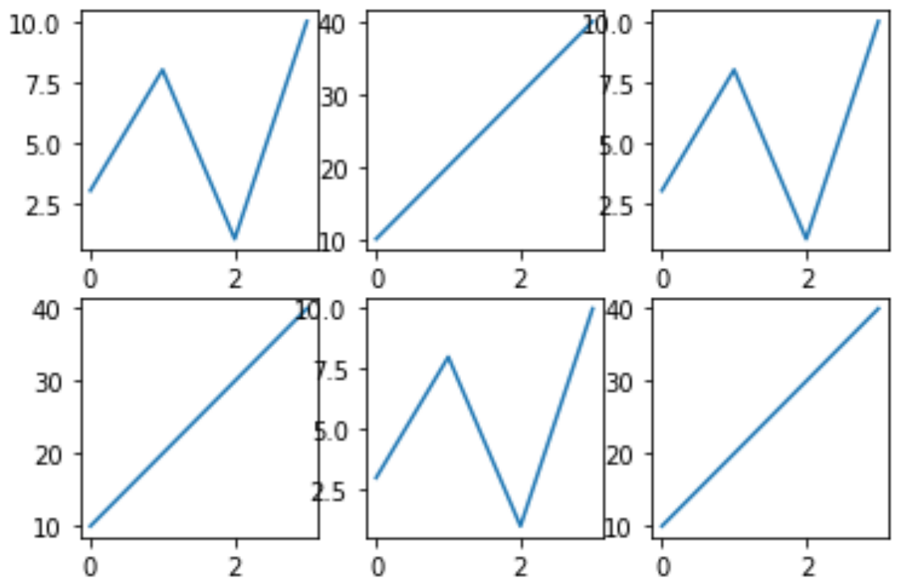

Slide 19
Creating Scatter Plots
you can use the scatter() function to draw a scatter plot.
This function plots one dot for each observation. It needs two arrays of the same length, one for the values of the x-axis, and one for values on the y-axis.
You can change the size of the dots with the s argument.
You can adjust the transparency of the dots with the alpha argument.

Slide 20
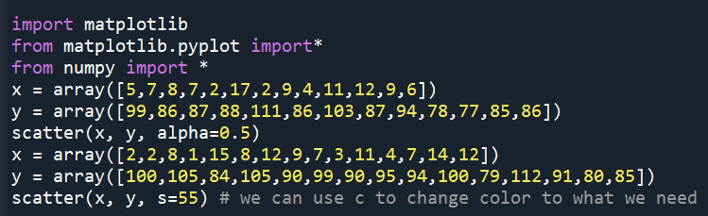
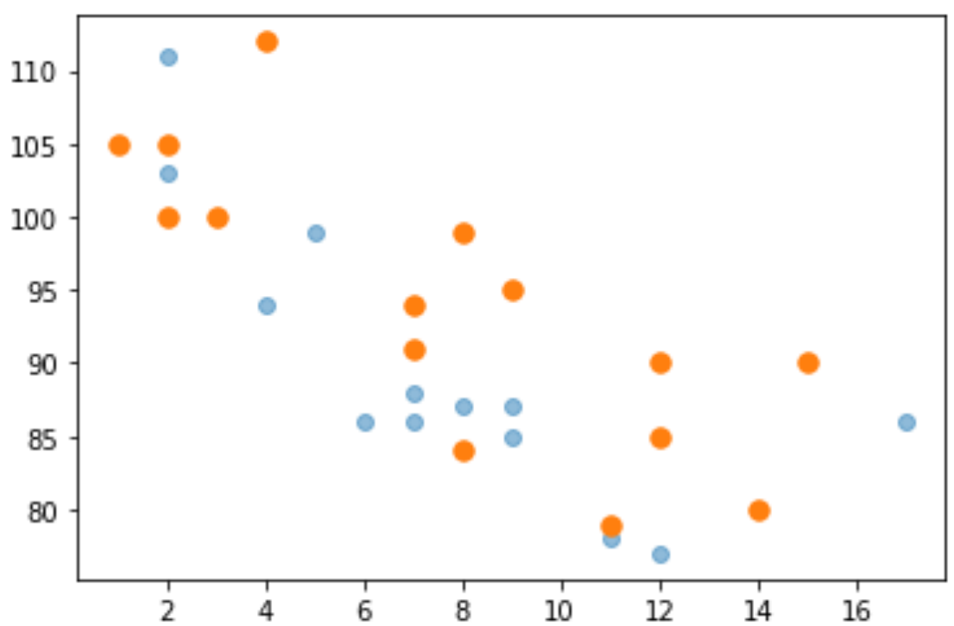
Example

Slide 21
Creating Bars
You can use the bar() function to draw bar graphs.
This function takes arguments that describes the layout of the bars.
The categories and their values represented by the first and second argument as arrays.
If you want the bars to be displayed horizontally instead of vertically, use the barh() function.
he bar() and barh() take the keyword argument color to set the color of the bars.
The bar() takes the keyword argument width to set the width of the bars.
The barh() takes the keyword argument height to set the height of the bars.

Slide 22
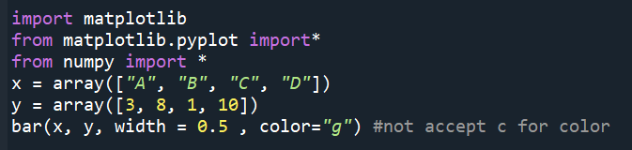
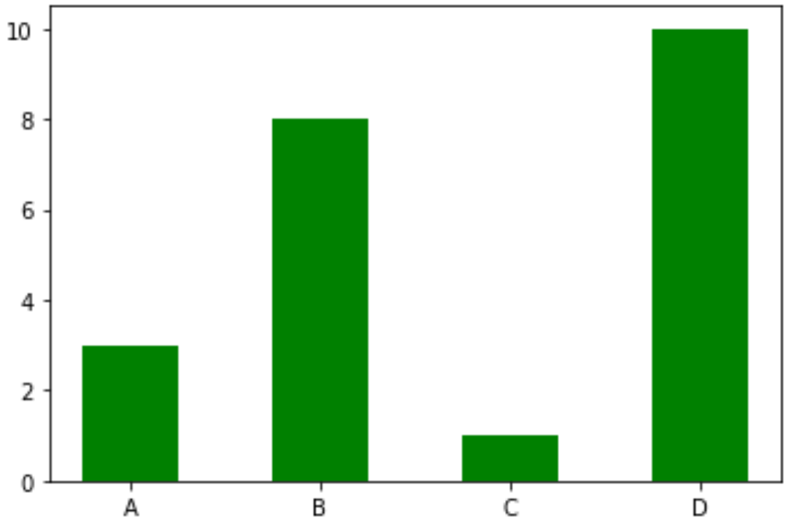
Example

Slide 23
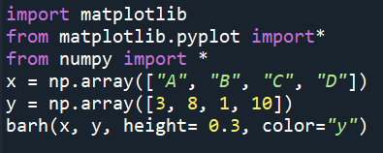
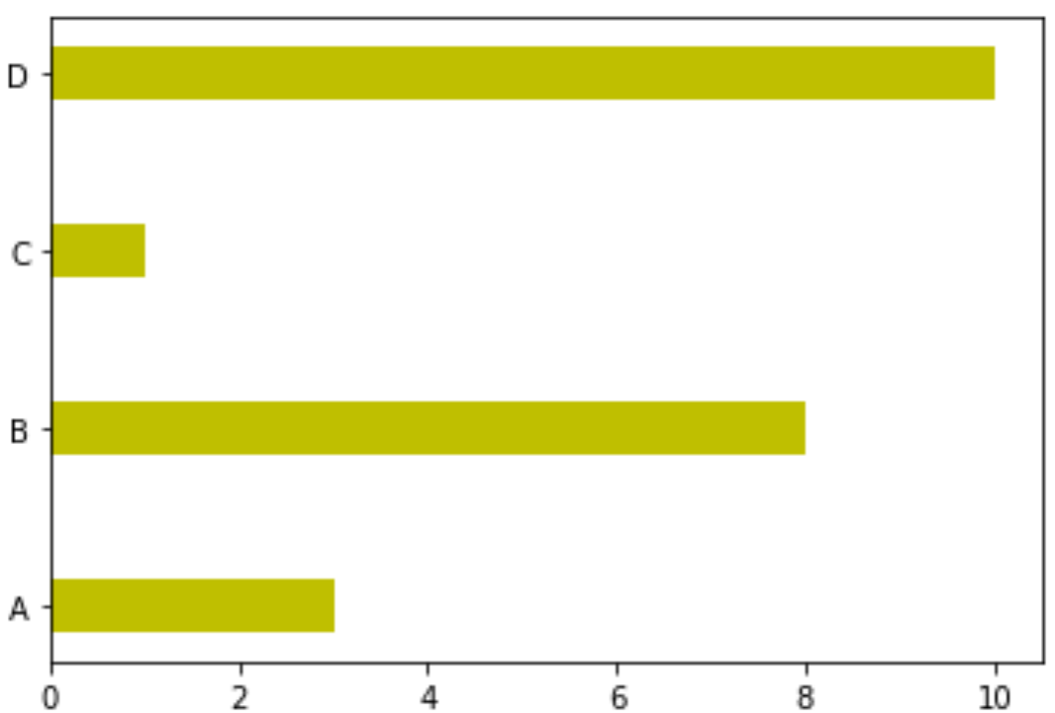
Example

Slide 24
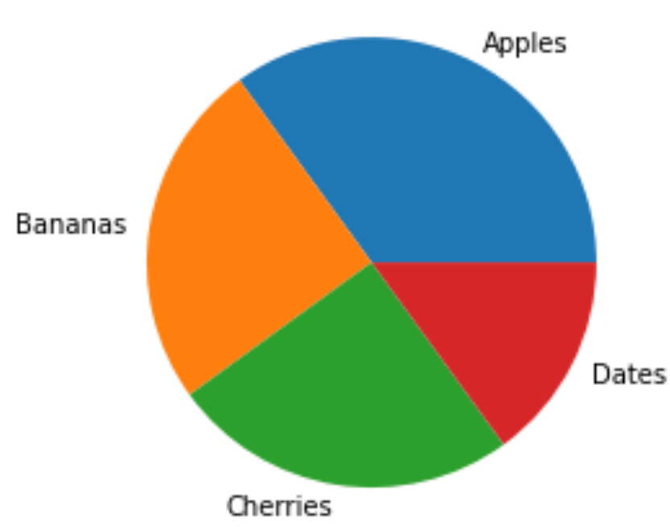
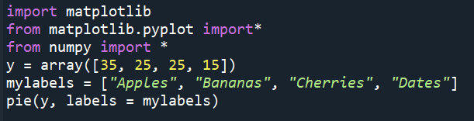
Creating Pie Charts
You can use the pie() function to draw pie charts.
Add labels to the pie chart with the labels parameter, which must be an array with one label for each wedge.
Example:

Slide 25
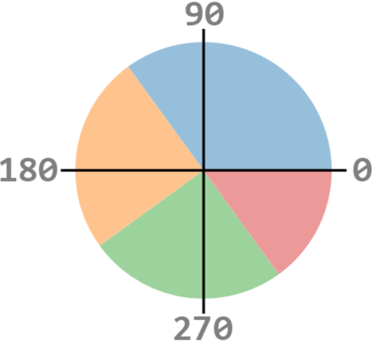
the default start angle is at the x-axis, and moves counterclockwise, but you can change the start angle by specifying a startangle parameter.
The startangle parameter is defined with an angle in degrees, default angle is 0.
The explode parameter, if specified, and not None,
must be an array with one value for each wedge.
Each value represents how far from the center
each wedge is displayed.
To add a list of explanation for each wedge, use
the legend() function.
With legend() function, you can use title and loc,
'best', 'upper right', 'upper left', 'lower left', 'lower right', 'right', 'center left', 'center right', 'lower center', 'upper center',
'center' can used for the location of legend.

Slide 26
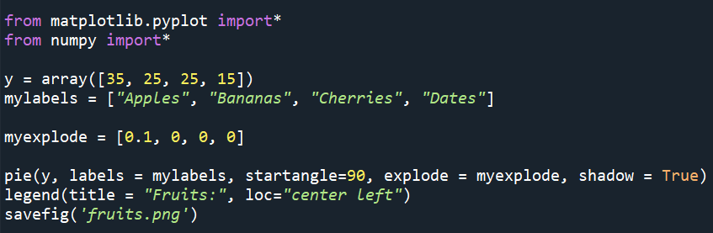
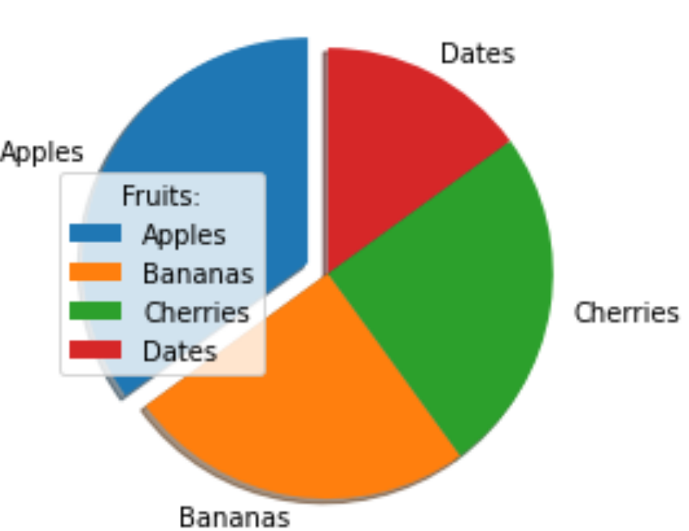
Example

Slide 27
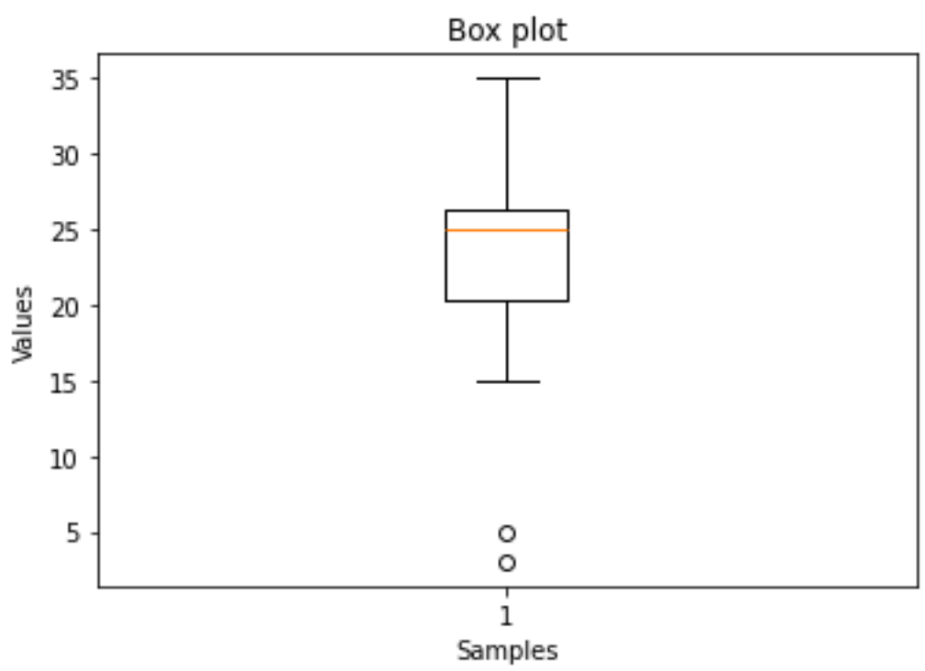
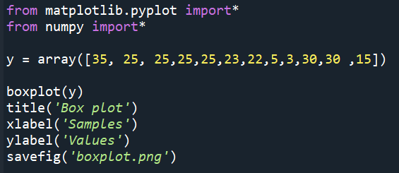
Creating Boxplot

