Slide 1
Python Programming Language
Lecture 8

Slide 2
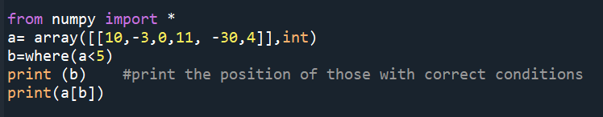
Where

Slide 3
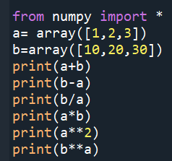
Array Mathematics (1 D array)
The result of Run:
[11 22 33]
[ 9 18 27]
[10. 10. 10.]
[10 40 90]
[1 4 9]
[ 10 400 27000]

Slide 4
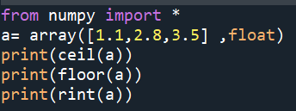
The result of Run:
[2. 3. 4.]
[1. 2. 3.]
[1. 3. 4.]

Slide 5
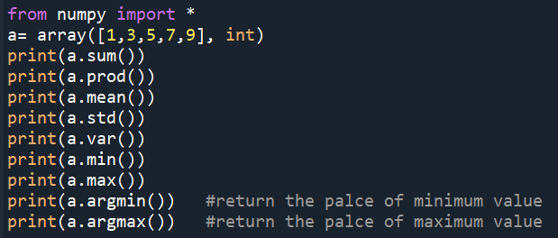
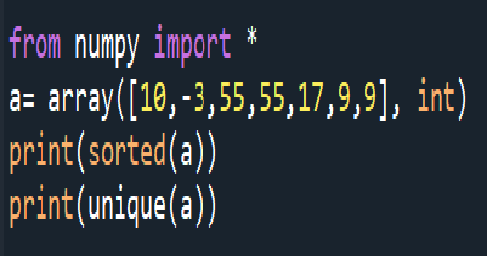
The result of Run:
[-3, 9, 9, 10, 17, 55, 55]
[-3 9 10 17 55]
The result of Run:
25
945
5.0
2.8284271247461903
8.0
1
9
0
4

Slide 6
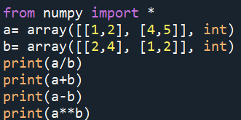
Array Mathematics (2D)
The result of Run:
[[0.5 0.5]
[4. 2.5]]
[[3 6]
[5 7]]
[[-1 -2]
[ 3 3]]
[[ 1 16]
[ 4 25]]

Slide 7
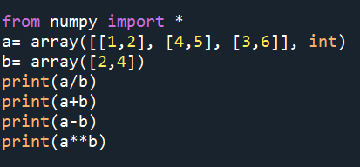
Array Mathematics (Different dimentions)
The result of Run:
[[0.5 0.5 ]
[2. 1.25]
[1.5 1.5 ]]
[[ 3 6]
[ 6 9]
[ 5 10]]
[[-1 -2]
[ 2 1]
[ 1 2]]
[[ 1 16]
[ 16 625]
[ 9 1296]]
This is called Broadcasted by Python

Slide 8
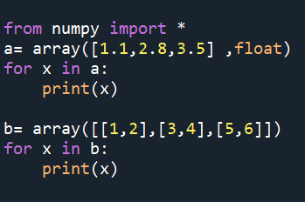
Array Iteration
The result of Run:
1.1
2.8
3.5
[1 2]
[3 4]
[5 6]

Slide 9
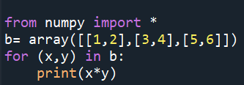

The result of Run:
2
12
30
The result of Run:
[10 17 5]

Slide 10
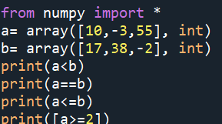
Comparision Operators and Value Testing
The result of Run:
[ True True False]
[False False False]
[ True True False]
[array([ True, False, True])]

Slide 11
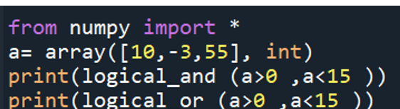
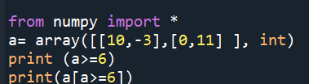

The result of Run:
[ True False False]
[ True True True]

Slide 12
