Slide 1
Artificial Intelligence
Lecture 13

Slide 2
Clause Form
The statements that are produced from the predicate logic method are nested and very complex to understand, so this will lead to more complexity in the resolution stage; therefore, the following algorithm is used to convert the predicate logic to clause form:
1. Eliminate all (→) by replacing each instance of the form (P → Q) by expression (ךPVQ)
Example:
∀X: [Romans(X) ∧ known (X, marcus)] hate (X, caesar) V ∀Y: [∃Z: hate (Y, Z)] thinkcrazy(X, Y)
Solution: ∀X: ך [Romans (X) ∧ known (X, marcus)] V hate(X, caesar) V ∀Y: ך[∃Z: hate (Y, Z)] V thinkcrazy(X, Y)

Slide 3
2. Reduce the scope of negation.
a ≡ך(ךa)
ך(∀X b(X)) ≡∃X ך b(X)
ך(∃X b(X)) ≡∀X ךb(X)
ך(a∧b) ≡ ךaVךb
ך(aVb) ≡ ךa∧ךb
Example: ∀X: ך [Romans (X) ∧ known (X, marcus)] V [hate(X, caesar) V ∀Y: ך[∃Z: hate (Y, Z) ]V thinkcrazy(X, Y)
Solution: ∀X: ך Romans (X) V ךknown (X, marcus) V hate(X, caesar) V ∀Y: ∀Z: ךhate (Y, Z) V thinkcrazy(X, Y)

Slide 4
3. Standardize variables: rename all variables so that each quantifier has its own unique variable name.
Example:∀X a(X) V ∀X b(X) ≡ ∀X a(X) V ∀Y b(Y)
4. Move all quantifiers to the left without changing their order.
Example: ∀X a(X) V ∀Y b(Y)
Solution:∀X ∀Y a(X) V b(Y)
5. Eliminate existential quantification by using the equivalent function.
Example:∀X ∃Y (mother(X, Y)) ≡ ∀X (mother(X, m(X)))
∀X ∀Y ∃Z ∀W (food(X, Y, Z, W)) ≡ ∀X ∀Y ∀W (food(X,Y,f(X,Y), W))

Slide 5
6. Remove universal quantification symbols.
∀X ∀Y (p(X, Y, f(X, Y))) ≡ p(X, Y, f(X, Y))
7. Distribute "and" over "or" to get a conjunction of disjunctions called conjunctive normal form.
aV (bVc) ≡ (aVb) Vc
a∧ (b∧c) ≡ (a∧b) ∧c
aV (b∧c) ≡ (aVb) ∧ (aVc)
a∧ (bVc) ≡ (a∧b) V (a∧c)

Slide 6
8. Split each conjunct into a separate clause.
-Example: (ךa(X) V ךb(X) V e(W))∧(ךb(X) V ךd(X,f(X)) V e(W))
ךa(X) V ך b(X) V e(W)
ךb(X) V ךd(X,f(X)) V e(W)
9. Standardize variables apart again so that each clause contains variable names that do not occur in any other clause.
ךa(X) V ך b(X) V e(W)
ךb(Y) V ךd(X,f(X)) V e(Z)

Slide 7
Resolution
Resolution is a technique for proving theorems in the predicate calculus using the resolution by refutation algorithm. The resolution refutation proof procedure answers a query or deduces a new result by reducing the set of clauses to a contradiction.
The Resolution by Refutation Algorithm includes the following steps:
a) Convert the statements to predicate Logic.
b) Convert the statements from predicate logic to clause forms.
c) Add the negation of what is to be proved to the clause forms.
d) Resolve the clauses to produce new clauses and produce a contradiction by generating the empty clause.

Slide 8
Example
Use the Resolution Algorithm to prove that “John is happy” with regard the following story:
Everyone passing their AI exam and winning the lottery is happy. But everyone who studies or lucky can pass all their exams, John did not study but he is lucky. Everyone who is lucky wins the lottery. Prove that John is happy.

Slide 9
Solution:
a) Convert all statements to predicate logic.
∀X pass(X, ai_ exam) ∧win(X,lottery) → happy(X)
∀X study(X) V lucky(X) → ∀E pass(X, E)
ךstudy(john) ∧ lucky(john)
∀X lucky (X) →win (X,lottery)
happy (john)?

Slide 10
b) Convert the statements from predicate logic to clause forms.
1-
∀X ך ((pass(X, ai_exam) ∧win(X,lottery)) V happy(X)
∀X ך ((study(X) V lucky(X)) V∀E pass(X, E)
ךstudy(john) ∧ lucky(john)
∀X ך (lucky (X)) V win (X,lottery)
happy (john)?

Slide 11
2-
∀X (ךpass(X, ai_exam) V ךwin(X,lottery)) V happy(X)
∀X (ךstudy(X) ∧ךlucky(X)) V ∀E pass(X, E)
ךstudy(john) ∧ lucky(john)
∀X ךlucky (X) V win (X,lottery)
happy (john)?

Slide 12
3-
∀X (ךpass(X, ai_exam) V ךwin(X,lottery)) V happy(X)
∀Y (ך study(Y) ∧ךlucky(Y)) V ∀E pass(Y, E)
ךstudy(john) ∧ lucky(john)
∀Z ךlucky (Z) V win (Z,lottery)
happy (john)?
4-
∀X (ךpass(X, ai_exam) V ךwin(X,lottery)) V happy(X)
∀Y ∀E (ך study(Y) ∧ךlucky(Y)) V pass(Y, E)
ךstudy(john) ∧ lucky(john)
∀Z ךlucky (Z) V win (Z,lottery)
happy (john)?

Slide 13
5-
Nothing to do here.
6-
(ךpass(X,ai exam) V ךwin(X,lottery)) V happy(X)
(ךstudy(Y) ∧ ךlucky(Y)) V pass(Y,E)
ךstudy(john) ∧ lucky(john)
ךlucky(Z) V win(Z,lottery)
happy (john)?

Slide 14
7-
ךpass(X,ai_exam) V ךwin(X,lottery) V happy(X)
(ךstudy(Y)∧ךlucky(Y))V pass(Y,E) ≡ (a∧b)Vc ≡ (cVa)∧(cVb)
The second statement become: pass(Y, E) V ךstudy(Y) ∧pass(Y, E) V ךlucky(Y)
ךstudy(john)∧lucky(john)
ךlucky(Z) V win(Z,lottery)
happy(john)?

Slide 15
8-
ךpass(X,ai_exam) V ךwin(X,lottery) V happy(X)
pass(Y,E) V ךstudy(Y)
pass(Y,E) V ךlucky(Y)
ךstudy(john)
lucky(john)
ךlucky(Z) V win(Z,lottery)
happy(john)?
9-
ךpass(X,ai_exam) V ךwin(X,lottery) V happy(X)
pass(Y,E) V ךstudy(Y)
pass(M,G) V ךlucky(M)
ךstudy(john)
lucky(john)
ךlucky(Z) V win(Z,lottery)
happy(john)?

Slide 16
c) Add the negation of what is to be proved to the clause forms.
ךhappy(john).
d) Resolve the clauses to producing new clauses and producing a contradiction by generating the empty clause.
There are two ways to do this:
1- backward resolution
2- forward resolution.

Slide 17
1- Backward Resolution
The proving for happy(john) using Backward Resolution is shown as follows:
ךpass(X,ai_exam) V ךwin(X,lottery) V happy(X)
pass(Y,E) V study(Y)
pass(M,G) V ךlucky(M)
ךstudy(john)
lucky(john)
ךlucky(Z) V win(Z,lottery)
ךhappy(john)

Slide 18
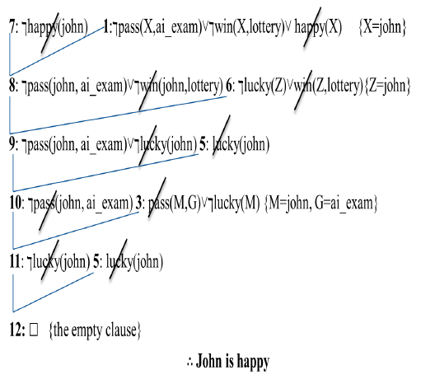

Slide 19
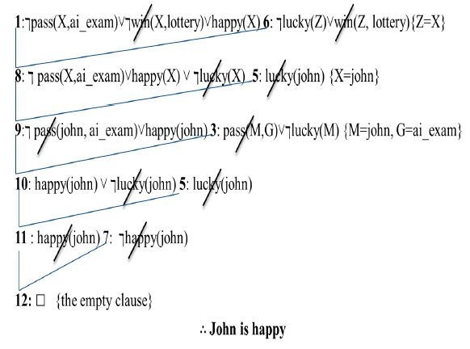
2- Forward Resolution
The proving for happy(john) using forward Resolution is shown as follows:

