Slide 1
Python Programming Language
Lecture 4

Slide 2
Dictionaries
A dictionary: is a data type similar to arrays, but works with keys and values instead of indexes. Each value stored in a dictionary can be accessed using a key, which is any type of object (a string, a number, a list, etc.) instead of using its index to address it. Keys are unique within a dictionary while values may not be. The values of a dictionary can be of any type, but the keys must be of an immutable data type such as strings, numbers, or tuples.
You can update a dictionary by adding a new entry or a key-value pair, modifying an existing entry, or deleting an existing entry.

Slide 3
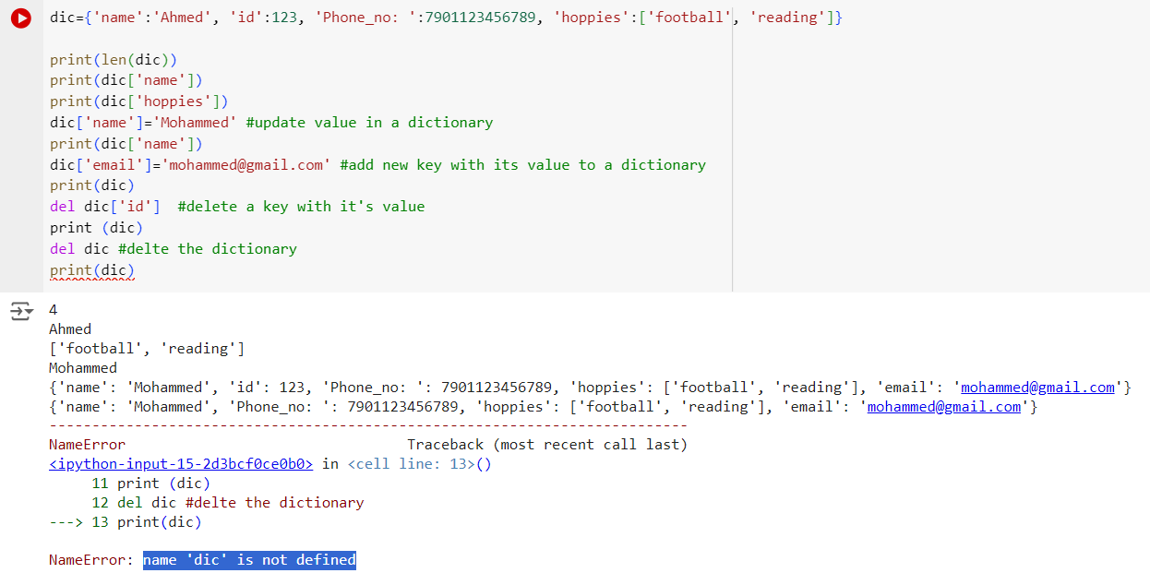
Example

Slide 4
Note:
More than one entry per key not allowed. Which means no duplicate key is allowed. When duplicate keys encountered during assignment, the last assignment wins as shown in the example below:

Slide 5
Function
- A function: is a block of organized, reusable code that is used to
perform a single, related action. Functions provide better modularity
for your application and a high degree of code reusing.
In Python, we have many built-in functions.
- To define a function:
def <function name>(<parameter list>)
• The function body is indented one level:
def computeSquare(x):
return x * x
# Anything at this level is not part of the function

Slide 6
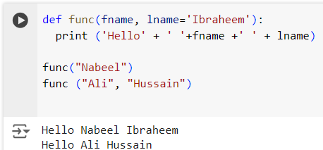
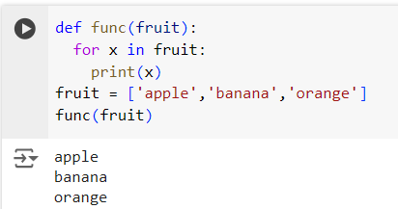
Examples

Slide 7
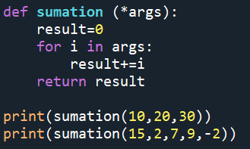

args
*args allows you to pass a varying number of positional arguments, as shown in the example:
Note: You’re not required to use the name args. You can choose any name that you prefer, but you must use * before the name.

