Slide 1
Search in AI
Lecture 3

Slide 2
Search in AI:
Search in AI: study the methods (ways) of searching with the knowledge base and comparison between them how to reach the goal with less time and cost. There are two types of search:
1)Blind search
2)Heuristic searching

Slide 3
1) Blind search
A)Breadth First Search (BFS)
B)Depth First Search (DFS)

Slide 4
Breadth First Search (BFS)

Slide 5
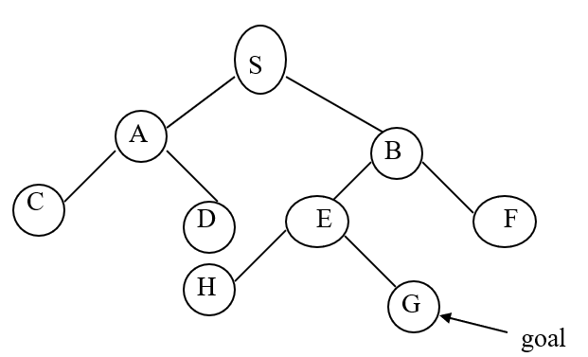
Example
See the tree and find the goal by the breadth first search?

Slide 6
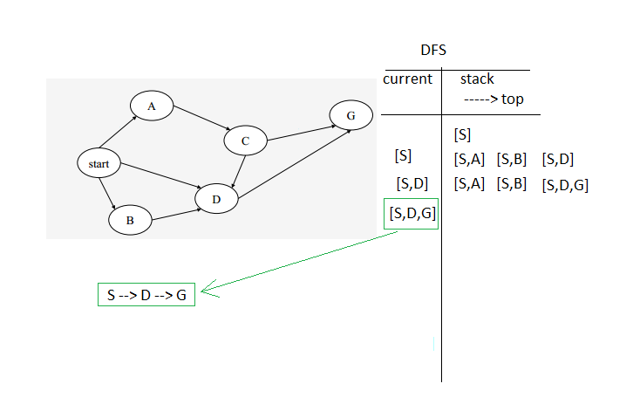
Depth First Search (DFS)

Slide 7
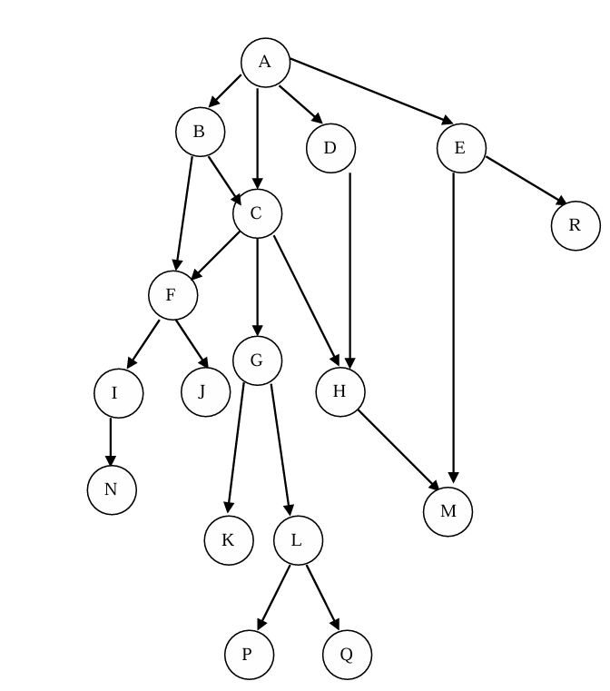
Example
Example: use DFS (alphabetical way) to find the path between A and L for the following search space:

Slide 8

Example
Example: use BFS (Left to Right way) to find the path between A and L for the following search space:

Slide 9
The advantages of BFS
1. BFS will not get trapped exploring a blind only; this contrasts with DFS, which may follow a single, unfruitful path for every long time.
2. If there is a solution, then BFS is guaranteed to find it, further more if there are multiple solutions, then a minimal solution (minimum number steps ) will be found ,this is guarantied by the fact that longer path are never explored until shorter ones have already been examined.

Slide 10
The advantages of DFS
1.DFS requires less memory since only the nodes on the current path are stored. This contrasts with BFS where all of the tree that has so far been generated must be stored.
2.DFS may find a solution without examining much of the search space at all. This contrasts with BFS in which all parts of the tree must be examined to level N before any nodes on level(n+1) can be examined this particularly significant if many acceptable solution exist, DFS can stop when one of them is found.

