Slide 1
Artificial Intelligence
Lecture 18

Slide 2
Analyze the provided dataset below and propose a comprehensive processing plan, including appropriate tools.
ID | Student_Name | Sex | Age | Subject | Degree | Date
1 | Ahmed Ameen | Male | 19 | Physics | 90 | 19/3/2025
2 | Noor Adil | Female | 20 | Science | 100 | 11/2/2025
3 | Reem Yassir | Female | 21 | Science | 60 | 11/2/2025
4 | Mohammed Ali | Male | 23 | Math | 50 | 5/13/2025
5 | Lina Fouad | Female | 25 | Arabic | 75 | 20/9/2024
6 | Sara Rami | Female | 18 | Art | 88 | 4/5/2025
7 | Sinan Ahmed | Male | 18 | Physics | 92 | 17/3/2025
8 | Mustafa Hussain | Male | 19 | Math |  | 13/5/2025
9 | Hassan Ali | Male | 22 | Math | 93 | 10/5/2025

Slide 3
Answer:
1. Cheking for missing values: the degree for ID=8 is missing. Different ways to solve this problem: Replace using mean, median, or mode.
2. Checking for the wrong format: the date for ID=4 is wrong. To correct it, you might be able to replace the wrong data, (but not for big data sets) using: df.loc[3,'Date'] = 13/5/2025
3. Checking for categorical data: convert Sex and Subject column to numerical ones (ex. 0 for Female and 1 for Male).
4. Remove ID coloumn because it is unnessesary.

Slide 4
Feature engineering: is the entire lifecycle of creating, modifying, and selecting features from raw data to improve model performance. It includes:
1. Feature extraction: is a specific technique within that lifecycle used to transform raw data into a more manageable, informative format.
2. Feature selection: picks the best subset of existing features to reduce complexity

Slide 5
What is feature?
Features: are the building blocks that enable machine learning models to learn patterns and make predictions. They can be:
Text: Natural Language Processing (NLP) features
Tabular: Structured data
Image: Vision features
Time Series: Temporal features

Slide 6
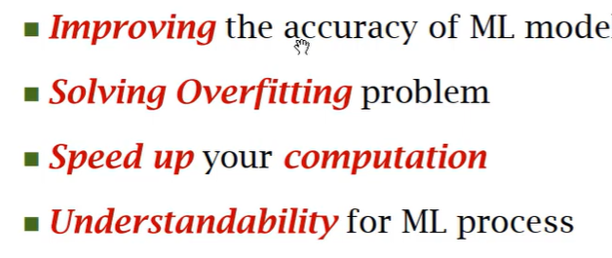
Benefits of Feature Engineering

Slide 7
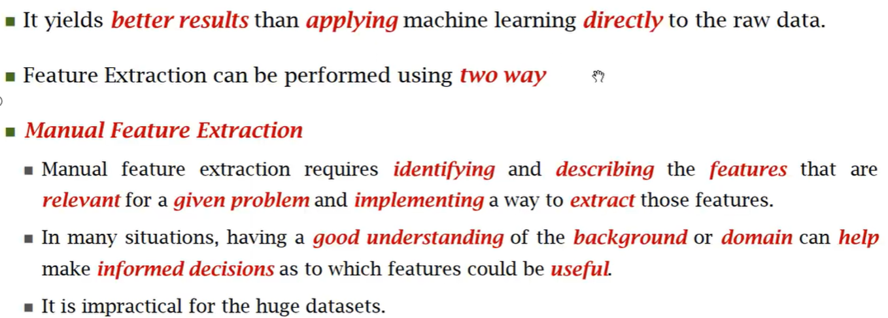
Feature Extraction
Feature Extraction: Transform raw data into numerical features that machine learning models can understand.

Slide 8
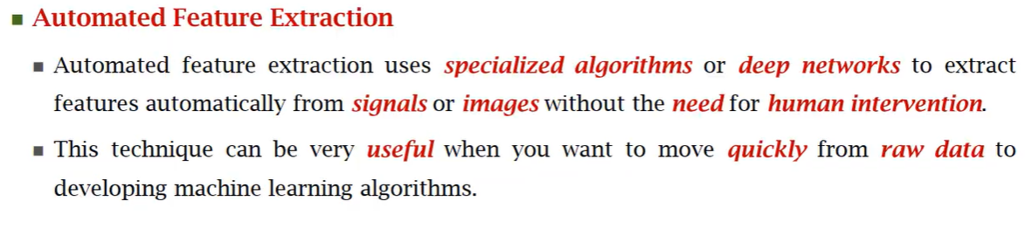
Feature Extraction

Slide 9
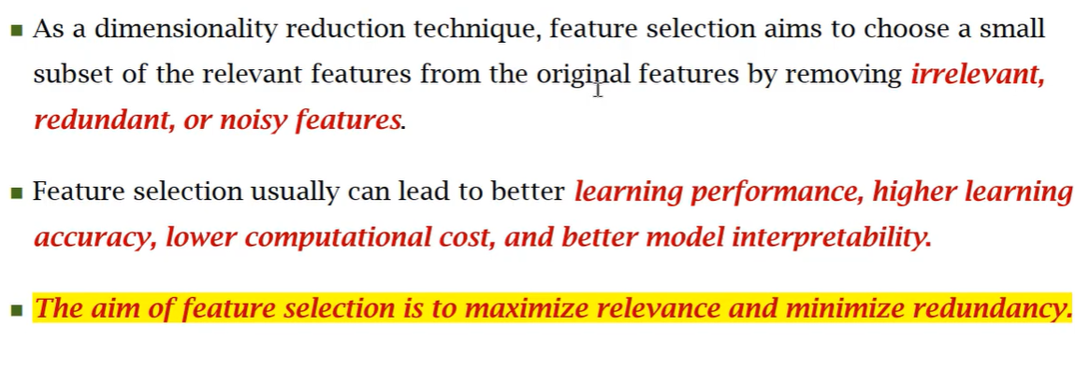
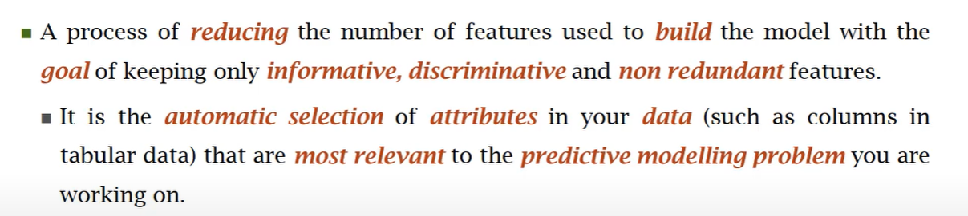
Feature Selection

Slide 10
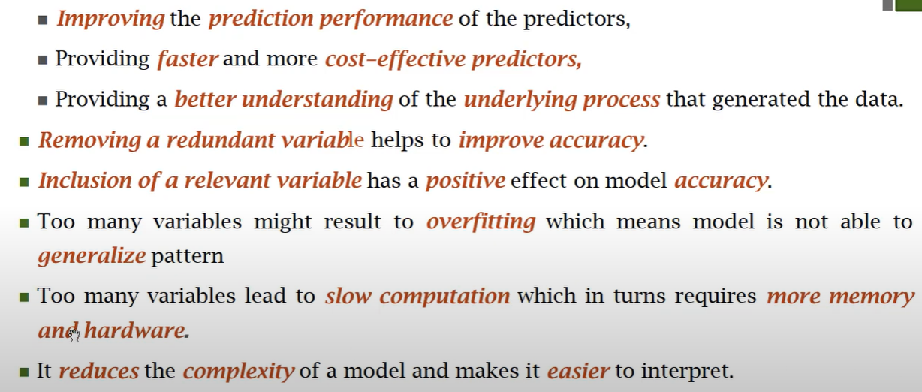
Feature Selection Objectives

Slide 11
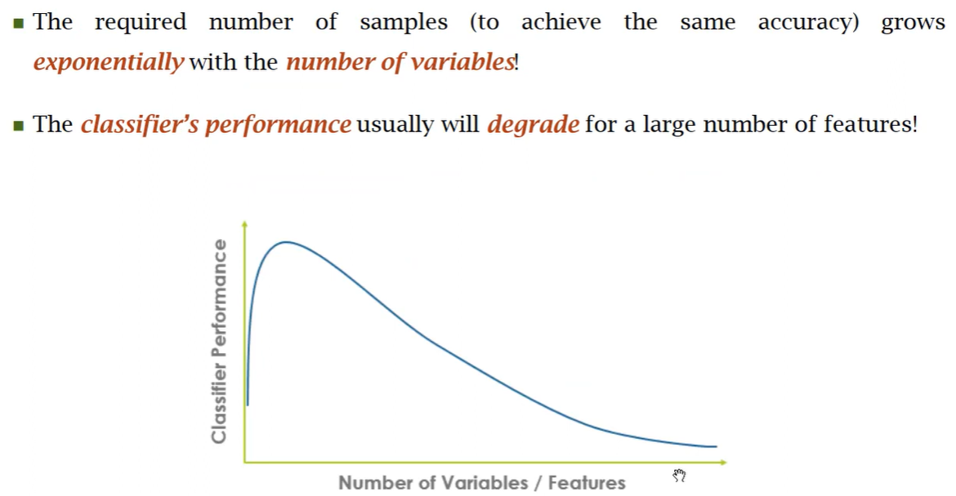
Curse of Dimentionality

Slide 12
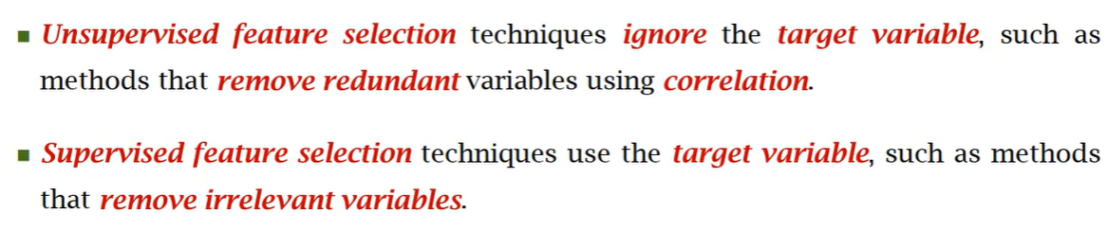
Feature Selection Techniques

Slide 13
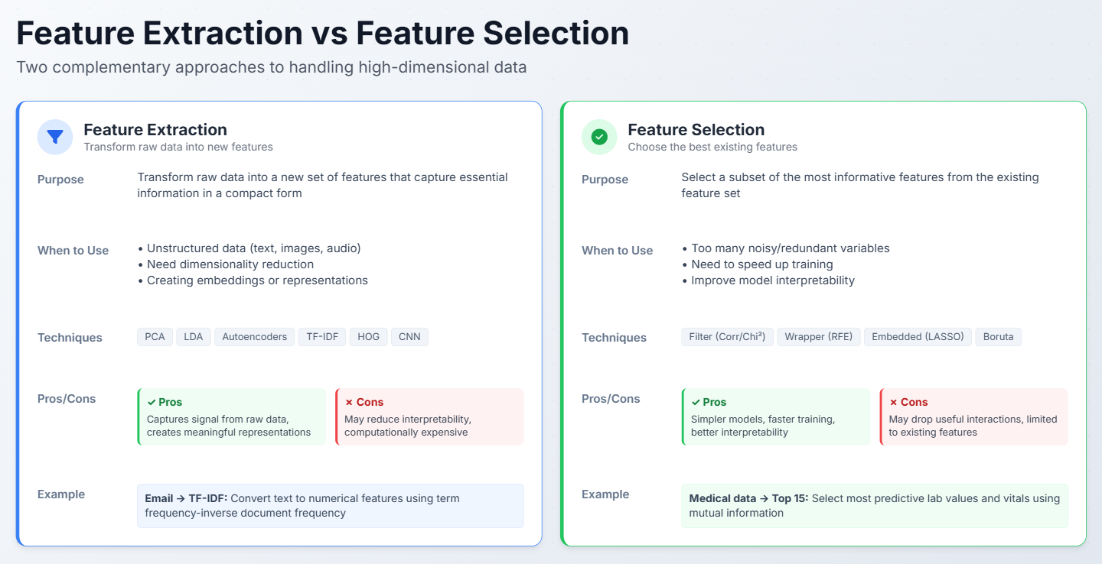

Slide 14
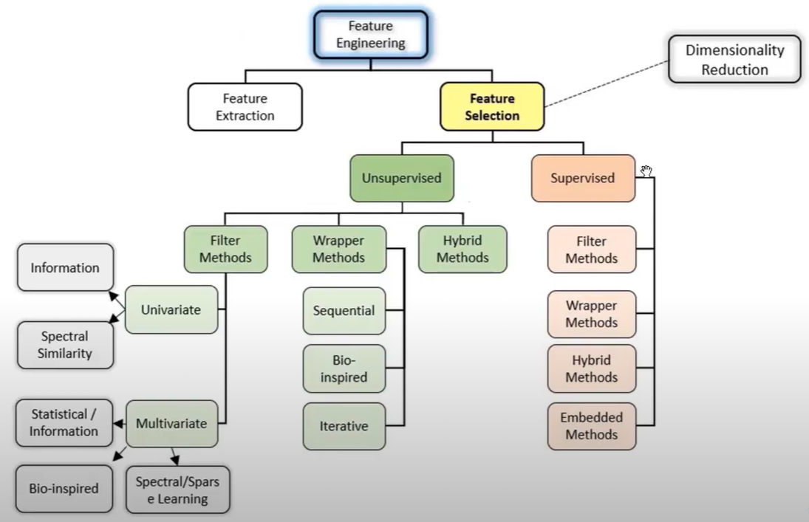

Slide 15
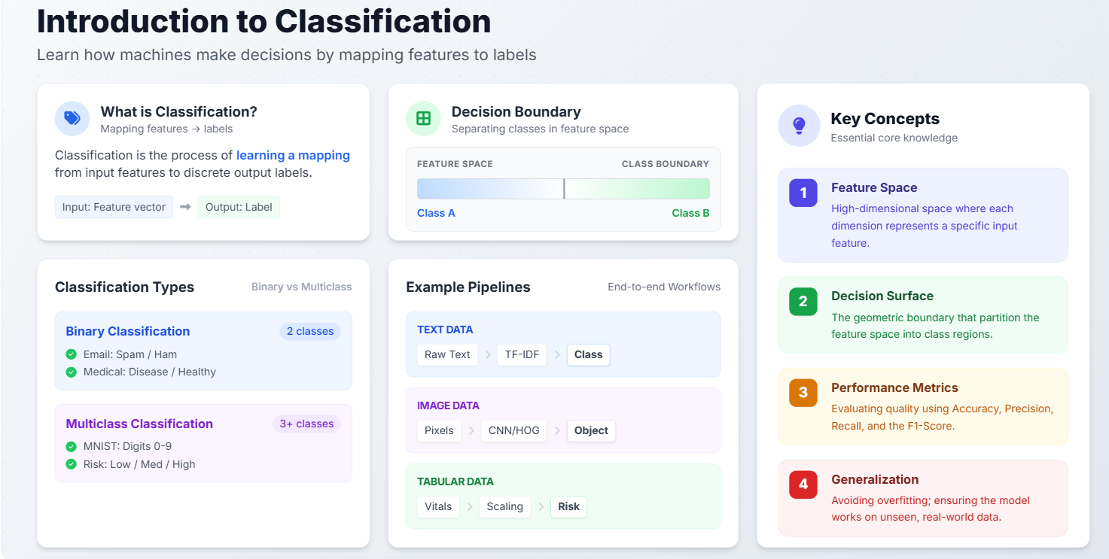

Slide 16
Classification Algorithms
Logistic Regression: is a linear classification algorithm that uses the logistic function to model the probability of binary or multi-class outcomes. It works well for linearly separable data and is interpretable.
Decision Trees: are non-parametric algorithms that recursively partition the feature space based on feature values. They create an interpretable tree structure and can handle both numerical and categorical features.
Support Vector Machines (SVM): find optimal hyperplanes that maximize the margin between classes. SVM is effective for high-dimensional data and performs well with both linear and non-linear kernels.
Neural Networks: are deep learning models composed of interconnected layers of neurons. They can learn complex non-linear relationships in data and are particularly powerful for high-dimensional classification problems.

Slide 17
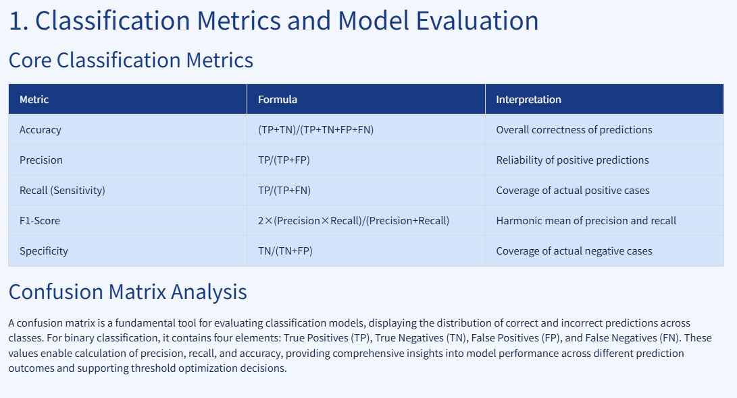

Slide 18
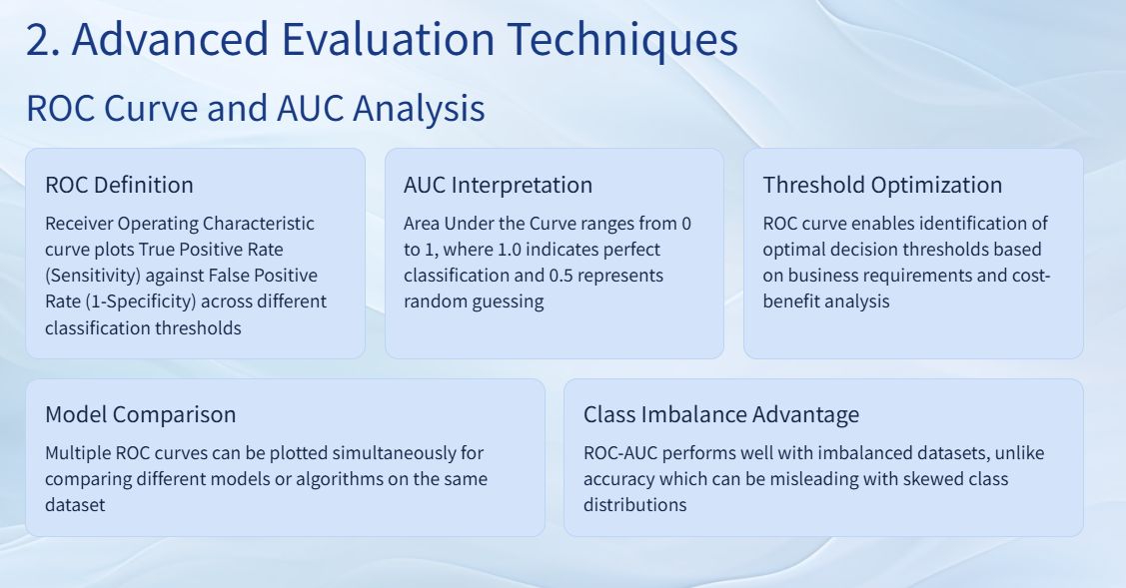

Slide 19
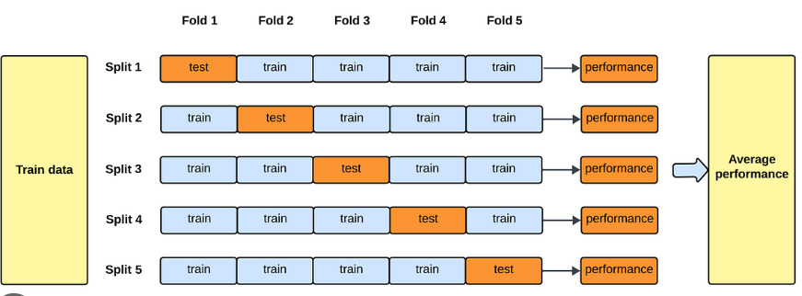
K-fold Cross Validation
Let k=5

