Slide 1
Python Programming Language
Lecture 7

Slide 2
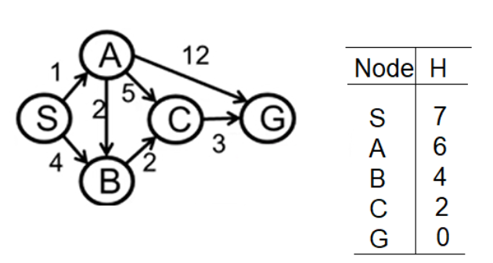
Implementation Code foe A* Search
We use the Graph below as an example for A* Search:

Slide 3
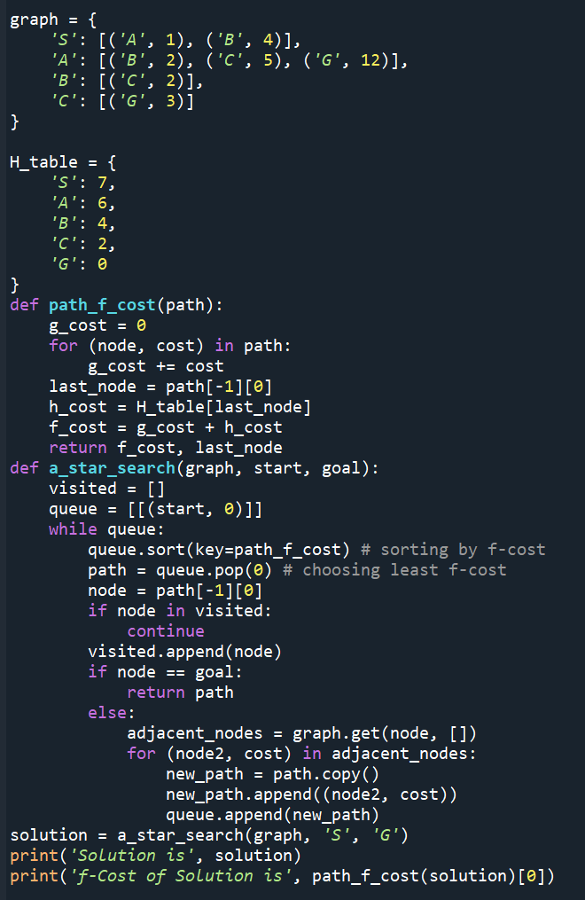


Slide 4
Numpy Library
NumPy is a Python library used for working with arrays. It also has functions for working in domain of linear algebra, fourier transform, and matrices. NumPy was created in 2005 by Travis Oliphant. It is an open source project and you can use it freely.
We can use it thrtrough different ways of calling:
import numpy
import numpy as np
from numpy import *

Slide 5
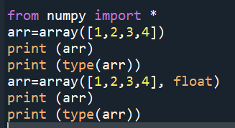
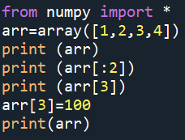
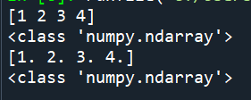
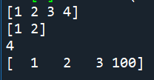
Example

Slide 6
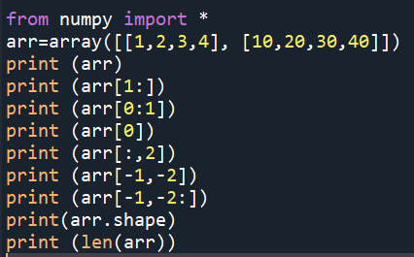
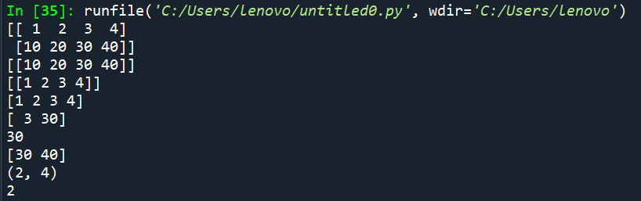
2D array
1 | 2 | 3 | 4
10 | 20 | 30 | 40

Slide 7
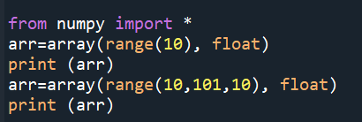

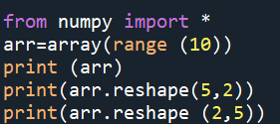
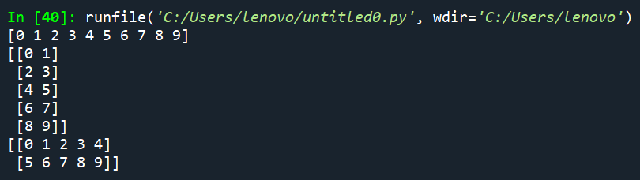
Examples

Slide 8
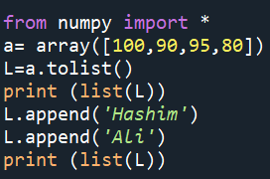

Create list from array

Slide 9
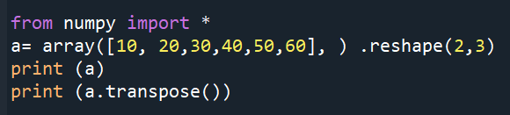
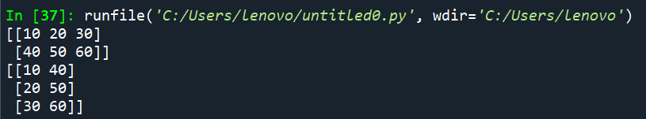
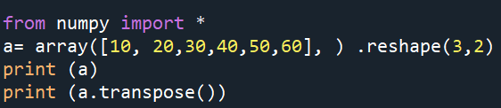
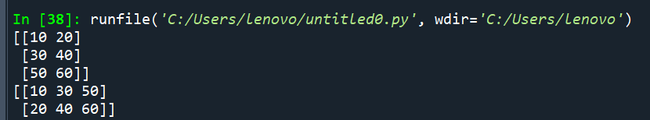
Reshape (Convert rows to coloumns or columns to rows)

Slide 10
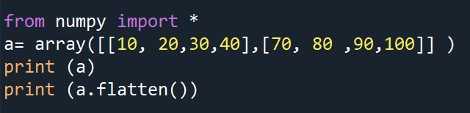
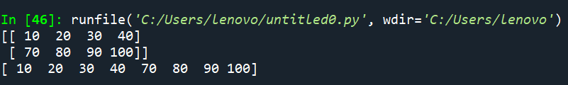
Flattern to convert 2D to 1D

Slide 11
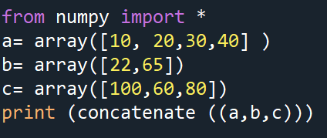
Concatenate

Slide 12
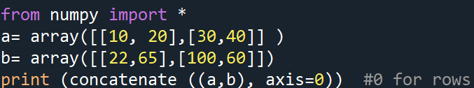
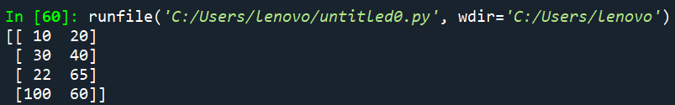
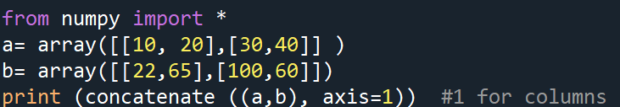

Concatenate

Slide 13
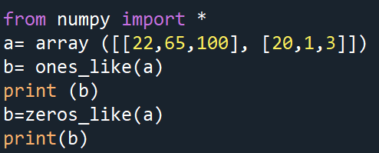
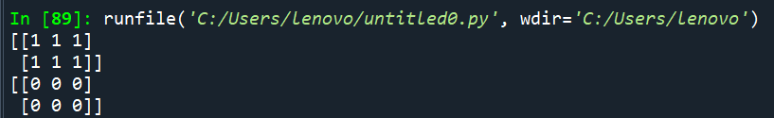
ones_like and zeros_like functions

Slide 14
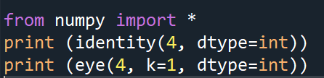
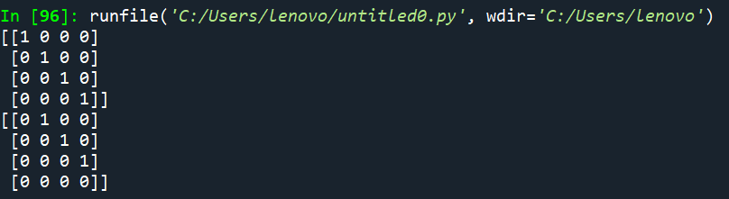
Identity and eye functions
Identity function creates 2D array with diameter = 1, while eye function returns matrrices with ones alog the kth diagonal as shown in example below:

Slide 15
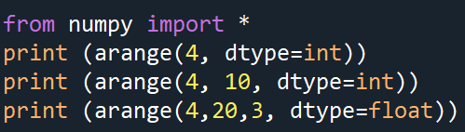
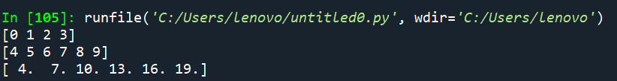
arange function
Another way to create a one dimentional array as shown in the example below:

