Slide 1
Artificial Intelligence
Lecture 9

Slide 2

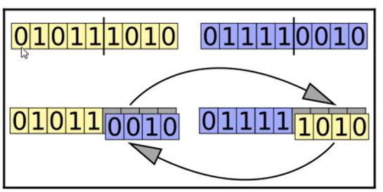
Crossover

Slide 3
Types of Crossover
Single Point Crossover.
One Point Crossover.
Two Point Crossover.
K-Point Crossover.
Uniform Crossover.
Arithmatic Crossover.

Slide 4
Single Point Crossover
Example:
Parent 1: 1000111
Parent 2: 1010101
Offspring1: 1000101
Offspring2: 1010111

Slide 5
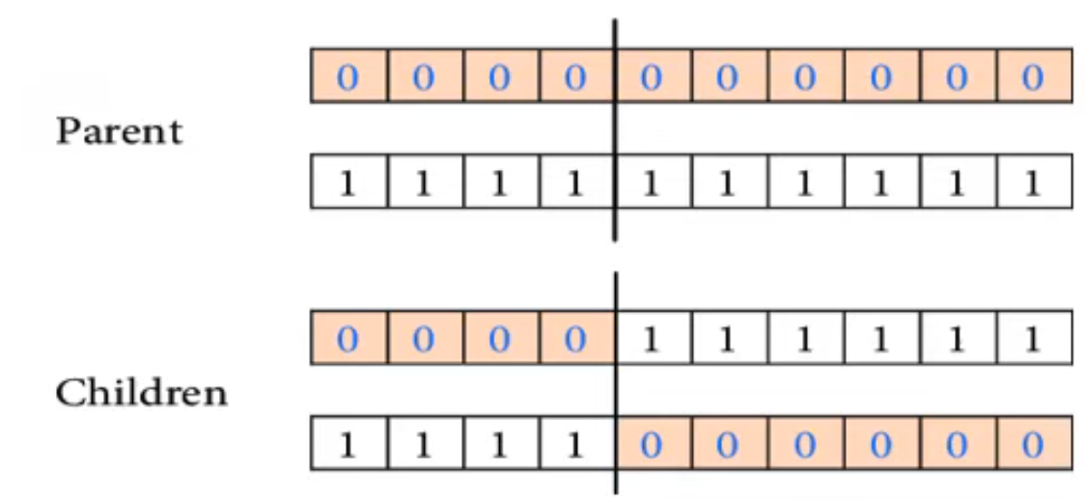
One Point Crossover

Slide 6
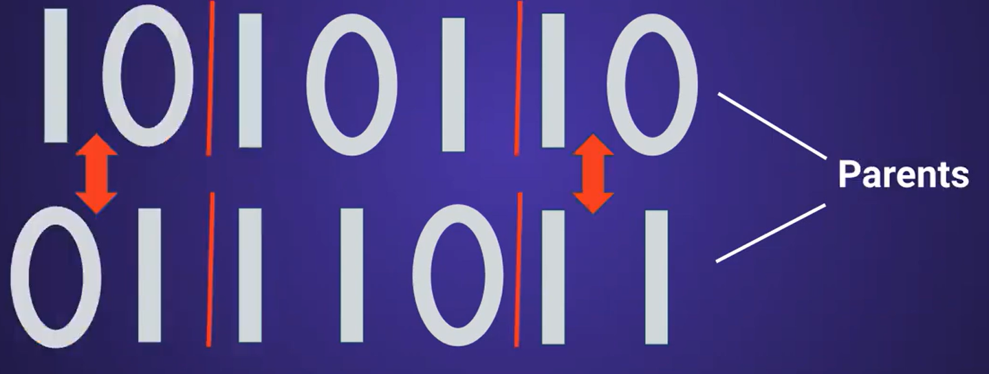
Two Point Crossover

Slide 7


Slide 8
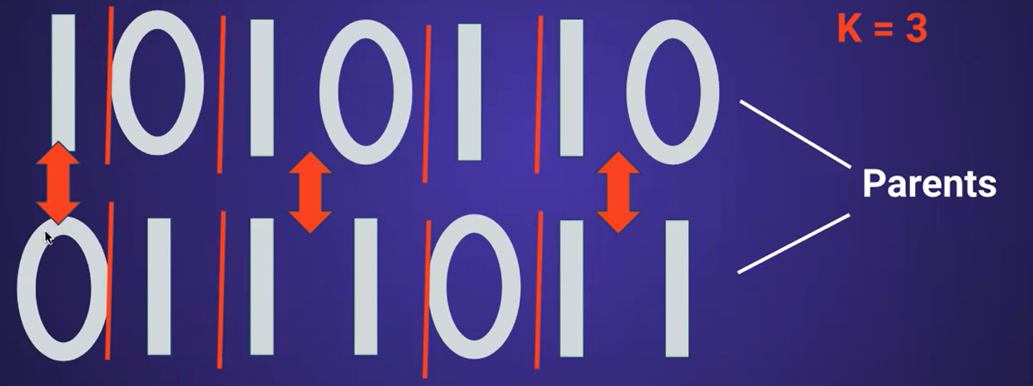
K-Point Crossover

Slide 9
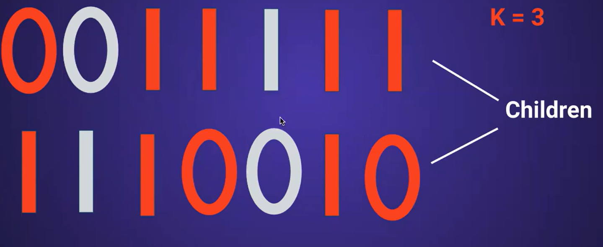

Slide 10
Uniform Crossover
Example:
Parent 1: 1 2 2 1 3 4 1 2 3 4
Parent 2: 4 1 3 2 1 2 4 3 2 1
Mask: 0 1 1 0 0 1 0 1 1 0
Offspring1: 4 2 2 2 1 4 4 2 3 1
Offspring2: 1 1 3 1 3 2 1 3 2 4

Slide 11
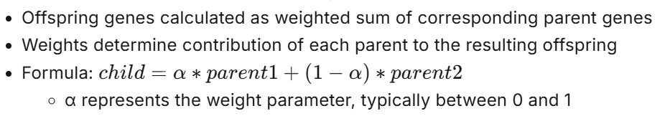
Arithmetic Crossover

