Slide 1
Python Programming Language
Lecture 7

Slide 2
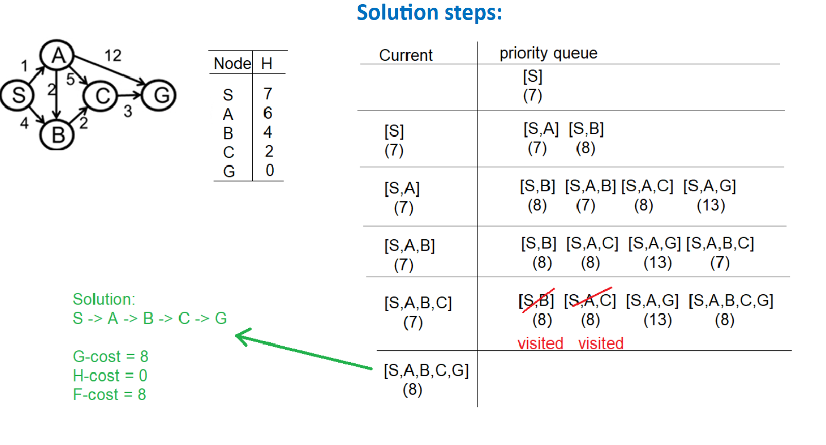
A* Search

Slide 3
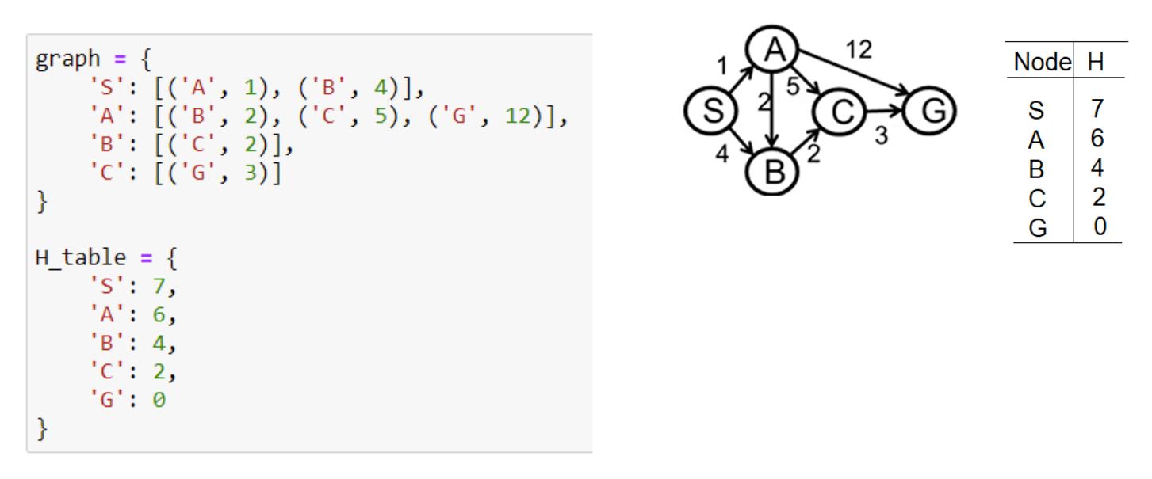
Implementation code:

Slide 4
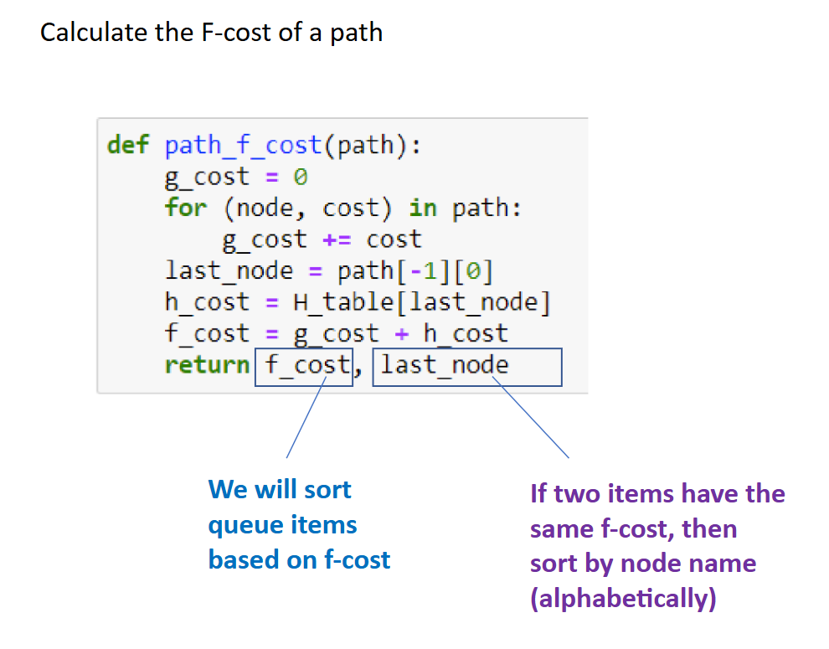

Slide 5
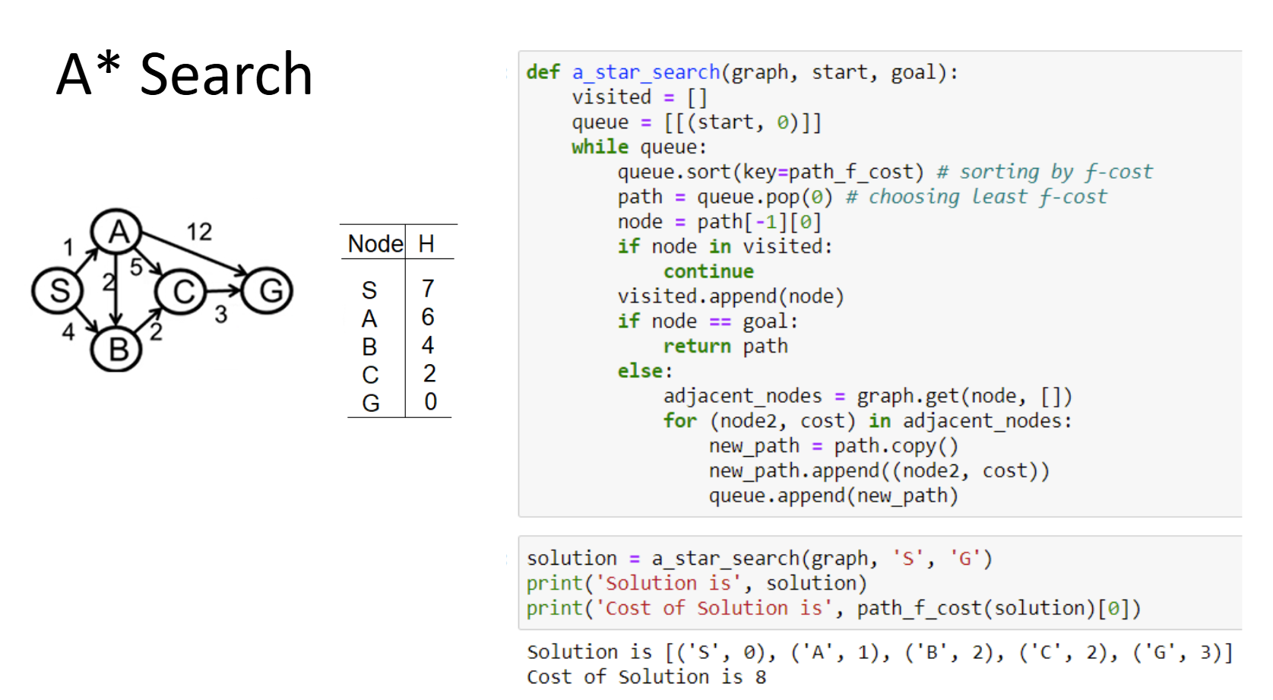

Slide 6
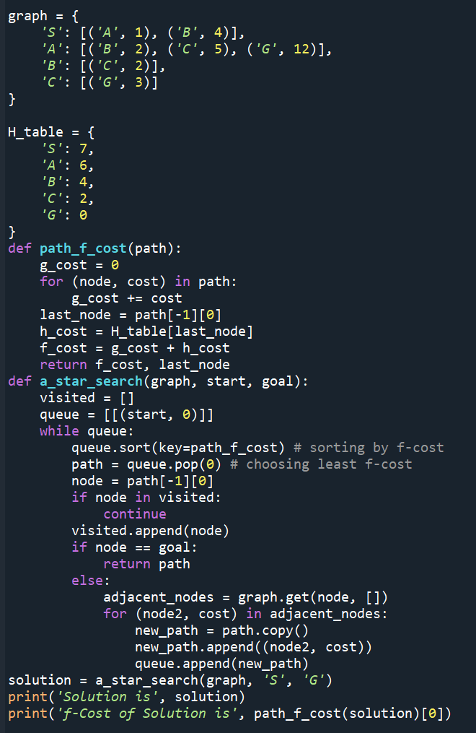


Slide 7
Numpy Library
NumPy is a Python library used for working with arrays. It also has functions for working in domain of linear algebra, fourier transform, and matrices. NumPy was created in 2005 by Travis Oliphant. It is an open source project and you can use it freely.
We can use it thrtrough different ways of calling:
import numpy
import numpy as np
from numpy import *

Slide 8
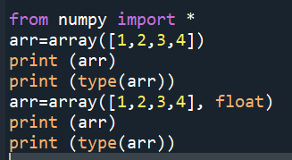
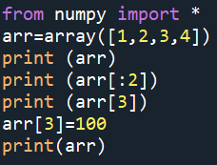
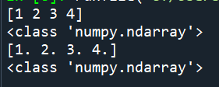
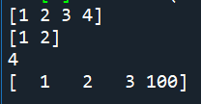
Example

Slide 9
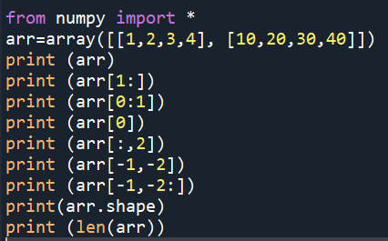

2D array
1 | 2 | 3 | 4
10 | 20 | 30 | 40

Slide 10
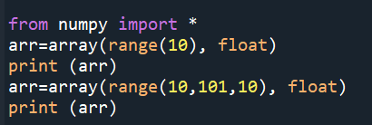

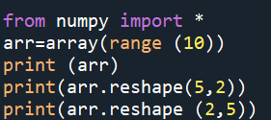

Examples

Slide 11
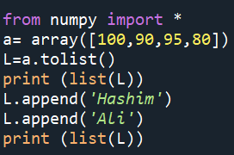

Create list from array

Slide 12




Reshape (Convert rows to coloumns or columns to rows)

Slide 13


Flattern to convert 2D to 1D

Slide 14
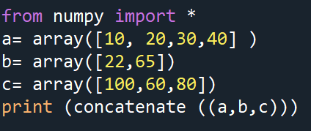
Concatenate

Slide 15




Concatenate

Slide 16
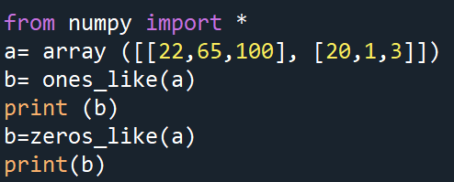

ones_like and zeros_like functions

Slide 17


Identity and eye functions
Identity function creates 2D array with diameter = 1, while eye function returns matrrices with ones alog the kth diagonal as shown in example below:

Slide 18


arange function
Another way to create a one dimentional array as shown in the example below:

