Slide 1
Artificial Intelligence
Lecture 10

Slide 2
Mutation
- The mutation is a random change in a chromosome to introduce new patterns to a chromosome.
- Mutation operator is a unary opertor and it needs only one parent to work on.

Slide 3
Mutation Types
Different types of mutation methods available, such as:
Flip bit mutation
Random resetting mutation
Swap mutation
Scramble mutation
Inversion mutation

Slide 4
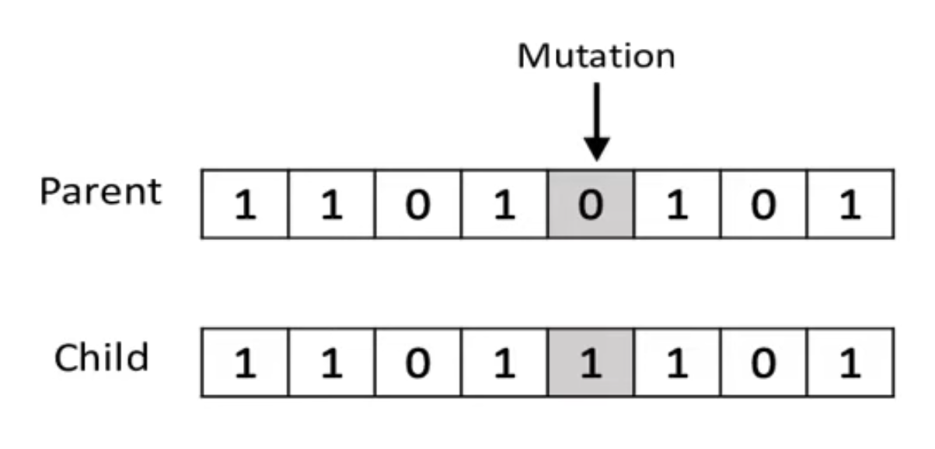
Flip bit mutation
In this type, we select one or more random bits and flip them.
This is used for binary encoded GA.
Example:

Slide 5
Random resetting mutation
It is an extension of the bit flip for the integer representation.
In this case, a random value from the set of permissible values is assigned to a randomly chosen gene.
Example:
Parent: 1 2 3 4 5 6 7 8 Permissible values:(5-10)
Result: 1 5 3 4 5 9 7 8

Slide 6
Swap mutation
In this type, we select two positions in the chromosome at random and exchange their values.
Example:
Parent: 1 2 3 4 5 6 7 8
Result: 1 6 3 4 5 2 7 8

Slide 7
Scramble mutation
Scramble mutation is also popular with permutation representations.
In this type, a subset of genes from the entire chromosome is chosen and their valuse are scrmbled or shuffled randomly.
Example:

Slide 8
Inversion mutation
In this type, a subset of genes from the entire chromosome is chosen and invert the entire string in the subset.
Example:

Slide 9
Example
Suppose a genetic algorithm uses chromosomes of the form x = abcdefgh with a fixed length of eight genes. Each gene can be any digit between 0 and 9. Let the fitness of individual x be calculated as:
f(x) = (a + b) − (c + d) + (e + f) − (g + h) ,
and let the initial population consist of four individuals with the following
chromosomes:
x1 = 6 5 4 1 3 5 3 2
x2 = 8 7 1 2 6 6 0 1
x3 = 2 3 9 2 1 2 8 5
x4 = 4 1 8 5 2 0 9 4

Slide 10
a) Evaluate the fitness of each individual, showing all your workings, and arrange them in order with the fittest first and the least fit last.
b) Perform the following crossover operations:
i) Cross the fittest two individuals using one–point crossover at the middle point.
ii) Cross the second and third fittest individuals using a two–point crossover (between points b and g).

Slide 11
iii) Cross the first and third fittest individuals (ranked 1st and 3rd) using a uniform crossover with:
Mask: 0 1 1 0 1 0 1 1
c) Evaluate the fitness of the new population, showing all your workings.

Slide 12
Answer:
a) f(x1) = (6 + 5) − (4 + 1) + (3 + 5) − (3 + 2) = 9
f(x2) = (8 + 7) − (1 + 2) + (6 + 6) − (0 + 1) = 23
f(x3) = (2 + 3) − (9 + 2) + (1 + 2) − (8 + 5) = −16
f(x4) = (4 + 1) − (8 + 5) + (2 + 0) − (9 + 4) = −19
The order is: x2, x1, x3 and x4.

Slide 13
b) i) One–point crossover on x2 and x1:
x2 = 8 7 1 2 6 6 0 1
x1 = 6 5 4 1 3 5 3 2 ⇒
Offspring1 = 8 7 1 2 3 5 3 2
Offspring2 = 6 5 4 1 6 6 0 1
ii) Two–point crossover on x1 and x3
x1 = 6 5 4 1 3 5 3 2
x3 = 2 3 9 2 1 2 8 5 ⇒
Offspring3 = 6 5 9 2 1 2 3 2
Offspring4 = 2 3 4 1 3 5 8 5

Slide 14
iii) x2 = 8 7 1 2 6 6 0 1
x3 = 2 3 9 2 1 2 8 5
Mask:0 1 1 0 1 0 1 1 ⇒
Offspring5 = 2 7 1 2 6 2 0 1
Offspring6 = 8 3 9 2 1 6 8 5
c) The new population is:
O1 = 8 7 1 2 3 5 3 2
O2 = 6 5 4 1 6 6 0 1
O3 = 6 5 9 2 1 2 3 2
O4 = 2 3 4 1 3 5 8 5
O5 = 2 7 1 2 6 2 0 1
O6 = 8 3 9 2 1 6 8 5

Slide 15
Now apply the fitness function f(x) = (a+b)−(c+d)+(e+f)−(g+h):
f(Offspring1) = (8 + 7) − (1 + 2) + (3 + 5) − (3 + 2) = 15
f(Offspring2) = (6 + 5) − (4 + 1) + (6 + 6) − (0 + 1) = 17
f(Offspring3) = (6 + 5) − (9 + 2) + (1 + 2) − (3 + 2) = −2
f(Offspring4) = (2 + 3) − (4 + 1) + (3 + 5) − (8 + 5) = −5
f(Offspring5) = (2 + 7) − (1 + 2) + (6 + 2) − (0 + 1) = 13
f(Offspring6) = (8 + 3) − (9 + 2) + (1 + 6) − (8 + 5) = −6

