Slide 1
Artificial Intelligence
Lecture 12

Slide 2
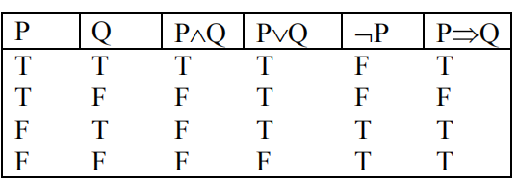
Truth Table

Slide 3
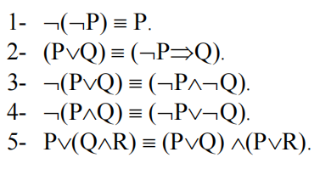
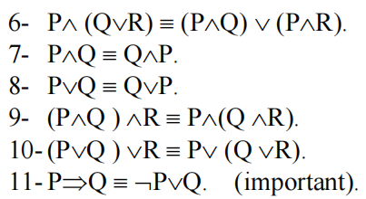
Common Identities in Propositional Logic

Slide 4
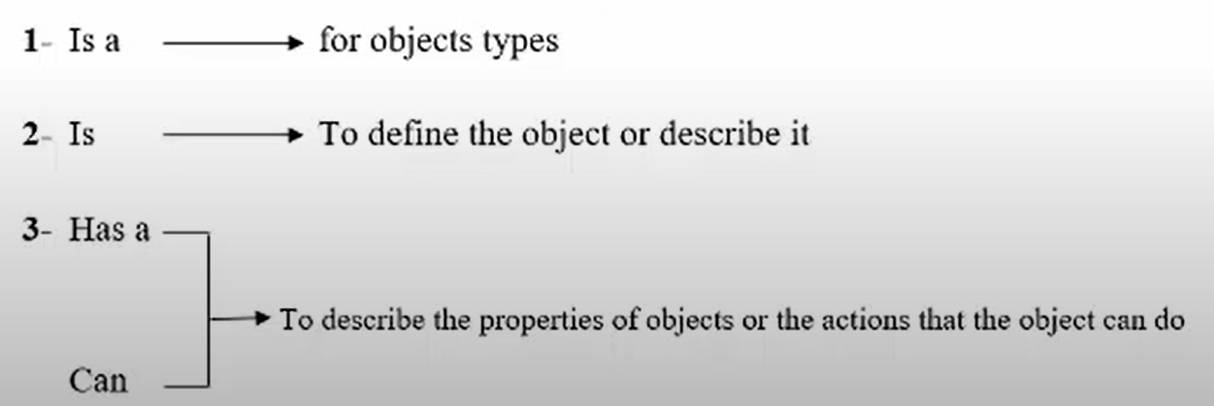
3- Semantic network
This type consisits of a set of nodes and arrows; each node is represented as a rectangle to describe the objects, concepts and the events. The arrows are used to connect the nodes, examples of these arrows are:

Slide 5
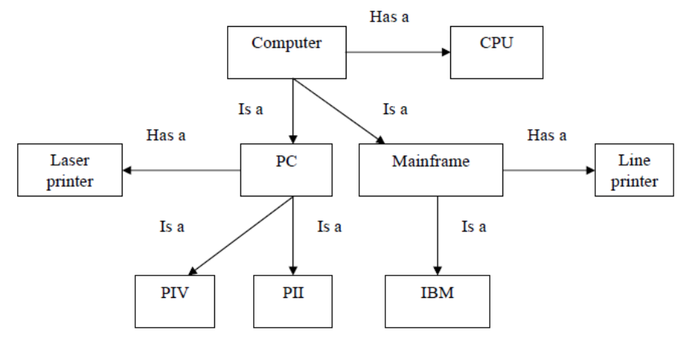
Example
Computer has a many part like a CPU and the computer divided into two kind one is the mainframe and the second is the personal computer. Mainframe has a line printer as a device with a large sheet, but the personal computer has the laser printer. IBM is an example of mainframe, but “PII” and “PIV” are as examples to the personall computer.

Slide 6
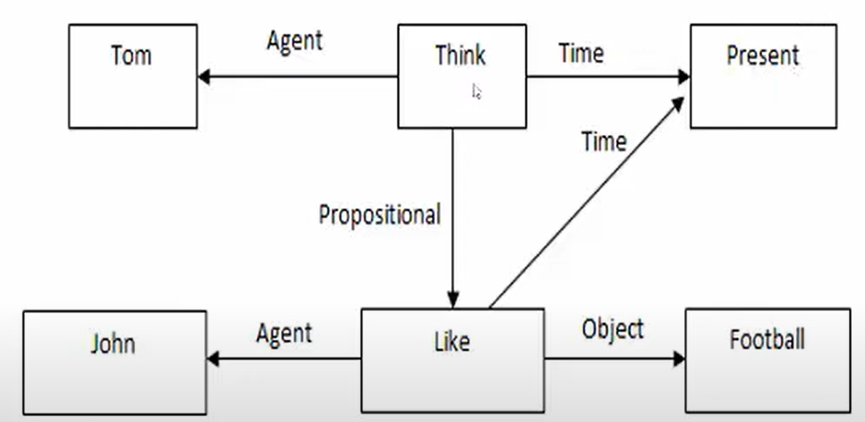
Example
Representing events in semantic net:
Tom thinks that John likes football.

Slide 7
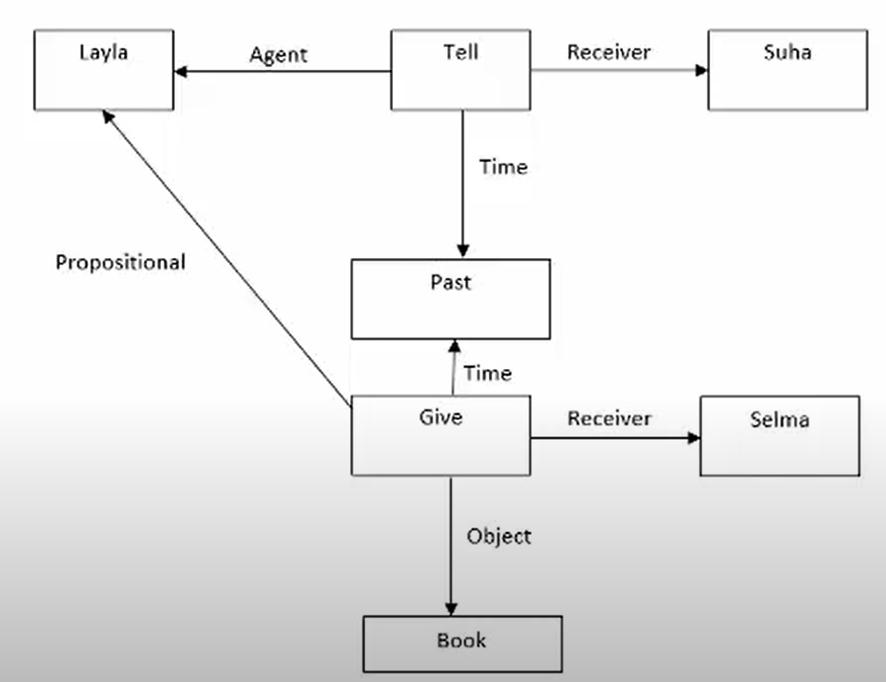
Example
Layla told Suha that she gave Selma a book.

Slide 8
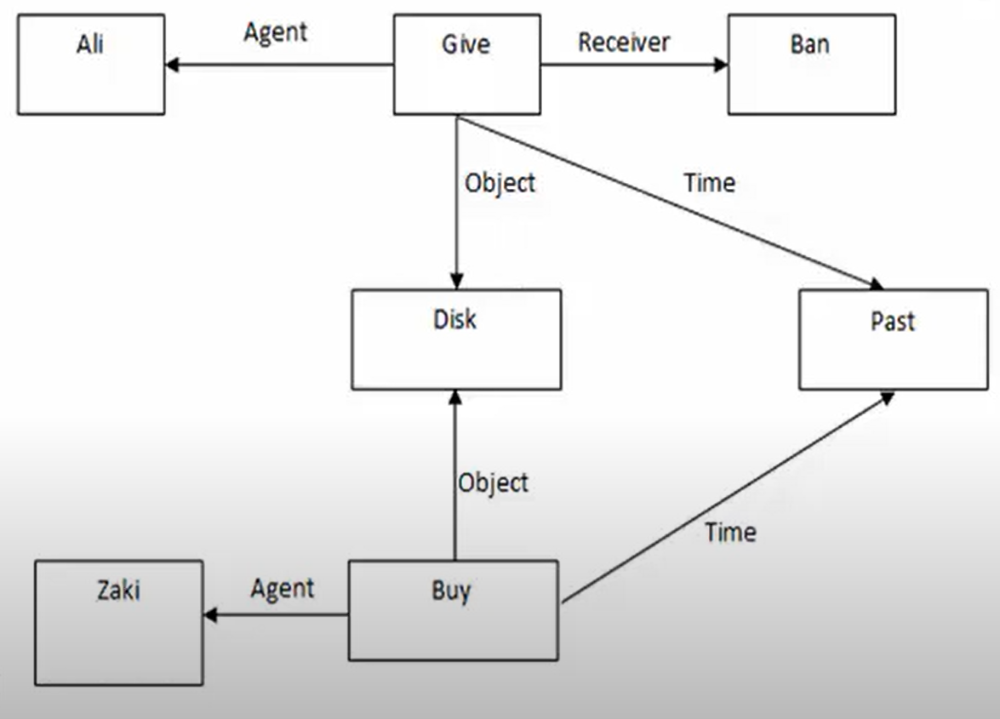
Example
Ali gave Ban a disk who Zaki bought.

Slide 9
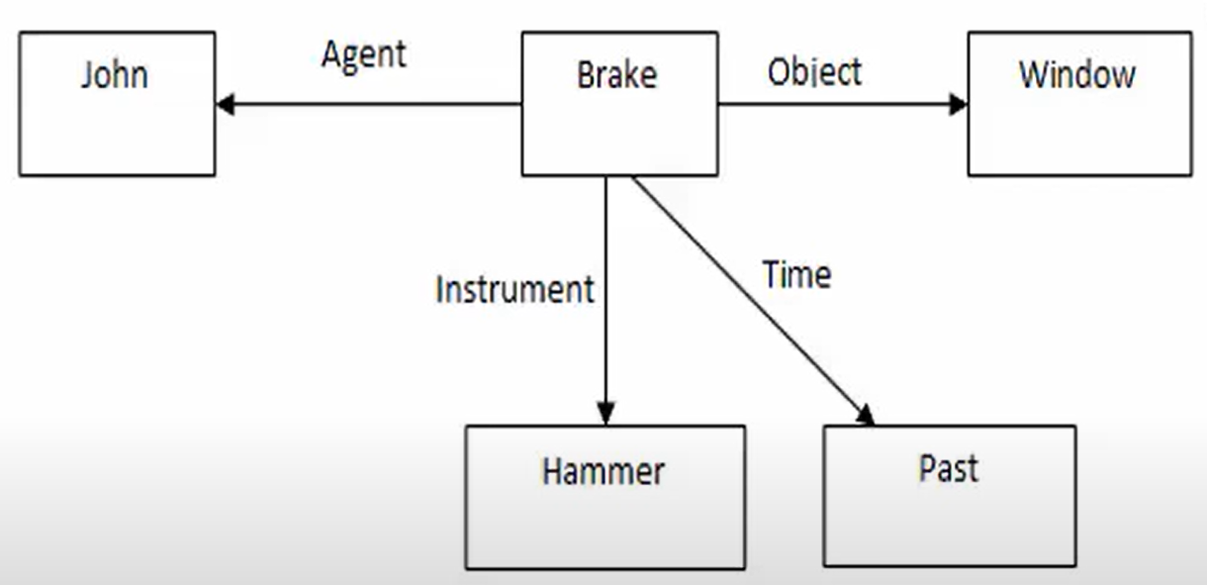
Example
John broke the window with a hammer.

Slide 10
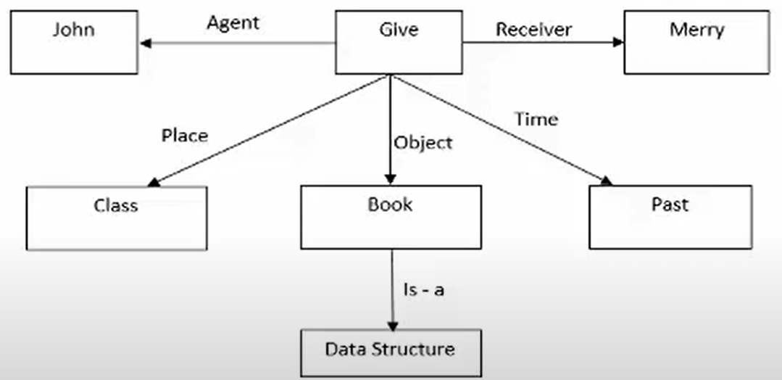
Example
John gave Merry a book of Data Structure in the class.

Slide 11
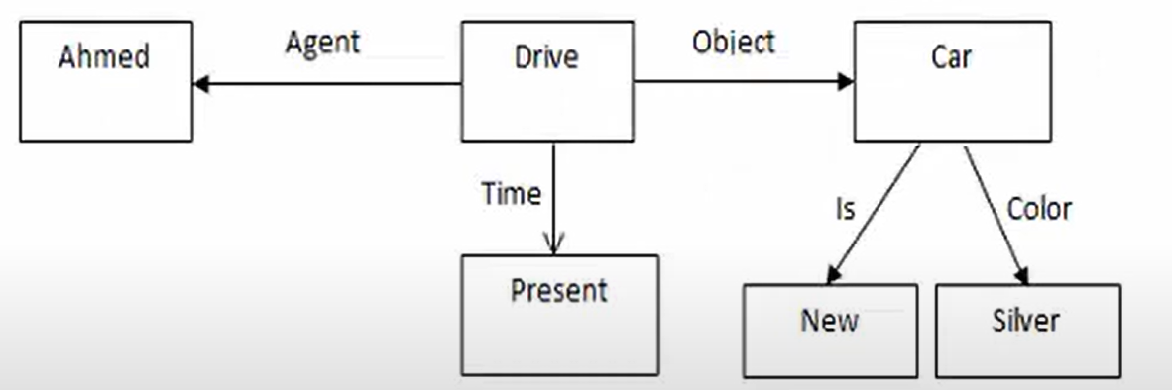
Example
Ahmed drives a new silver car.

Slide 12
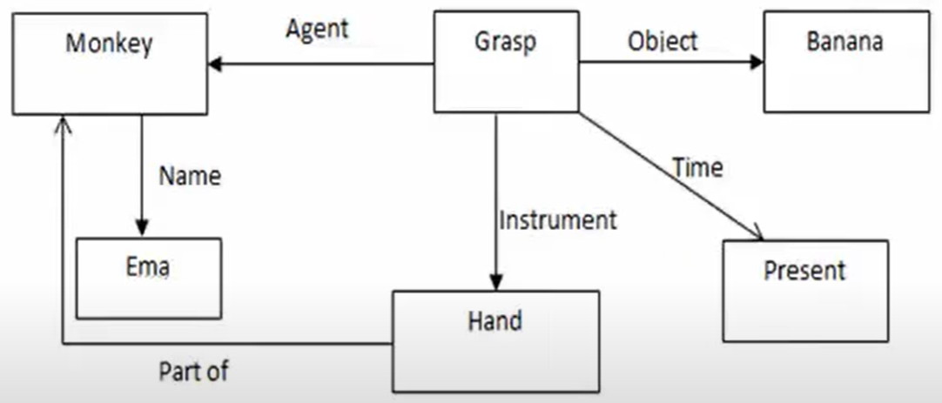
Example
Monkey Ema grasps the Banana with hand.

Slide 13
4- Conceptual Graph
This type based on semantic networks.
Concepts are represented as a rectangle.
Conceptual relations are represented as an ellipse.
A relation may have more than one edge.

Slide 14
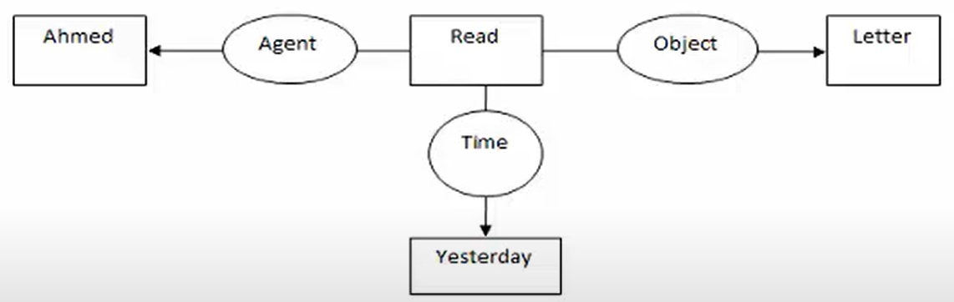
Example
Ahmed read a letter yesterday.

Slide 15
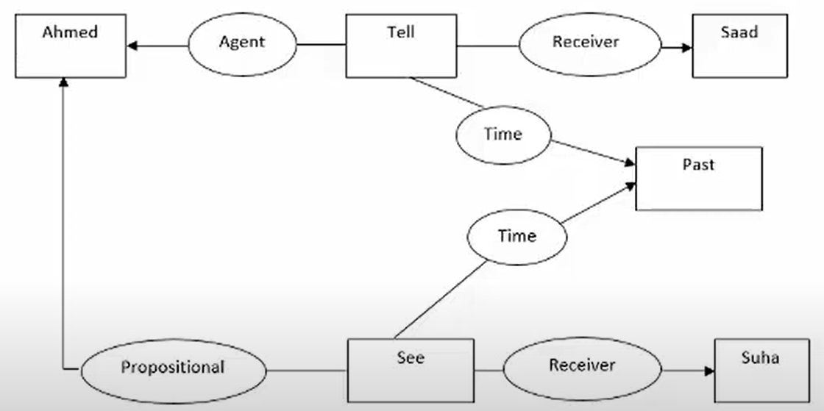
Example
Ahmed told Saad that he saw Suha.

Slide 16
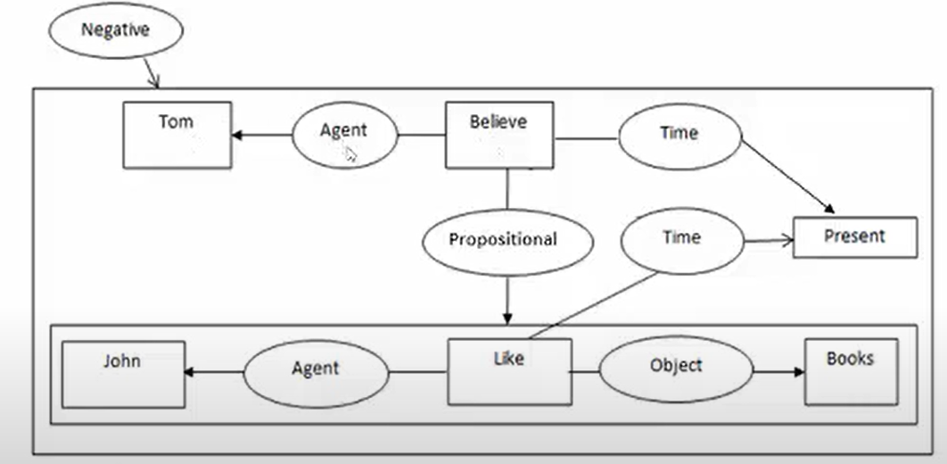
Example
Tom Doesn’t believe that John likes books.

Slide 17
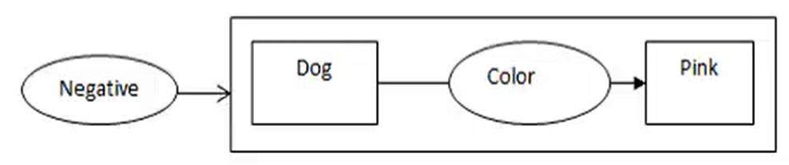
Example
There are no pink dogs.

Slide 18
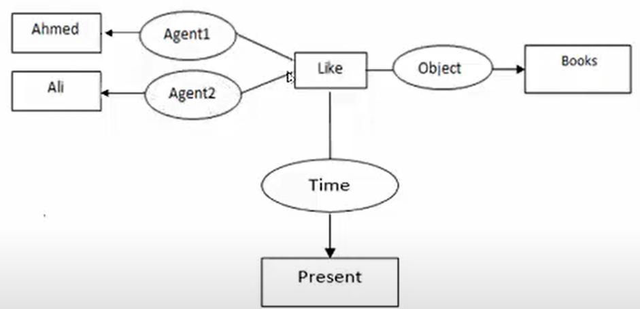
Example
Ahmed and Ali like books.

Slide 19
5- Frame Representation
The frame reprecsentation consists of two parts:
1- Frame list (node_name, parent, [child]).
2- Slot list (node_name, parent)

Slide 20
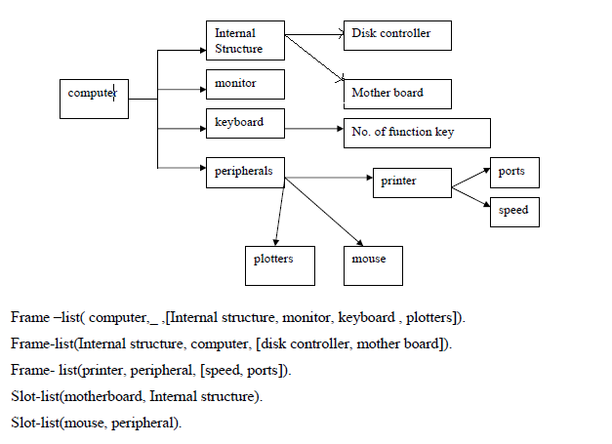
Example
Using the frame representation method to represent the following figure as knowledge, then illustrate how many frames and slots are in this figure?
There are 5 frames and 8 slots.

