Slide 1
Artificial Intelligence
Lecture 14

Slide 2
Example:
Using a a semantic net to solve the following:
Ships are divided into two types: the first is an “ocean liner,” and the second is an “oil tanker.” Ships have engines; the oil tanker is designed to transfer oil; therefore, it has “ fire tools.” The ocean liner is designed to transport travelers; consequently, it has a “swimming pool.” Ibn Khaldun is an example of an oil tanker, and ships B and N are examples of ocean liners.

Slide 3
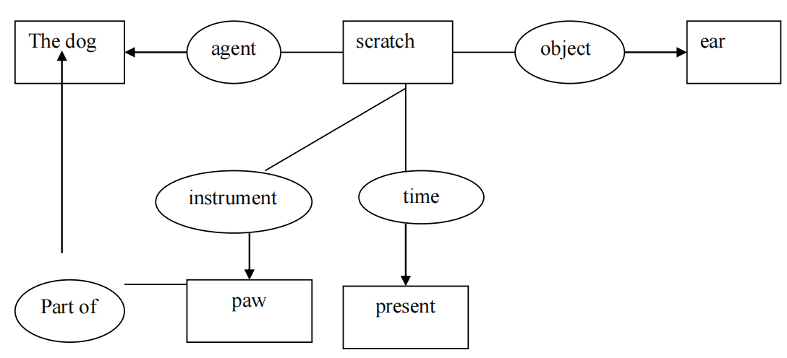
Example:
Using a Conceptual graph to solve the following:
1- The dog scratches its ear with its paw.

Slide 4
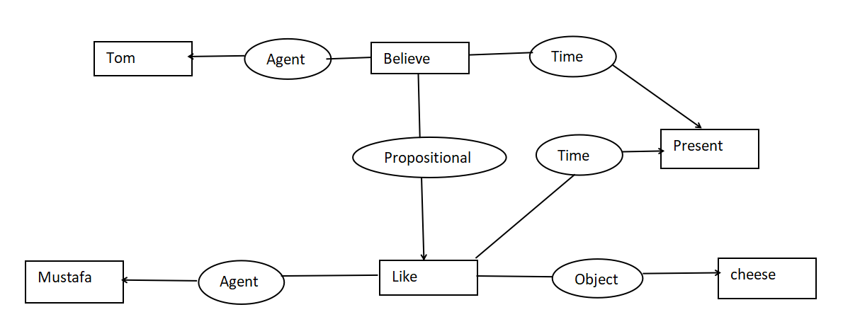
Example:
2- Tom believes that Mustafa likes cheese.

Slide 5
Example:
Use the Resolution Algorithm with regard to the following story:
All people who are not poor and are smart are happy. Those people who read are smart. John can read and is not poor. Happy people have an exciting life. Can anyone be found with an exciting life?

Slide 6
a) Step 1: Convert Statements to First-Order Logic (predicate)
∀Xךpoor(X)∧smart(X)→happy(X)
∀Xread(X)→smart (X)
read(john)∧ ךpoor(john)
happy(X)→ exciting(X,life)
∃X exciting(X,life)?

Slide 7
b) Step 2: Convert to Clausal Normal Form (CNF)
1.
∀X ך(ךpoor(X)∧smart(X))˅ happy(X)
∀Xךread(X)˅smart(X)
read(john)∧ך poor(john)
ך happy(X)˅ exciting(X,life)
∃X exciting(X,life)
2.
∀X (poor(X)˅ךsmart(X))˅ happy(X)
∀Xךread(X)˅smart(X)
read(john)∧ ךpoor(john)
ך happy(X)˅ exciting(X,life)
∃X exciting(X,life)

Slide 8
3.
∀X (poor(X)˅ךsmart(X))˅ happy(X)
∀Yך read(Y)˅smart(Y)
read(john)∧ ךpoor(john)
ך happy(Z)˅ exciting(Z,life)
∃W exciting(W,life)
4.
Nothing to do here.

Slide 9
5.
∀X (poor(X)˅ךsmart(X))˅ happy(X)
∀Y ך read(Y)˅smart(Y)
read(john)∧ ךpoor(john)
ך happy(Z)˅ exciting(Z,life)
exciting(W,life)
6.
(poor(X)˅ךsmart(X))˅ happy(X)
ךread(Y)˅smart(Y)
read(john)∧ ךpoor(john)
ך happy(Z)˅ exciting(Z,life)
exciting(W,life)

Slide 10
7.
Nothing to do here.
8.
poor(X)˅ךsmart(X)˅ happy(X)
ךread(Y)˅smart(Y)
read(john)
ךpoor(john)
ך happy(Z)˅ exciting(Z,life)
exciting(W,life)
9.
Nothing to do here.

Slide 11
c) Step 3: Negated Goal: ך exciting(W,life)
d)
Proving exciting (W,life) using Backward Resolution
1- poor(X)˅ך smart(X)˅ happy(X)
2- ךread(Y)˅smart(Y)
3- read(john)
4- ךpoor(john)
5- ך happy(Z)˅ exciting(Z,life)
6- ך exciting(W,life)

Slide 12
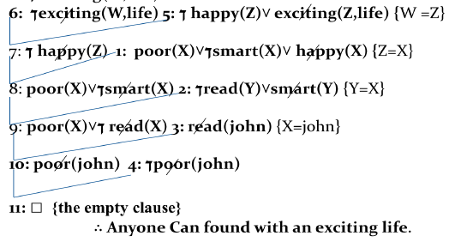

Slide 13
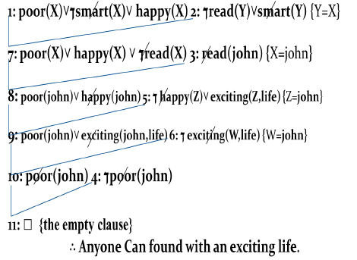
Proving exciting(W,life) using Forward Resolution

Slide 14
Example:
Use the Resolution Algorithm with regard to the following story:
All people who are not lazy and are fit are successful. Those people who exercise are fit. Lina exercises and is not lazy. Successful people have a fulfilling career. Can anyone be found with a fulfilling career?

Slide 15
a) Step 1: Convert Statements to First-Order Logic (predicate)
1. All people who are not lazy and are fit are successful
∀x [(¬Lazy(X) ∧ Fit(X)) → Successful(X)]
2. Those who exercise are fit
∀x [Exercise(X) → Fit(X)]
3. Lina exercises and is not lazy
Exercise(lina) ∧ ¬Lazy(lina)
4. Successful people have a fulfilling career
∀x [Successful(X) → Fulfilling(X, career)]
5. Goal: Can anyone have a fulfilling career?
∃x Fulfilling(X, career) ?

Slide 16
b) Step 2: Convert to Clausal Normal Form (CNF)
1-
∀x [¬(¬Lazy(X) ∧ Fit(x)) V Successful(X)]
∀x [¬Exercise(X) ∨ Fit(X)]
Exercise(lina) ∧ ¬Lazy(lina)
∀x [¬Successful(X) ∨ Fulfilling(X, career)]
∃x Fulfilling(X, career) ?
2-
∀x [(Lazy(X) V ¬Fit(X)) V Successful(X)]
∀x [¬Exercise(X) ∨ Fit(X)]
Exercise(lina) ∧ ¬Lazy(lina)
∀x [¬Successful(X) ∨ Fulfilling(X, career)]
∃x Fulfilling(X, career) ?

Slide 17
3-
∀x [(Lazy(X) V ¬Fit(X)) V Successful(X)]
∀Y [¬Exercise(Y) ∨ Fit(Y)]
Exercise(lina) ∧ ¬Lazy(lina)
∀Z [¬Successful(Z) ∨ Fulfilling(Z, career)]
∃W Fulfilling(W, career) ?
4-
Nothing to do here.

Slide 18
5-
∀x [(Lazy(X) V ¬Fit(X)) V Successful(X)]
∀Y [¬Exercise(Y) ∨ Fit(Y)]
Exercise(lina) ∧ ¬Lazy(lina)
∀Z [¬Successful(Z) ∨ Fulfilling(Z, career)]
Fulfilling(W, career) ?
6-
(Lazy(X) V ¬Fit(X) V Successful(X)
¬Exercise(Y) ∨ Fit(Y)]
Exercise(lina) ∧ ¬Lazy(lina)
¬Successful(Z) ∨ Fulfilling(Z, career)
Fulfilling(W, career) ?

Slide 19
7-
Nothing to do here.
8-
(Lazy(X) V ¬Fit(X) V Successful(X)
¬Exercise(Y) ∨ Fit(Y)]
Exercise(lina)
¬Lazy(lina)
¬Successful(Z) ∨ Fulfilling(Z, career)
Fulfilling(W, career)
9-
Nothing to do here.

Slide 20
c) Step 3: Negated Goal: ¬Fulfilling(W, career)
d) Apply Resolution (Forward and Backword) as in previous example.
For both methods, you will get an empty clause, which proves:
Lina has a fulfilling career.

