Slide 1
The Search Space
Lecture 2

Slide 2
Structures and Strategies for State Space Search
To successfully design and implement search algorithms, a programmer must be able to analyze and predict their behavior. Questions that need to be answered include:
Is the problem solver guaranteed to find a solution?
Will the problem solver always terminate, or can it become caught in an infinite loop?
When a solution is found, it is guaranteed to be optimal?
What is the complexity of the search process in terms of time usage? Space usage?
How can the interpreter most effectively reduce search complexity?
How can an interpreter be designed to most effectively utilize a representation
language?

Slide 3
State Space Search
The theory of state space search is the primary tool for answering these questions.
By representing a problem as a state space graph, the graph theory can be used to analyze the structure and complexity of both the problem and the procedures used to solve it.

Slide 4
Problem Solving
To solve a problem we must determine the following:
1- Initial state and goal state.
2- Problem state space.
3- Find the path between start state and goal state.
4- Search about the solution between the start state and the goal state.

Slide 5
Problem state space
The general rules used in knowledge base of the problem state space are:
1- find all parameter.
2- State all the value of parameter.
3- State the initial state and goal state.
4- Find all the rules of the problem.
5- Find the tree of the solution.

Slide 6
If a graph is used, the problem of cycles will occur so the best structure to represent a problem is a tree structure (there is a unique path between every two nodes), which can be defined as a tree with no cycles. It is important to distinguish between problems whose state space is a tree and those that may contain loops (graph).
General graph search algorithms must detect and eliminate loops from potential solution paths, while tree searches may gain efficiency by eliminating this test and its overhead. So convert graph representation to a tree representation.
To convert a graph to a tree, remove any nodes that may cause a cycle.

Slide 7
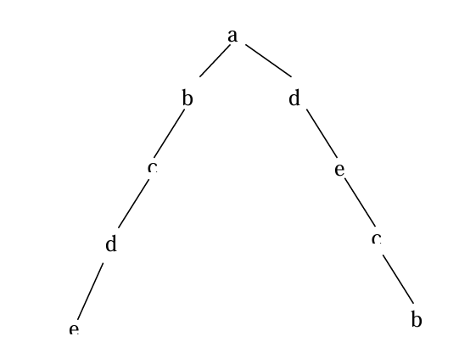
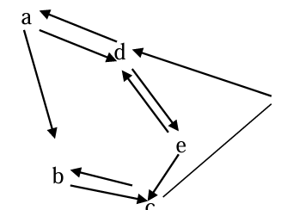
Example
Convert a graph to a tree:

Slide 8
Traversal vs Search
Traversal: Visit each node once
Search: Find a path between two nodes

Slide 9
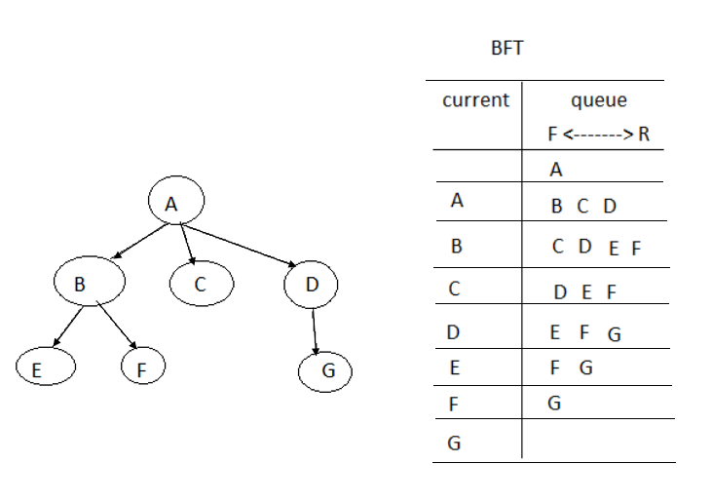
Breadth First Traversal (BFT)
BFS: works with a principle of Queue (FIFO)

Slide 10
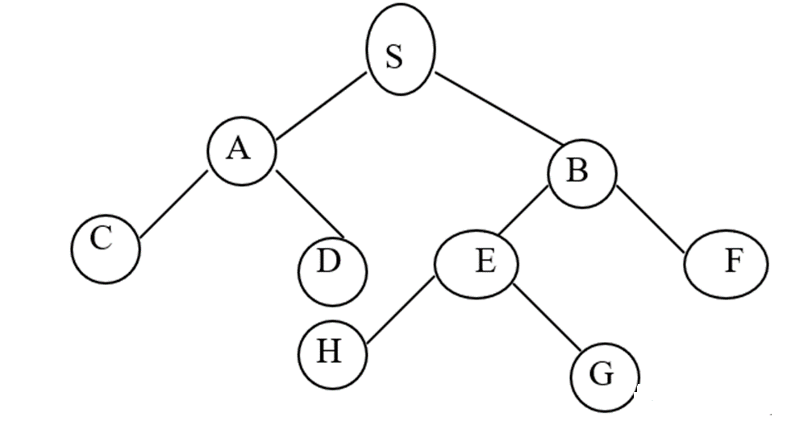
Example
See the tree and find the goal by the breadth first traversal?

Slide 11
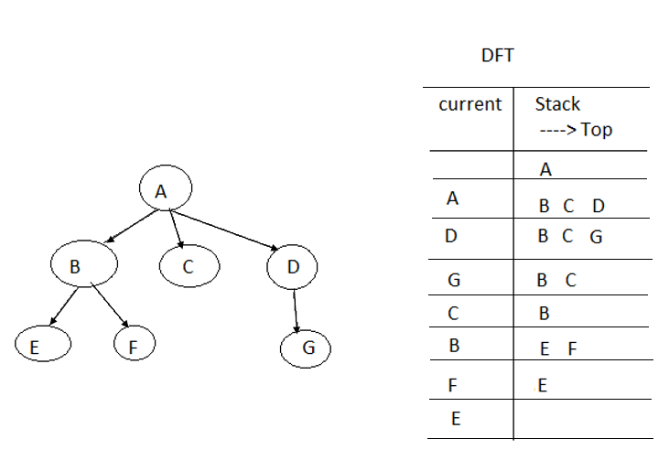
Depth First Traversal (DFT)
DFS: works with a principle of Stack (LIFO)

