Slide 1
Artificial Intelligence
Lecture 15

Slide 2
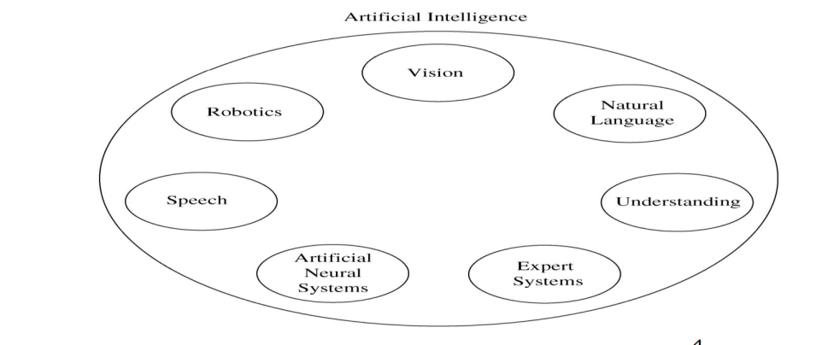
Areas of Artificial Intelligence

Slide 3
Expert System
Expert system is a subfield of artificial intelligence that deal with restricted problem domains. Used in medical disease diagnosis, business, science, engineering, manufacturing, and many other fields.
An expert system is a computer system that emulates, or acts in all respects, with the decision-making capabilities of a human expert.

Slide 4
Expert System Main Components
Knowledge base: Obtainable from books, magazines, knowledgeable persons, etc.
Inference engine: draws conclusions from the knowledge base.
The user: supplies facts or other information to the system and receives expert advice or expertise in response

Slide 5
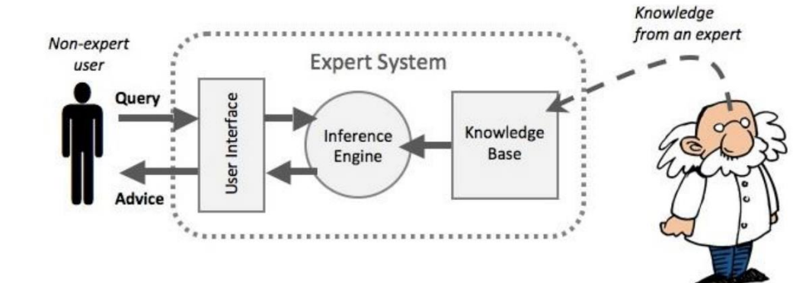

Slide 6
PROBLEM DOMAIN VS. KNOWLEDGE DOMAIN
Problem Domain: An expert’s knowledge is specific to one problem domain medicine, finance, science, engineering, etc.
knowledge domain: The expert’s knowledge about solving specific problems.
The problem domain is always a superset of the knowledge domain.

Slide 7
Advantages of Expert Systems
Increased availability
Reduced cost
Reduced danger
Performance – the expertise will last forever
• Multiple expertise combined from several experts
• Increased reliability – means of 2nd opinion

Slide 8
Advantages of Expert Systems
• Expplanation
• Fast response – usually faster than human
• Steady, unemotional, and complete responses at all times
• Intelligent tutor
• Intelligent database – e.g. data mining

Slide 9
Representing the Knowledge
The knowledge of an expert system can be represented in a number of ways, including IF-THEN rules:
Example: IF you are hungry THEN eat
The process of building an expert system is called knowledge engineering and is done by a knowledge engineer:
1. The knowledge engineer establishes a dialog with the human expert to elicit knowledge.
2. The knowledge engineer codes the knowledge explicitly in the knowledge base.
3. The expert evaluates the expert system and gives a critique to the knowledge engineer.
4. This process iterates until the system’s performance is judged by the expert to be satisfactory.

Slide 10
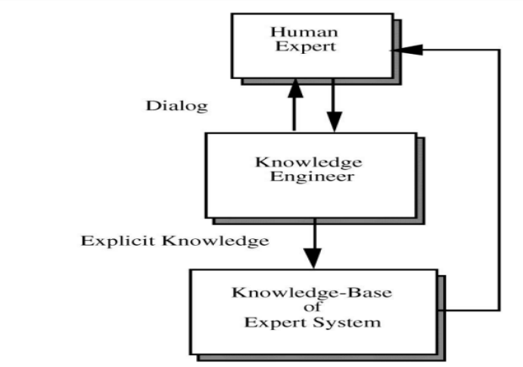

Slide 11
The Role of AI
An algorithm is an ideal solution guaranteed to yield a solution in a finite amount of time.
When an algorithm is not available or is insufficient, we rely on artificial intelligence (AI).
Expert system relies on inference – we accept a “reasonable solution.

Slide 12
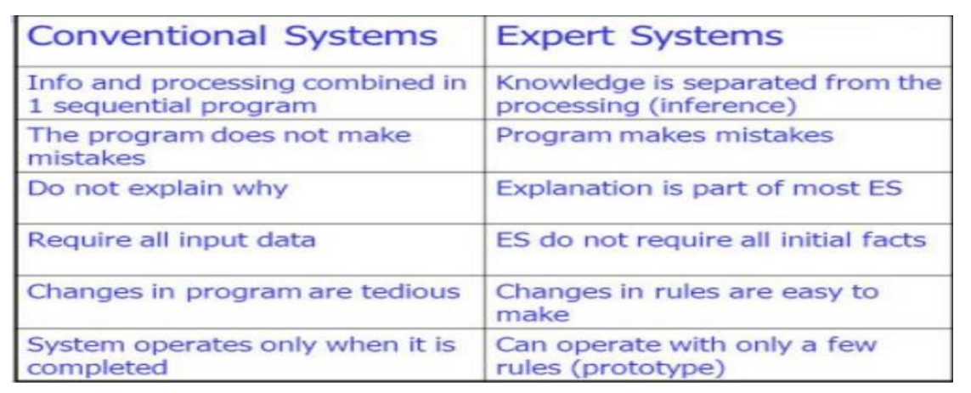
COMPARISON OF CONVENTIONAL SYSTEM & EXPERT SYSTEM

Slide 13
Uncertainty
One of the strengths of an expert system is its ability to handle uncertainty just like a human expert.
Uncertainty: is lack of information to make a decision.
Algorithmic paradigm is not appropriate for problems with uncertainty.

Slide 14
Early Expert Systems
DENDRAL – used in analysis of chemical mass spectrogram to identify chemical constituents
MYCIN – medical diagnosis of illness
DIPMETER – geological data analysis for oil
PROSPECTOR – geological data analysis for minerals
• XCON/R1 – configuring DEC computer systems

Slide 15
Considerations for Building Expert Systems
Can the problem be solved effectively by conventional programming? (without uncertainty)
Is there a need and a desire for an expert system?
Is there at least one human expert who is willing to cooperate?
Can the expert explain the knowledge to the knowledge engineer so that it is understandable by the knowledge engineer?
Is the problem-solving knowledge mainly heuristic and uncertain (not based on logic and algorithm) ?

Slide 16
ELEMENTS OF AN EXPERT SYSTEM
1- User interface: the mechanism by which the user and the system communicate.
2-Exploration facility: explains the reasoning of the expert system to the user.
3-Working memory: a global database of facts used by rules.
4-Inference engine: makes inferences, deciding which rules are satisfied and prioritizing them.
5-Agenda: a prioritized list of rules created by the inference engine, whose patterns are satisfied by facts or objects in working memory.
6-Knowledge acquisition facility: an automatic way for the user to enter knowledge into the system, bypassing the explicit coding by the knowledge engineer.

Slide 17
PRODUCTION RULES
Knowledge base is also called production memory.
Production rules can be expressed in IF-THEN pseudocode format.
In rule-based systems, the inference engine determines which rule
antecedents are satisfied by the facts.

Slide 18
Rule-Based Expert Systems
It is the most popular type today.
Knowledge is represented as multiple rules that specify what should/not be concluded from different situations.
Forward chaining: start with facts and use rules do draw conclusions.
Backward chaining: start with hypothesis and look for rules that allow hypothesis to be proven true.

Slide 19
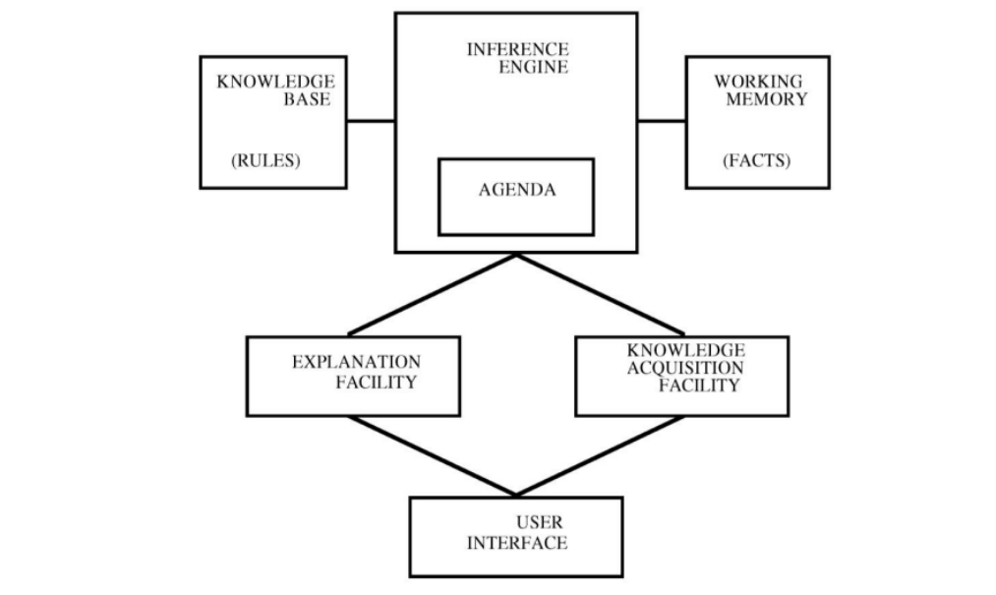
General Structure of a Rule-Based Expert System

Slide 20
Example
– Rule 1: IF the light is red THEN stop
– Rule 2: IF the light is green THEN go
– Rule 3: IF the light is yellow THEN slow down
– Fact (or pattern): the light is green
– Inference engine decides to use rule 2 (agenda)
– Conclusion/action: go

