Slide 1
Python Programming Language
Lecture 2

Slide 2
For loop
for variableName in range (group OfValues):
<statements>
• The range function specifies a range of integers:
range(start, stop) - the integers between start (inclusive)
and stop (exclusive)
• It can also accept a third value specifying the change between values.
range(start, stop, step) - the integers between start (inclusive)
and stop (exclusive) by step

Slide 3
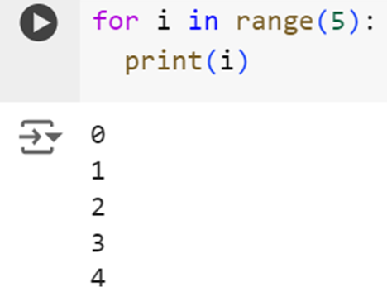
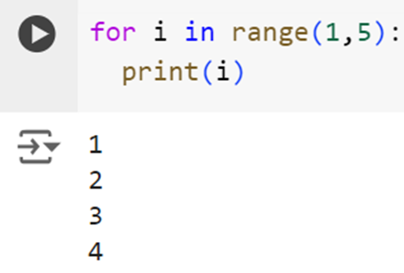
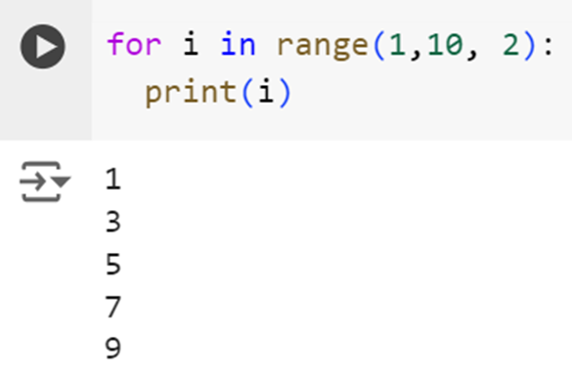



Slide 4
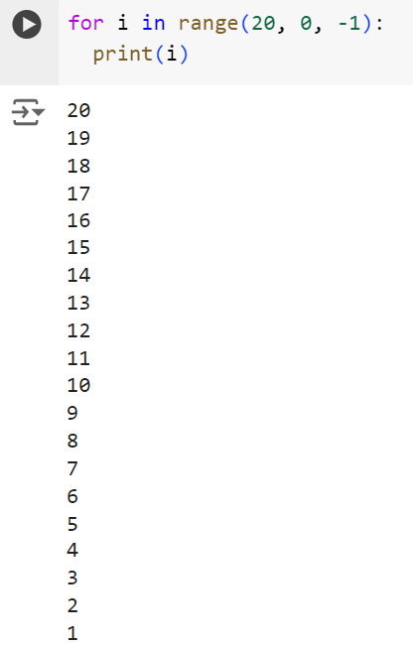
Exersice
Write a python program to print the numbers
from 20 to 1

Slide 5
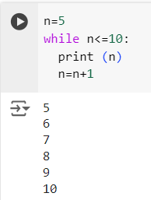
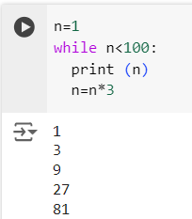
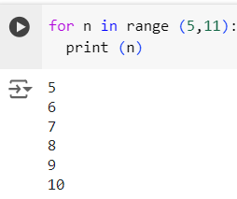
The While Loop
Executes a group of statements as long
as a condition is True.
• Syntax:
while <condition>:
<statements>
Example:

Slide 6
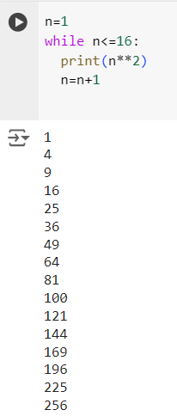
Exercise
Write a Python program to compute and display the first 16 numbers
powers of 2, starting with 1
Answer

Slide 7
Numbers
Python supports four different numerical types −
• int (signed integers) − They are often called just integers or ints, are positive or negative whole numbers with no decimal point.
• long (long integers ) − Also called longs, they are integers of unlimited size, written like integers and followed by an uppercase or lowercase L.
• float (floating point real values) − Also called floats, they represent real numbers and are written with a decimal point dividing the integer and fractional parts. Floats may also be in scientific notation, with E or e indicating the power of 10 (2.5e2 = 2.5 x 102 = 250).
• complex (complex numbers) − are of the form a + bJ, where a and b are floats and J (or j) represents the square root of-1 (which is an imaginary number). The real part of the number is a, and the imaginary part is b. Complex numbers are not used much in Python programming

Slide 8
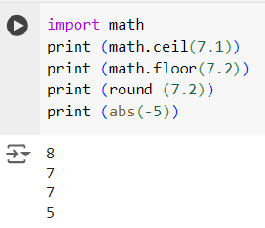
Math Functions
To use math functions, we need to use math library. You Should write at the top of program: import math
Note: with any command you use, you should write the name of library as shown in the example:

Slide 9
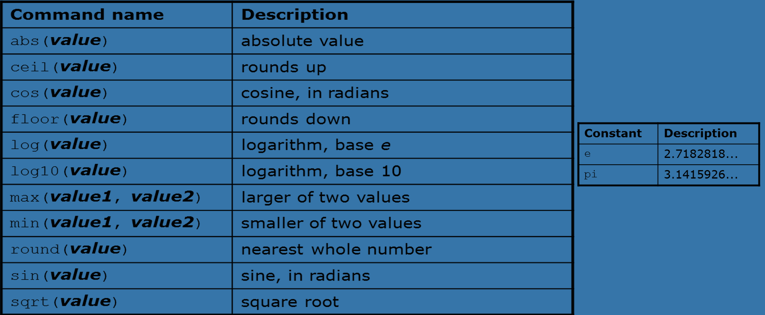
Math Functions

Slide 10
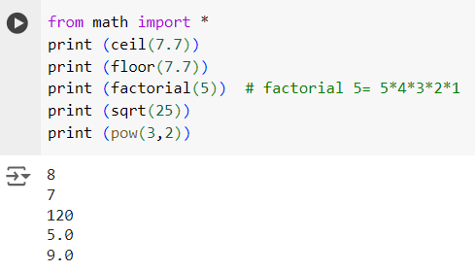
If I don’t want to write the math library name with each command, then in the beginning of the program, I should write the following:
from math import * as shown in the example:

Slide 11
Strings
String: A sequence of text characters in a program.
Strings start and end with quotation mark " or apostrophe ‘ characters.
Examples:
"hello“
‘This is a string’
“This, too, is a string. It can be very long!”
Note: "This is not a "legal" String either."

Slide 12
Strings
A string can represent characters by preceding them with a backslash.
\t (give 3 spaces)
tab character
\n new line character
\" quotation mark character
\\ backslash character

Slide 13
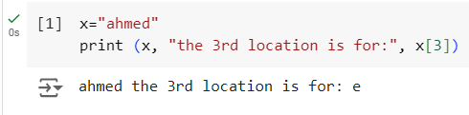
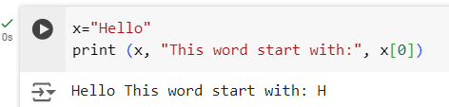
Indexing String

Slide 14
String Functions
len(string)- number of characters in a string
str.lower(string)- lowercase version of a string
str.upper(string)- uppercase version of a string
str.isalpha(string)- True if the string has only alpha chars
Many others: split, replace, find, format, etc.

Slide 15






Examples

Slide 16
Exercise
1- Write a Python program to get a string and n (non-negative integer) from the user, and show a given string n times.
2- Write a Python program to test whether a passed letter from a user is a vowel or not.

Slide 17
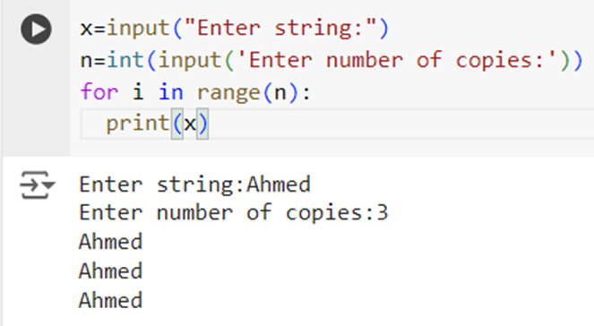
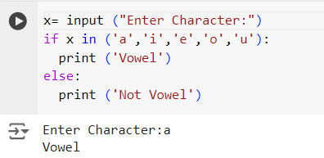
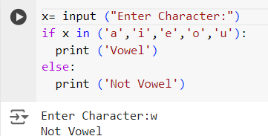
Answers

