Slide 1
Chapter one
Basic Concept In Mathematics

Slide 2
Real Number( R ):
a number can be used to measure a continuous one-dimensional quantity such as a distance. Real numbers including both rational & irrational numbers.
rational numbers:
Any number that can be written as a ratio (or fraction) of two integers is a rational number.
Such as integers (-2, 0, 1), fractions (1/2, 2.5) .

Slide 3
Rational No.:
Terminating (ending infinite string of zero) for example,
$\frac{3}{4}$ = 0.75000 = 0.75
Eventually repeating (ending a block of digits repeats over &over), for
$\frac{3}{4}$ = 2.090909 = 2.$\overline{09}$

Slide 4
Irrational No.:
All the real numbers that are not rational numbers. That is, irrational numbers cannot be expressed as the ratio of two integers such as: $\sqrt{3}$ , π (22/7), etc
Note:
In the 17th century by René Descartes to distinguish real numbers (associated with physical reality) from imaginary numbers.

Slide 5
Imaginary No.
The numbers which are not real and are Imaginary are known as not real or non-real numbers. Non-real numbers cannot be represented on the number line. Complex numbers:
4+i5 where “i” represents imaginary, i=$\sqrt{−1}$ .

Slide 7
Example of real No. groups:

Slide 8
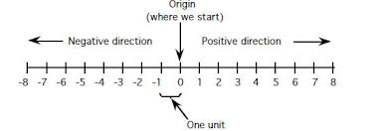
The real number line:
A representation of all the real numbers on a horizontal line such that each point on the line corresponds to a real number and every real number corresponds to a point on the line.

Slide 9
Operation on Rational No.
The arithmetic operations, such as addition, subtraction, multiplication, and division are applicable to the rational numbers:
In addition and subtraction of rational numbers, the process of addition and subtraction can be categorized in two different ways. They are:
-Numbers with the same denominators
-Numbers with different denominators

Slide 10
$\frac{2}{9} +\frac{3}{9}= \frac{2+3}{9}= \frac{5}{9}$ (Addition with the same denominators)
$\frac{4}{3} +\frac{5}{2}= \frac{8+15}{6}= \frac{23}{6}$ (Addition with the different denominators)
$\frac{7}{6}−\frac{5}{6}= \frac{7−5}{6}= \frac{2}{6}$ (Subtraction with the same denominators)
$\frac{4}{3}−\frac{5}{2}= \frac{8−15}{6}= \frac{−7}{6}$ (Subtraction with the different denominators)

Slide 11
The multiplication of rational numbers is similar to the multiplication of integers.
Product of Rational Numbers = $\frac{product of Numerator}{Product of Denominator }$
$$\frac{6}{5} ×\frac{4}{3}= \frac{6×4}{5×3}= \frac{24}{15}$$
The division of rational numbers is similar to division of fractions.
Assume that 6/5 and 9/7 are the two rational numbers.
$$\frac{6}{5} ÷\frac{7}{9}=\frac{6}{5}×\frac{9}{7} =\frac{6×9}{5×7}= \frac{54}{35}$$

Slide 12
Positive &Negative power of numbers:
A positive exponent tells us how many times to multiply a base number, and a negative exponent tells us how many times to divide a base number.
We know:
a × a = a², a × a × a = a³, etc., and a × a × a × .... n times = a^{n}, where n is a positive integer. a^{n} is a power of a whose base = a & index of power = n.
a^{-n} is the reciprocal of a^{n} where n is a positive rational number Thus, a^{n} is a power of a for all values of n. where n = positive/negative integer or positive/negative fraction.
In fact, a^{n} is a power of a where n is any real number.

Slide 13
Examples on Power of a Number:
1. Find the value of 4⁵.
4⁵ = 4 × 4 × 4 × 4 × 4 = 1024.
2. Find the value of 4⁻⁵.
4⁻⁵ = Reciprocal of 4⁵ = $\frac{1}{4^{5}}$ = $\frac{1}{ 4×4×4×4×4 }$ = $\frac{1}{1024 }$
3. Find the value of (1024)^{1/5}.
(1024)^{1/5} = 5th root of 4 × 4 × 4 × 4 × 4 = 5th root of 4⁵ = 4^{5/5} = 4.

Slide 14
Note:
Though positive or negative integral powers of positive or negative numbers can be found, it becomes difficult or impossible to find the value of any power of negative numbers in the set of real numbers. for a^{n} we assume a > 0, a ≠ 1 and n is any real number.
When you raise a quotient to a power you raise both the numerator and the denominator to the power. When you raise a number to a zero power you'll always get 1. Negative exponents are the reciprocals of the positive exponents. The same properties of exponents apply for both positive and negative exponents

Slide 16
Law of Zero Exponent: a⁰ = 1
Law of Negative Exponent: a^{-m} = $\frac{1}{a^{m}}$
Fractional exponents
Are ways to represent powers and roots together. In any general exponential expression of the form a^{b}, a is the base and b is exponent .
When b is given in the fractional form, it is known as a fractional exponent. A few examples of fractional exponents are 2^{1/2}, 3^{2/3}, etc. The general form of a fractional exponent is x^{m/n}, where x is the base and m/n is the exponent.

Slide 17
Fractional exponents

Slide 18
Fractional Exponents Rules:
There are certain rules to be followed that help us to multiply or divide numbers with fractional exponents easily.
Rule 1: a^{1/m} × a^{1/n} = a^{(1/m + 1/n)}
Rule 2: a^{1/m} ÷ a^{1/n} = a^{(1/m - 1/n)}
Rule 3: a^{1/m} × b^{1/m} = (ab)^{1/m}
Rule 4: a^{1/m} ÷ b^{1/m} = (a÷b)^{1/m}
Rule 5: a^{-m/n} = (1/a)^{m/n}

Slide 19
Example: Evaluate the following:
a) $27$^{1/3} b) 8^{-1/3}
c) 4^{0.5} d) 16^{-0.25}
Answer:
a)$27$^{1/3} = $\sqrt[3]{27}$ = 3 b) 8^{-1/3} = $\frac{1}{8^{ \frac{1}{ 3} }}$ = $\frac{1}{\sqrt[3]{8}}$ = $\frac{1}{2}$
c) 4^{0.5} = 4^{1/2} $=\sqrt{4}=2$
d) 16^{-0.25} = $\frac{1}{{16}^{0.25}}$ = $\frac{1}{{16}^{ \frac{1}{4} }}$ = $\frac{1}{\sqrt[4]{16}}$ = $\frac{1}{2}$

Slide 20
We will now consider fractional exponents of the form: a^{m/n} In general, we define:
$a^{\frac{m}{n}}$ = $\left(\sqrt[n]{a} \right)$^{m} = $\sqrt[n]{a^{m}}$
Example: Evaluate the following,
a) $27$^{2/3} b) 16^{1.5}
Answer:
Method 1: $27$^{2/3} = ( $\sqrt[3]{27}$ )² = 3² = 9
Method 2: $27$^{2/3} = $\sqrt[3]{{27}^{2}}$ = $\sqrt[3]{729}$ =9
16^{1.5} = 16 ^{3/2} = ( $\sqrt{16}$ )³ = 64

Slide 21
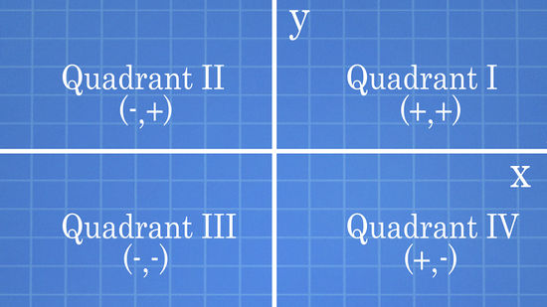
Coordinate: Every point on the coordinate plane is expressed in the form of the ordered pair (x,y) where x and y are numbers that denote the position of the point with respect to the x-axis and the y-axis respectively.

Slide 22
The x-value tells how the point moves either to the right or left along the x-axis. This axis is the main horizontal line of the rectangular axis or Cartesian plane.
The y-value tells how the point moves either up or down along the y-axis. This axis is the main vertical line of the rectangular axis or Cartesian plane.
Placing a dot at the origin which is the intersection of x and y axes. Think of the origin as the “home” where all points come from.

Slide 23
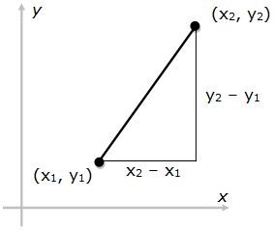
Distance between two points
Distance Formula: Given the two points (x₁, y₁) and (x₂, y₂), the distance between these points is given by the formula:
$$d=\sqrt{{\left(x_{2}−x_{1}\right)}^{2} +{\left({ y}_{2}−{ y }_{1}\right)}^{2}}$$

Slide 24
For example:
a) Find the distance between the point (3,1) and the point (6,5) substitute their coordinates into the formula like so:
d= $\sqrt{{\left(6−3\right)}^{2}+{\left(5−1\right)}^{2} }$ = $\sqrt{9+16}$ = $\sqrt{25}$ = 5
b) The distance from the origin and Q(3,4) is:
d= $\sqrt{{\left(x−0\right)}^{2}+{\left(y−0\right)}^{2}}$= $\sqrt{x^{2}+y^{2}}$

Slide 25
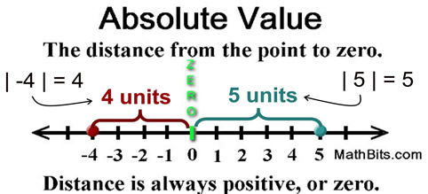
Absolute value:
The absolute value of a number is the distance between the number and zero on the real number line. Distances are measured as positive units (or zero units). Consequently, absolute value is never negative.

Slide 26
Statement:
$\left|x\right|=x if x≥0$
$$\left|x\right|=−x if x<0$$
$$if x=5 ,\left|5\right|=5 since 5≥0$$
$$if x=−8 ,\left|−8\right|=8 since−8<0$$
Measuring Distance: | 8 − 3 | = 5 and | 3 − 8 | = 5 The expression | a − b | represents the distance from a to b on the number line. distance is the same when measured forward from 3 to 8, or backward from 8 to 3.

Slide 27
Example
 | 1. | − 3 | = 3 | 2. − | − 7 | = − 7
 | 3. | 0 | = 0 | 4. | − 5 |² = 25
 | 5. − | (− 8)² | = − 64 | 6. − | − 3 |² = − 9
 | 7. | 3 | + | − 7 | − | − 2 | = 8 | 8. | − 8 | + ( − 9) + | − 14 | + ( − 2) = 11

Slide 28
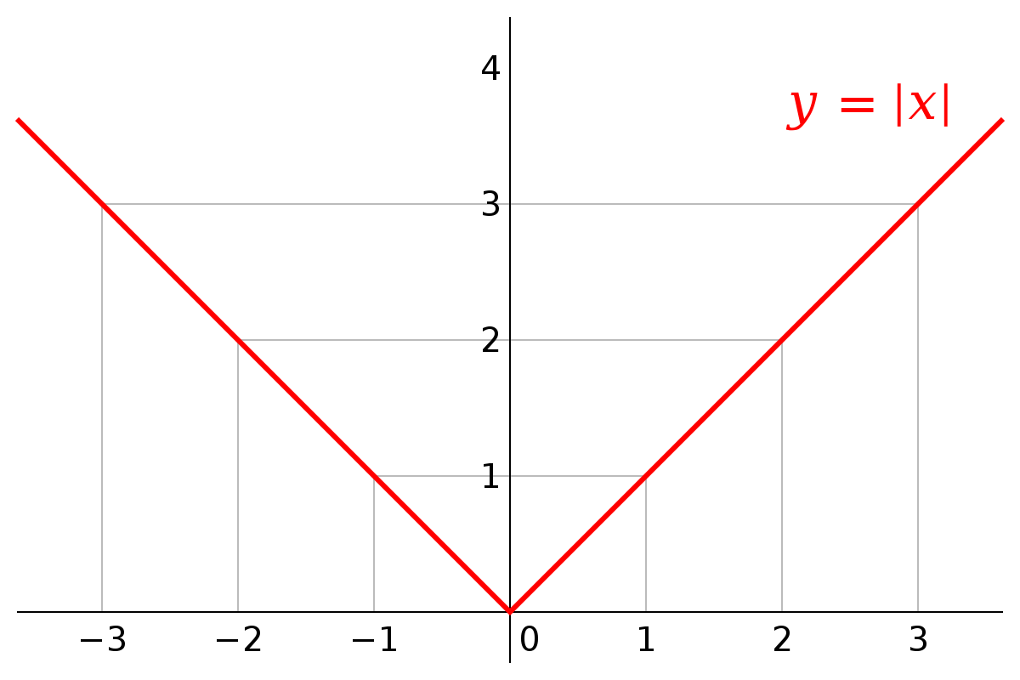
Graph:
Since absolute value always yields a positive result, or zero, the graph of absolute value plots only y-values that are positive, or zero. The graph resides above the x-axis (plus the origin), in quadrants I and II.

Slide 29
The figure show function y = -| x |

Slide 30
Increments & straight line.
When a particle moves from one point in the plane to another, the net changes in its coordinates are called increments.
The amount of positive or negative change in the value of one or more of a set of variables.
$$∆x=x_{2}−x_{1}$$
Example:
In going from A (4,-3) to the point B (2,5) & from C (5,6) to the point D (5,1) the increment in x & y coordinates are:
$∆x=2−4=−2$ $∆y=5−\left(−3\right)=8$
$∆x=5−5=0$ $∆y=1−6=−5$

Slide 31
See Figure: Coordinate increments may be positive, negative, or Zero.

Slide 32
Given two points P₁(x₁,y₁)& P₂(x₂,y₂) in plane, we call the increments
$∆x=x_{2}−x_{1}$ & $∆y=y_{2}−y_{1}$the run and the rise, respectively, between P₁&P₂,two such points always determine a unique straight line passing through them both, call the line P₁P₂.
Any non-vertical line in plane has property that the ratio is:
$$m=\frac{rise}{run}=\frac{∆y}{∆x}= \frac{y_{2}−y_{1}}{x_{2}−x_{1}}=\tan{θ}$$

Slide 34
In mathematics, the slope or gradient of a line is a number that describes both the direction and the steepness of the line. Slope is often denoted by m.
The direction of a line is either increasing, decreasing, horizontal or vertical.
A line is increasing if it goes up from left to right. The slope is positive, i.e. m>0.
A line is decreasing if it goes down from left to right. The slope is negative, i.e. m<0.

Slide 35
If a line is horizontal the slope is zero. This is a constant function.
If a line is vertical the slope is undefined .
The steepness, incline, or grade of a line is measured by the absolute value of the slope.
A slope with a greater absolute value indicates a steeper line.

Slide 36
If y is a linear function of x, then the coefficient of x is the slope of the line created by plotting the function. Therefore, if the equation of the line is given in the form:
$$y=mx+b$$
Then m is the slope. This form of a line's equation is called the slope-intercept form, because b can be interpreted as the y-intercept of the line, that is, the y-coordinate where the line intersects the y-axis.

Slide 37
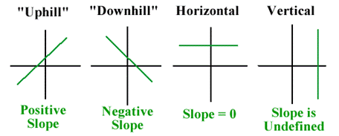
If the slope m of a line and a point (x₁,y₁) on the line are both known, then the equation of the line can be found using the point-slope formula:

Slide 38
Parallel and Perpendicular lines:
Parallel lines are lines that are always the same distance apart. Parallel lines never intersect.
The slopes of parallel lines are are equal ($m_{1}=m_{2}$ ).
Lines that are parallel have equal angles of inclination so they have the same slope (if they are not vertical). conversely, lines with equal slopes have equal angles of inclination and so are parallel.

Slide 39
Perpendicular lines are lines that intersect at a right angle. the slopes of perpendicular lines are opposite reciprocals.
If two non-vertical lines L₁&L₂ are perpendicular. Their slopes m₁ and m₂ satisfy m₁m₂= -1, so each slope is the negative reciprocal of the other.
$m_{1}= − \frac{1}{m_{2}}$ $m_{2}= − \frac{1}{m_{1}}$

Slide 40
Note:
Intersecting Lines cross each other at a point.

