Slide 1
Enzymes
Prof.Dr. Layla Othman Farhan
Third stage

Slide 2
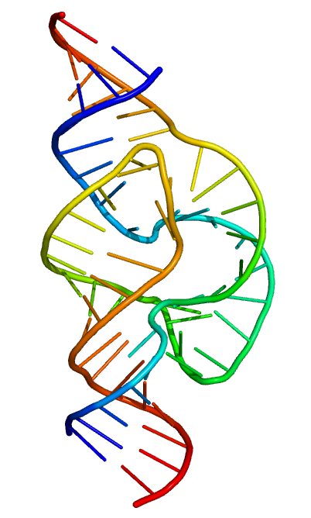
Enzymes are biological catalysts that speed up the rate of the biochemical reaction.
Most enzymes are three dimensional globular proteins (tertiary and quaternary structure).
Some special RNA species also act as enzymes and are called Ribozymes e.g. hammerhead ribozyme.
Hammerhead enzyme
Notes:
Hammer

Slide 3
Structure of Enzymes
The active site of an enzyme is the region that binds substrates, co-factors and prosthetic groups and contains residue that helps to hold the substrate.
Active sites generally occupy less than 5% of the total surface area of enzyme.
Active site has a specific shape due to tertiary structure of protein.
A change in the shape of protein affects the shape of active site and function of the enzyme.

Slide 4
Active site
Active site can be further divided into:
It chooses the substrate It performs the catalytic
and binds it to active site. action of enzyme.
Active Site
Binding Site
Catalytic Site

Slide 5
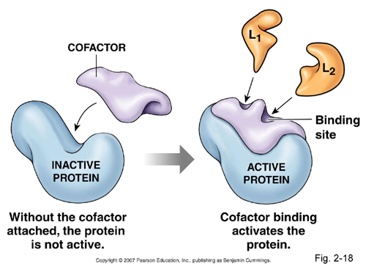
Co-factors
Co-factor is the non protein molecule which carries out chemical reactions that can not be performed by standard 20 amino acids.
Co-factors are of two types:
  Organic co-factors
  Inorganic cofactors

Slide 6
Inorganic co-factors
These are the inorganic molecules required for the proper activity of enzymes.
Examples:
Enzyme carbonic anhydrase requires Zn for it’s activity.
Hexokinase has co-factor Mg
++
++
Organic co-factors
These are the organic molecules required for the proper activity of enzymes.
Example:
Glycogen phosphorylase requires the small organic molecule pyridoxal phosphate.

Slide 7
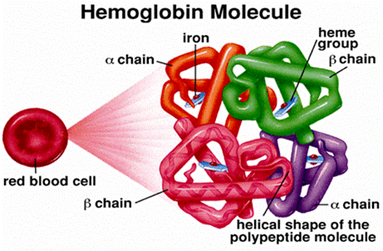
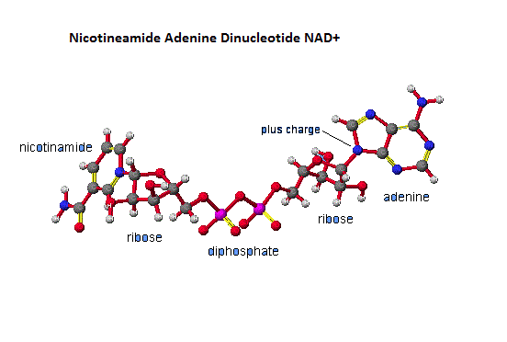
Types of Organic co-factors
Prosthetic Group
Coenzyme
A prosthetic group is a tightly bound organic co-factor e.g. Flavins, heme groups and biotin.
A coenzyme is loosely bound organic co-factor. E.g. NAD
+
+

Slide 8
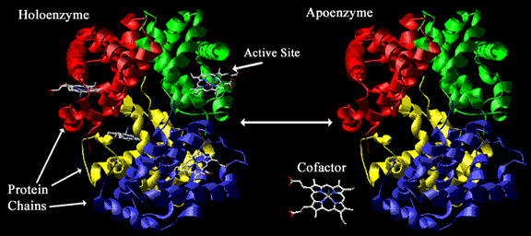
Types of co-factors Continued…
An enzyme with it’s co-factor removed is designated as apoenzyme.
The complete complex of a protein with all necessary small organic molecules, metal ions and other components is termed as holoenzyme of holoprotein.

Slide 9
substrate
The reactant in biochemical reaction is termed as substrate.
When a substrate binds to an enzyme it forms an enzyme-substrate complex.
Joins
Substrate
Enzyme

Slide 10
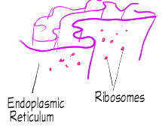
Sites of enzyme synthesis
Enzymes are synthesized by ribosomes which are attached to the rough endoplasmic reticulum.
Information for the synthesis of enzyme is carried by DNA.
Amino acids are bonded together to form specific enzyme according to the DNA’s codes.

Slide 11
Intracellular and extracellular enzymes
Intracellular enzymes are synthesized and retained in the cell for the use of cell itself.
They are found in the cytoplasm, nucleus, mitochondria and chloroplast.
Example :
Oxydoreductase catalyses biological oxidation.
Enzymes involved in reduction in the mitochondria.
Extracellular enzymes are synthesized in the cell but secreted from the cell to work externally.
Example :
Digestive enzyme produced by the pancreas, are not used by the cells in the pancreas but are transported to the duodenum.

