Slide 1
Enzymes
Prof.Dr. Layla Othman Farhan
Third stage

Slide 2
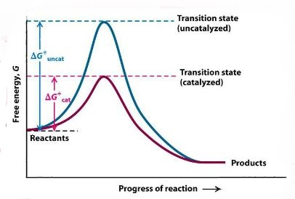
Thermodynamic changes
All chemical reactions have energy barriers between reactants and products.
The difference in transitional state and substrate is called activational barrier.

Slide 3
Thermodynamic changes
Only a few substances cross the activation barrier and change into products.
That is why rate of uncatalyzed reactions is much slow.
Enzymes provide an alternate pathway for conversion of substrate into products.
Enzymes accelerate reaction rates by forming transitional state having low activational energy.
Hence, the reaction rate is increased many folds in the presence of enzymes.
The total energy of the system remains the same and equilibrium state is not disturbed.

Slide 4
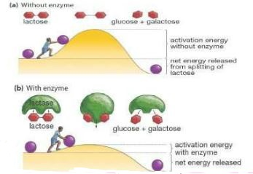
Thermo-dynamic changes overview

Slide 5
Processes at the active site
Covalent catalysis
Acid base catalysis
Catalysis by strain
Catalysis by proximity

Slide 6
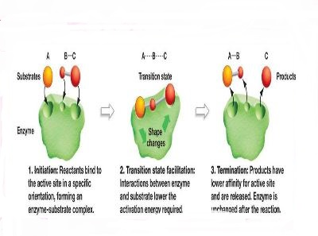
Covalent catalysis
Enzymes form covalent linkages with substrate forming transient enzyme-substrate complex with very low activation energy.
Enzyme is released unaltered after completion of reaction.

Slide 7
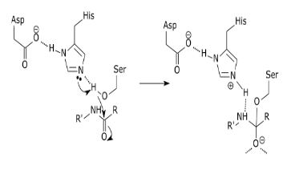
acid-base catalysis
Mostly undertaken by oxido- reductases enzyme.
Mostly at the active site, histdine is present which act as both proton donor and proton acceptor.

Slide 8
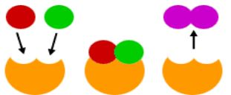
Catalysis by proximity
In this catalysis molecules must come in bond forming distance.
When enzyme binds:
A region of high substrate concentration is produced at active site.
This will orient substrate molecules especially in a position ideal for them.

Slide 9
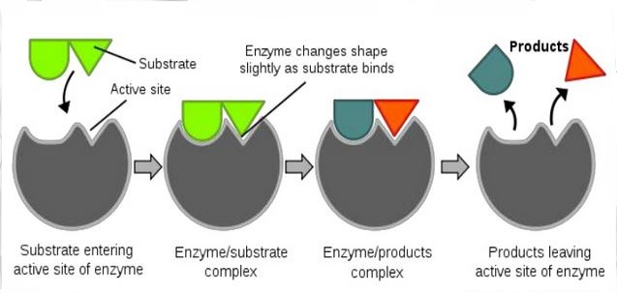
Catalysis by bond strain
Mostly undertaken by lyases.
The enzyme-substrate binding causes reorientation of the structure of site due to in a strain condition.
Thus transitional state is required and here bond is unstable and eventually broken.
In this way bond between substrate is broken and converted into products.

