Slide 1
Enzymes
Prof.Dr. Layla Othman Farhan
Third stage

Slide 2
Lock and key model
Proposed by EMIL FISCHER in 1894.
Lock and key hypothesis assumes the active site of an enzymes are rigid in its shape.
There is no change in the active site before and after a chemical reaction.

Slide 3
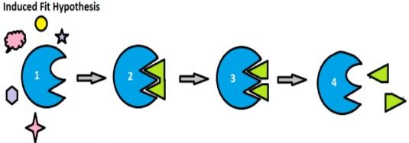
Induced fit model
More recent studies have revealed that the process is much more likely to involve an induced fit model(proposed by DANIAL KOSH LAND in 1958).
According to this exposure of an enzyme to substrate cause a change in enzyme, which causes the active site to change it’s shape to allow enzyme and substrate to bind.

Slide 4
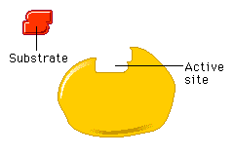
Induced Fit Model
4

