Slide 1
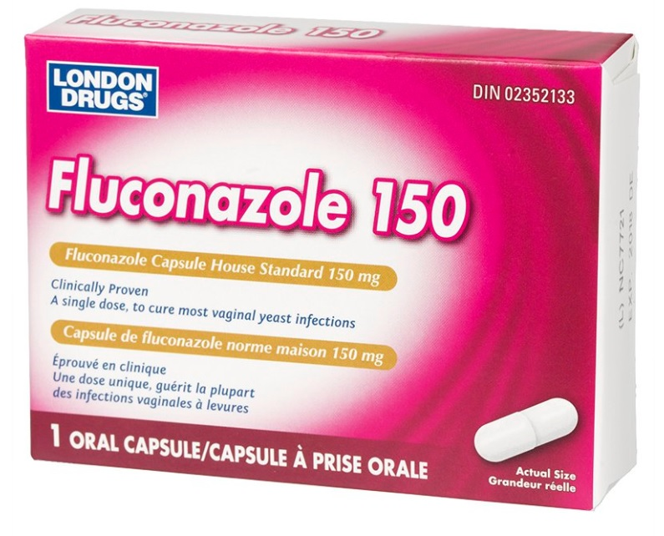
Antifungal Agents
Lecture 3…..
Prof. Dr. Safaa Al-Deen Ahmed

Slide 2
• Fungi consist of:
-Rigid cell wall composed of chitin (N – acetylglucosamine) (bacterial cell wall is composed of peptidoglycan)
-Plasma or cell membrane which contains ergosterol (human cell membrane is composed of cholesterol) (selectivity to some antifungal agents)

Slide 3
-Fungi have nucleus and well defined nuclear membrane, and chromosomes, Fungi are eukaryotic organisms that live as saprobes or parasites. They are complex organisms in comparison to bacteria (prokaryotic cells=have no nuclear membranes and no mitochondria). Therefore antibacterial agents are not effective in fungal infections and antifungal agents are ineffective in bacterial infections.

Slide 4
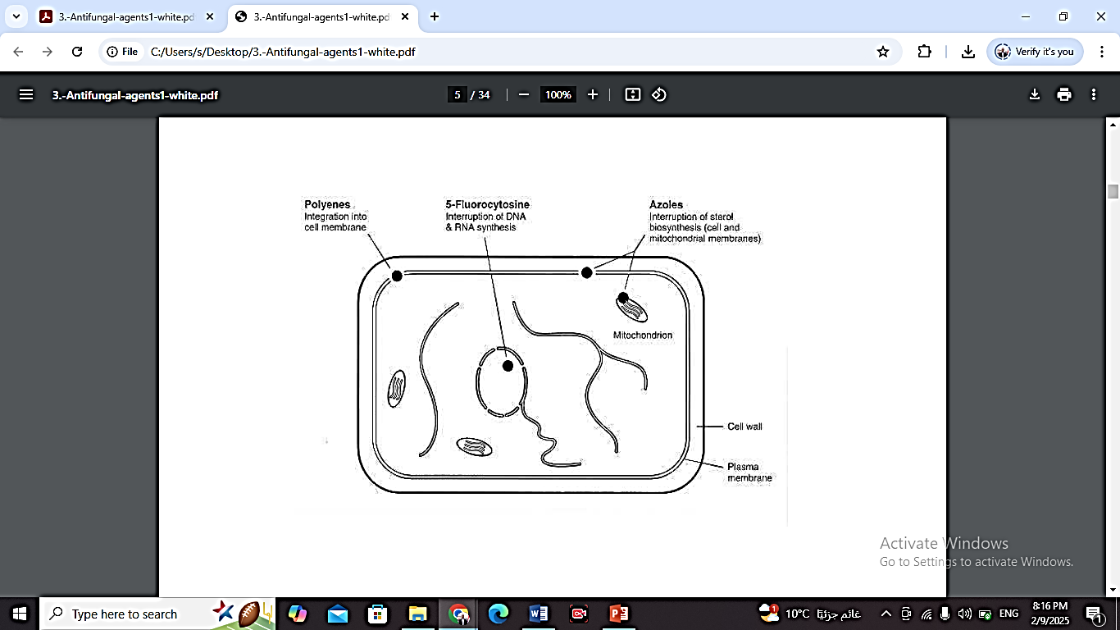

Slide 5
• Fungal infections are termed mycoses and can be divided into:
(1) Superficial infections: affecting skin, nails, scalp or mucous membranes
(2) Systemic infections: affecting deeper tissues and organs
• Superficial fungal infections can be classified into the dermatomycoses and candidiasis (Candida is a common normal flora of mouth, skin, intestines and vagina)

Slide 6
• Systemic fungal infections include:
- Systemic candidiasis
- Cryptoccocal meningitis or endocarditis
- Pulmonary aspergillosis
- Blastomycosis
- Histoplasmosis
- Coccidioidomycosis
- Paracoccidioidomycosis…etc

Slide 7
• Fungal infections whether, superficial or
systemic, are common in patients with weak
immune system e.g.:
- Patients with AIDS
- Debilitated patients
- Patients underwent organ transplantation and
on immunosuppressants
- Patients under anticancerous therapy

Slide 8
Antifungal Drugs Classes
1. Polyenes (polyene macrolide antibiotics)
- Amphotericin B
- Nystatin
- Natamycin

Slide 9
• Polyenes mechanism of action:
Bind to ergosterol in fungal plasma membrane, leading to formation of pores and hence increased permeability of the membrane. This allows leakage of intracellular ions and
enzymes especially loss of intracellular k+ causing death to the fungus They bind selectively to ergosterol in fungus but
not to cholesterol in mammalian plasma membranes

Slide 10
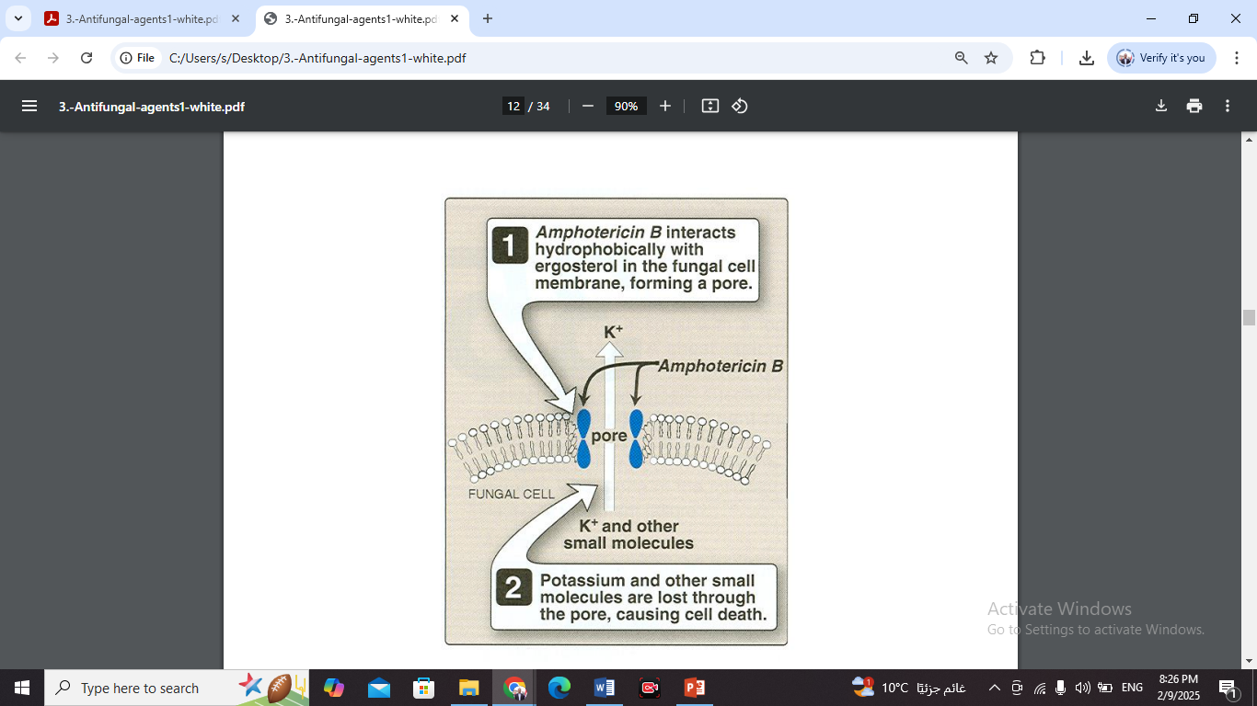

Slide 11
• Mechanisms of resistance to polyenes:
- Decreased ergosterol content of the fungal membrane
- Impaired binding to ergosterol

Slide 12
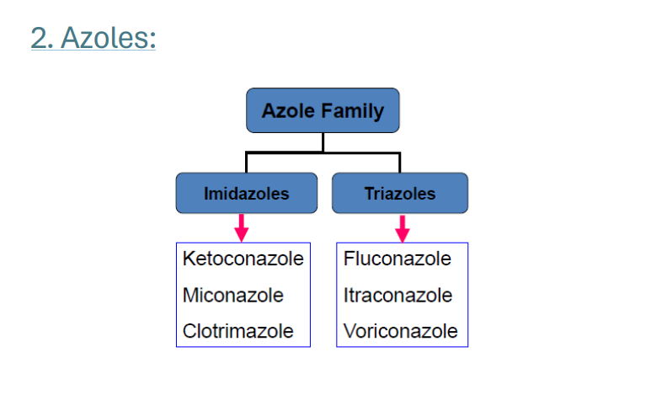

Slide 13
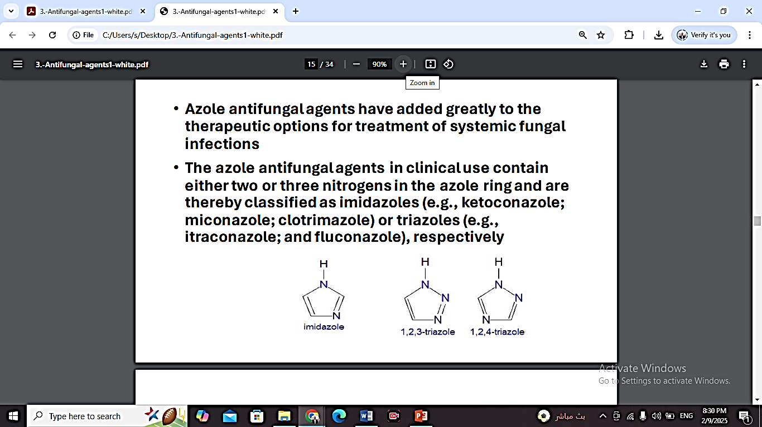
• Azole antifungal agents have added greatly to the therapeutic options for treatment of systemic fungal infections.
• The azole antifungal agents in clinical use contain either two or three nitrogens in the azole ring and are thereby classified as imidazoles (e.g., ketoconazole; miconazole; clotrimazole) or triazoles (e.g., itraconazole; and fluconazole), respectively

Slide 14
• Azoles mechanism of action:
- Azoles are fungistatic.
- They inhibit cytochrome P450 demethylase enzyme which is important for formation of ergosterol.
- This inhibition disrupts membrane structure and function and, thereby, inhibits fungal growth.
• Mechanism of resistance to Azoles:
Mutation in the gene encoding for demethylase

Slide 15
3. Allylamines:
Terbinafine
Naftifine
Butenafine

Slide 16
• Mechanism of action Allylamines:
Inhibit fungal squalene epoxidase, thereby decreasing the synthesis of ergosterol. This plus the accumulation of toxic amounts of squalene result in the death of the fungal cell Significantly higher concentrations of Terbinafine are needed to inhibit human squalene epoxidase, an enzyme required for the cholesterol synthetic pathway (representing some selectivity to fungi)

Slide 17
• Echinocandins:
Echinocandins are a class of antifungal drugs that inhibit the synthesis of β-glucan in the fungal cell wall. They are fungicidal or fungistatic against some yeasts and molds
- Caspofungin
- Micafungin
- Anidulafungin
• Mechanism of action:
Interfere with the synthesis of the fungal cell wall by inhibiting the synthesis of D-glucan, leading to lysis and fungal cell death

Slide 18
• Antifungals that inhibit mitosis:
Griseofulvin
• Mechanism of action:
- It inhibits fungal mitosis by inhibiting mitotic spindle formation
- The drug binds to tubulin, interfering with microtubule function, thus inhibiting mitosis

Slide 19
• Drugs that inhibit DNA synthesis (antimetabolites):
Flucytosine (5FC=5-fluorocytosine)
• Mechanism of action:
It enters fungal cells by permease (an enzyme not found in mammalian cells) and is then converted by a series of steps to 5-
fluorodeoxyuridine 5'-monophosphate. This false nucleotide inhibits thymidylate synthase, thus depriving the fungus of thymidylic acid an essential DNA component.

Slide 20
The mononucleotide is further metabolized to a trinucleotide (5-fluorodeoxyuridine 5‘ triphosphate) and is incorporated into fungal RNA, thus disrupting nucleic acid and protein synthesis. Amphotericin B increases cell permeability, allowing more Flucytosine to penetrate the cell. Thus, Flucytosine and Amphotericin B are synergistic

Slide 21
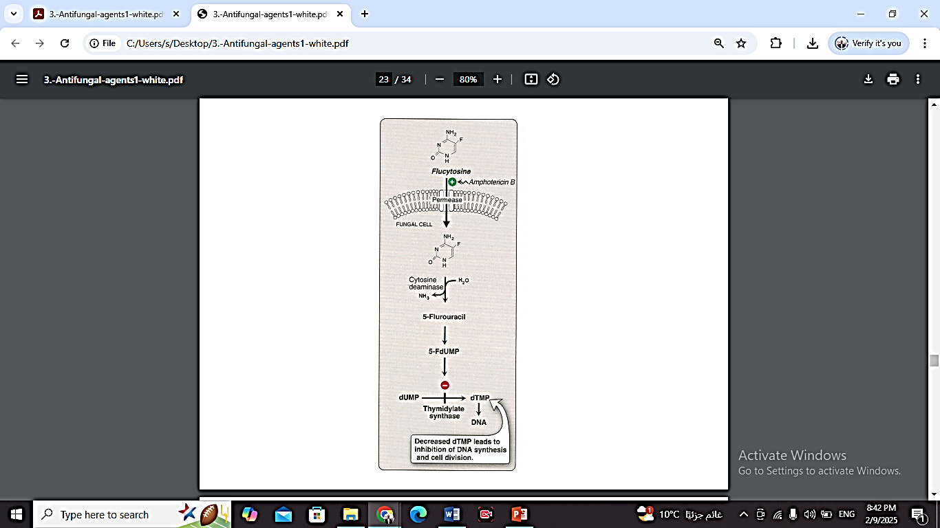

Slide 22
Amphotericin B
- It is a macrolide antibiotic (Macrolides are a class of mostly natural products with a large macrocyclic lactone ring to which one or more deoxy sugars, usually cladinose and desosamine, may be attached), poorly absorbed
orally, useful for fungal infection of gastrointestinal tract
- Drug of choice for most systemic infections, given as slow IV infusion
- Locally used in corneal ulcers (ophthalmic point.),
arthritis (intra-articular) and bladder irrigation
Penetration through BBB (The Blood–Brain Barrier) is poor but increases in inflamed meninges.
- Excreted slowly via kidneys, traces found in urine for months after cessation of drug.
- Half life 15 days

Slide 23
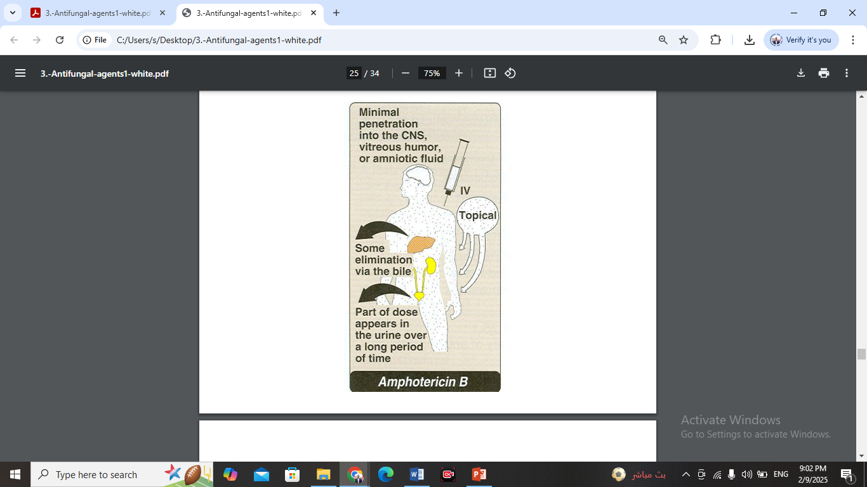

Slide 24
• Side effects to Amphotericin:
- Most serious is renal toxicity, which occurs in 80% of patients
- Hypokalaemia in 25% of patients
- Hypomagnesaemia
- Anemia & thrombocytopenia
- Impaired hepatic function

Slide 25
More common side effects
- fever and chills
- headache
- increased or decreased urination
- irregular heartbeat
- muscle cramps or pain
- nausea
- pain at the place of injection
- unusual tiredness or weakness
- vomiting

Slide 26
- Anorexia, nausea, vomiting, abdominal, joint
and muscle pain, loss of weight, and fever
- Anaphylactic shock
- To reduce the toxicity of Amphotericin B, several new formulations have been developed in which amphotericin B is packaged in a lipid-associated delivery system (Liposomal preparations)

Slide 27
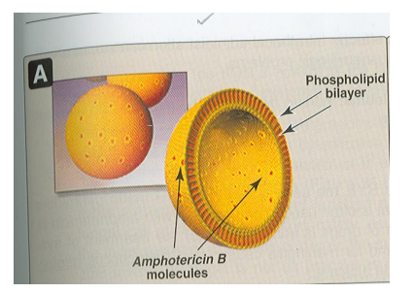
• Such delivery systems have more efficacy , less nephrotoxicity but very expensive

Slide 28
Nystatin
- It is a polyene macrolide, similar in structure to Amphotericin B and with same MOA
- Too toxic for systemic use
- Not absorbed from GIT, skin or vagina,
therefore administered orally to prevent or treat superficial candidiasis of mouth, esophagus or intestinal tract

Slide 29
- Oral suspension of 100,000 U/ml 4 times a day and tablets 500,000 U of Nystatin are used to decrease GIT colonization with Candida
- For vaginal candidiasis in form of vaginal cream or pessaries used for 2 weeks
- In cutaneous infection available in cream, ointment or powder forms and applied 2-3 times a day

Slide 30
Natamycin
- It is a macrolide polyene antifungal used to
treat fungal keratitis, an infection of the eye. It is especially effective against Aspergillus and Fusarium corneal infections
- Also effective in Candida, Cephalosporium and Penicillium
- Not absorbed when given orally
- Available in cream and ophthalmic eye drops

Slide 31
Flucytosine
- Has useful activity against Candida and Cryptococcus
- It is synthetic pyrimidine antimetabolite that is often used in combination with Amphotericin B
- It is fungistatic, effective in combination with Itraconazole for treating chromoblastomycosis and with Amphotericin B for treating cryptococosis
- Highly effective in cryptococcal meningitis in AIDS patients

Slide 32
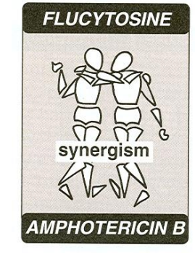

Slide 33
Flucytosine is absorbed rapidly and well from GIT
- Widely distributed in body and penetrates well into CSF
• Side effects to Flucytosine:
- Reversible neutropenia, thrombocytopenia and
occasional bone marrow depression
- Nausea, vomiting, diarrhea, severe enterocolitis
- Reversible hepatic enzyme elevation in 5% of patients

