Slide 1
SOFT GELATIN CAPSULE
Dr. Nawal Ayash

Slide 2
Soft gelatin capsule
DEFINITION:-
soft Gelatin capsules are one piece, hermetically sealed, soft gelatin shells containing a liquid, a suspension, or a semisolid.
The Nomenclature for this dosage form has now
been changed to soft gel .
They have long been preferred dosage form for those, taking Health & Nutritional supplements.

Slide 3
ADVANTEGES
Easy to administer
Easy to Manufacture
Liquids can be encapsulated ( non water soluble)
Small to large sizes possible
Elegance
Portability
Odour and taste masking
Ready availability of drug hence faster action.
Specialised dosage forms can be made e.g. chewable, extended release, captabs etc.
Can be used for ophthalmic preparations e.g. aplicaps, vaginal / rectal suppositories

Slide 4
DISADVANTEGES
Water soluble material are difficult to incorporate
Highly Moisture sensitive
Efflorescent material cannot be incorporated, they may cause softening / leaching
Deliquescent materials cannot be incorporated, they may cause hardening or brittle capsules.

Slide 5
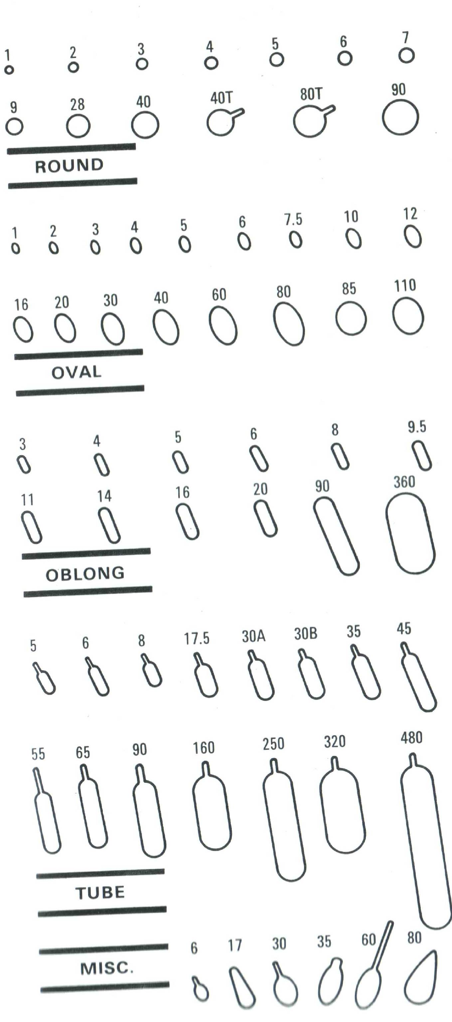
Shapes of Capsules -

Slide 6
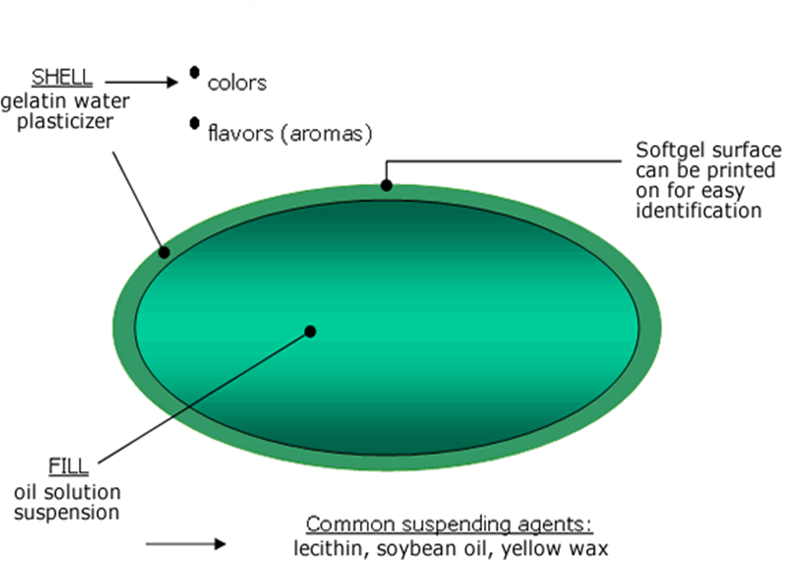

Slide 7
CAPSULE SHELL
The capsule shell is basically composed of
Gelatin, a plasticizer & water, it may contain additional ingredients such as preservative ,coloring &opacifying agents, flavorings, sugars, acids & medicaments to achieve desired effects.
GELATIN:-Obtain from partial hydrolysis of collagen derived from the skin, connective tissue & Bones of animals. may have viscosity of 38 mpa
Bloom strength:-150-250
cost of gelatin α Bloom strength

Slide 8
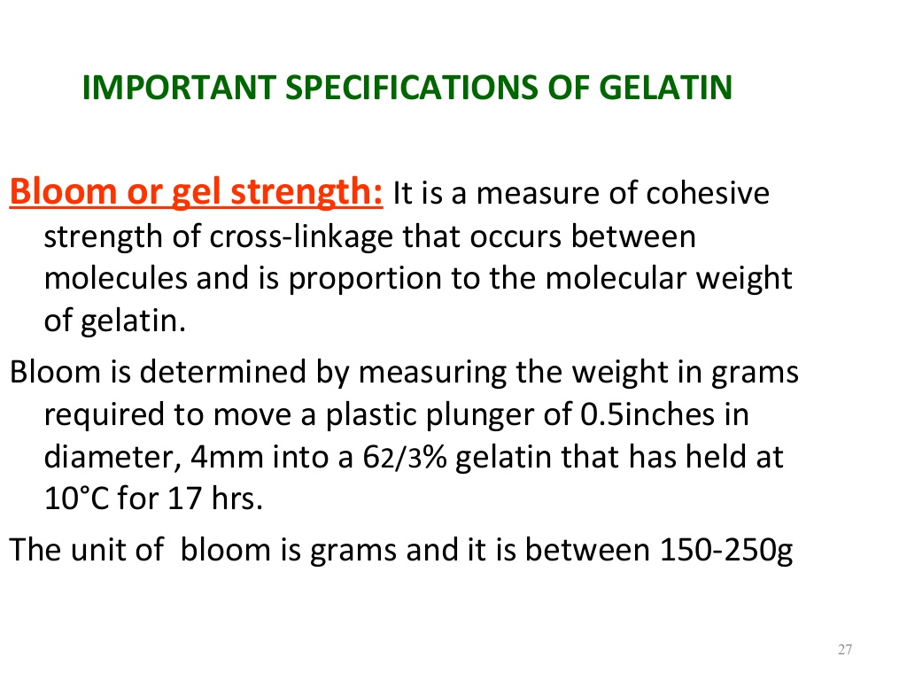

Slide 9
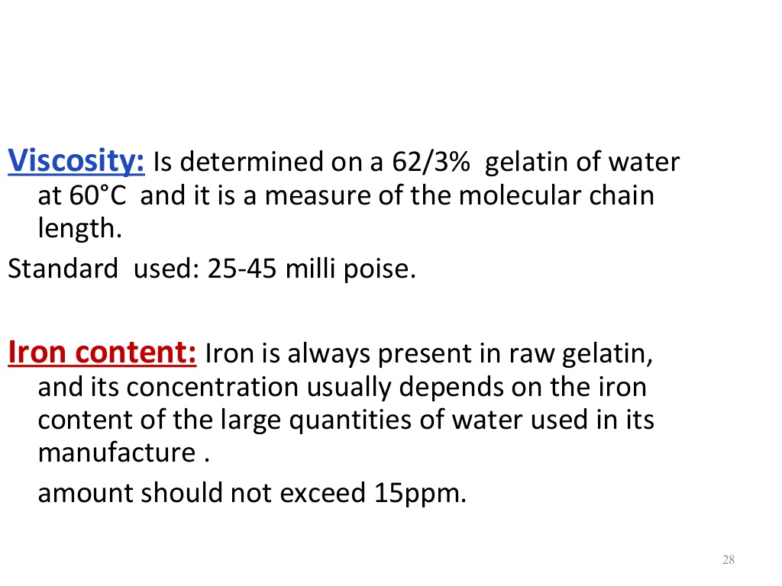

Slide 10
Capsule shell
WATER:-n.m.t. 45% w/w
The ratio by weight of water to dry gelatin can vary from 0.7 to1.3(water) to 1.0(dry gelatin) depending on the viscosity of the gelatin being used.
PLASTICIZER:-Used to make the soft gel shell elastic & pliable.
Ratio used is between 0.3 to 1.8 for soft to hard shell on dry basis.
E.g. glycerin , sorbitol
.

Slide 11
COLOUR used in shell has to be darker than colour of encapsulating material
colours may be natural or synthetic.
OPACIFIER, usually titanium dioxide, may be added to produce an opaque shell ,when the fill formulation is a Suspension or to prevent photo degradation of light sensitive fill ingredients. Conc. Of opacifier may be up to 0.5%

Slide 12
Chelating Agents:- Iron is always present in raw gelatin, & should not contain iron more than 15 ppm
Additionally chelating agent may be used for preventing the reaction of iron with materials or colours.

Slide 13
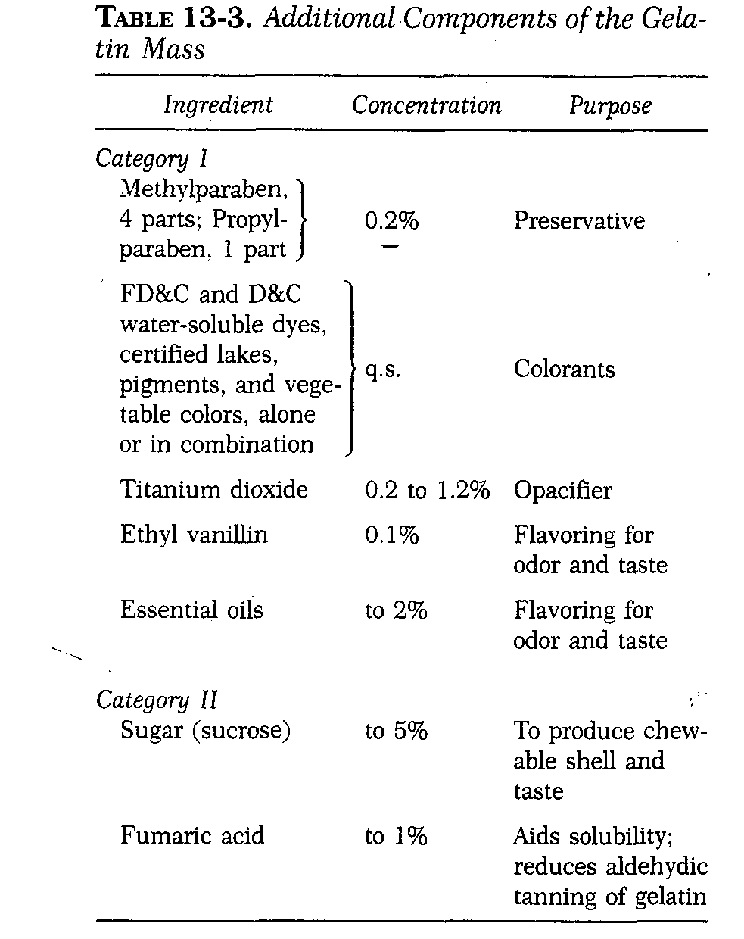

Slide 14
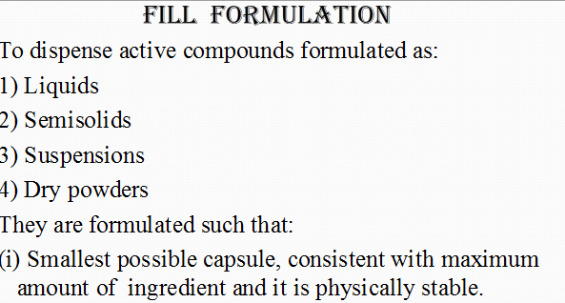


Slide 15
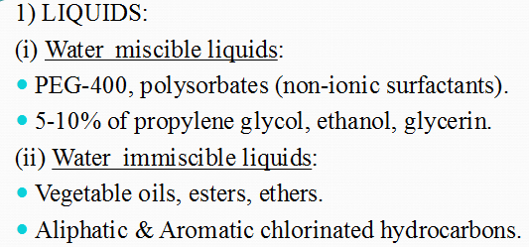
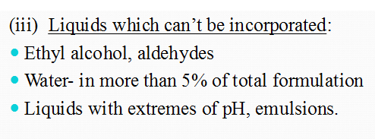

Slide 16
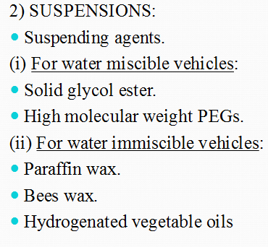
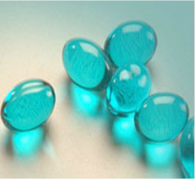

Slide 17
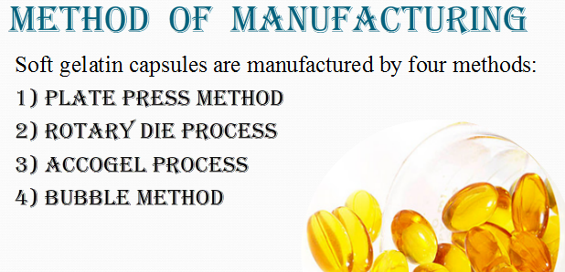

Slide 18
Gelatin Mass Manufacture
The gel is prepared in a 300-litre stainless steel vessel.
Gelatin powder is mixed with water and glycerine.
Heating Stirring
The molten gelatin mass is formed.
It is decanted into 200-kg mobile vessels.
Turbine mixing
where colours and flavours can be added.

Slide 19
It ensures consistency of gelatin mass.
This mass is kept at a constant temperature until it is needed for the next stage of the process.

Slide 20
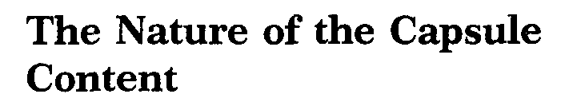

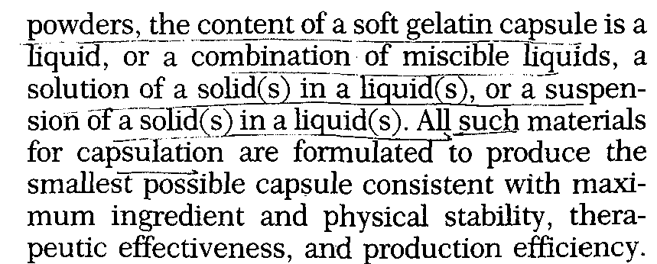

Slide 21
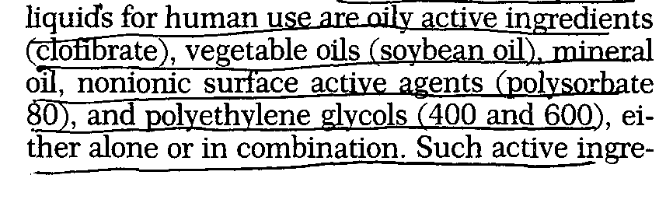
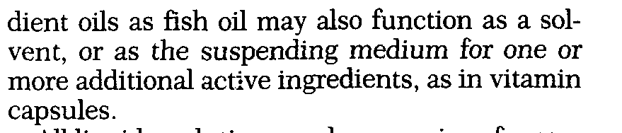

Slide 22
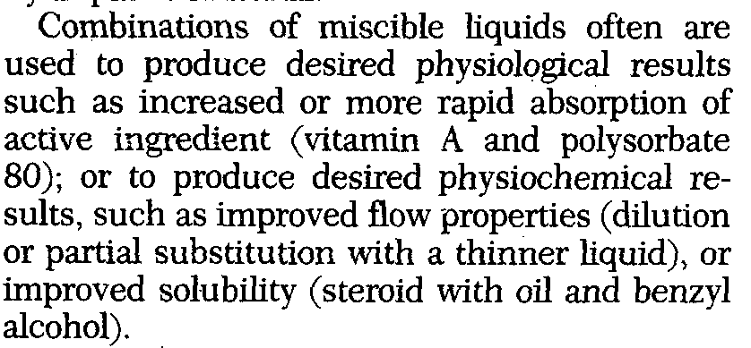
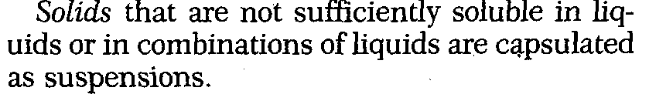

Slide 23
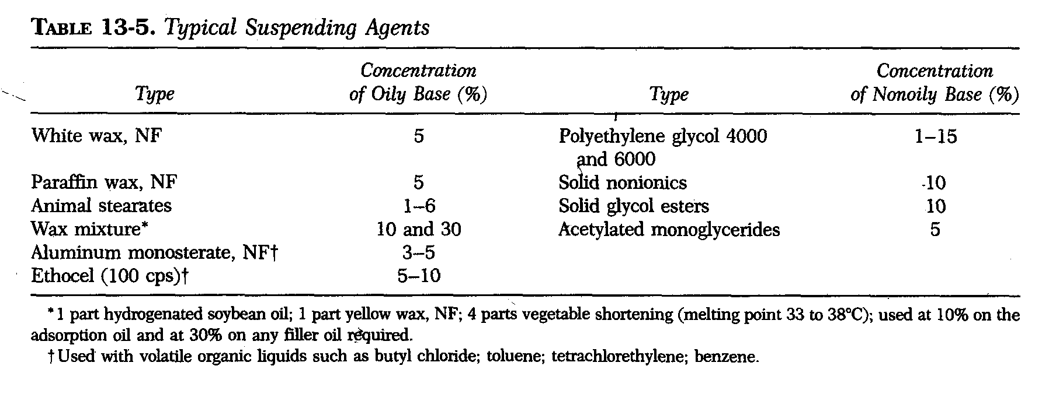

Slide 24
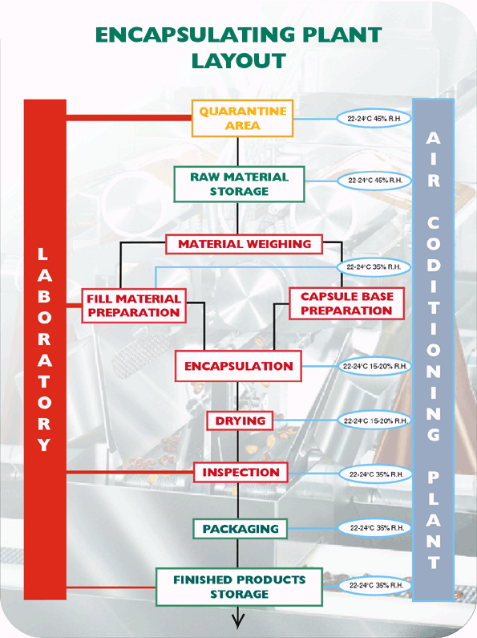

Slide 25
Manufacturing process
Encapsulation
The gel and fill mobile vessels are then taken to the encapsulation bays.
Where each encapsulation machine is segregated in individual bays.
The molten gel is pumped to the machine.
Two thin ribbons of gel are formed, one either side of the machine.

Slide 26
These ribbons then pass over a series of rollers and over a set of dies that determine the size and shape of the capsules

Slide 27
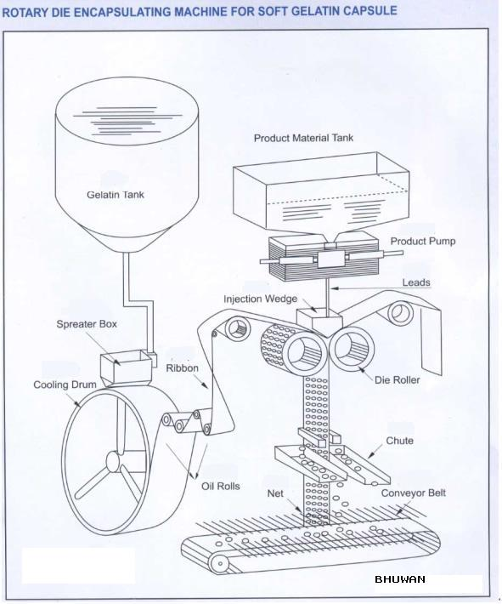
ROTARY DIE ENCAPSULATING MACHINE

Slide 28
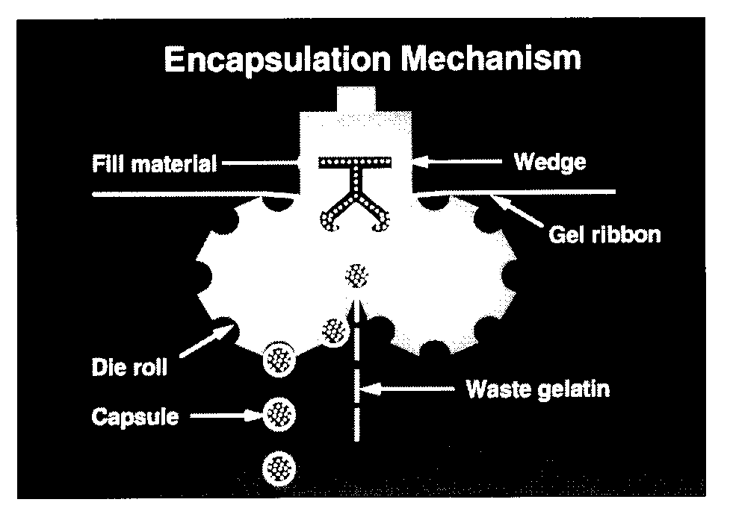
BHUWAN

Slide 29
Capsule Manufacturing
Encapsulation
Tumble Drying :-Dry, sterile air is forced across the tumbler and removes the moisture from the outer surface of the capsules.
Supplemental Drying (curing):- After the tumbler dryers, the soft capsules are placed on special trays for final drying in the drying room. For a period up to 48 hrs.

Slide 30
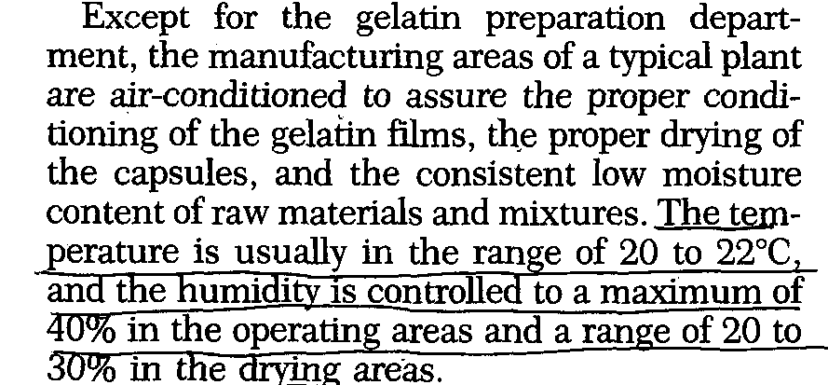

Slide 31
Sizing:- Automatic capsule sizing machine eliminates undersized and oversized capsules.
Inspection:- includes visual inspection to check malformed, damaged or improperly filled capsules.
Packaging:- capsule may be packaged in glass or plastic containers or may be strip-packaged, so long as such packaging involves tight closures & plastics having a low moisture vapor transfer rate.

Slide 32
PRODUCT QUALITY CONSIDERATIONS
1-Ingredient specifications
all ingredients of a soft gel are controlled and tested to ensure compliance with pharmacopoeial specifications.
E.g. Impurities such as aldehydes & peroxides which may be present in polyethylene glycols. Presence of high levels of these impurities gives rise to cross-linking of the gelatin polymer, leading to insolubilization through further polymerization.

Slide 33
2-In-process testing
During the encapsulation process the four most important tests are:-
The gel ribbon thickness;
Soft gel seal thickness at the time of encapsulation;
Fill matrix weight & capsule shell weight;
Soft gel shell moisture level and soft gel hardness at the end of the drying stage.

Slide 34
Finished product testing
These normally includes
Capsule appearance,
active ingredient assay & related substances assay
Fill weight
Content uniformity and
Microbiological testing.

Slide 35
VEGICAPS SOFT CAPSULES
Vegicaps®Soft capsules are an alternative animal free capsule. The shell is made from seaweed extract and gluten free starch, and contains no modified sugars or artificial ingredients. The shell can be clear or coloured and there is a wide range of shapes, sizes and colours available.

Slide 36
An alternative to gelatin for those who prefer an animal free product
Those with a level of concern about animal-derived products
Vegetarians
Those with religious or cultural restrictions
Consumers looking for the most natural alternative.

Slide 37
Benefits of Vegicaps®Soft capsules
Free of all animal derivatives – no pork or beef content.
Easy to swallow
Soft
Natural
Perception of a healthier product
Plant based shell
Low shell odour.

Slide 38
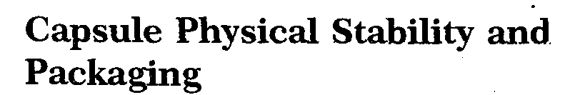
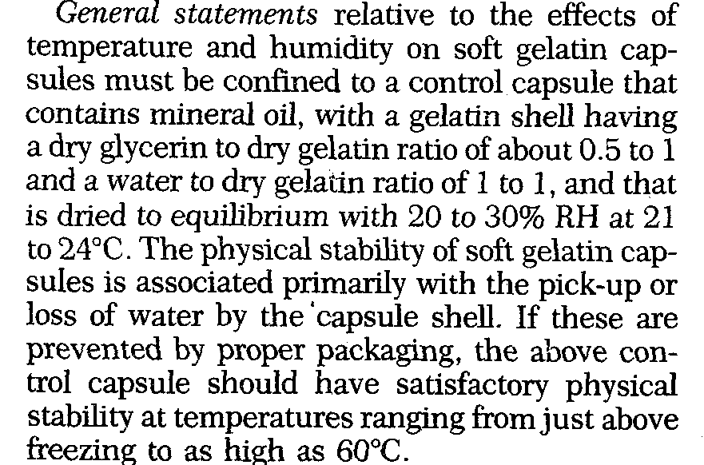

Slide 39
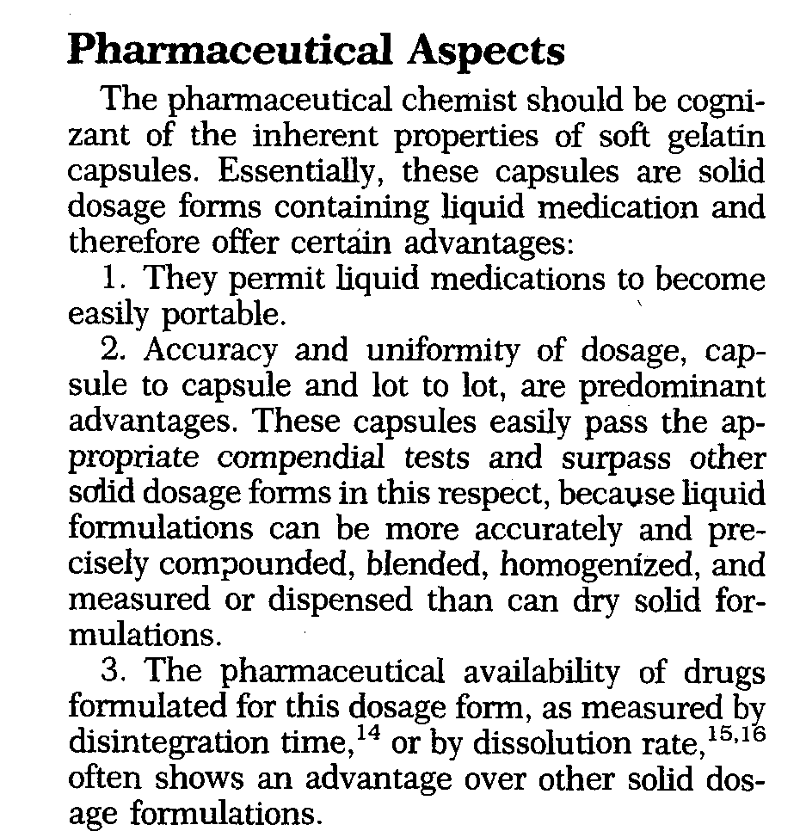

Slide 40
THANKS

