Slide 1
Hard capsules Dr. Nawal Ayash

Slide 2
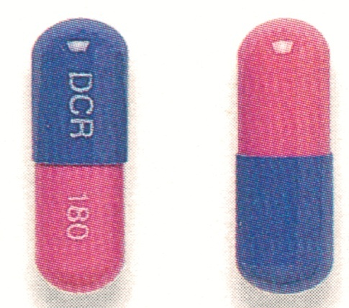
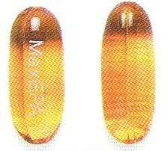
Capsules
latin – capsulae (caps.)
The drug is contained in a gelatin shell that breaks open after the capsule has been swallowed, releasing the drug.
The hard-shell gelatin
capsules contain solid drugs
The soft-shell gelatin
capsules contain oils

Slide 3
Slow-release capsules contain pellets
that dissolve in the gastrointestinal tract, releasing the drug slowly.
Gastro-resistant capsules contain
pellets that dissolve in the intestine.

Slide 4
Capsule shell
These capsules are made up of gelatine blends, small amount of certified dyes, opaquants, plasticizers and preservatives.

Slide 5
Gelatin it is hetrogeneous product derived by hydrolytic extraction of animal collagen.the source of gelatins including animal bones,hide portions and frozenpork skin

Slide 6

Gelatin

Slide 7
Type A
Derived from acidic treated precursor that exhibits an isoelectric point at pH at 9. It is manufactured mainly from pork skin.

Slide 8
Type B
Derived from alkali treated precursor that exhibits an isoelectric point at pH at 4-7. It is manufactured mainly from animal bones.

Slide 9
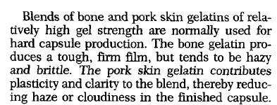

Slide 10
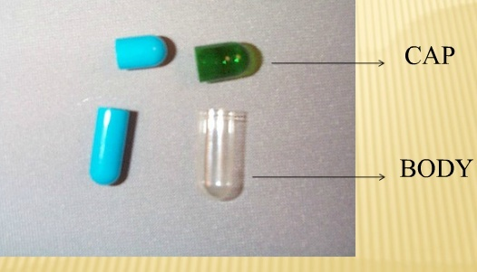
Parts of capsules

Slide 11
Manufacture of empty gelatin capsules
Steps involved are:
Dipping
Spinning
Drying
Sipinning
Trimming and joining
Polishing

Slide 12
Dipping:
Pairs of the stainless steel pins are dipped into the dipping solution to simultaneously form the caps and bodies.
The dipping solution is maintained at a temp.of about 50 ⁰C in a heated,jacketed dipping pan.

Slide 13
Spinning:
The pins are rotated to distribute the gelatin over the pins uniformly and to avoid the formation of a bead at the capsule ends.

Slide 14
Drying:
The gelatine is dried by a blast of cool air to form a hard shell.
The pins are moved through a series of air drying kilns to remove water.

Slide 15
Stripping:
A series of bronze jaws strip the cap and body portions of the capsules from the pins.

Slide 16
:Trimming and joining
The stripped cap and body portions are trimmed to the required length by stationary knives.
After trimming to the right length, the cap and body portion are joined and ejected from the machine.

Slide 17
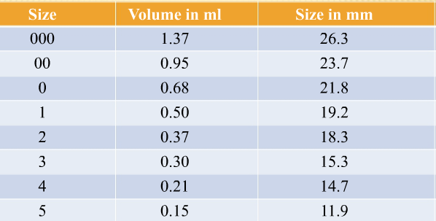
Size of capsules

Slide 18
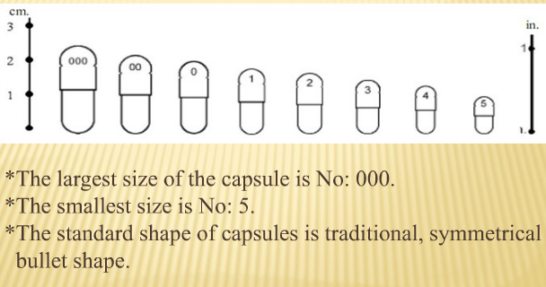
Shapes of capsules

Slide 19
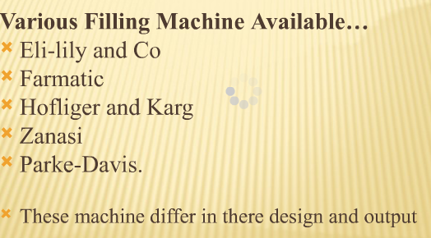
Filling of hard gelatin capsules

Slide 20
Polishing
Pan polishing: Acela-cota pan is used to dust and polish.
Cloth dusting: capsules are rubbed with cloth.
Brushing: capsules are feed under soft rotating brush

Slide 21
Storage
Finished capsules normally contain an equilibrium moisture content of 12-15% .
To maintain a relative humidity of 40-60% when handling and storing capsules.

Slide 22
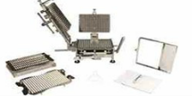
Hard gelatin capsules machine
Bench-scale filling: for small scale filling of capsules
Manual filling machine
Profile 100

Slide 23
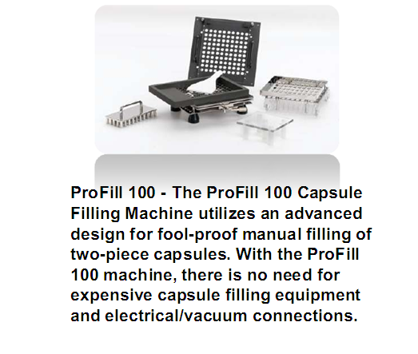

Slide 24
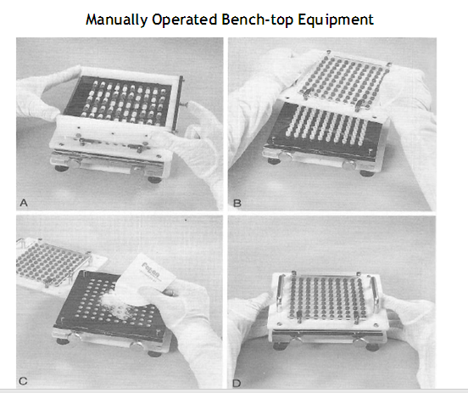

Slide 25
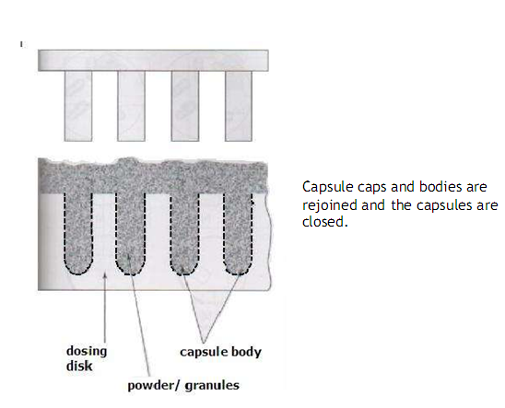

Slide 26
Quality control of capsules
1-Length of capsules
2- Shape, size and color.
3- Thickness of capsules shell.
4- Weight variation test.
5-Uniformity of content
6-Disintegration test
7- Dissolution test
8-Stability test

Slide 27
Advantages of hard gelatin capsules
Masking capacity.
Production of medicament.
Therapeutic inert and easy to digest.
Easy to swallow.
Easy to handle and carry.
Different sizes are available.

Slide 28
advantages
No need of complicated machinery.
Filling of incompatible substance in the same shell.
Product identification.
Provide enteric & sustained release effects

Slide 29
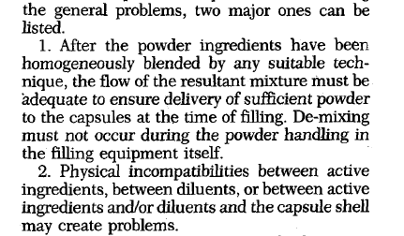
Formulation

Slide 30


General consideration in cap. formulation

Slide 31


Special techniques
Imprinting
Special purpose capsuls

Slide 32
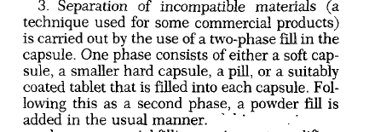

Slide 33


Slide 34
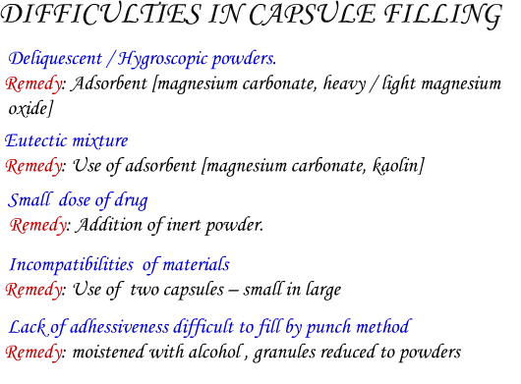

Slide 35
Thank you

