Slide 1

2022/2021
Fundamentals of
Pharmaceutical Calculations
Practical Physical Pharmacy-I
For 2nd year students
Concentration Expressions,
Preparation and Dilution of Solutions and Mixtures

Slide 2


Objectives
Define solutions and learn how to prepare them
Define concentration, and learn the methods used to express concentration
Learn how to dilute prepared solutions
Practical experiments:
Preparation of solutions/mixtures in different concentrations

Slide 3
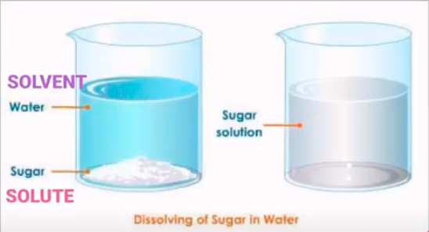

Definitions
Solute: The substance which is dissolved, or has gone into solution (typically a solid).
Solvent: The substance which does the dissolving (typically a liquid, such as water or alcohol). Must be greater than 50% of the solution.
Solution: is uniform homogeneous mixture of two or more substances. The individual substances may be present in varying amounts.

Slide 4
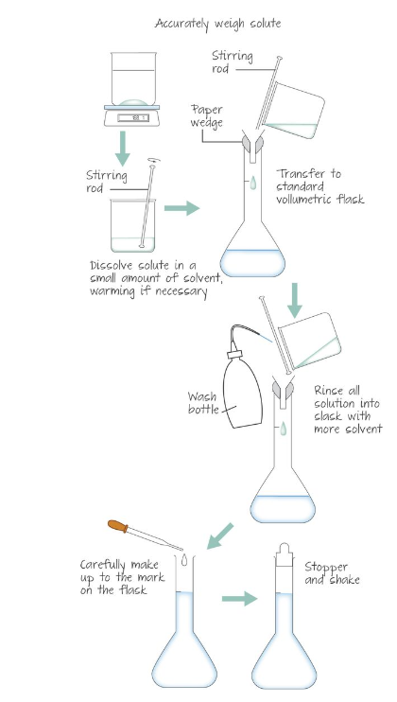
General steps in solution preparation
Weigh an appropriate amount of solute and place it in a beaker.
Add enough solvent and stir to dissolve
Transfer the solution to a volumetric flask. Rinse the beaker with more solvent and transfer to the volumetric flask.
Add more solvent to the volumetric flask carefully until an accurately calibrated final volume is reached.
Stopper your volumetric flask, shake it then put a suitable label.

Slide 5
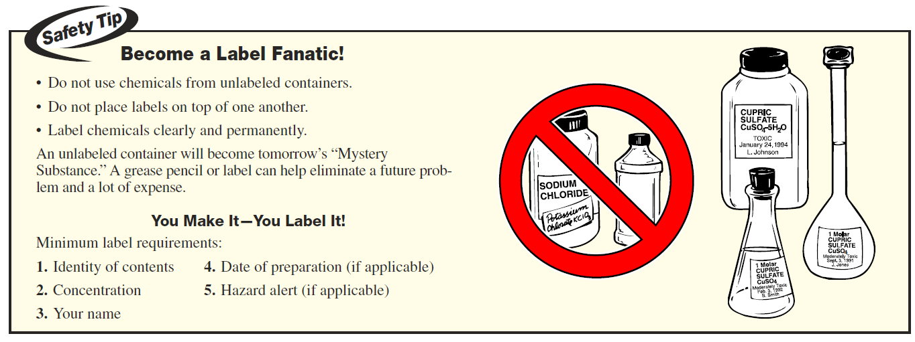

Slide 6
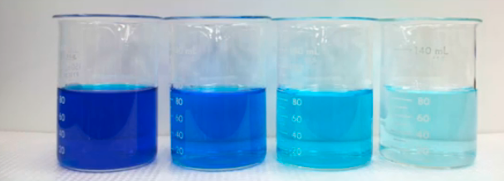
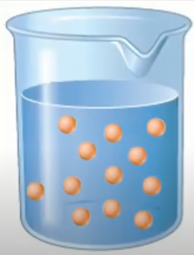
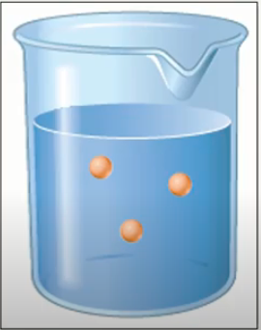
Expressing Concentrations
Concentration is expression referring to the amount (volume or mass) of solute that is present in a given amount (volume or mass) of solution.
1. Qualitative methods
Concentrated solution
Diluted solution
Darker in color
Stronger in taste and odor
More solute
Less solvent
Lighter in color
Milder in taste and odor
Less solute
More solvent
Notes:
The terms “Dilute” and “Concentrated” are relative terms and does not give indication about the real amount of solute and solvent present in a solution> We need more exact quantitative terms.

Slide 7
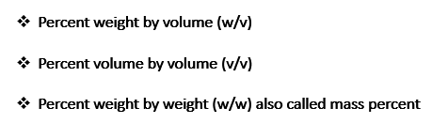
Expressing Concentrations
2. Quantitative methods
There are many ways to express concentrations of solute in a solution, the most common being:
    Molar concentration
    Normal concentration
    Percentage concentrations

Slide 8
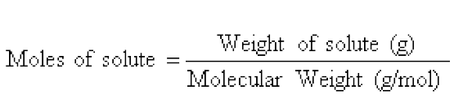


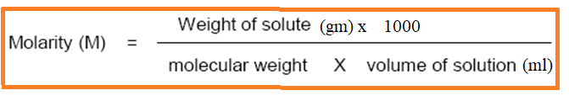
Expressing Concentrations
2. Quantitative methods
  A. Molarity (M): is the number of moles of solute dissolved in one liter (1000 mL) of solution. Molarity, therefore, is a ratio between moles of solute and liters of solution. Typical units of molarity are mol/L (or M)
  To determine molarity, the molecular weight or molar mass of the solute is needed.
So:
Or:

Slide 9

Example:
Prepare (50 ml) of (0.5 M) sodium chloride solution (M.wt NaCl is 58.5 gm/mol)
Answer: using the equation
Weight =???
0.5
58.5
50
Weigh and dissolve 1.46 gm NaCl in about 40 ml of DW in beaker, stir until dissolve, transfer to a volumetric flask and complete the volume by DW up to 50 ml.

Slide 10


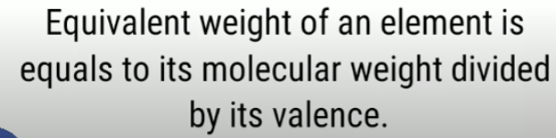


Expressing Concentrations
2. Quantitative methods
  B. Normality (N): is the number of gram equivalent weights of solute dissolved in one liter of solution. Typical units of molarity are mol/L or N.
So:
Or:
Or: the equivalent weight is defined as the molecular weight of the acid or base divided by the number of replaceable hydrogen or hydroxyl ions

Slide 11


Example:
Prepare (50 ml) of (0.5 N) sodium carbonate solution (M.wt Na₂CO₃ is 106 gm/mol).
Answer: using the equation
Weight =???
0.5
50
Weigh and dissolve 1.325 gm Na₂CO₃ in about 40 ml of DW in beaker, stir until dissolve, transfer to a volumetric flask and complete the volume by DW up to 50 ml.

Slide 12



Expressing Concentrations
2. Quantitative methods
If % concentration type is not mentioned, assume it as % (w/v)
C. Percent (%) Concentration Expressions
Percent weight by volume (w/v)
Percent volume by volume (v/v)
Percent weight by weight (w/w)
Gram of solute present in 100 ml of solution
Milliliters of solute present in 100 ml of solution
Gram of solute present in 100 gm of solution/mixture
Used in preparing solutions of solid solute in liquids
Used in preparing solutions of liquid solute in liquids
Used in preparing of mixtures of solid solute in solids (as in ointments, creams, etc.), or gases in liquids, or concentrated commercial aq. reagents (HCl is sold as a 37% w/w solution, which means that the reagent contains 37 g of HCl per 100 g of solution).
Example:
0.9% sodium chloride solution is a solution containing 0.9 g of sodium chloride dissolved in sufficient water to make 100 ml of solution
Example:
5% v/v methanol solution is a solution containing 5 ml of methanol dissolved in sufficient water to make 100 ml of solution
To determine the % of solutions, we use the following equations:
Notes:
Weight percent is frequently employed to express the concentration of solids (e.g., in creams, ointments) or concentrated commercial aqueous reagents.
For example, hydrochloric acid is sold as a 37% w/w solution, which means that the reagent contains 37 g of HCl per 100 g of solution.

Slide 13

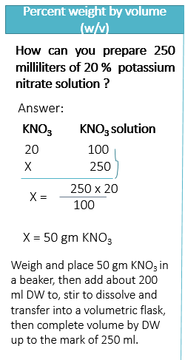
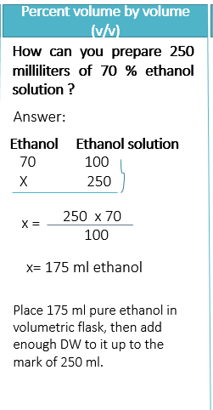
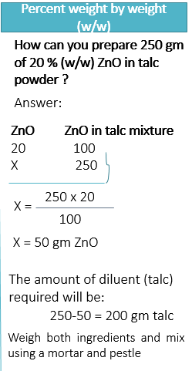

Slide 14
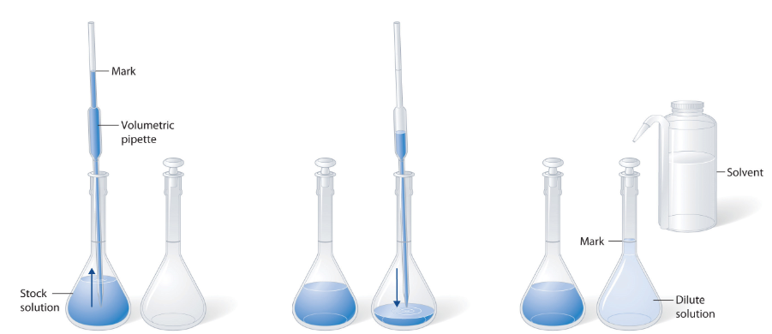
Dilution and Concentration
To prepare a dilute solution from a concentrated solution:
stock solution is a strong solutions from which weaker solutions are made
  A suitable amount of stock solution is pipetted into a clean volumetric flask and solvent added to the mark

Slide 15
Dilution Law
C1V1 = C2V2
Or
C1W1= C2W2
  C1 = initial concentration expressed as a percentage (stock solution or mixture)
  C2 = final, or desired, concentration expressed as a percentage (final solution or mixture)
  V1 or W1= initial volume (or weight) from stock to be used
  V2 or W2 = final, or desired volume or quantity of solution or mixture to be prepared
Example:
How can you prepare 250 ml of 4% w/v glucose solution from 20% w/v glucose solution using DW as a solvent ?
Answer:
Measure 5 ml of 20% glucose solution and transfer it to a volumetric flask, then add enough DW up to the mark of 250 ml. Shake an put a suitable label.
C1V1 = C2V2
20%x V1 = 4% x 250
V1 = 5 ml

Slide 16
Experimental work
Prepare the following using suitable glassware and lab equipments:
50 ml of 0.5 M NaCl solution (M.wt NaCl = 58.5 gm/mol); then, using the prepared solution, prepare 50 ml of 0.1 M NaCl solution.
50 ml of 0.5 N Na₂CO₃ solution (M.wt Na₂CO₃ = 106 gm/mol); then, using the prepared solution, prepare 50 ml of 0.1 N Na₂CO₃ solution.
50 ml of 10 % (w/v)NaCl solution; then, using the prepared solution, prepare 50 ml of 2 % (w/v) NaCl solution.
50 ml of 5 % (v/v) Ethanol solution; then, using the prepared solution, prepare 50 ml of 2 % (v/v) ethanol solution.
5 gm of 2 % (w/w) ZnO in talc powder; then using the prepared mixture prepare 2 gm of 0.5 % (w/w) ZnO in talc powder.

Slide 17

Critical thinking question:
How can you calculate molarity from percent solutions ?
???

