Slide 1

2024-2025

Slide 2
Objectives
University of Baghdad/ College of Medicine 2022-2023
▶ Describe cross-tabulation and assess the relationship between two categorical (nominal- ordinal level) variables with two or more categories.
▶ Understand the concept of observed and expected frequencies.

Slide 3
Objectives
University of Baghdad/ College of Medicine 2022-2023
▶ Interpret the SPSS output for the Chi-square procedure.
▶ Understand the applications of Fischer exact test and yate continuity test

Slide 4
CHI-SQUARE(X²) DISTRIBUTION
University of Baghdad/ College of Medicine 2022-2023
▶ PROPERTIES:
It is one of the most widely used distribution in statistical applications
This distribution may be derived from normal distribution
This distribution assumes values from ( zero to + infinity)

Slide 5
CHI-SQUARE(X²) DISTRIBUTION
University of Baghdad/ College of Medicine 2022-2023
X² relates to frequencies of occurrence of individuals (or events) in the categories of one or more variables.
X² test used to test the agreement between the observed frequencies with certain characteristics and the expected frequencies under certain hypothesis.

Slide 6
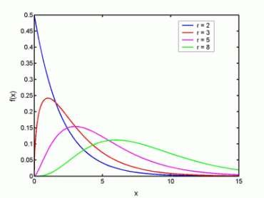
CHI-SQUARE(X²) DISTRIBUTION
University of Baghdad/ College of Medicine 2022-2023
▶ The values of test statistic in Chi-square distribution is between zero and + ∞. No negative values are present since they are squared values.
▶ The Chi-square distribution has one tail only (positively skewed distribution).
▶ The higher the df the more flattened is the curve.

Slide 7
CHI-SQUARE(X²) DISTRIBUTION
University of Baghdad/ College of Medicine 2022-2023
▶ CHI-SQUARE(X²) test of Goodness of fit (non parametric)
▶ CHI-SQUARE(X²) test of homogeneity
▶ CHI-SQUARE(X²) test of Independence

Slide 8
CHI-SQUARE(X²) test of Independence
University of Baghdad/ College of Medicine 2022-2023
▶ It is used to test the null hypothesis that two criteria of classification when applied to the same set of entities are independent (NO ASSOCIATION)

Slide 9
CHI-SQUARE(X²) test of Independence
University of Baghdad/ College of Medicine 2022-2023
▶ Generally , a single sample of size (n) can be drawn from a population, the frequency of occurrence of the entities are cross-classified on the basis of the two variables of interest( X & Y). The corresponding cells are formed by the intersections of the rows (r), and the columns (c).
The table is called the ‘contingency table’

Slide 10
CHI-SQUARE(X²) test of Independence
University of Baghdad/ College of Medicine 2022-2023
Calculation of expected frequency is based on the ▶
Probability Theory
The hypotheses and conclusions are stated on in ▶
terms of the independence or lack of independence of the two variables.

Slide 11
CHI-SQUARE(X²) test of Independence
University of Baghdad/ College of Medicine 2022-2023
▶ X²=∑(O-E)²/E
▶ df=(r-1)(c-1)

Slide 12
Steps in constructing X² -test
University of Baghdad/ College of Medicine 2022-2023
Hypotheses
Ho: the 2 criteria are independent (no association)
HA: The 2 criteria are not independent (There is association)
Construct the contingency table

Slide 13
Observed frequencies in a fourfUn_{o}iver_{l}sit_{d}y of Ba_{t}gh_{a}dad/_{b}Coll_{l}eg_{e}e of Medicine 2022-2023
 | Y1 | Y2 | Total row total
X1 | a | b | a+b
X2 | c | d | c+d
Total column total | a+c | b+d | N=a+b+c+d

Slide 14
Steps in constructing X² -test
University of Baghdad/ College of Medicine 2022-2023
3. Calculate the expected frequency for each cell
By multiplying the corresponding marginal totals of that cell, and divide it by the sample size
E = (row total x column total) / grand total

Slide 15
Steps in constructing X² -test
University of Baghdad/ College of Medicine 2022-2023
4. Calculated the X² value (calculated X² c)
X²=∑(O-E)²/E
For each cell we will calculate X² value
_{X}2
value for all the cells of the contingency table
will be added together to find X² c

Slide 16
Steps in constructing X² -test
University of Baghdad/ College of Medicine 2022-2023
5. Define the critical value (tabulated X²)
This depends on alpha level of significance and degree of freedom The value will be determined from X² table
df=(r-1)(c-1) r: no. of row
c: no. of column

Slide 17
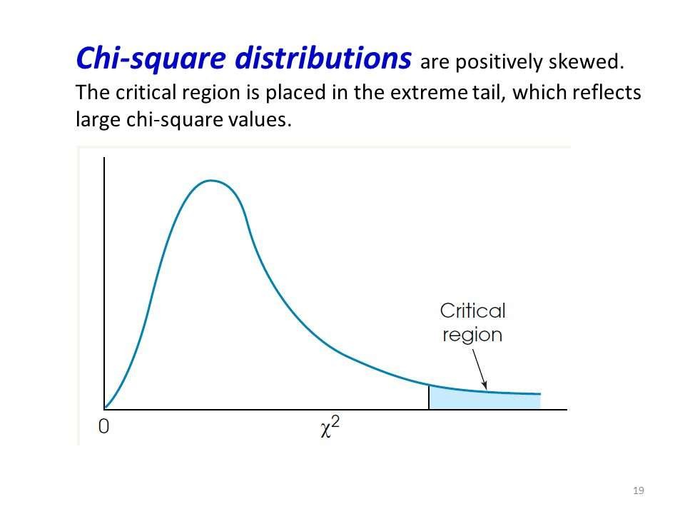
University of Baghdad/ College of Medicine 2022-2023

Slide 18
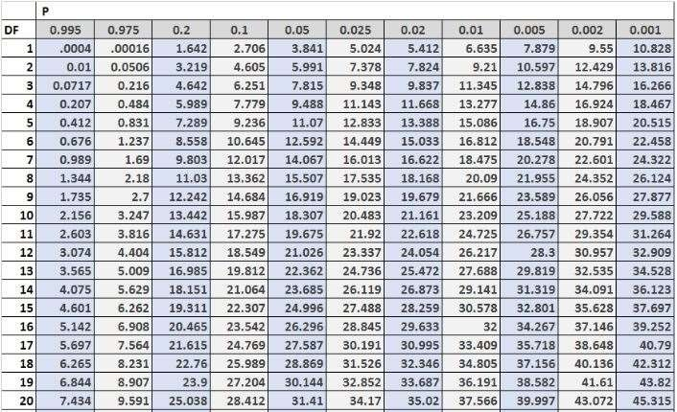
University of Baghdad/ College of Medicine 2022-2023

Slide 19
Steps in constructing X² -test
University of Baghdad/ College of Medicine 2022-2023
6. Conclusion
If the X² c is less than X² _{tab} we accept Ho.
If the X² c is more than X² _{tab} we reject Ho.
The tabulated X² for 2x2 table with df=1 and alpha error= 0.05 is equal to (1.96) ² = 3.84.

Slide 20
▶ The table shows the distribution of individuals
according to 3 categories of Socioeconomic Index Level
University of Baghdad/ College of Medicine 2022-2023
(SEIL).
SEIL | No | %
Low | 50 | 25
Average | 110 | 55
High | 40 | 20
Total | 200 | 100

Slide 21
▶ In the same sample the location of residence was also
University of Baghdad/ College of Medicine 2022-2023
▶ classified into 3 sectors: south, center and north.
 | N | %
south | 44 | 22
center | 96 | 48
north | 60 | 30
Total | 200 | 100

Slide 22
▶ the relationship between two
University of Baghdad/ College of Medicine 2022-2023
▶ categorical variables, tabulated one against other.
SEIL | South | Center | North | Total
Low | 33 | 7 | 10 | 50
Average | 9 | 81 | 20 | 110
High | 2 | 8 | 30 | 40
Total | 44 | 96 | 60 | 200

Slide 23
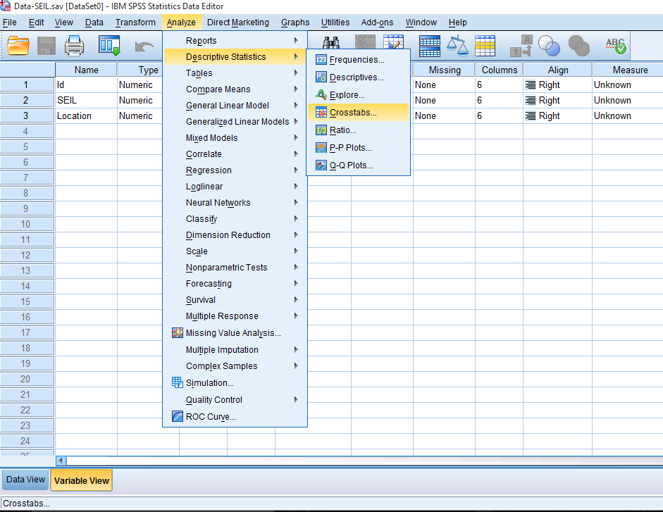
SPSS output
University of Baghdad/ College of Medicine 2022-2023

Slide 24
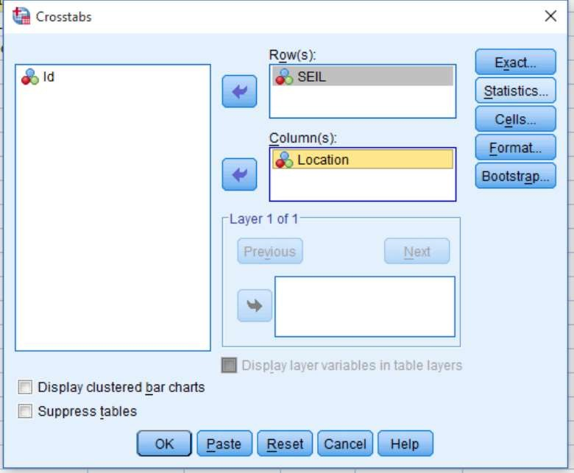
SPSS output
University of Baghdad/ College of Medicine 2022-2023

Slide 25
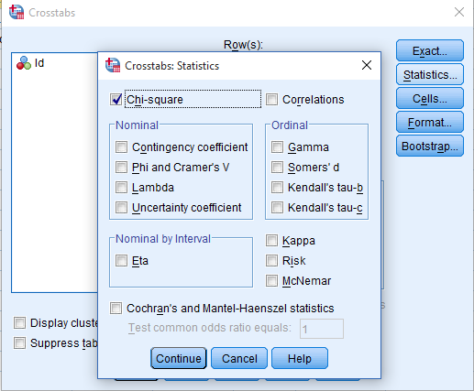
SPSS output
University of Baghdad/ College of Medicine 2022-2023
Add here
Then click
continue

Slide 26
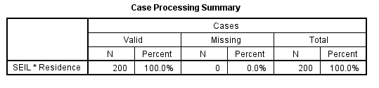
SPSS output
University of Baghdad/ College of Medicine 2022-2023

Slide 27
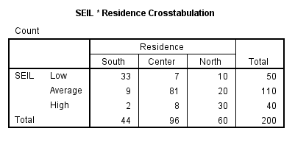
SPSS output
University of Baghdad/ College of Medicine 2022-2023

Slide 28
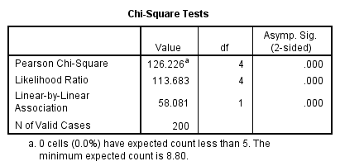
SPSS output
University of Baghdad/ College of Medicine 2022-2023
The last one is the most important. It shows the calculated Chi square
=126.2
The df = 4 and P value <0.001.

Slide 29
For r X c table X² –test is not applicable if:
University of Baghdad/ College of Medicine 2022-2023
The expected frequency of any cell is <1
The summation of the least expected frequencies in 20% of the cells is < 5

Slide 30
For 2 X 2 table X² –test is not applicable if:
University of Baghdad/ College of Medicine 2022-2023
The expected frequency of any cell is <5

Slide 31
Fisher’s Exact Test
University of Baghdad/ College of Medicine 2022-2023
▶ This test is used if chi square test is not applicable because of small expected value. (when the expected frequency of any cell in a 2 X 2 table is less than 5)
▶ For tables in which the use of chi square test is appropriate, the two tests give very similar results

Slide 32
Fisher’s Exact Test
University of Baghdad/ College of Medicine 2022-2023
(a+b)! (c+d)! (a+c)! (b+d)!
P=-----------------------------------------
n! a! b! c! d!

Slide 33
Yate’s Continuity Correction
University of Baghdad/ College of Medicine 2022-2023
▶ Because Chi square is a continuous distribution and categorical data are discrete, some statisticians use a version of chi square called Yate’s corrected chi square.

Slide 34
Yate’s Continuity Correction
University of Baghdad/ College of Medicine 2022-2023
▶ X² = ∑ ( |0 –E| - 0.5)² / E
▶ The corrected version is more conservative than the non corrected version

Slide 35
THANK YOU
University of Baghdad/ College of Medicine 2022-2023

