Slide 1
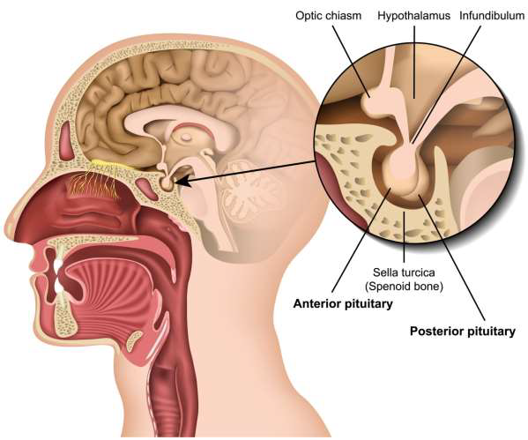
Pituitary Disorders

Slide 2
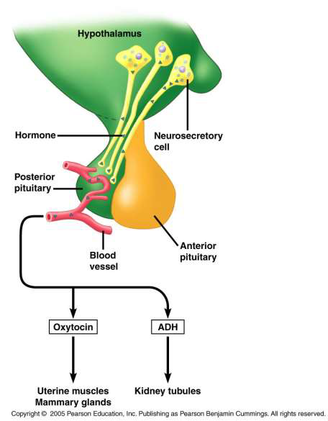
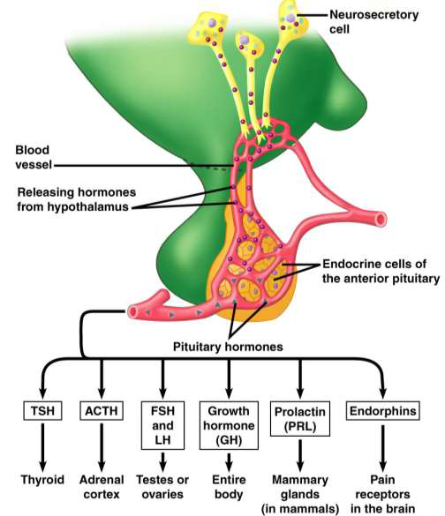

Slide 3
Two reasons for pituitary disorders
* Hyperactivity
* Hypoactivity
HYPO | HYPER | Parts
1.Dwarfism | 1.Gigantism | Anterior Pituitary
2.Acromicria | 2.Acromegaly
3.Simmond’sdisease | 3.Cushing’sdisease
Diabetes insipidus | Syndrome of inappropriate hypersecretion of ADH(SIADH) | Posterior Pituitary

Slide 4
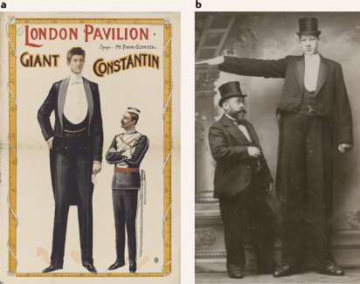
Gigantism: It is caused by over production of the Growth Hormone that occurs during childhood. The over production of the growth hormone is due to a Pituitary Gland tumor As the tumor grows it compresses against the Pituitary Gland making an excessive amount of GH.
Signs and symptoms:
* General overgrowth of the person
Leads to the development of a huge stature, with a height of more than 7-8 feet The limbs are disproportionally long.
*Giants are hyperglycemic and develop
Glycosuria and pituitary diabetes.
Hyperglycemia causes constant
Stimulation of β-cells of Langerhans
in pancreas.

Slide 5
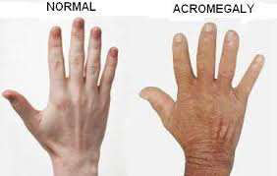
Acromegaly: Hormonal disorder ,pituitary gland produces too much growth hormone during adulthood Acromegaly patient bones increase in size, Including hands ,feet and face Acromegaly usually affects middle-aged adults.
Signs and symptoms:
*Acromegalic or ( gorilla face) Face with rough feature ,such as, thickening of lips, thickening and wrinkles formation on forehead and pragmatism (protrusion of lower jaw).
*Enlargement of hands and feet.
*Enlargement of visceral organ ,such as, lungs ,thymus, heart, liver, etc.
*Hyperactivity of thyroid, parathyroid ,and
Adrenal gland.

Slide 6
CUSHING'S DISEASE
Rare disease characterized by obesity.
Develop by basophilic adenoma of adenohypophysis It increases secretion of AcTH which in turn stimulate adrenal cortex to release cortisol.
Develop by hyperplasia or tumor of adrenal cortex.
The disorder due to the pituitary cause is Cushing's diseases and when due to adrenal cause, called Cushing syndrome.

Slide 7
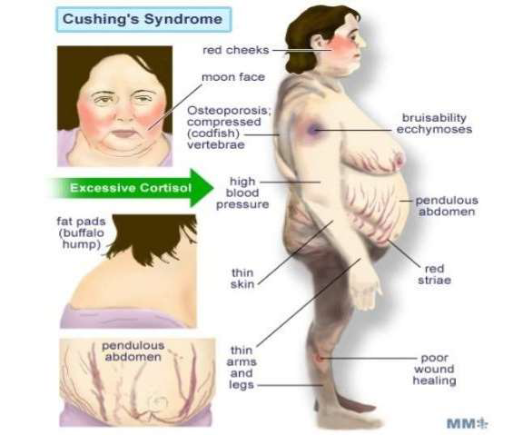

Slide 8
DWARFISM
It is a pituitary disorder in children, characterized by stunted growth.
Tumor of chromophobe cell It is an on functioning tumor, which compresses and destroys the normal cells secreting GH.
It is a common cause for hyposecretion of GH ,leading to dwarfism.
Deficiency of growth hormone releasing hormone(GRH), secreted by hypothalamus.
Deficiency of somatomedin-C.
Atrophy or degeneration of acidophilic cells in anterior pituitary.
Panhypopituitarism: There is reduction in the secretion of all the hormones of anterior pituitary hormones.

Slide 9
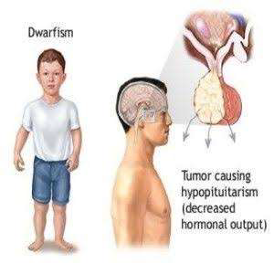

Slide 10
Signs and symptoms:
* Inhibit skeletal growth Maximum height 3 feet.
*Body proportions of different parts of body are almost
normal, only head becomes slightly larger in relation to
Body
*Mental activity normal, with no mental retardation
*Reproductive function is not affected, if only GH
deficient, but during panhypopituitarism the dwarfs do
not obtain puberty due to the deficiency of gonadotropic
hormone

Slide 11
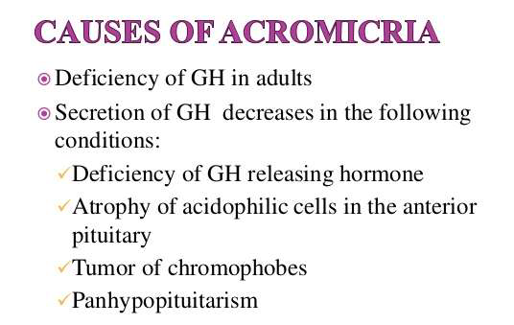
Acromicria
Rare disease in adults characterized by the atrophy of the extremities of the body

Slide 12
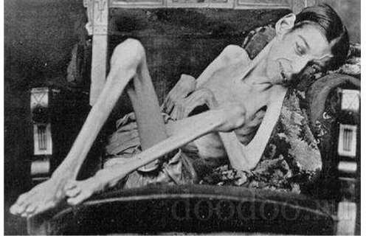
Simmonds disease:
is a chronic deficiency of function of the pituitary gland, a form of hypopituitarism that leads to atrophy of many of the viscera, including the heart, liver, spleen, kidneys, thyroid, adrenals, and gonads The disease results in emaciation and death if left untreated

Slide 13
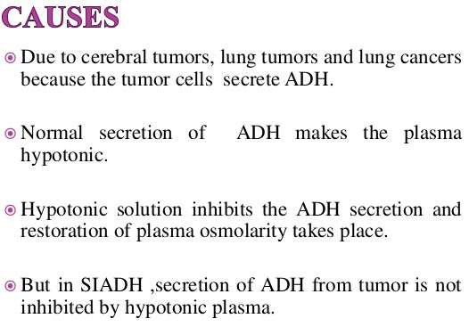
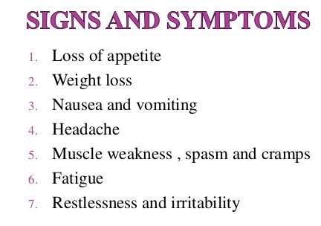
Syndrome of inappropriate hypersecretion of ADH (SIADH)
It is characterized by loss of sodium through urine due to hypersecretion of ADH

Slide 14
:Diabetes insipidus
Hyposecretion of ADH causes excess excretion of water through urine It causes water imbalancement in the body This imbalance leads to intense thirst even after drinking fluids( polydipsia and excretion of (large amounts of Urine( polyuria
:It is of two types
a) central diabetes insipidus
b)Nephrogenic diabetes insipidus

Slide 15
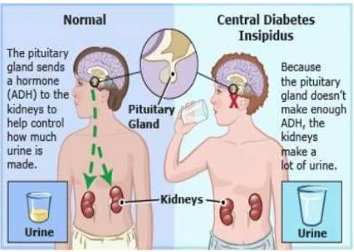

Slide 16
Treatment :
* Drug therapy: Bromocriptine.
* Radiation therapy.
*Surgery: To remove pituitary adenoma

Slide 17


