Slide 1
Principles of Antimicrobial Therapy
Dr. farah kais

Slide 2
Drug Resistance
Bacteria are considered resistant to an antibiotic if the maximal level of that antibiotic that can be tolerated by the host does not halt bacterial growth. Some organisms are inherently resistant to an antibiotic.
For example, most gram-negative organisms are inherently resistant to vancomycin.
However, microbial species that are normally
responsive to a particular drug may develop more virulent or resistant strains through spontaneous mutation or acquired resistance and selection.
Some of these strains may even become resistant to more than one antibiotic.

Slide 3
A. Genetic alterations leading to drug resistance
Acquired antibiotic resistance requires the temporary or permanent gain or alteration of bacterial genetic
information.
Resistance develops due to the ability of DNA to undergo spontaneous mutation or to move from one organism to another .

Slide 4
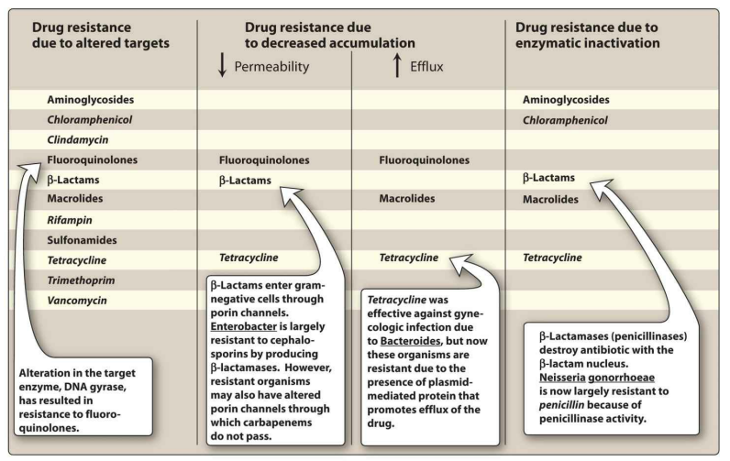
Figure 1: Some mechanisms of resistance to antibiotics.

Slide 5
B. Altered expression of proteins in drug-resistant organisms
Drug resistance is mediated by a variety of mechanisms, such as
An alteration in an antibiotic target site
Decreased penetration of the drug due to lower permeability
Increased efflux of the drug, or presence of antibiotic-inactivating enzymes.

Slide 6
1. Modification of target sites
Alteration of the target site of an antibiotic through mutation can confer resistance to one or more related antibiotics.
For example, S. pneumoniae resistance to β-lactam antibiotics involves alterations in one or more of the major bacterial penicillin-binding proteins, resulting in decreased binding of the antibiotic to its target.

Slide 7
2. Decreased accumulation
Decreased uptake or increased efflux of an antibiotic can confer resistance because the drug is unable to attain access to the site of its action in sufficient concentrations to injure or kill the organism.
For example, gram-negative organisms can limit the penetration of certain agents, including β-lactam antibiotics, as a result of an alteration in the
number and structure of porins (channels) in the outer membrane.
Also, the presence of an efflux pump can limit levels of a drug in an organism, as seen with tetracyclines.

Slide 8
3. Enzymatic inactivation
*The ability to destroy or inactivate the antimicrobial agent can also confer resistance on microorganisms. Examples of antibiotic-inactivating enzymes include 1) β-lactamases (“penicillinases”) that hydrolytically inactivate the β-lactam ring of penicillins, cephalosporins, and related drugs;
2) Acetyltransferases that transfer an acetyl group to the antibiotic, inactivating chloramphenicol or aminoglycosides; and
3) Esterases that hydrolyze the lactone ring of
macrolides.

Slide 9
H.W
Prophylactic Use of Antibiotics

Slide 10
Complications of Antibiotic Therapy
Even though antibiotics are selectively toxic to an invading organism, the host may still experience adverse effects.
For example, the drug may produce an allergic response or may be toxic in ways unrelated to the antimicrobial activity.

Slide 11
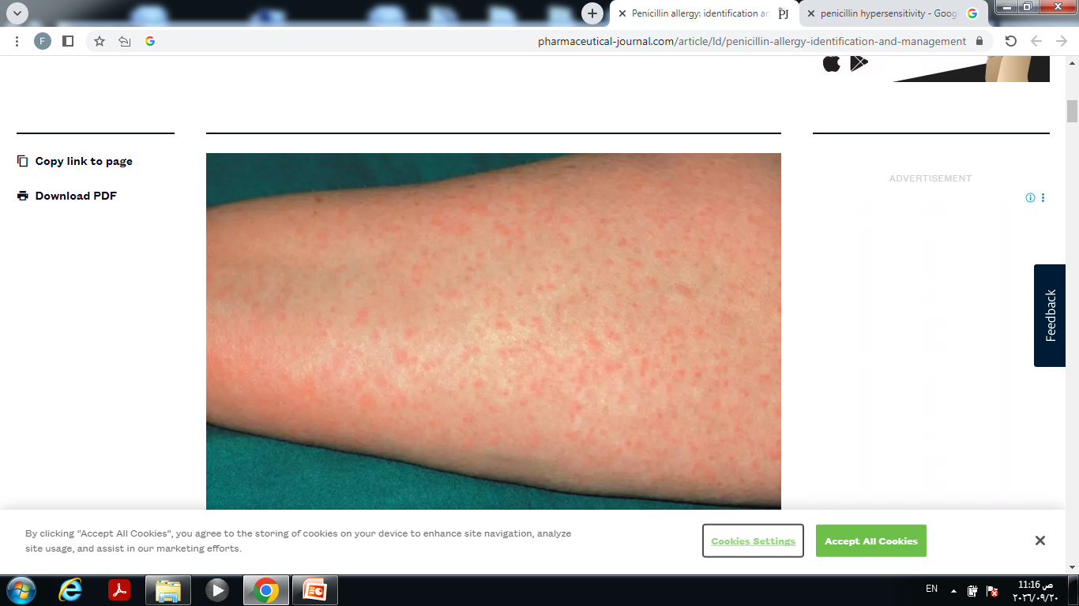
A. Hypersensitivity
Hypersensitivity or immune reactions to antimicrobial drugs or their metabolic products frequently occur.
For example, the penicillins, despite their almost absolute selective microbial toxicity, can cause serious hypersensitivity
problems, ranging from urticaria to anaphylactic shock

Slide 12
H.W
What are the medications to treat mild ,moderate , sever penicillin hypersensitivity?

Slide 13
B. Direct toxicity
High serum levels of certain antibiotics may cause toxicity by directly affecting cellular processes in the host.
For example, aminoglycosides can cause ototoxicity by interfering with membrane function in the auditory hair cells.
Chloramphenicol can have a direct toxic effect on mitochondria, leading to bone marrow suppression.
Fluoroquinolones can have effects on cartilage and tendons, and tetracyclines have direct effects on bones.
A number of antibiotics can cause photosensitivity.

Slide 14
C. Superinfections
Drug therapy, particularly with broad-spectrum antimicrobials or combinations of agents, can lead to alterations of the normal microbial flora of the upper respiratory, oral, intestinal, and genitourinary tracts, permitting the overgrowth of opportunistic organisms, especially fungi or resistant bacteria.
These infections usually require secondary treatments using specific anti-infective agents.

Slide 15
Sites of Antimicrobial Action
Antimicrobial drugs can be classified in a number of ways:
1) By their chemical structure (for example, β-lactams or aminoglycosides)
2) By their mechanism of action (for example, cell wall synthesis inhibitors) or
3) By their activity against particular types of organisms (for example, bacteria, fungi, or viruses).

Slide 16
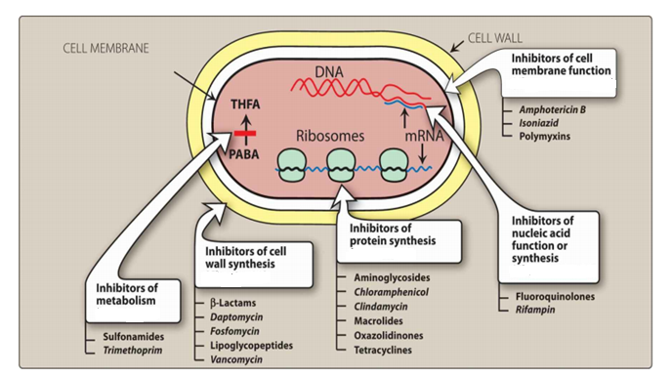
Figure 2: Classification of some antimicrobial agents by their sites of action. THFA = tetrahydrofolic acid; PABA = p-aminobenzoic acid.

Slide 17
Thank you

