Slide 1
Poison Control Centers
Dr. farah kais

Slide 2
A poison control center
is a medical service that is able to provide immediate, free, and expert treatment advice and assistance over the telephone in case of exposure to poisonous or hazardous substances.
Poison control centers answer questions about potential poisons in addition to providing treatment management advice about household products, medicines, pesticides, food poisoning , and fumes.

Slide 3
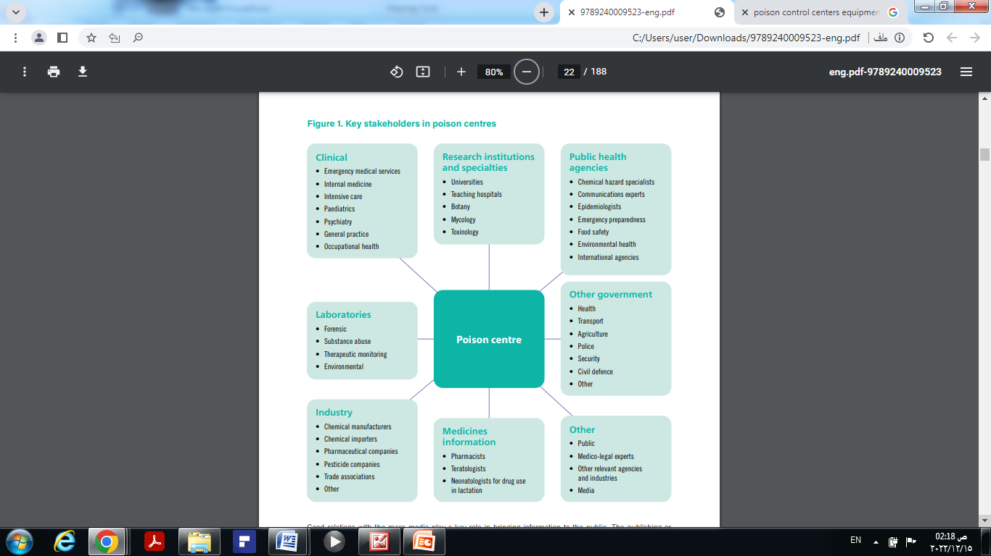

Slide 4
Poison control centers are made up of
physicians, pharmacists, nurses, and health educators and respond to calls from healthcare professionals and the public regarding both human and animal poisonings 24 hours a day, seven days a week, 365 days a year.

Slide 5
Goals & Mission of Poison Centers
The objective of poison centers is to
Reduce morbidity and mortality associated with poisonings.
Poisons can include exposures to medications, supplements, illicit drugs, household, and industrial chemicals, environmental toxins, plants, and animals.

Slide 6
Modern regional PCCs are staffed by highly trained and certified health professionals who are assisted by extensive information systems.
Support is provided by 24-hour access to board-certified medical toxicologists and consultants from diverse medical disciplines, the natural sciences, and industry.

Slide 7
The PCC is charged with seven major objectives:
Maintaining and interpreting a database of xenobiotics
Providing information and advice to the public and to health professionals
Collecting epidemiologic data on the incidence and severity of poisoning
Integrating epidemiologic data as part of the public health surveillance system
Preventing unnecessary hospitalizations after exposure and thereby cutting health care costs
Educating health care professionals on the diagnosis and treatment of poisoning
Contributing to the science of toxicology

Slide 8
In the past, PCCs were evaluated based on the number of incoming calls and measures of community awareness.
Current emphasis should be placed on evaluating health outcomes such as intensive care unit (ICU) admissions, length of stay in hospitals, and total health care expenditures.
One crucial test of the utility of modern PCCs will be their ability to help reverse the increased adult deaths from pharmaceutical poisoning largely driven by prescription opioids.

Slide 9
Functions of a Poison Center
The service is free to the public, and most centers do not charge a fee for a physician or hospital consultations.
Poison centers also serve to triage calls from the public and provide safe management recommendations and monitoring which allow individuals to be monitored at home without unnecessarily using hospital resources and healthcare dollars.

Slide 10
1: Healthcare cost savings
Poison centers also help minimize unnecessary healthcare costs through appropriate management recommendations.
And decrease the length of stay and healthcare costs associated with hospitalization.

Slide 11
H.w
2- Toxico-surveillance

Slide 12
3- Public and professional education :
Poison centers provide a critical function in educating the public on both poisoning prevention as what services poison centers provide and how to use the service. They provide educational sessions to school-aged children, aging adults, and to community groups.
Poison centers also provide professional education to medical students, medical residents. It also educates pharmacy students and pharmacy residents training in toxicology.
Finally, poison centers frequently provide continuing medical education programs, symposiums , etc. to help keep healthcare providers up to date on poison-related topics.

Slide 13
4-Drug and product safety research
All poison centers upload data which serves as a rich repository of data that can be used to monitor the safety and clinical effects of new medications, chemicals, and emerging drugs of abuse.
Poison center data are used to identify needs for defects in packaging and medication formulations and monitor recalls and public health interventions.

Slide 14
Clinical Significance
Value of Poison Centers
Poison centers have evolved to serve a unique and key role in both direct patient care and public health.
They serve as an easily accessible and cost-effective resource for healthcare professionals and the public alike and provide access to the most up to date and evidence-based information on exposures to poison.
Clinicians are encouraged to continue to use poison center services and report all poison exposures.

Slide 15
RESEARCH ACTIVITIES OF THE CENTRE
a. Clinical b. Analytical c. Epidemiological d. Other
PUBLICATIONS
a. Publications, reports, brochures issued by the centre (title, brief summary, reference)
b. Publications written by staff of the centre ((for example, case reports, articles, monographs, theses, books; provide title, brief summary and reference for each)

Slide 16
FUNCTIONS OF AN ANALYTICAL TOXICOLOGY SERVICE
The main functions of an analytical toxicology service are to provide the following:
• Emergency qualitative and/or quantitative assays for common poisons, especially when knowledge of the plasma, serum or urine concentration may influence treatment;
• More complex analyses, such as screening when the cause of illness is unknown but poisoning is suspected (Even if such analyses are not available immediately, they may be helpful in identifying the cause of poisoning and guide further treatment.)

Slide 17
• Analyses to monitor the efficacy of certain treatment or elimination techniques (such as chelation therapy, haemoperfusion, haemodialysis, multiple-dose activated charcoal);
• Analyses for biological monitoring of populations exposed to chemicals occupationally or environmentally and environmental monitoring (such as soil, air, water);
• Advice on the collection, storage and transport of specimens and on the interpretation of results of analyses;
• Research into the toxicokinetics and mechanisms of toxicity of drugs and chemicals, in collaboration with clinical services and poisons information centres; and
• Training in analytical methods and laboratory procedures and in interpretation of analytical data.

Slide 18
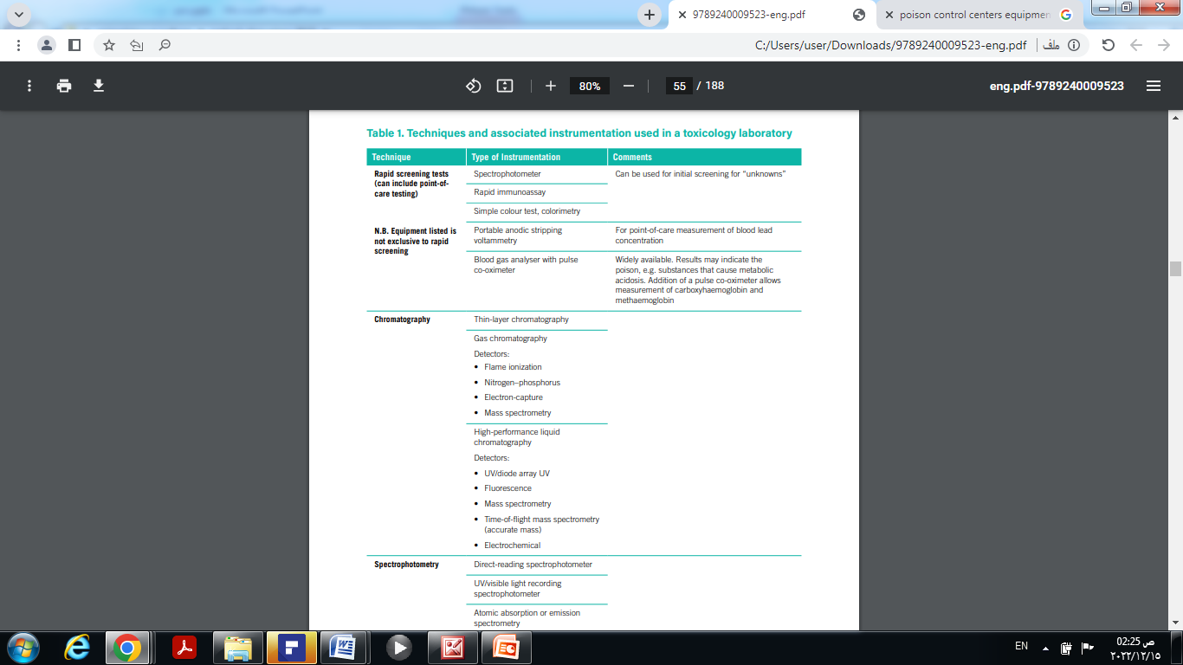

Slide 19
The most important factor to consider in the treatment of acute toxic poisoning is the causative substance.
Decontamination and treatment methods as well as antidotes used are different according to toxic substances.
Therefore, access to data on substances commonly associated with toxic poisoning is very important for medical staff dealing with patients in emergency departments.

Slide 20
* Hospitals providing emergency care routinely stock 24 antidotes for a wide range of toxicities, including
Toxic-alcohol poisoning, exposure to cyanide and other industrial agents, and intentional or unintentional overdoses of prescription medications (e.g., calcium-channel blockers, β-blockers, digoxin, isoniazid).

Slide 21
What Poison Control Pharmacists do?

Slide 22
Pharmacists can help reduce morbidity and mortality due to poisonings and overdoses by
(1) Recognizing the signs and symptoms of various types of toxic exposure,
(2) Guiding emergency room staff on the appropriate use of antidotes and supportive therapies,
(3) Helping to ensure appropriate monitoring of patients for antidote response and adverse effects, and
(4) managing the stocking of antidotes to ensure availability.

Slide 23
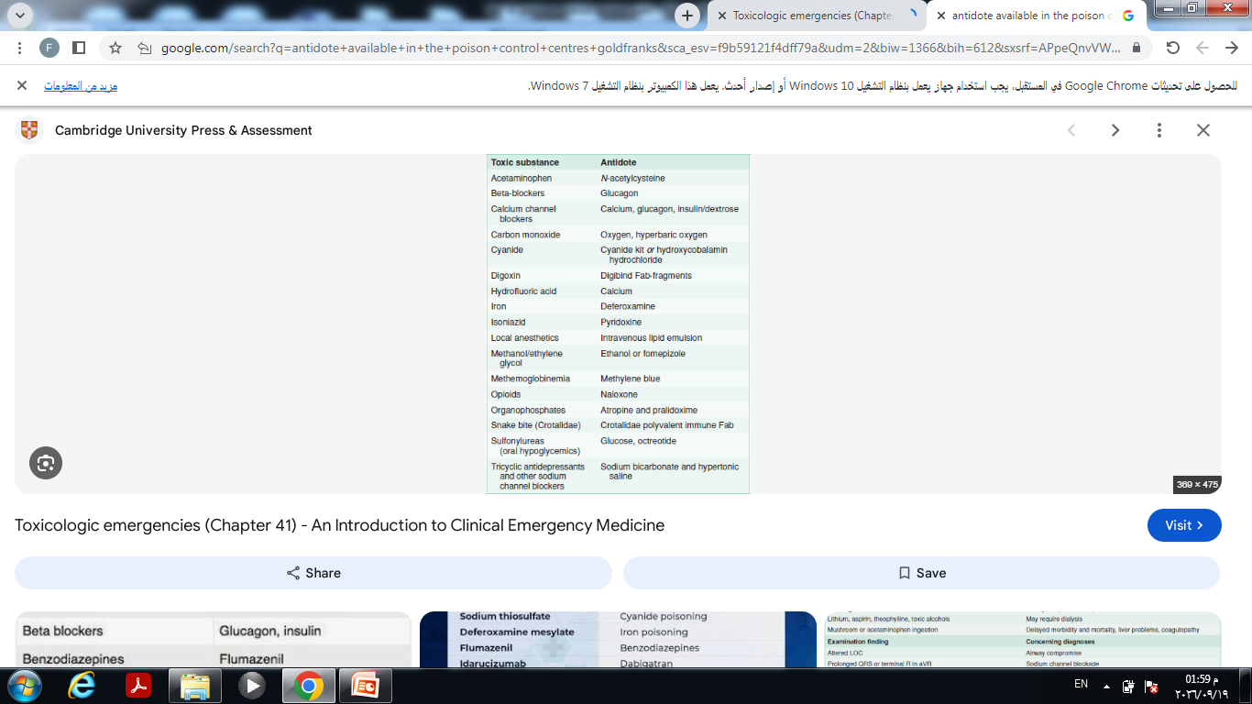

Slide 24
H.W
What are the challenges faced by poison control pharmacists?

Slide 25
Thank you

