Slide 1
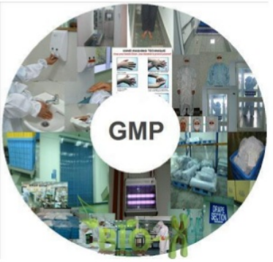
Current Good Manufacturing Practices (cGMP)

Slide 3
Objectives
List common terms used in the Current Good Manufacturing Practice (cGMP) for finished pharmaceuticals
Define cGMP and its importance
Outline Code of Federal Regulation (CFR)

Slide 4
Common terms
Drug product: Finished form contains active drug and inactive ingredients.
Component: Any ingredient used in manufacture of drug product.
Active pharmaceutical ingredient (API): any component have pharmacologic activity or direct effect in diagnosis, cure, mitigation, treatment or prevention of disease.
Inactive ingredient: Any component other than the active ingredients in drug product.

Slide 5
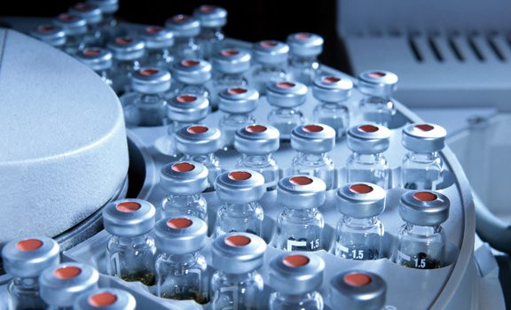
Batch: a specific quantity of a drug of uniform specified quality produced according to single manufacturing order during the same cycle of manufacture.
Lot: A batch or any portion of a batch having uniform specified quality and a distinctive identifying lot number.

Slide 6
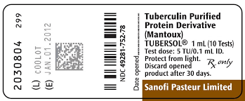
Lot number
Expiry date
Lot number, control number, or batch number:
combination of letters, numbers, or symbols from which the complete history of manufacture, processing, packaging, holding, and distribution of a batch or lot of a drug product may be determined

Slide 7
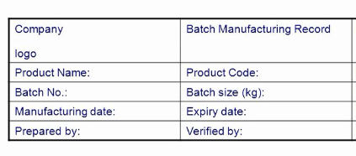
Common terms
Master record: the records for the
formulation, specifications, manufacturing
procedures, quality assurance requirements,
and labeling of each finished product.
Master Batch record and Batch production
record: contain
- Product name, dosage form and strength, batch size

Slide 8
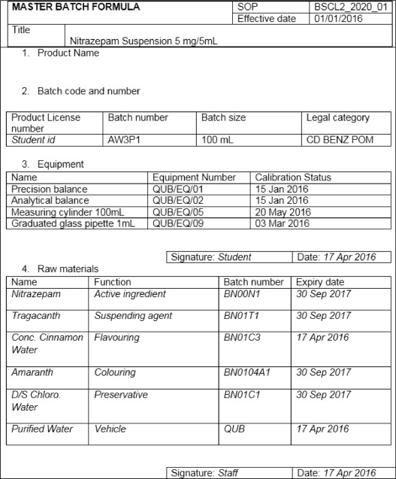

Slide 9
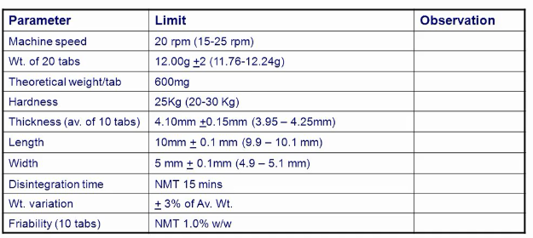
-List and quantity of each component in dosage unit
-list of equipment used
-Calibration of instruments
-Specific instructions for each state in the manufacturing process.
-Statement of theoretical yield at each step in the manufacturing process
-Yield of final product
-Sampling and testing procedures (in-process control)

Slide 10
Validation: Establishing documented evidence which provides a high degree of assurance that a specific process will consistently produce a product meeting its predetermined specifications and quality
attributes. i.e Action of proving
Phase I- Pre-validation qualification (Process Design), relate to drug development, pilot study and scale-up reliably.
Phase II- Process validation, verify that all established limits of the critical process parameter
Phase III- Validation Maintenance Phase, it requires frequent review of all process related documents

Slide 11
Validation protocol: experimental plan to produce documented evidence that the system has been validated.
It gives idea about future performed:
➢ What activities are to be performed?
➢ Who is going to perform these activities?
➢ When the activities should start and when they should get over?
➢ What documents will be generated?
➢ What the policy on revalidation

Slide 12
The major types of Validation :
❖ Process validation  Cleaning validation
❖ Equipment validation  Validation of analytical methods
Flow

Slide 13
The purpose of operational qualification is to check:
(A) Has it been built/installed correctly?
(B) Has it been designed correctly?
(C)The dynamic attributes of a piece of equipment and whether it works correctly?
(D) Does it produce product correctly?

Slide 14
Common terms
Certification: Documented testimony by qualified authorities that a system qualification, calibration, validation, or revalidation has been performed appropriately and that the results are acceptable.
Compliance: manufacturer acting with prescribed regulations, standards, and practices.
Quarantine: An area that is marked, designated, or set aside for the holding of incoming components prior to acceptance testing and qualification for use

Slide 15
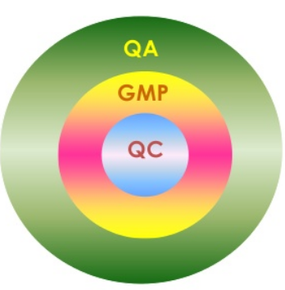
Quality Relationship
Quality assurance: all evidence needed that activities relating to quality are being performed adequately.
Quality control: process through which industry measures actual quality performance, compares it with standards.
Quality control unit:
the organizational element
designated by a firm to be
responsible for work related
to quality control

Slide 16
Quality control GMP Quality Assurance
(1) All matters that individually or collectively influence product quality
(2) Activity relating to the product release procedures only
(3) Ensuring that all products are tested according to specifications
(4) Minimizing risks inherent in production that cannot be prevented thorough testing of finished products
(5) The top management of the pharmaceutical company

Slide 17
In 1937, a public health disaster tragically (liquid Sulfanilamide formulation contained a poison, it killed 107 people) drove home the need for a stronger federal law
In 1941, nearly 300 people were killed or injured by one company’s sulfathiazole tablets, a sulfa drug tainted with the sedative phenobarbital.
That incident caused FDA to
drastically revise manufacturing and quality control requirements, leading to what would later be called GMPs

Slide 18
What are cGMPs?
GMP: regulations are established by the Food and Drug Administration (FDA) to ensure that minimum standards are met for drug product quality
In another words, Rules set up by the FDA that drug manufacturers need to follow in order to ensure that a safe , effective and high quality product is manufactured
cGMP, employ technologies and up-to-date (“current”) in order to comply with the regulation

Slide 19
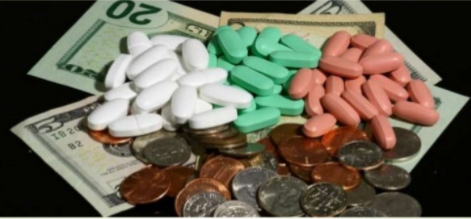
Why GMP is important?
It is designed to saves costs, minimize risks involved in any pharmaceutical production that cannot be eliminated through testing the final product, improve the standard of drugs worldwide.
**Some of the main risks are
Unexpected contamination of products,
Incorrect labels on containers,
Insufficient or too much active ingredient,

Slide 20
Principle of GMP
Written step by step operating procedure and work instruction
Carefully following written procedures
Promptly and accurately documenting work for compliance and traceability
Validating work ensures that system is doing what they are designed to do
Develop a good design for the facility and the equipment from the beginning

Slide 21
Properly maintaining facilities and equipment
Clearly defining, developing and demonstrating job competence
Protecting products against contamination by making cleanliness a continual habit Practice good Hygiene
Design the quality in product manufacturing “effective control of quality”

Slide 22
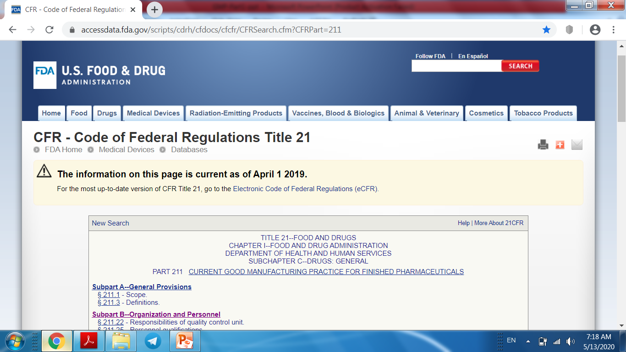
cGMP Code of Federal Regulations (CFR) Finished Pharmaceuticals, Biologic products, Medicated articles, Medical devices

Slide 23
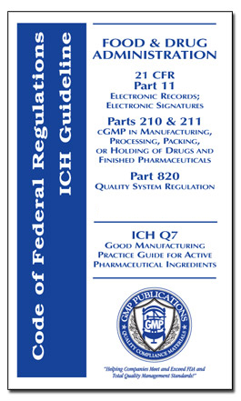
Outline of Current Good Manufacturing Practice Regulations
Subpart A--General Provisions
• Subpart B--Organization and Personnel
Personnel qualifications
Personnel responsibilities
Consultants
• Subpart C--Buildings and Facilities
Design and construction features
Lighting
Ventilation, air filtration
Plumbing
Sewage and refuse Warehousing
Washing and toilet facilities Sanitation
Maintenance

Slide 24
• Subpart D—Equipment
Equipment design, construction
Equipment cleaning and maintenance
Subpart E--Control of Components and Drug Product Containers and Closures
• Subpart F--Production and Process Controls
Written procedures,
Charge-in of components
Calculation of yield
In-process testing of materials and products
Subpart G--Packaging and Labeling Control
Subpart H--Holding and Distribution
Subpart I--Laboratory Controls
Subpart J--Records and Reports
Subpart K-- Returned and Salvaged Drug Products

Slide 25
Organization and Personnel
deals with responsibilities of
quality control unit, employees, and consultants.
quality control unit have responsibility for all functions that affect product quality. This includes accepting or rejecting product components, product specifications, finished products, packaging, and labeling. Adequate laboratory facilities shall be provided, written procedures followed, and all records maintained.
All personnel required to have education, training, and experience. Appropriate programs of education and training, and performance evaluations are essential for maintaining quality assurance.

Slide 26
Operators need to be trained:
(A) But QC staff may be exempt because they are generally better educated.
(B) In order that they carry out the procedures correctly.
(C) But only when batch rejections occur.
(D) But only when complaints are proven to be their fault.
The following should be excluded from all production areas:
(A) Food and drink.
(B) Chewing gum.
(C) Plants and animals.
(D) All of the above

Slide 27
Buildings and Facilities
Buildings and Facilities must be designed with adequate size and space for operations.
There must be a good flow pattern for personnel, materials, products and waste materials (helps to eliminate mix-ups and contamination)
The facility must be easy to clean,
and sanitize (surfaces, equipment,..)
Environmental controls must be in
place (lighting, ventilation, air
filtration, air heating and cooling
clean rooms)
Utilities must be validated (water systems, plumbing, electrical, …..)

Slide 28
Premises used for the manufacture of drug products:
(A) Should be constructed as economically as possible.
(B) Do not have to control entry of pests if all processes are fully enclosed.
(C) Only need maintenance when something breaks down.
(D) Should be designed and constructed to facilitate good sanitation.

Slide 29
Equipment
Each piece of equipment must be: appropriate design and size to facilitate use, cleaning, and maintenance.
Equipment's surfaces and parts must not interact with processes or products so not affect purity, strength, or quality.
Standard operating procedures (SOP) must be written and followed for proper use, maintenance, and cleaning of each piece of equipment.
Equipment and computers used in the processes must be routinely calibrated, maintained, and validated for accuracy.
Filters used in the manufacture of injectable drug products must not release fibers into such products.

Slide 30
Control of components,
containers and closure
Written procedures describing: identification, storage, handling, sampling, testing, and approval or rejection of all product components, containers, and closures must be maintained and followed.
Bulk pharmaceutical chemicals, containers, and closures must meet the required property.
Raw materials should verified through sampling and qualitative and quantitative analysis.

Slide 31
Rejected components, containers, and closures are identified and controlled under a quarantine system to prevent their use in manufacturing and processing operations.
Mainly bulk chemicals (APIs) are synthesized in China and India. it is important to confirm their identity and purity with USP and NF prior to use in finished pharmaceuticals.

Slide 32
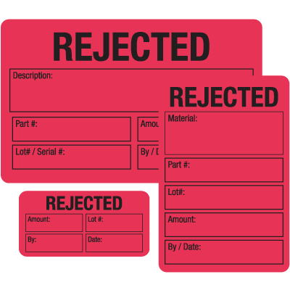
The label of quarantined raw material is just enough to carry name of material to identify material.
Yes
NO

Slide 33
Production and Process Controls
Written procedures are required to ensure that drug products have correct identity, strength, quality, and purity.
In-process samples taken from production batches periodically for product control.
(a) performed by production personnel at the time of operation
(b) performed by the quality control laboratory personnel to ensure compliance with all product specifications and batch-to-batch consistency.
If in-process product out the standards ??????

Slide 34
Packaging and Labeling Control
Written procedures are required for the issuance of labeling and packaging materials.
Labels must meet the legal requirements for content.
Each label must contain expiration dating and the production batch or lot number to facilitate product identification.
Appropriate stability testing used to determine expiration date to assure that a drug product meets applicable standards at the time of use.

Slide 35
- Exception for the requirement are homeopathic drug products, allergenic extracts, and investigational drugs (INA) that meet the standards established during preclinical and clinical studies.
In 1982, several consumers of OTC Tylenol capsules suddenly died of cyanide poisoning. An intensive investigation of the production records showed that this was not the result of a raw materials mix-up during manufacturing. Rather, tampering apparently occurred on store shelves.

Slide 36
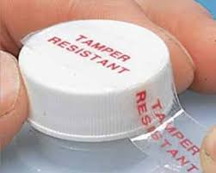
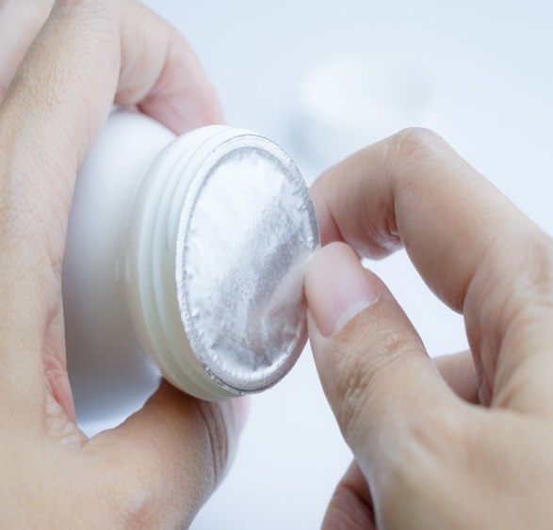
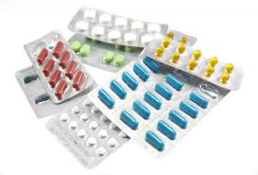
- A tamper-evident package is defined as “one having one or more indicators or barriers to entry which, if breached or missing, can reasonably be expected to provide visible evidence to consumers that tampering has occurred”. Some ex. Blister/strip pack, seal band for capsule, bottle seal, tape seal and aerosol container

Slide 37
Holding and Distribution
Written procedures must be established and followed for the holding and distribution of product.
Finished pharmaceuticals must be quarantined in storage until released by the quality control unit.
Products must be stored and shipped under conditions that do not affect product quality.
The oldest approved stock is distributed first.
The distribution control system must allow the distribution point of each lot of drug product to be readily determined to facilitate its recall if necessary.

Slide 38
Storage and distribution arrangements for the product:
(A) Are not the responsibility of the manufacturer once it has left his factory.
(B) Have no impact on product shelf-life or product quality.
(C) Have to be satisfactory as far as possible throughout the supply chain to ensure quality is maintained.
(D) Is the responsibility of government?

Slide 39
Laboratory controls
are requirements for the establishment of and conformance to: written specifications, standards, sampling plans, test procedures.
 The specifications, which apply to each batch of drug product,include:
sample size
test intervals
sample storage
stability testing
special testing requirements for parenteral, ophthalmic , controlled-release products, and radioactive pharmaceuticals.

Slide 40
Records and Reports
The master records of each batch must document that each step in the production, control, packaging, labeling, and distribution of the product was accomplished and approved by the quality control unit.
Equipment cleaning and use log.
Component, drug product container, closure, and labeling records.
Master production and control records.
Batch production and control records.
Production record review.
Laboratory records.
Distribution records. - Complaint files.

Slide 41
Additional cGMP Regulatory Requirements
Inspection of Bulk Pharmaceutical Chemicals (product components) to assure that all required standards for quality are met.
Because the quality of any finished pharmaceutical
product depends on the quality of the various components
GMP focuses on all elements of chemical purity and quality, including following:
 Specifications and analytical methods for components used to detect impurities or chemical
residues and limits set.
 critical chemical reaction steps and handling of chemical intermediates

Slide 42
Quality of water used.
Solvent handling and recovery systems
Effect of scale-up of chemical batches on
the yield
Stability studies of bulk pharmaceutical chemical
Biologics
the basic cGMP regulations for biologic products are similar to finished pharmaceuticals , with specific additional mandates

Slide 43
Medical Devices
devices are approved for marketing when shown to
be safe and effective through premarket approval.
The regulations for “good manufacturing practice for medical devices” are similar in organizational structure to those for finished pharmaceuticals. They include personnel; buildings; equipment; control of components; production and process controls; packaging and labeling; holding, distribution, and installation; device evaluation; and records
Medical devices are subject to the reporting of adverse events, to recall, and to termination of approval.

Slide 44
Devices covered by cGMP regulations include:
intraocular lenses, hearing aids, intrauterine devices, cardiac pacemakers, clinical chemistry analyzers, catheters, dental X-ray equipment, surgical gloves, condoms, prosthetic hip joints, computed tomography equipment, and wheel-chairs

Slide 45
Objectives
cGMP- Part 4
Determine the similarity and difference between pharmaceutical manufacturing and extemporaneous compounding
Describe the various types of packaging containers and their properties.

Slide 46
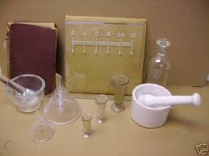
cGMP and cGCP
Pharmaceutical manufacturing is large-scale production of drugs or drug products for distribution and sale.
Compounding is professional preparation of prescriptions for specific patients as a part of the traditional practice of pharmacy.

Slide 47
The increase in preparing patient-specific medications, due to the following:
Many patients need drug dosages or strengths that are not commercially available.
2. Many patients need dosage forms, such as suppositories, oral liquids, or topical, that are not commercially available.
3. Many patients are allergic to excipients in commercially available products.

Slide 48
4. Children’s medications must be prepared as liquids, flavored to enhance compliance.
5. Some medications are not very stable and require preparation and dispensing every few days; they are not suitable to be manufactured products.
6. Home health and hospice care has resulted in new approaches to pain management and higher concentrations and combinations of drugs that are now used

Slide 49
Does the compounded drug in community pharmacy have required quality and meet standard specifications ?????
To ensure quality compounded products; consequently, many Standards-setting agencies since 1990 tried to establish guidelines for pharmaceutical compounding.

Slide 50
Chapters and monograph related to pharmacy compounding were developed and published in U.S. Pharmacopeia–National Formulary (USP-NP). They provide:
a tested, uniform formulation with valid beyond-use dating (Discard after).
Also, conditions and practices to prevent harm, including death, to patients that could possibly result from microbial contamination, excessive bacterial endotoxins, variability in the intended strength and composition, unintended chemical and physical contaminants, and ingredients of inappropriate quality

Slide 51
The Good Compounding Practices (GCP) applicable to State-Licensed Pharmacies”, developed by the National Association of Boards of Pharmacy
General Provisions and Definitions;
Organization and Personnel;
Drug Compounding Facilities;
(D) Equipment;
(E)Control of Components and Drug Product Containers and Closures;
(F) written procedures to ensure that the finished products are of the proper identity, strength, quality, and purity, as labeled
(H) Labeling Control of Excess Products; and Records and Reports.

Slide 52
According GCP, For component selection, handling and storage :
A- check safety and purity by means of certificate analysis, manufacturer reliability
B- use components and container before manufacturer expiration date
C- all components should be stored as directed by manufacturer or according to USP monograph
D- all the above

Slide 53
Comparing and contrasting between expiry date of pharmaceutical manufacturing and extemporaneous compounding.
Expiration Date
- The date at which a manufacturer can no longer guarantee the strength or safety of a medication
- Determined by the US Food and Drug Administration
- Based on testing a drug in specific conditions related to storage containers, lighting, temperature, etc.
- Usually the date given in “years” for commercial products
Beyond-Use Date
- The date when the compounded prescription should no longer be used
- Determined by the pharmacy when they fill a prescription
- Based on the type of drug, how fast it degrades, dosage, type of container, storage conditions, prescription length, the likelihood of contamination
- The dates are generally given in days or months

Slide 54
These maximum BUDs are recommended for non-sterile compounded drug preparations in the absence of stability information that is applicable to a specific drug or preparation.
USP CHAPTER <795> PHARMACEUTICAL COMPOUNDING— NON-STERILE PREPARATIONS
BUD | DOSAGE FORM
No later than the time remaining until the earliest expiration date of any API or 6 months, whichever is earlier. | Non-aqueous formulations
No later than 14 days when stored at controlled cold temperatures | Water-containing oral formulations
No later than 30 days. | Water-containing topical/ dermal and mucosal liquid and semi-solid formulations

Slide 55
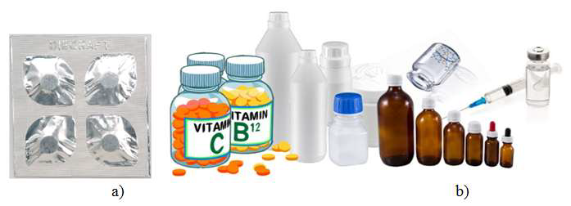
Proper Packaging, Labeling and storage of pharmaceuticals: are all essential for providing adequate product stability and efficacious use.
Containers:
According to USP, a container is “that which holds the article and is or in direct contact with article.” The immediate container is “that which is in direct contact with the article at all times.”
The closure is part of the container

Slide 56
Depending on the intended use and type of container, among the qualities tested are the following:
• Physicochemical properties.(eg. sorption of diazepam onto low density plastics)
• Light transmission for glass or plastic
• Drug compatibility
• Vapor transmission for plastics
• Leaching and/or migration
• Moisture barrier
• Toxicity for plastics
• Valve, actuator, metered dose, particle size, spray characteristics, and leaks for aerosols
• Sterility and permeation for parenteral containers
• Drug stability for all packaging

Slide 57
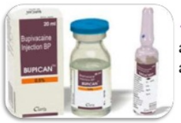
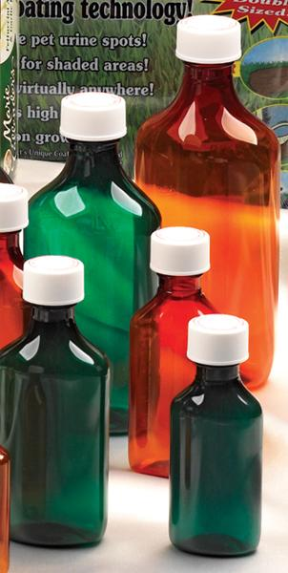
The USP classifies containers according to their ability to protect their contents from external conditions of handling, shipment, storage, and distribution:
Containers
Tight-closed
Hermetic
well-closed
is impervious to air or any other gas under the ordinary conditions.
Sterile hermetic containers hold preparations intended for injection or parenteral administration
protects contents
from solids and
from loss under
ordinary conditions.
protects contents from contamination by liquids, solids or vapors, or evaporation
under the ordinary
conditions
It is capable of tight re-closure

Slide 58
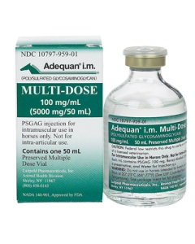
Single-dose container: when opened, cannot be resealed with assurance that sterility has been maintained.
These containers include
fusion sealed ampoules and
prefilled syringes and cartridges.
Multiple-dose container: is a hermetic container that permits withdrawal of successive portions of the contents without changing the strength or quality or purity of the remaining portion. These containers are commonly called vials.

Slide 59
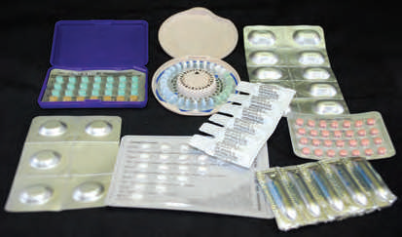
Unit-dose package (single-dose): (Avantages)
positive identification of each dosage unit and reduction of errors, reduced contamination of the drug, greater ease of inventory control in pharmacy and nursing station, and better management and less discarded medication .
The packaging materials may be combinations of paper, foil, plastic, or cellophane.
The packaging of solid
dosage forms in clear plastic or aluminum blister wells is perhaps the most popular single-unit packaging
Blister packaging of pharmaceuticals

Slide 60
Oral liquids may be dispensed in single units in paper, plastic, or foil cups or prepackaged and dispensed in glass containers having threaded caps or crimped aluminum caps.
disposable plastic oral syringes with rubber or plastic tips on the orifice for closure
Other dosage such as, suppositories, powders, ointments, creams, and ophthalmic solutions, are also commonly found in single-unit packages.

Slide 61
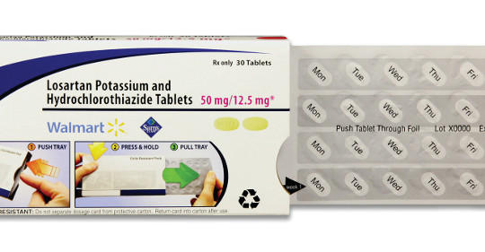
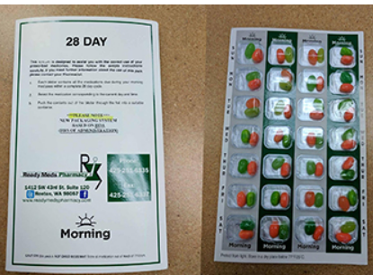
Unit–of- use packaging :
The quantity of drug product prescribed is packaged in a container Ex: if certain antibiotic capsules are prescribed to be taken 2 times a day for 10 days, unit-of-use packaging would contain 20 capsules. Other products may be packaged to contain a month's supply, such packaging “Compliance packaging” useful for patients taking multiple medications

Slide 62
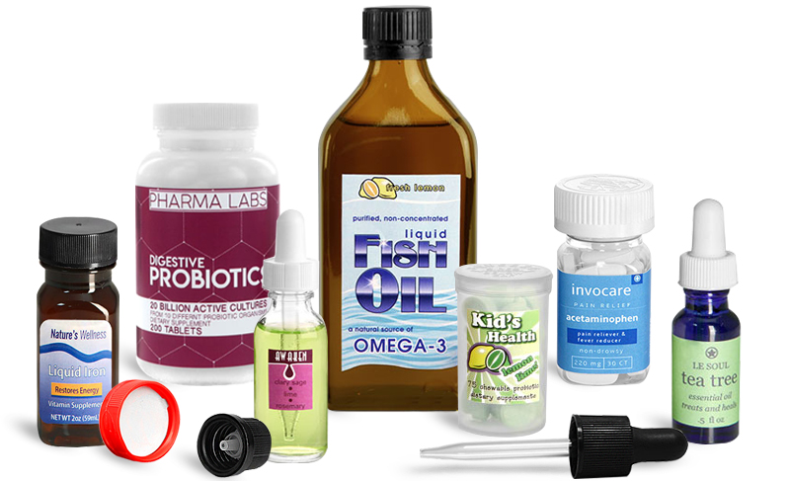
Light-resistant containers
Amber glass or a light-resistant opaque plastic will reduce light transmission sufficiently to protect a light-sensitive pharmaceutical.
Ultraviolet absorbers (ex Tinuvin®) may be added to transparent plastic to decrease the transmission of short ultraviolet rays.
USP standards that define the acceptable limits of light transmission at any wavelength between 290 and 450 nm.

Slide 63
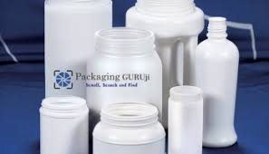
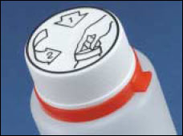
Recently, plastic packaging is the coextruded two-layer high-density polyethylene (HDPE) bottle, which has an inner layer of black polyethylene coextruded with an outer layer of white polyethylene. Increasingly being used in packaging of tablets and capsules. The container provides: light resistance and moisture protection.
Child-resistant & adult-senior use packaging
a container that is fitted with a closure that is significantly difficult by children under 5 years of age to open or to obtain a harmful amount of its contents within a reasonable time and that is not difficult for “normal adults” to use properly

Slide 64
Material Used For Manufacture Of Containers
There are mainly four types of material: glass, plastic , metal and rubber.
Glass used in packaging pharmaceuticals are four categories :
Types I, II, and III intended for parenteral products,
and type IV: NP is intended for other products.
Each type tested according to resistance to water attack.
Degree of attack is determined by amount of alkali
released from glass in specified test conditions.
leaching of alkali from glass to preparation could alter by pH and stability of product.
Type I is most resistant glass of 4 categories.

Slide 65
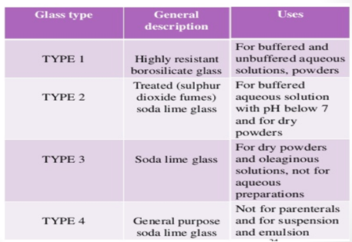
Constitution and description of official glass types

Slide 66
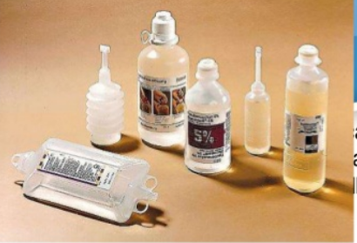
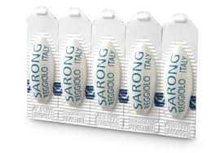
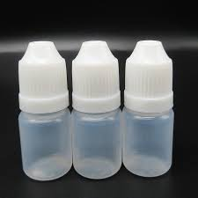
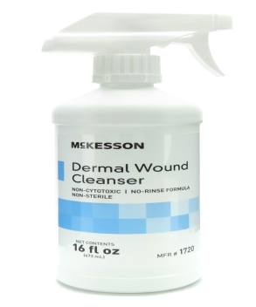
Today, most products are packaged in plastic.
 intravenous fluids, plastic ointment tubes, plastic film-protected suppositories, and plastic tablet and capsule vials.
The widespread use of Plastic containers arose from a number of factors:
1. The preference of plastic over glass due to: Lightness weight and resistance to impact, which reduces transportation cost and losses due to container damage

Slide 67
2. Versatility in container design, consumer acceptance
3. Consumer preference for plastic squeeze bottles in administration of ophthalmic, nasal sprays, and
lotions
4. The popularity of blister packaging and unit-dose
dispensing.
The physical and chemical alteration of the packaging material by the drug product is called modification. Example
polyethylene
+ methyl groups to every other carbon atom
Polypropylene
( can be
autoclaved)

Slide 68
chlorine atom is added to every other carbon
Polyethylene Polyvinyl chloride
(PVC)
PVC is rigid and has good clarity, making it particularly useful in the blister packaging of tablets and capsules. However, it has a significant drawback for packaging medical devices (e.g.,syringes): it is unsuitable for gamma sterilization.
Among the newer plastics are polyethylene terephthalate (PET), amorphous polyethylene terephthalate glycol (APET), and polyethylene terephthalate glycol (PETG). Both APET and PETG have excellent transparency and can be sterilized with gamma radiation.

Slide 69
Comparing plastic material to glass for packaging,
A- Glass is lighter with lowest cost for transportation
B- Glass is more mandible in design, modification and consumer acceptance
C- Both opaque plastic and amber glass can protect light sensitive drugs
D- Plastic can be used for packaging sterile products

Slide 70
Among problems encountered in the use of plastics in packaging are:
(a) Permeability of containers to atmospheric oxygen and moisture vapor
(b) leaching of the constituents of the container to the internal contents
(c) absorption of drugs from the contents to the container
(d) Transmission of light through the container
(e) Alteration of the container upon storage.
Agents frequently added to alter the properties of
plastic include plasticizers, stabilizers, antioxidants,
antifungal agents, colorants, and others

Slide 71
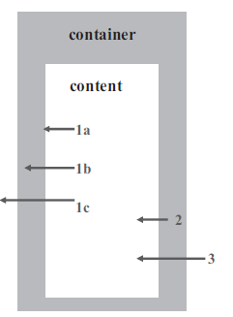
decrease of the activity due to an adsorption of the active substance
active ingredient degradation due to released substances
content precipitation
pH change due to a leaching of the material components
appearance change (color) due to a leaching of the material components
analytical interference during the determination of the active ingredient
safety change due to a leaching of the material components
(1a adsorption,
1b absorption ),
1c permeation
2 leaching (release)
3 permeability

Slide 72
The permeability of a plastic is a function of:
1. Nature of polymer;
2. the amounts and types of plasticizers, fillers, lubricants, pigments and other additives;
3. pressure; and temperature.
Increases in temperature, pressure, and the use of additives tend to increase permeability of plastic. Glass containers are less permeable than plastic containers.

Slide 73
Many products liable to deteriorate in humidity unless
protected by high-barrier packaging.
Desiccant silica gel in small packets, commonly included as protection against effects of moisture vapor.
Drug substances that are subject to oxidative degradation may undergo a greater degree of degradation when packaged in plastic than in glass.
Liquid in plastic may lose drug molecules or solvent to the container, altering the concentration of drug in product and affecting its potency.

Slide 74
 Leaching is term used to describe movement of components of container to contents.
 Compounds leached: polymer additives, such as the plasticizers, stabilizers, or antioxidants.
 The leaching occurs when liquids or semisolids are packaged in plastic. Little leaching occurs when tablets or capsules are packaged in plastic.
 influenced by temperature, excessive agitation of the filled container, and the solubilizing effect of liquid contents on one or more of the polymer additives

Slide 75
 Sorption indicate binding of molecules to polymer includes both adsorption and absorption.
 Sorption occurs through chemical or physical means.  Sorption may occur with active pharmacologic agents or with excipients.
 Sorption may be initiated by the adsorption of a solute to the inner surface of a plastic container.
 After saturation of the surface, the solute may diffuse into the container and bound within plastic container.
 Plastic materials with polar groups are prone to
sorption. Because sorption depends on penetration
or diffusion of a solute into plastic.

Slide 76
 un-ionized species of solute has greater tendency
to bound than ionized species. The degree of ionization of a solute affected by pH of solution, the pH may influence sorption of particular solute.
 The sorption of excipients :colorants, preservatives, or stabilizers would likewise alter the quality of product.
 Methylparaben may be sorbed to some types of plastics, resulting in a decrease in the available concentration of preservative.

Slide 77
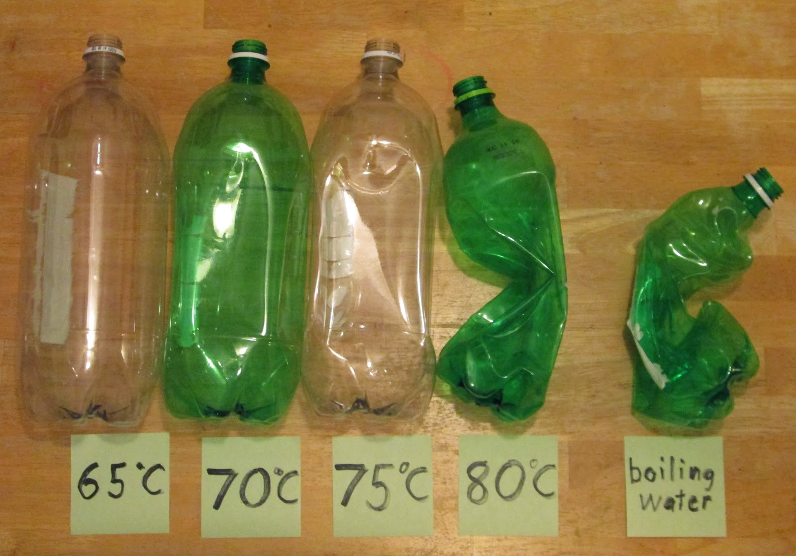
Deformations, softening, hardening, and other physical changes in plastic containers can be caused by the action of container's contents or external factors, including changes in temperature and physical stress placed upon the container in handling and shipping.

Slide 78
Match between column A and B
A-
1-Sorption
2- Permeability
3- light transmission
4- Softing and deformation
B-
a- can be prevented using amber glass
B- binding of drug or any excipient with container materials
C- may lead to deterioration of moisture sensitive drugs or formulations
D- occurs as a result of changing temperature

Slide 79
Pharmaceuticals labeling
All drug products distributed must meet labeling requirements: Investigational drugs, Manufacturer’s prescription drugs, Controlled substances, Dispensed prescription medication, OTC products, Products for animals, Medical devices.
In addition of labeling on the immediate container and packaging, manufacturers’ drug product insert:
Company literature
Advertising and promotional material (brochures, booklets, bulletins, sound recordings, price lists, catalogs, sound recordings, motion picture films, exhibits, and computer-accessed information etc.)
Important information for a prescription-only drug is provided to health professionals

Slide 80
Manufacturer’s Product Label
The information usually appearing on label affixed to the container is the following

Slide 81
The nonproprietary name of drug
The name of the manufacturer, or distributor of the product
A quantitative statement of the amount of each drug per unit of weight, volume, or dosage unit, whichever is most appropriate
The pharmaceutical type of dosage form constituting the product
The net amount of drug product contained in the package, in units of weight, volume, or number of dosage units, as appropriate
The logo “Rx only” or the federal legend “Caution—Federal law prohibits dispensing without prescription” or a similar statement

Slide 82
A label reference to refer to the accompanying package insert or other product literature for dosage and other information
Special storage instructions when applicable
The National Drug Code identification number for the product and a bar code
An identifying lot or control number
An expiration date
“Warning—May be habit forming” may also appear.

Slide 83
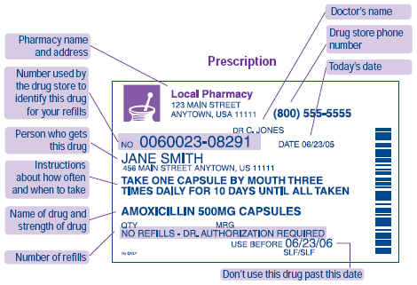
Prescription Label
When dispensing a prescription include the following information on the label of the dispensed medication:

Slide 84
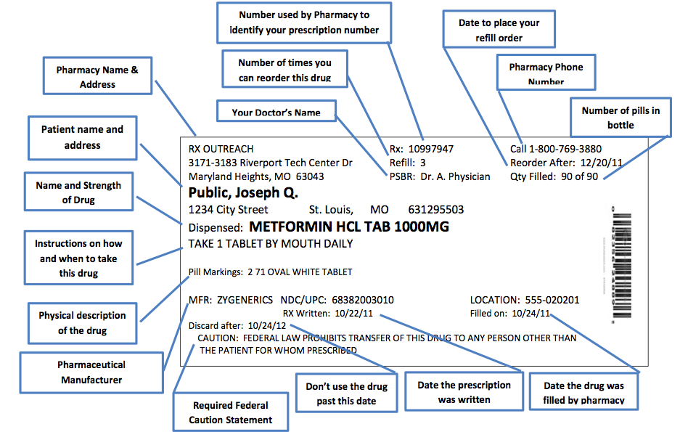

Slide 85
The name and address of the pharmacy
The serial number of the prescription
The date of the prescription or the date of its filling or refilling (state law often determines which date is to be used)
The name of the prescriber
The name of the patient
Directions for use, including any precautions, as indicated on the prescription
In addition, state laws may require additional information:
• The address of the patient

Slide 86
The initials or name of the dispensing pharmacist
The telephone number of the pharmacy
The drug name, strength, and manufacturer’s lot or control number
The expiration date of the drug
The name of the manufacturer or distributor
In an effort to decrease medication errors, there is thought to include the “indication” on the prescription label to help the pharmacist assure the prescribed drug is appropriate

Slide 87
Over- The-Counter Labeling
the name of the product, the name and address of the manufacturer or distributor, the quantity of net contents, the bar code and other product-identifying items, the
expiration date, and the other drug-specific required information

Slide 90
Over- the-counter labeling
Additional information, “drug facts” must appear in label
 Names and quantities of all active ingredients /dosage
unit. Inactive ingredients also listed.
 Statement of pharmacologic category (e.g., antacid, antihistaminic, analgesic, etc….)
 adequate directions for safe and effective use. Ex. dose, frequency of dose, dose and age considerations, route of administration, and preparation for use, such as shaking before use or dilution.
 Name of any substances in the preparation. Ex. sodium content for certain orally ingested product that contains 5 mg of sodium or more/single dose or 140 mg or more in maximum daily dose.  Storage conditions

Slide 91
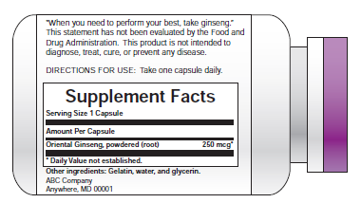
Dietary Supplement Labeling
A vitamin
• A mineral
• An herb or other botanical
• An amino acid
• A dietary substance for use
• A concentrate, metabolite, constituent,
extract, or a combination of any above ingredient
Disallows “disease claims” that infer or imply that the product can be used to prevent, treat, cure, mitigate or diagnose a disease

Slide 92
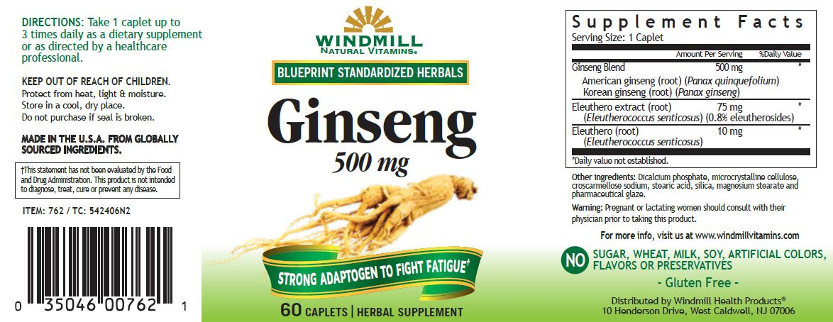
Dietary Supplement Labeling

Slide 93
Storage
 The product must be stored in proper conditions to ensure product stability during its shelf life.
 The labeling of product includes the desired storage conditions, and such terms employed (USP):
 Cold: Any temperature not exceeding 8°C.
-A refrigerator is a cold place in which the temperature is maintained thermostatically between 2° and 8°C.
-A freezer is a cold place in which the temperature is maintained thermostatically between -25° and -10°C.
 Cool: Any temperature between 8° and 15°C.
 Room temperature: The temperature prevalent in a working area which is ranged 20°C to 25°C. (but also allows for temperature variations between 15°C and 30°C.

Slide 94
 Warm: Any temperature between 30° and 40°C.
 Excessive heat: Above 40°C.
Protection from freezing: freezing subjects products to the risk of container breakage, loss of strength or potency, or to destructive alteration of dosage form
Transportation to and within geographic areas of extreme temperatures and humidity requires special consideration

Slide 95
Cold storage condition means that the temperature should be higher than 8°C
-Yes
-NO

