Slide 1
Industrial Pharmacy/Fifth Stage
Lecturer Dr.Nawar Michael
Lecture:8

Slide 2
Hard Gelatin Capsules
Capsules are solid dosage form in which medicinal agents and or inert substances are enclosed in a small shell of gelatin or other suitable materials.
The word capsule is derived from the Latin word capsula meaning a small box.
The capsule shell in addition to gelatin blend it may contain small amount of dyes ,opaquants to make them distinctive, plasticizer and preservatives

Slide 3
Hard Gelatin Capsules
There are two types of capsule hard and soft or better adjectives would be two -piece instead of hard and one- piece instead of soft
The hard capsules consist of two pieces in the form of cylinders closed at one end, the shorter piece called cap fits over the open end of the longer piece called body
The hard capsule contain solid drugs or powder while soft gelatin contain liquefied drugs
Capsule Parts

Slide 4
Hard Gelatin Capsules
Hard capsule is considered the second most popular solid dosage form behind the tablet and this can be attributed to many merits:
Elegance, ease of use and portability, accurate dosing
Easily swallowed ,slippery , tasteless shell for drugs and this is important for drugs with unpleasant taste or odor
Large scale production is possible in economic manner in wide range of colors

Slide 5
Hard Gelatin Capsules
More stable and have longer shelf life than their liquid counterparts
Can be used by pharmacist for extemporaneous compounding of prescription
Ready availability of the contained drug since minimal excipient and little pressure are required to compact the material as is necessary in tableting
Different release pattern can be obtained by change the content of capsules

Slide 6
Hard Gelatin Capsules
Gelatin is a substance of natural origin but does not occur as such in nature, it is prepared by the irreversible hydrolysis of collagen which is the main constituent of connective tissue
Animal skin and bones are the raw materials used for the manufacture
The physical and chemical properties are mainly functions of the parent collagen, method of extraction ,pH value, thermal degradation, and electrolyte content

Slide 7
Hard Gelatin Capsules
Accordingly we have two types of gelatin :
Type A derived from acidic treated precursors that exhibits an isoelectric point at pH9. It is manufactured mainly from pork skin
Type B derived from alkali treated precursors that exhibits an isoelectric point at pH4.7,it is manufactured mainly from animal bones

Slide 8
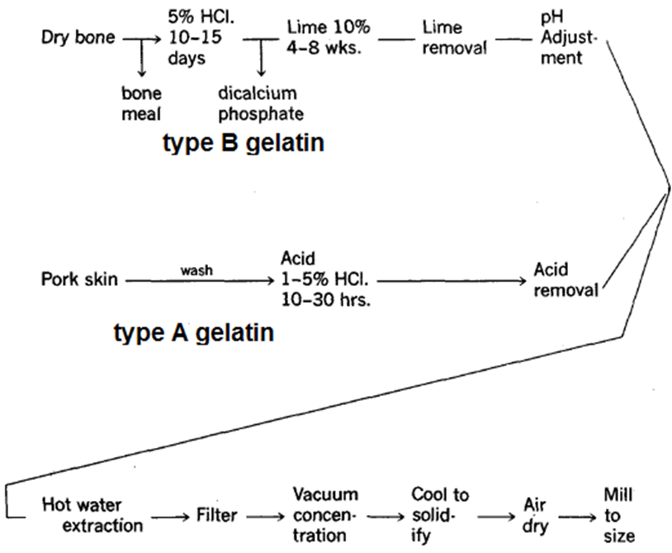
Hard Gelatin Capsules

Slide 9
Hard Gelatin Capsules
Hard capsules may be made by either type of gelatin , but practically mixture from both types are used
Blends of bone and pork skin gelatins of relative high gel strength
The bone gelatin produce tough ,firm film but tend to be hazy and brittle while pork skin gelatin contribute plasticity and clarity to the blend by reducing haze and cloudiness in the finished capsules

Slide 10
Hard Gelatin Capsules
Gelatin is considered the major component used for capsule manufacturing and the replacing polymers should have the same basic properties that make it suitable for capsule manufacturing
Non toxic
Readily soluble in biological fluid at body temperature

Slide 11
Hard Gelatin Capsules
It is good film forming material, can produce flexible strong film
Highly concentrated solution of about 40% is mobile at 50c° while other polymer are not
Gelatin solution in water undergo reversible change from solution to gel at temperature only a few degree above ambient.

Slide 12
Hard Gelatin Capsules
Gelatin is stable in air when dry but it is subjected to microbial growth when it become highly moist and preservative is optionally added
Normally hard capsule may contain 13to 16% of moisture which have plasticizing effect and don’t support microbial growth as it is strongly bonded to gelatin molecules
Recently hypromellose have been used to produce shell with low moisture content

Slide 13
Hard Gelatin Capsules
When it is stored in environment of high humidity additional moisture is absorbed by capsules and it will be distorted and lose their rigid texture
While in extreme dry condition the moisture already present is lost and the capsule become brittle

Slide 14
Hard Gelatin Capsules
Therefore it is desirable to maintain hard capsule in an environment free from excessive dryness and humidity
Capsules should not be used for efflorescent or deliquescent materials as the efflorescent material can soften the capsule shell while the deliquescent may dry the shell and make it brittle

Slide 15
Hard Gelatin Capsules
Manufacture of hard gelatin capsules involve many steps:
1-Dipping
2-Spinning
3-Drying
4-Stripping
5-Trimming and joining

Slide 16
Hard Gelatin Capsules
Dipping
Pairs of the stainless steel pins are dipped into the dipping solution (containing gelatin) to simultaneously form the caps and bodies.
The dipping solution contain concentrated gelatin solution(35-40%) and maintained at a temperature of about 50 C° in a heated ,jacketed dipping pan.

Slide 17
Hard Gelatin Capsules
Spinning
The pins are rotated to distribute the gelatin over the pins uniformly and to avoid formation of a bead at the capsule ends.
Drying
The gelatin Is dried by a blast of cool air to form a hard shell, the pins are moved through a series of air drying kilns to remove water.

Slide 18
Hard Gelatin Capsules
Stripping
A series of bronze jaws strip the cap and body portions of the capsules from the pins.
Trimming and joining
The stripped cap and body portions are trimmed to the required length by stationary knives , after trimming to the right length the cap and body portions are joined .

Slide 19
Hard Gelatin Capsules
The thickness of capsule wall is controlled by the viscosity of gelatin solution and speed and time of dipping.
Pin dimension ,precise drying, machine control cut length are critical parameters for final capsule dimension.

Slide 20
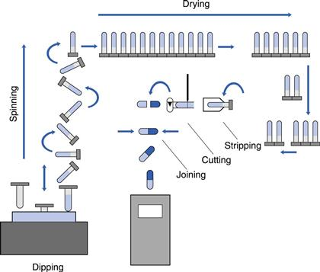
Hard Gelatin Capsules

Slide 21
Hard Gelatin Capsules
Capsule size
Empty gelatin capsules are manufactured in various lengths, diameters and capacities.
The size selected for use is determined by the amount of fill material to be encapsulated
The density and compressibility of the fill will determine the extent of its package into capsule shell

Slide 22
Hard Gelatin Capsules
Size of capsules
All capsules
with different
size share the
same traditional
symmetrical
bullet shape
size | Volume in ml | Size in mm
000 | 1.37 | 26.3
00 | 0.95 | 23.7
0 | 0.68 | 21.8
1 | 0.5 | 19.2
2 | 0.37 | 18.3
3 | 0.3 | 15.3
4 | 0.21 | 14.7
5 | 0.15 | 11.9

Slide 23
Hard Gelatin Capsules
Preparation of filled hard gelatin capsules:
The large or small scale preparation is divided into general steps:
1-Developing and preparing the formulation and selecting the capsule size.
2-Filling the capsule shell.
3-Capsule sealing
4-Cleaning and polishing the filled capsules.

Slide 24
Hard Gelatin Capsules
Hard capsules can be filled with a large variety of materials with different physicochemical properties, but certain limitations are present:
1- The substance should not react with gelatin(formaldehyde).
2- The substance should not interfere with the integrity of the shell.
3- large dose of low density formulations cannot be used.

Slide 25
Hard Gelatin Capsules
Accordingly, many substances can be filled inside hard capsules such as:
1-powder or granules
2-pellet mixture
3-paste
4-capsule
5-tablet

Slide 26
Hard Gelatin Capsules
Inserting tablets or small capsules into capsules is done for many reasons:
1- separate chemically incompatible agents.
2- add premeasured amount of potent drug.
Coated pellets designed to achieve modified- release drug are commonly placed inside capsule shell.

Slide 27
Hard Gelatin Capsules
For human use ,empty capsules ranging in size from 000 (the largest) to 5 (the smallest) are available
Larger capsules are available for veterinary use.

Slide 28
Hard Gelatin Capsules
Some non aquoes liquids ,such as fixed or volatile oils that do not interfere with the stability of gelatin shell can be added.
It is possible, rather than placing a liquid as such in capsule, the liquid mixed with inert powder to make a wet mass or paste which can be placed in capsules in usual manner.

