Slide 1
Industrial Pharmacy/Fifth Stage
Lecturer Dr.Nawar Michael
Lecture:1

Slide 2
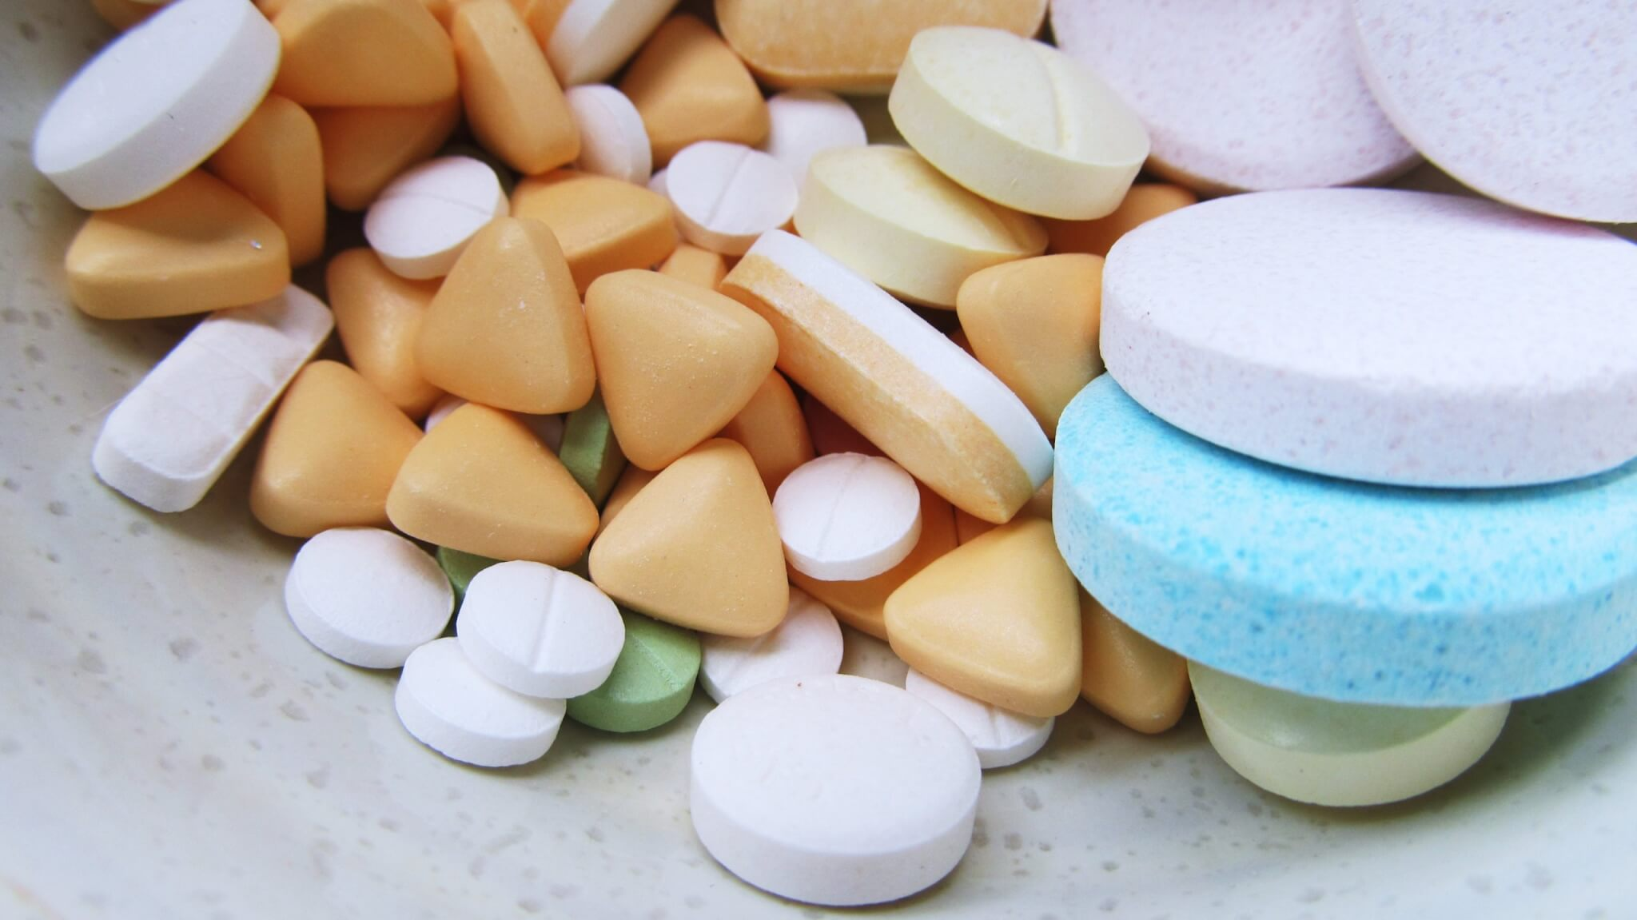
Oral Solid Dosage Forms(Tablets)

Slide 3
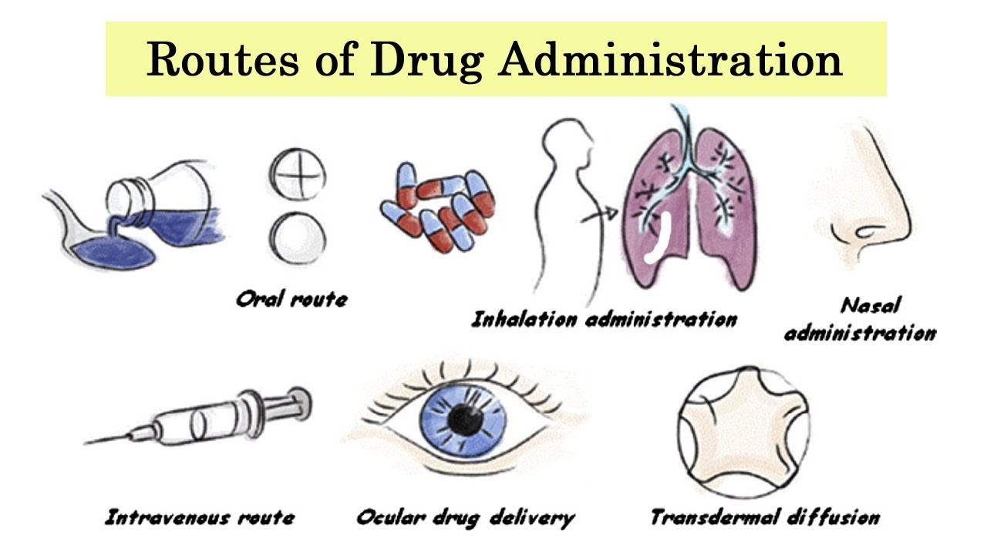
Introductory Concepts
Among different routes of administration , the oral route is considered the most common way.
Tablets is the most popular oral dosage form

Slide 4
Introductory Concepts
The term tablet derived from the Latin word (tabuletta) which is related to the appearance of the dosage form (small disc like)
In 1843 the first patent for a hand –operated device used to form a tablet was granted.
After that , the use of tablets as a dosage form increased gradually at small scale level.

Slide 5
Definition
Tablets defined as, solid preparations each containing single dose of one or more active ingredients and usually obtained by compressing uniform volume of particles.(other methods like molding and freeze drying are also used)
Tablets usually prepared with the aid of suitable pharmaceutical excipients.
It vary in size , shape, weight , hardness, thickness, disintegration ,and dissolution depending on its intended use and manufacturing method

Slide 6
Definition
Most tablets are used for oral administration, swallowed whole, or after being chewed, some are dissolved before administration, or retained in mouth
Tablets such as those administered sublingually ,buccally , or vaginally, are prepared to have features most applicable to their particular route of administration.

Slide 7
Definition
Tablets are used mainly to induce systemic effect, but sometimes for local drug action in the mouth or GIT, or to increase the pH of stomach temporarily.
For systemic use, the drug must be released from the tablet , dissolved in the fluid of the mouth ,stomach or intestine and absorbed by systemic circulation .

Slide 8
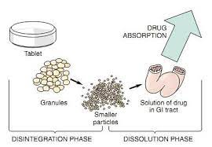

Slide 9

Advatages
Tablets are unit dosage form of great accuracy with least content variability
The cost of production is very low.
Easiest and cheapest dosage form to package and ship.
Portable dosage form due its light weight
Tablets are of high stability(physical ,chemical and microbiological) compared with other dosage forms

Slide 10
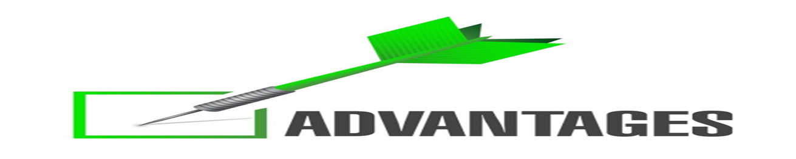
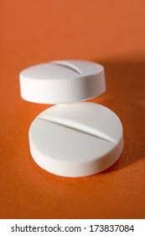
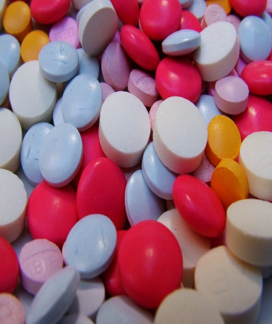
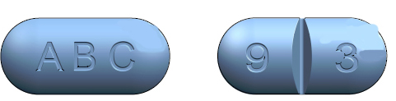
Product identification is easy when the tablet is colored ,scored ,or embossed
Different release profile can be obtained with tablets

Slide 11

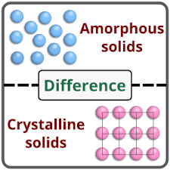
Disadvantages
Some drugs resist compression into dense compacts due to its amorphous nature or low density.
Drugs with poor wetting , slow dissolution properties, with window absorption (bioavailability problems) , intermediate to large dose or any combination of these features may complicate formation of tablets.

Slide 12

Disadvantages
Drugs with bitter taste, objectionable odor, or those sensitive to oxygen or atmospheric moisture may require encapsulation before compression or may require coating which impose additional cost, in such cases capsules is considered better alternative.

Slide 13
Stages of Tablet Formation
The tablets are prepared by directing particles into close proximity by powder compression.
The particles cohere into porous, solid specimen of defined geometry(compact).

Slide 14
Stages of Tablet Formation
Powder compression is the reduction in the volume or increasing density of powder owing to the application of a force.
Bonds are formed between particles which provide coherence to the powder and compact is formed.
Compaction is formation of solid specimen of defined geometry due to compression.
Is compaction part from compression?

Slide 15
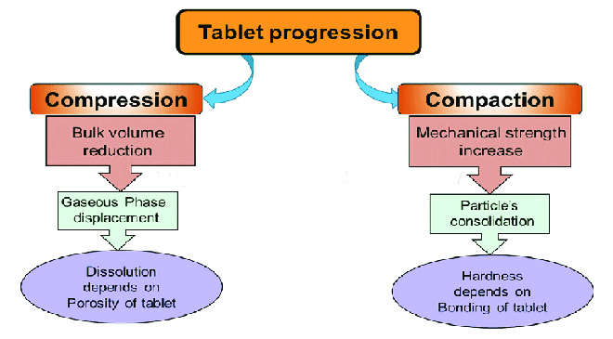
Stages of Tablet Formation

Slide 16
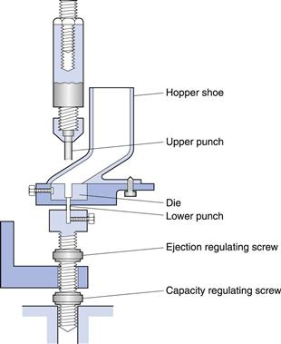
Parts of Tablet Machines

Slide 17
Types of Tablet Machines
1- Single-Punch Press
This type has one die and one pair of punches .
The output is about 200 tablets per minute
Its primary use is limited to the production of small batches during formulation developments and clinical trials

Slide 18
Types of Tablet Machines
2-Rotary Press
Also called multi-station press ,it is developed to increase the output of tablets and its main use is during large-scale production
It has multiple set of tableting tools up to 60 and the output can reach 10000 tablets per minute.

Slide 19
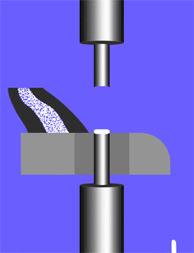
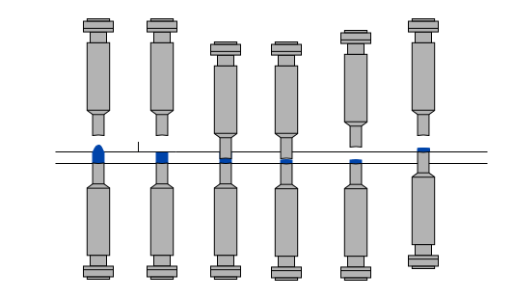

Slide 20
Stages of Tablet Formation
The process of tableting can be divided into three stages:
DDie Filling
By the effect of gravitational flow of the powder from hopper to die
Tablet Formation
The upper punch descends and enter the die, the powder compressed and the tablet formed, the lower punch can be stationary or move upward ,then the upper punch leaves the powder
Tablet Ejection
The lower punch rises until its tip reach the level of the top of the die,then the tablet removed from die

Slide 21
Types of Tablets According to Method of Administration
Oral tablets for ingestion
Tablets used in oral cavity
Tablets administered by other routes
Tablets used to prepare solutions
Compressed Tablets
Buccal tablets
Vaginal Tablets
Effervescent tablets
Multiple compressed
Sublingual tablets
Implantation tablets
Chewable tablets
Lozenges
Coated Tablets

Slide 22
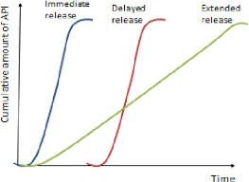
Types of Tablets According to Release Pattern
Another means of classifying tablets is based on the drug release pattern from the tablets into ,immediate release ,delayed release

Slide 23
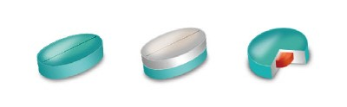
Oral Tablets for Ingestion
2- Multiple Layered Tablets:
These are compressed tablets made by more than one compression cycle
The result may be multiple layered tablet or a tablet within a tablet, where the inner tablet being a core and the outer portion being the shell

Slide 24
Oral Tablets for Ingestion
1-Compressed tablets:
These tablets are formed by compression and in their simplest form, contain no special coating.
They are made from powdered, crystalline, or granular materials, alone or in combination with binders, disintegrants, controlled-release polymers, lubricants, diluents, and in many cases colorants.
The vast majority of tablets commercialized today are compressed tablets, either in an uncoated or coated state.
Most of these tablets are intended to provide rapid disintegration and release to induce either local or systemic effect.

Slide 25
Oral Tablets for Ingestion
Layered tablets are prepared by initial compaction of a portion of a fill material in a die ,
followed by additional fill material and compression to form two or three layered tablet.

Slide 26
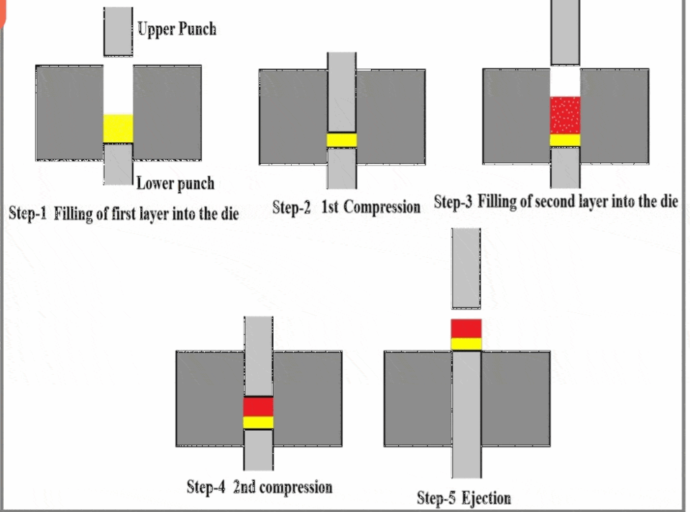

Slide 27
Oral Tablets for Ingestion
The tablet within a tablet are prepared by feeding previously compressed tablets into a special tableting machine and compressing another granulation layer around the preformed tablets.
Each layer may contain the same or different active ingredient.

Slide 28
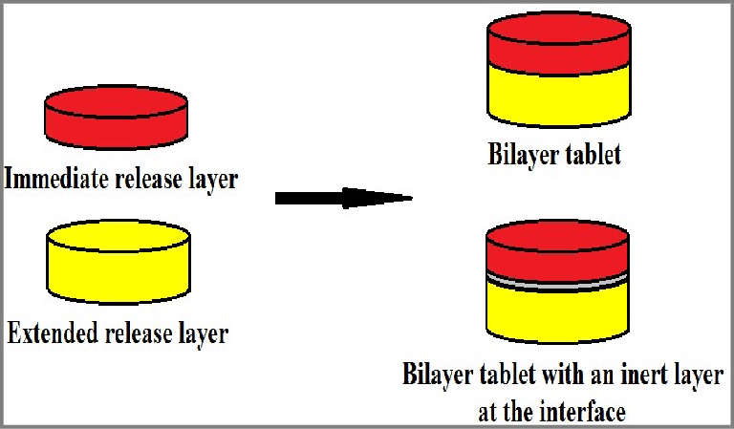
Oral Tablets for Ingestion
Layered tablets are prepared for many reasons:
1- Chemical or physical instability.
2- Staged drug release

Slide 29
Oral Tablets for Ingestion
If the mixing process is inadequate to guarantee uniform distribution of two or more active ingredients
Unique appearance of the of the layered tablet, as each layer has different color to produce distinctive-looking.

Slide 30
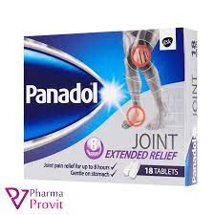
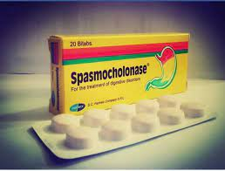
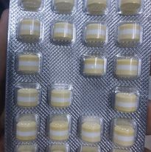
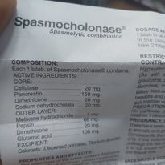
Oral Tablets for Ingestion

Slide 31
Oral Tablets for Ingestion
Disadvantages of the layered tablets:
1-release of part of sustained release layer with the immediate release
2- tablet hardness not enough
3-the tablet has tendency to laminate
4- large size difficult to swallow, and require complicated techniques in preparation.

Slide 32
Oral Tablets for Ingestion
3- Chewable Tablets
Have smooth ,rapid disintegration upon chewing (mechanical) ,.
The drug is normally not dissolved in the mouth but in stomach or intestine.
It can be used to induce local and systemic effect
Chewable tablets is very useful for administration of tablets to children or elderly with difficulty in swallowing solid dosage form without need of water.

Slide 33
Oral Tablets for Ingestion
Chewable tablets are similar in composition to conventional tablets except that the disintegrant is not included.
Flavoring and coloring agent such as mannitol and sorbitol are commonly used in this type of tablets.

Slide 34


