Slide 1
Industrial Pharmacy/Fifth Stage
Lecturer Dr.Nawar Michael
Lecture:9

Slide 2
Hard Gelatin Capsules
In developing a capsule formulation the goal is to prepare a capsule with certain criteria:
1-accurate dosage
2-good bioavailability
3-ease of filling and production
4- stable and elegant

Slide 3
Hard Gelatin Capsules
The majority of products for filling into capsules are formulated as powders.
These powders are typically mixtures of active ingredients combined with different excipients.
The easiest active compound to formulate are low dose potent ones (excipients governed)
The mixture properties of compounds of high unit dose are (active ingredients governed)

Slide 4
Hard Gelatin Capsules
Before filling , the active and inactive ingredients must be blended thoroughly to ensure a uniform powder mix for the fill.
Care in blending is important especially for low dose drugs. Since lack of homogeneity may lead to significant therapeutic consequences.
Preformulation studies are done to determine the efficiency of mixing.

Slide 5
Hard Gelatin Capsules
The resultant powder for filling should have the following properties:
1- good flow
2- cohesion
3- no adhesion

Slide 6
Hard Gelatin Capsules
The flow of resultant mixture must be adequate to ensure delivery of sufficient powder to the capsule at time of filling.
Demixing or segregation must not occur during the powder handling in the filling equipment itself.
To ensure good flow properties free flowing diluents and glidants are added.

Slide 7
Hard Gelatin Capsules
A diluent or filler may be added to the formulation to produce the proper capsule fill volume
In addition to provide bulk, diluents give cohesion to the powders which is beneficial in the transfer of the powder blend into capsule shell.
Lactose, microcrystalline cellulose , starch are commonly used diluents.

Slide 8
Hard Gelatin Capsules
When the space in the capsule is limited , then we can use either glidants or lubricants.
Glidants are materials that reduce interparticulate friction such as colloidal silicon dioxide
Lubricants are materials which reduce powder –metal adhesion such as magnesium stearate.

Slide 9
Hard Gelatin Capsules
Both these types of materials exert their effect by coating the surface of other ingredients.
The lubricants have waterproofing characteristics and thus can retard the penetration of gastrointestinal fluids and delay the drug dissolution and absorption
Disintegrants also added in capsule formulation to assist breakup and distribution of capsule contents in GIT fluids.

Slide 10
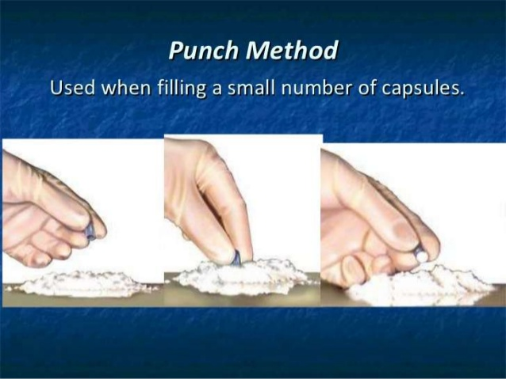
Hard Gelatin Capsules
Capsule filling: many methods have been developed for capsule filling
Punch method , or called Bench-scale filling ,when a small number of capsules are prepared in pharmacy this method is used , after powder mixing ,the capsule body held between thumb and forefinger and punched vertically into the powder until filled

Slide 11
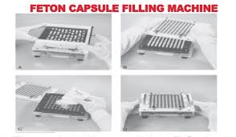
Hard Gelatin Capsules
Manual filling machine: this method used when the pharmacist prepare capsules on a regular or extensive basis , hand operating filling machine with capacities ranging from 24to 300 capsules.

Slide 12
Hard Gelatin Capsules
Industrial-scale filling
The machines for capsules filling come in great variety of shapes and sizes.
They can be semi or fully automated and ranging in output from 5000-150000 capsule per hour
The machine fill the bodies ,scrape off the excess powder ,seal the cap ,clean outside of cap

Slide 13
Hard Gelatin Capsules
The dosing system in these machine can be either dependent or independent system
Dependent dosing system use the capsule body directly to measure the powder, uniformity achieved by complete capsule filling
Independent dosing system, the powder measured in special measuring device independently of the body capsule.

Slide 14
Hard Gelatin Capsules
Capsule polishing
Small amount of powder may adhere to the outside of capsule after filling , which may be bitter or unpalatable and should be removed before packaging or dispensing
On small scale capsules may be cleaned individually or in a small number by rubbing them with clean gauze or cloth.

Slide 15
Hard Gelatin Capsules
On large scale , capsule filling machine with a cleaning vacuum that remove any extraneous materials from the capsule as they exit the equipment

Slide 16
Hard Gelatin Capsules
Special techniques may be applied to capsule as a dosage form such as:
1- Imprinting : is a method by which a company and or product identification can be placed upon each capsule which is best performed on empty capsule.
2-Special purpose capsule ; are capsule in which special treatment has been given in an attempt to retard the solubility in some manner.

Slide 17
Hard Gelatin Capsules
Sometimes delay absorption of active ingredients or enteric absorption is required hence therefore the solubility of gelatin modified by:
1- treatment with formalin
2- using certain coating which have the ability to affect gelatin solubility such as shellac and cellulose acetate phthalate?.

Slide 18
Hard Gelatin Capsules
Quality control of capsule should include the following tests
Capsule appearance (size , shape, color , thickness of capsule shell.
Weight variation
Content uniformity
Disintegration test
Dissolution test

Slide 19
Hard Gelatin Capsules
20 capsules are taken randomly and weighed , the average weight is calculated then each capsule is weighed individually and their weight noted.
The capsule is considered passes the test if the weight of individual capsule falls with in 90-110% of the average weight

Slide 20
Hard Gelatin Capsules
Content uniformity
10 capsules are assayed individually ,the capsules should contain _+ 15% or less of the labeled amount.
If one capsule is greater than +_ 15% then additional 20 capsule should be tested.
No capsule outside the range of +_25% of the labeled amount

Slide 21
Hard Gelatin Capsules
Disintegration Test
6 capsules are placed in the basket –rack assembly , which is repeatedly immersed 30times per minute into thermostatically controlled fluid at 37c and observed over time described in the individual monograph
All the capsules must disintegrate excluding the fragments from the capsule shell

Slide 22
Hard Gelatin Capsules
If1 or 2capsules fail to disintegrate the test should be repeated for additional 12 capsules ,not fewer than 16 of 18 capsules should disintegrate completely
The shell pieces after disintegration may agglomerate forming large mass of gelatin which delay the disintegration or may adhere to the mesh and blocking the holes.

Slide 23
Hard Gelatin Capsules
Dissolution test
Place each capsule in the apparatus 1, operate with a rate as specified in dissolution medium at 37c , aliquots should be withdrawn at specified time point
The amount dissolved should be as described in the individual monograph.

