Slide 1
Industrial Pharmacy/Fifth Stage
Lecturer Dr.Nawar Michael
Lecture:2

Slide 2
Oral Tablets for Ingestion
4- Coated Tablets: involve sugar coating and film coating and compression coating??????
Coating: is a process by which an essentially dry ,outer layer of coating material is applied to the surface of dosage form to confer specific function ranging from product identification to modifying drug release.
Coating may be applied to a wide range of oral solid dosage form including tablets ,capsules and multi-particulates system

Slide 3
Oral Tablets for Ingestion
Reasons for Coating:
1-protection of the active ingredients from the environmental factors ,like light moisture(enhance stability)
2-masking bitter taste of certain drugs
3- improve the ease of swallowing for large dosage forms
4-improving product identification and appearance
5-impating modified release characteristics (functional coating)

Slide 4
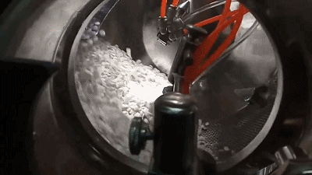
Automated spray coating equipment is employed, with high drying efficiency coating pan.

Slide 5
Oral Tablets for Ingestion
Sugar Coated Tablets:
These are compressed tablets surrounded by a sugar coating.
It involves the successive application of sucrose-based coating formulations to the tablet core in suitable coating equipment.
The water evaporates from the syrup leaving thick sugar layer around each tablet, which is often shiny and colored.

Slide 6
Oral Tablets for Ingestion
Sugar coated tablets has many demerits:
1-Sugar coated tablets easily mistaken as a candy
2- Time and expertise require in the coating process
3- Sugar coating may add 50% to the weight and bulk of the uncoated tablets.

Slide 7
Oral Tablets for Ingestion
Film Coated Tablets:
These are compressed tablets that
are covered with a thin layer of polymer film
A number of polymeric substances with film-forming properties may be used.
Film coating imparts the same general characteristics as sugar coating with the added advantage of a greatly reduced time period required for the coating operation, besides being more durable and less bulky.

Slide 8
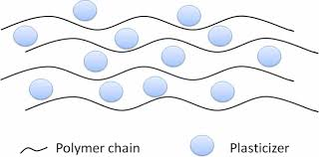
Oral Tablets for Ingestion
The majority of film-coating process involves the application of coating liquid where significant proportion of vehicle is removed by drying process which is concurrent with the application of liquid coating.
Film –coating formulations typically comprise:
1-polymer
2-plasticizer
3-colourants
4-vehicle/solvent

Slide 9
Oral Tablets for Ingestion
Types of Film Coating
1- immediate release film coating which has no effect on biopharmaceutical properties
2-modified release film coating which may be categorized into delayed release or extended release coatings

Slide 10
Oral Tablets for Ingestion
Aqueous solution of polymers such as HPMC and HPC provide immediate release ,
while colloidal dispersion of EC may provide sustained release
Enteric coatings resist dissolution in gastric fluid but disintegrate in the intestine
Enteric coatings can be used for tablets containing
drug substances that are inactivated or destroyed in the stomach, for those that irritate the mucosa or as a means of delayed release of the medication(antibiotics with high concentration undiluted)

Slide 11
Oral Tablets for Ingestion
The used polymer for enteric coating are natural or synthetic containing mixed acid functionality and acid ester functionality.
These polymer being insoluble at low pH, once the pH rise at intestine, they start to hydrate and the film rupture and dissolve.
Example on such polymers cellulose acetate phthalate, hydroxypropyl methyl cellulose phthalate , polyvinyl acetate phthalate

Slide 12
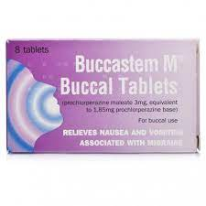
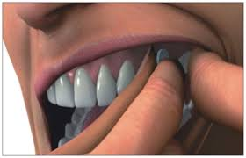
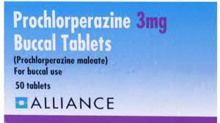
Tablets Used in Oral Cavity
1-Buccal Tablets:
These are small tablets intended for buccal administration by inserting into the buccal pouch
These tablets may dissolve or erode slowly; to provide effective time for absorption .

Slide 13
Tablets Used in Oral Cavity
Therefore, they are formulated and compressed with sufficient pressure to give a hard tablet.
Some newer approaches have employed materials that act as bioadhesives? to increase absorption of the drug.

Slide 14
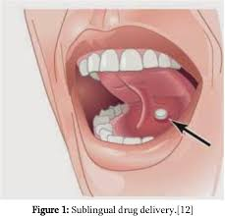
Tablets Used in Oral Cavity
2-Sublingual Tablets:
These tablets are placed under the tongue, dissolve rapidly, and the drug substances are absorbed readily by this form of administration
The drugs administered by buccal or sublingual tablets should have good absorption properties through oral cavity.

Slide 15
Tablets Used in Oral Cavity
Tablets administered by oral cavity avoid hostile environment of GIT and first pass effect, and provide rapid onset of action in case of (sublingual tablets).
Buccal and sublingual tablets should be formulated with bland excipients, which don’t stimulate salivation.

Slide 16
Tablets Used in Oral Cavity
3-Lozenges:
These type of tablets are intended to exert local effect in the mouth or throat
Mostly they contain , antibacterial, local anesthetic, antiseptic.
The drugs are incorporated in a flavored, hard candy base

Slide 17
Tablets Used in Oral Cavity
Lozenges may be prepared by compression ,but usually made by fusion or candy molding process
Lozenges are designed not to disintegrate but dissolve in mouth over a period of 30 minutes or less.

Slide 18
Tablets Administered by Other Routes
2- Vaginal Tablets:
are designed to undergo slow dissolution and release in the vaginal cavity.
the vehicle used are slowly soluble materials similar to that used in buccal tablets.

Slide 19
Tablets Administered by Other Routes
1- Implantation Tablets:
Or it may called depots, are designed for subcutaneous implantation.
The main purpose is to provide prolonged drug effect, ranging from one month to a year with constant drug release.
These tablets are small ,cylindrical , not more than 8mm in length, but of little use nowadays due to safety concern.

Slide 20
Tablets Used to Prepare Solutions
1-Effervescent Tablets:
Prepared by compression of the active ingredient with organic acid and sodium bicarbonate that release gas upon contact with water.
The used medicinal agents should dissolve rapidly when added to water

Slide 21
Tablets Used to Prepare Solutions
These tablets produced clear ,pleasantly flavored carbonated solution which mask the taste of certain drugs.
The selected drug and any additive used should be soluble at neutral or alkaline solution
The main advantage of effervescent tablet is considered easy method for extemporaneous solution preparation with accurate dose

Slide 22
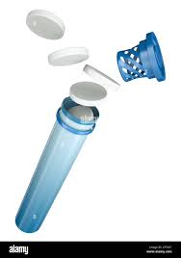
Tablets Used to Prepare Solutions
The major disadvantage of effervescent tablet, which limits its use widely is the difficulty of producing chemically stable product.
The moisture in the air during preparation can initiate effervescence reaction
After opening the container the subjection to moisture result in rapid loss of quality
Therefore they are stack-packed in cylindrical tubes with minimum air space.

Slide 23


