Slide 1
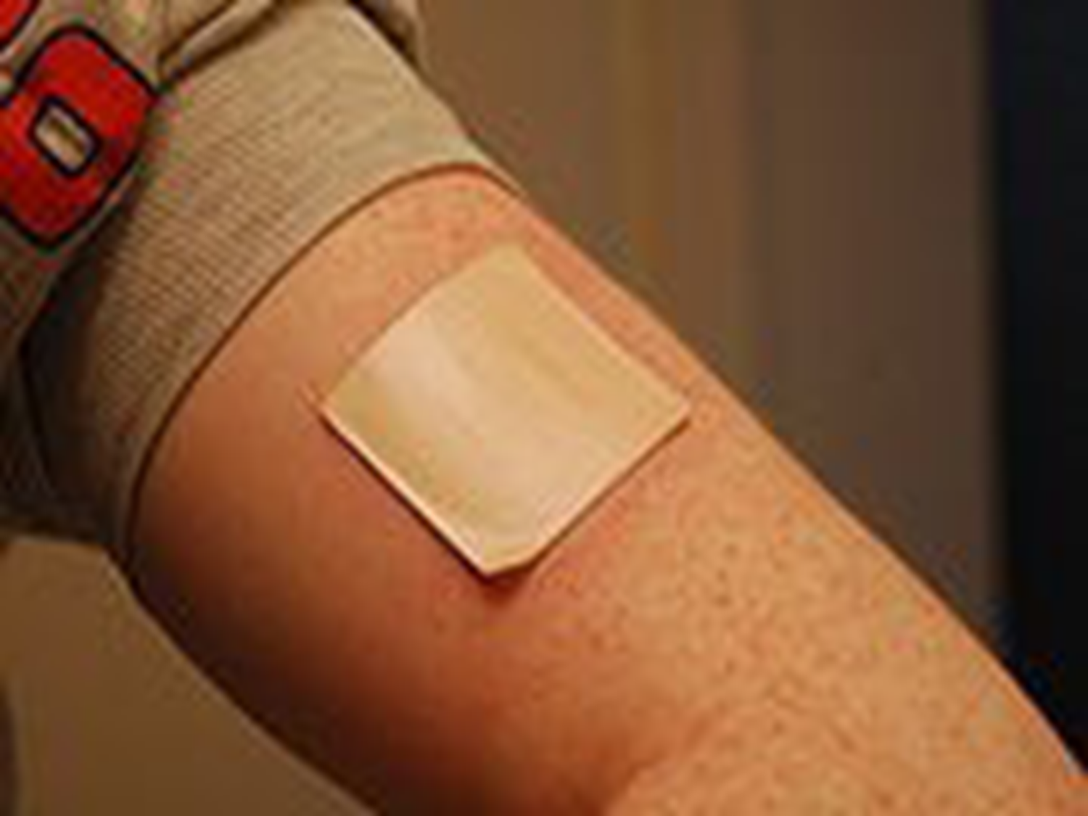
Industrial Pharmacy II
5th stage
Transdermal Drug Delivery System
Lecturer Dr. Nawar Michael
Lecture:10

Slide 2
Most efforts in drug delivery has focused on an oral route of administration for several considerations, namely: patient compliance and a high degree of flexibility on dosing.
The oral route is not without profound drawbacks posed by the hostile environment in the GIT in addition to the first-pass effect encountered directly after absorption, which constrains the administration of essential biologics orally

Slide 3
In 1979, with the introduction of a scopolamine transdermal patch for the prevention of motion sickness by Alza corporation, the era of transdermal drug delivery was started virtually and divert the conventional perspective towered the skin from topical use to alleviate dermal ailments into a promising site for percutaneous absorption

Slide 4
Transdermal drug delivery is a way to achieve a systemic effect by applying drugs topically; upon contact with skin, the drug proceeds to penetrate the epidermis passing through its different layers without localization reaching the dermal circulation to be accessible for systemic absorption

Slide 5
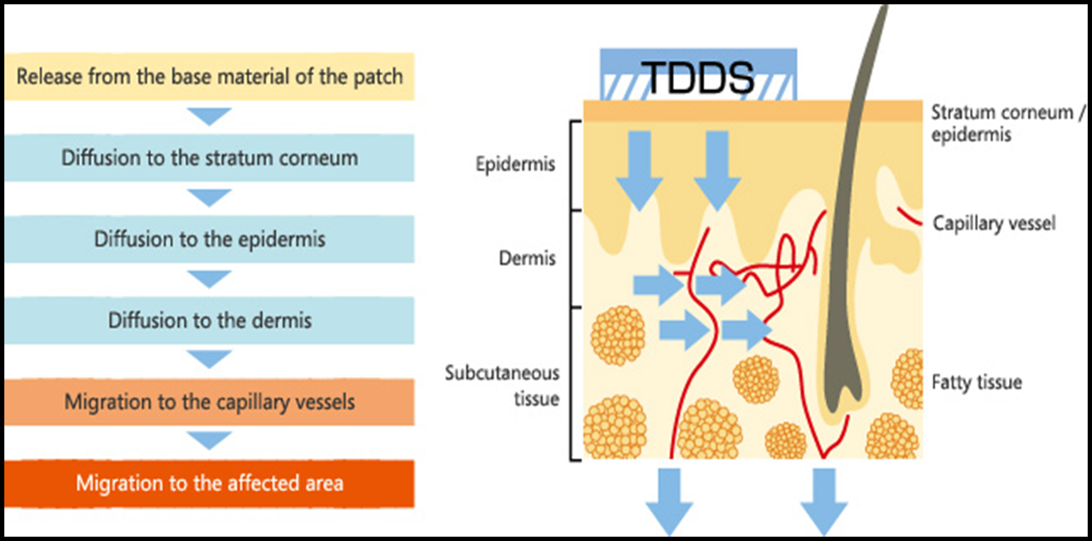

Slide 6
Besides being patient-friendly, transdermal drug delivery impart further merits such as:
escaping the first-pass metabolism
minimizing variation in drug blood concentration by controlled delivery over time
suitability as an alternative route whenever oral dosing is impermissible
the existence of antigen-presenting cells copiously in skin layers may render the skin as an upcoming site for vaccination

Slide 7
Despite these remarkable features, the number of drugs has been launched to the market is yet limited, which is an anticipated finding as a consequence of impermeable nature of skin which serves as a physiological barrier for the entrance of drug molecule

Slide 8

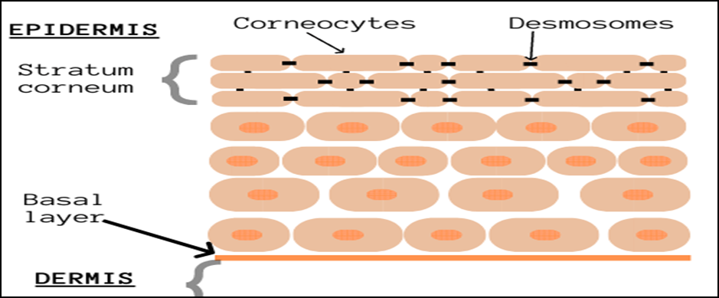
Drug
Blood
skin

Slide 9
Nevertheless, the market of transdermal drug delivery has attained substantial growth, which surpasses the oral route; therefore, considerable attention has been paid to overcome obstacles imposed by skin complex structure aiming to better utilization of skin as a route of administration

Slide 10
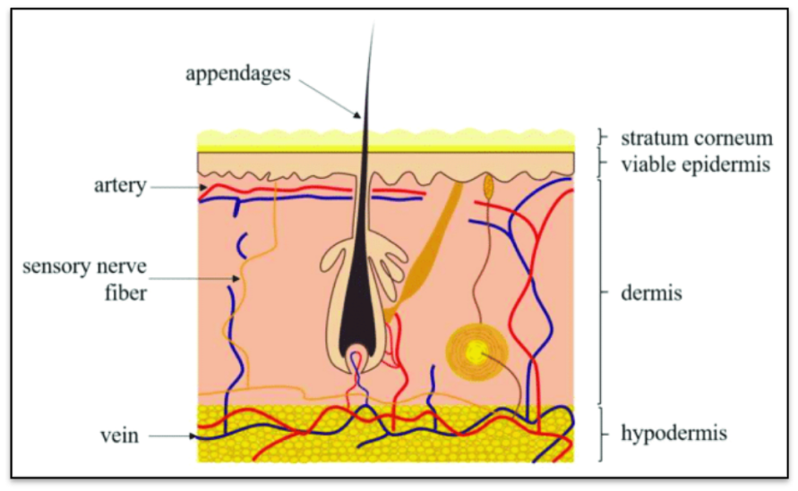
The skin is a multilayered organ with three distinguished layers which is from top to bottom: epidermis, dermis, and hypodermis

Slide 11
The uppermost layer epidermis is subdivided into the viable epidermis and superficial stratum corneum;
the major components of the viable epidermis are keratinocytes; furthermore, melanocytes and Langerhans cells also exist

Slide 12

Stratum corneum cells are keratin-rich cells called corneocytes which are terminally differentiated keratinocytes, polyhedral, acutely flatted, arranged in 15-25 layers with 10-15µm thickness in a dry state, pervaded with intercellular lamellar lipid bilayers consists of a mixture of ceramides, cholesterol, cholesterol esters.
The stratum corneum is organized in a unique style comparable to a wall of "bricks and mortar" afford the skin its defensive, impermeable properties

Slide 13
According to the heterogeneous skin anatomy, a drug molecule should penetrate the barrier of the stratum corneum to approach viable skin tissue through the well-acknowledged pathways, which are: intercellular route, transcellular route, and trans appendageal route

Slide 15
The intercellular pathway is considered the essential route for drug penetration, in which the drug molecules pass through tortuous, lipid-rich gaps around the corneocytes
The transcellular is direct path towered the dermis in which the penetrant molecules transported through corneocytes cytoplasm and extracellular lipid, the sequential series of partition and diffusion; inevitably, complicate the penetration process

Slide 16
The trans appendageal route has minor contribution in transdermal transport as it occupies only 0.1% of skin surface area
The penetrant molecules that overcome the stratum corneum barrier diffuse through viable epidermis towered the dermis where the blood and lymphatic vessels eventually remove the drug from the skin to be absorbed

Slide 17
The transport through stratum corneum is achieved by passive diffusion, and it is governed by Fick's law, as shown in equation.
dm/dt=D C_{o} K /h
where (dm/dt) is steady flux, (D) is a diffusion coefficient, (C_{o}) is the concentration of drug in solution, (K) is the partition coefficient of the drug, and (h) is the thickness of skin tissue; the flux of drug through the skin can be increased dramatically by manipulating the principal variables involved in the mentioned equation

Slide 18
Physicochemical Factors Affecting Absorption
1-Temprature and pH
The penetration rate of material through human skin can increase 10 fold by increasing temperature
Only unionized molecules pass across the lipid membrane.

Slide 19
Physicochemical Factors
2-Diffusion Coefficient
Represent the diffusional speed of a molecules which depend greatly on the drug properties and consider the measurement of molecules penetration rate
Some drug may bind to stratum corneum and become immobile

Slide 20
Physicochemical Factors
3-Drug Concentration
The flux of solute is proportional to its concentration according to Ficks law
Saturated solution may be obtained at selected concentration of drug by changing solvent

Slide 21
Physicochemical Factors
4- Partition Coefficient
The partition coefficient is essential in establishing the flux of a drug through stratum corneum
The optimal K well below which they are too water soluble to partition effectively into the horny layer
At high K the compound will be too lipid soluble and cannot pass through stratum corneum

Slide 22
Physicochemical Factors
5-Molecular Size
Transdermal absorption is inversely related to the molecular weight
Small molecules penetrate faster than large ones

Slide 23
Given the above considerations, the drug should meet specific criteria to penetrate the stratum corneum passively, which are:
low molecular weight <600 Da
it should have good solubility in water and oil with partition coefficient log p<3
the drug molecule should have potent pharmacological activity
low melting point as it is correlated to optimum solubility

Slide 24
Basic Components Of TDDS
Polymer matrix / Drug reservoir
Drug
Permeation enhancers
Pressure sensitive adhesive (PSA)
Backing laminates
Release liner
Other excipients like plasticizers and solvents

Slide 25
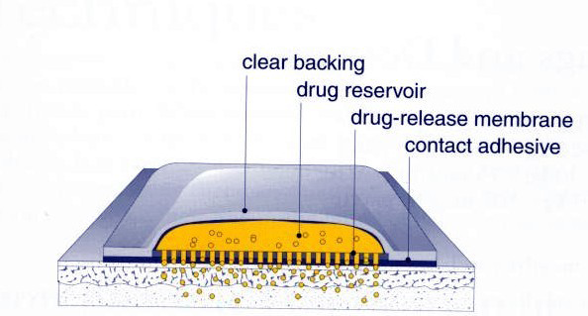

Slide 26
Polymer matrix / Drug reservoir
Polymers are the backbone of TDDS, which control the release of the drug from the device.
Polymer matrix can be prepared by dispersion of drug in liquid or solid state polymer base.
Polymers used in TDDS should have biocompatibility and chemical compatibility with the drug and other components of the system
The polymers utilized for TDDS can be classified as:
1-Natural Polymers: e.g. cellulose derivatives, and chitosan etc.
2-Synthetic Polymers: e.g. polyvinyl alcohol

Slide 27
Permeation Enhancers
These are the chemical compounds that increase permeability of stratum corneum so as to attain higher therapeutic levels of the drug candidate.
Penetration enhancers interact with structural components of stratum corneum i.e., proteins or lipids.
They alter the protein and lipid packaging of stratum corneum, thus chemically modifying the barrier functions leading to increased permeability

Slide 28
Pressure sensitive adhesives
A PSA is a material that helps in maintaining an intimate contact between transdermal system and the skin surface.
It should adhere with not more than applied finger pressure and exert a strong holding force.
Additionally, it should be removable from the smooth surface without leaving a residue.
Polyacrylates, and silicon based adhesives are widely used in TDDSs.

Slide 29
Other excipients
Various solvents such as chloroform, methanol, acetone, are used to prepare drug reservoir.
In addition plasticizers such as glycerol, triethyl citrate, polyethylene glycol and propylene glycol are added to provide plasticity to the transdermal patch

Slide 30
Transdermal transport can be enhanced passively either by traditional techniques, which essentially depend on horny layer modification and changing physicochemical properties of penetrant drug molecules, or through formulation optimization exploiting the expanding use of colloidal carriers

Slide 31
passive methods of enhancements do not achieve a significant increase in drug permeation as the skin preserve its barrier properties
plus the slow onset of action incurred due to lag time for reaching systemic circulation to elicit therapeutic effect

Slide 32
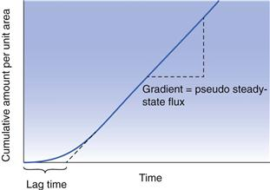

Slide 33
Active Enhancement Techniques
To accomplish better profit from the skin as a site of administration and to expand the number of drugs that deliver transdermally to include hydrophilic molecules and biologics, active methods of enhancement have been utilized
which in principle increase molecular kinetic energy across the skin or perturb skin barriers by physical means; generally, these methods can be assorted into electrical, thermal and mechanical methods

Slide 34
Electrical Based Techniques
Electroporation can increase skin permeability through the formation of transient holes in the lamellar lipids surrounding keratinocytes by application of high voltage electrical pulses for a short time, and this resulted in vast increase transport through skin even for large molecules up to 40kDa

Slide 35
Thermal Based Techniques
Laser Thermal Ablation
laser has found application in transdermal delivery without affecting the viable epidermis, and underlying tissue,
ablation of horny layer after subjecting to direct and precise laser beam have been reported,
the mechanism for ablation is ascribed to the heat generated from laser optical energy, which consequently forms micro-paths for the transport of molecules with different physicochemical properties

Slide 36
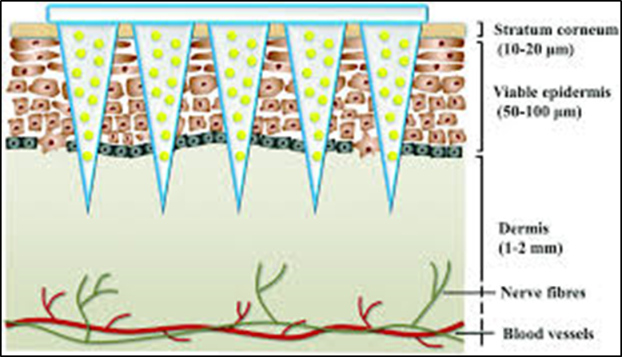
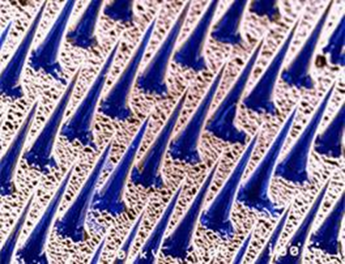
Microneedles(mechanical approach)
Microneedles are micron-scale tiny projections arranged in arrays supported by a baseplate, have the potential to bypass the stratum corneum
once applied to the skin, temporal micro conduits are created through which different varieties of drugs can be delivered to the systemic circulation
Microneedles unite the merits of hypodermic needles and transdermal patches in one package

Slide 37
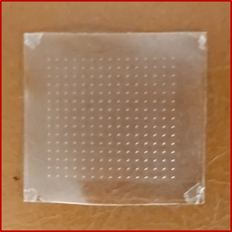
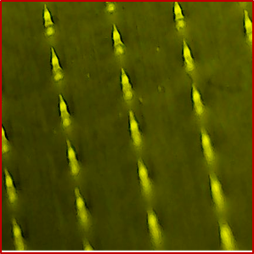

Slide 38
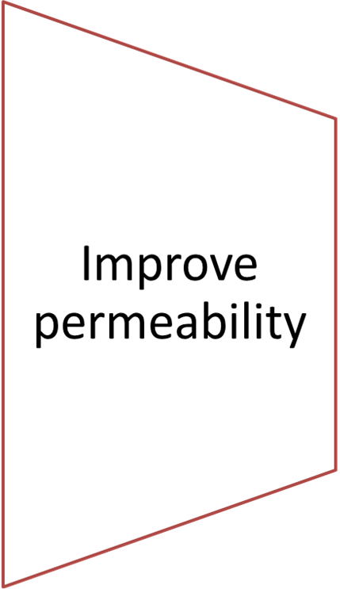
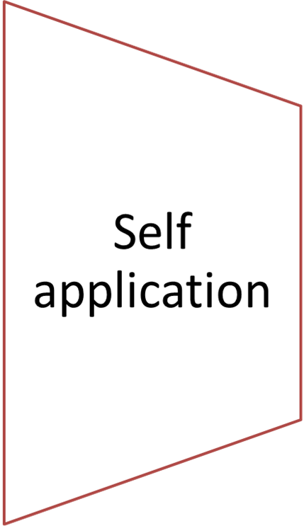
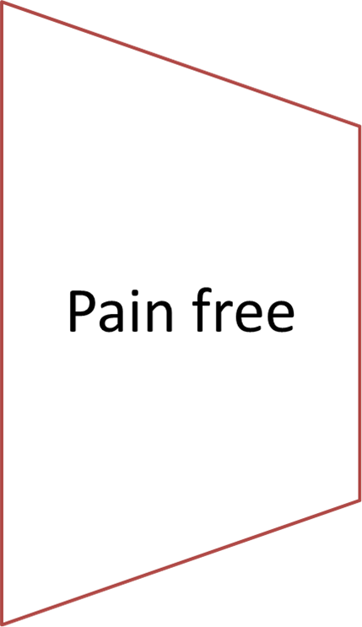
Microneedles have become a core of comprehensive research, and this is accountable to several properties

Slide 39
شكرا لمن تفانى, شكرا لمن حضر,اتمنى لكم مخلصا الموفقية والنجاح واني اتوسم فيكم السمو
والرفعة
د.نوار ميخائيل

