Slide 1
Industrial Pharmacy/Fifth Stage
Lecturer Dr.Nawar Michael
Lecture:7

Slide 2
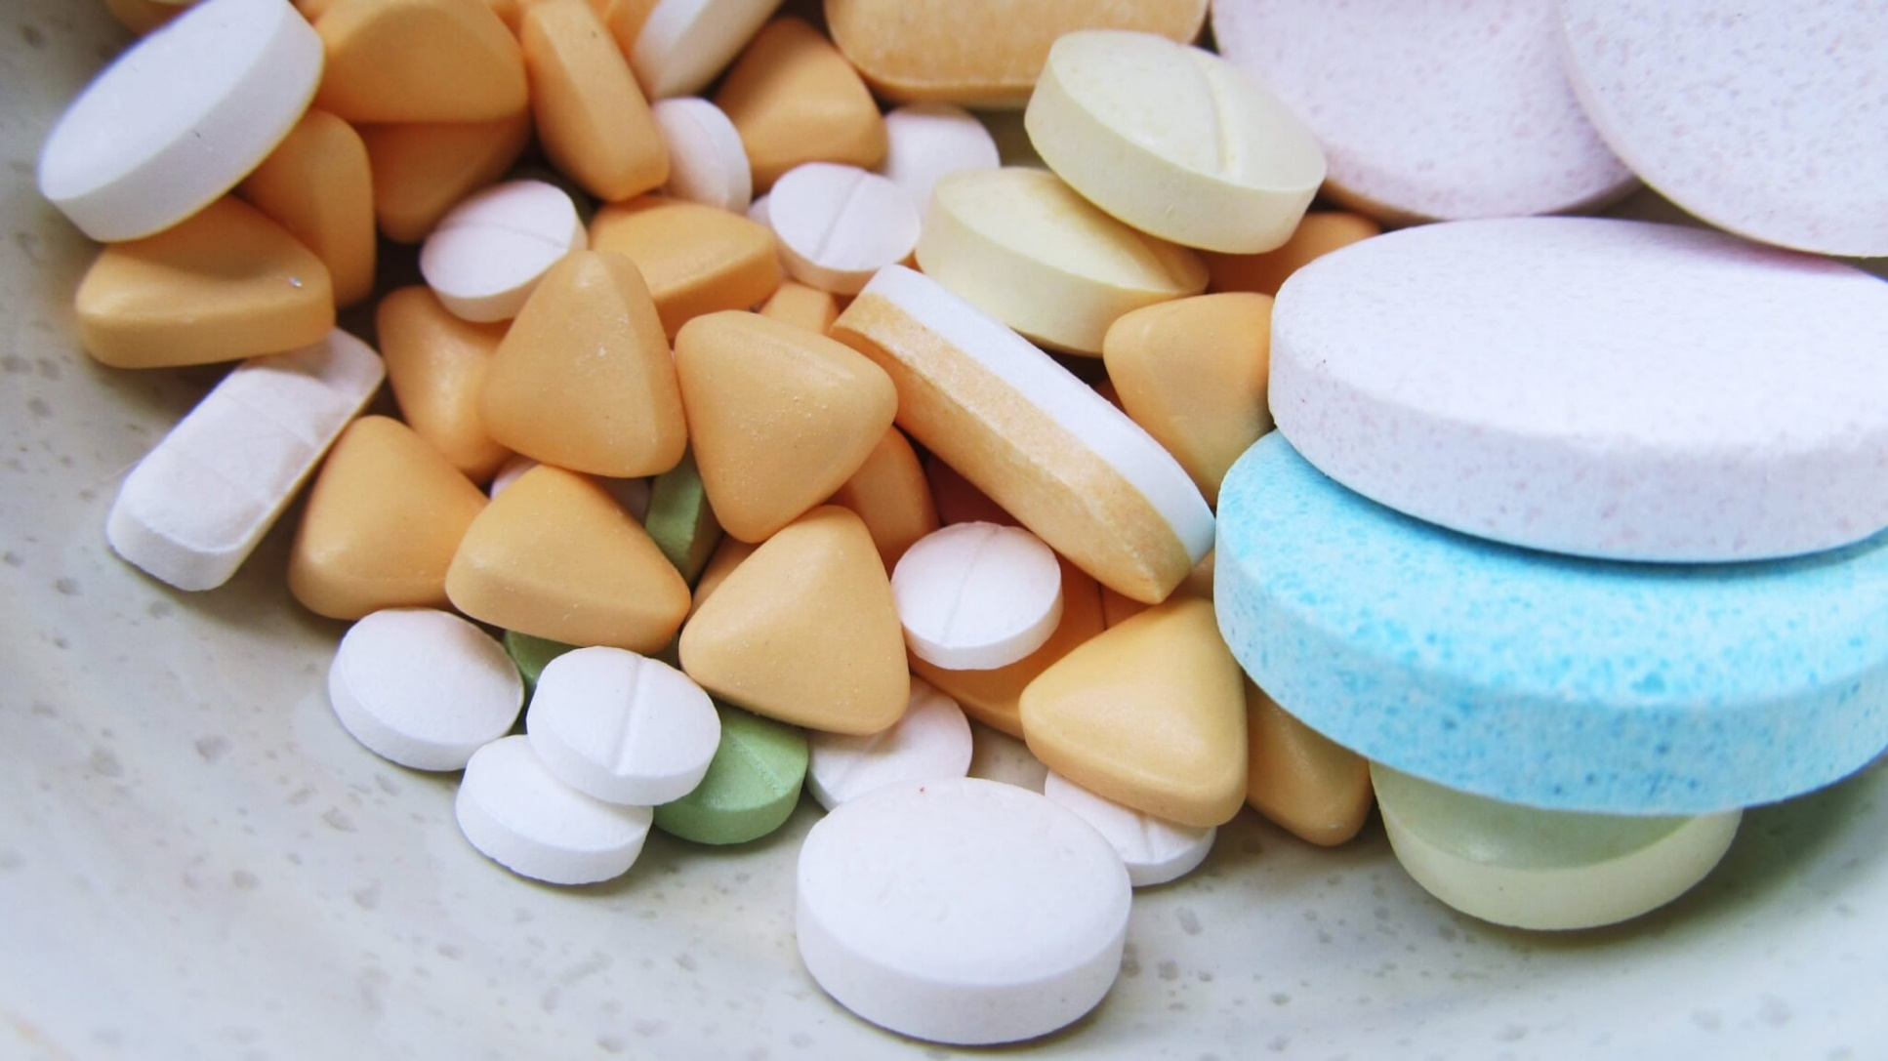
Oral Solid Dosage Forms(Tablets)

Slide 3
Tablet Evaluation and Quality Control
To design tablets and later monitor its quality, a quantitative evaluations of tablets and assessment of its physical, chemical and bioavailability properties must be made.
The tablets should be elegant, with sufficient mechanical strength, chemically and physically stable over time and must release its content inside the body in predictable manner.

Slide 4
Non official tests
General appearance
This test is of high importance for:
Consumer acceptance
Lot-to-lot uniformity
Tablet-to-tablet uniformity
Monitoring trouble free manufacturing
attributes such as size, shape, color ,presence or absence of odor and taste are monitored

Slide 5
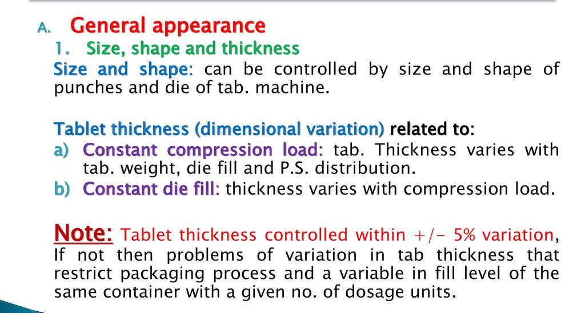
Non official tests

Slide 6
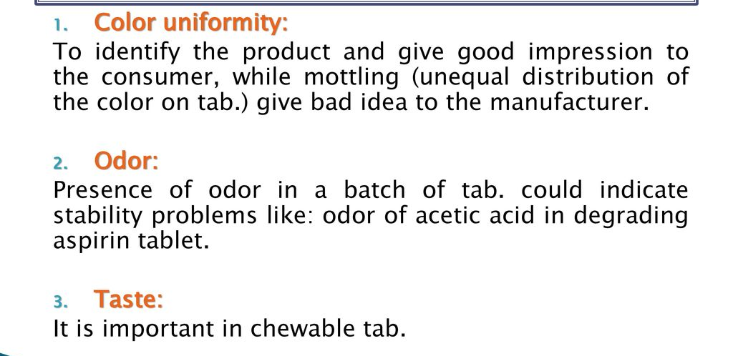
Organoleptic Properties

Slide 7
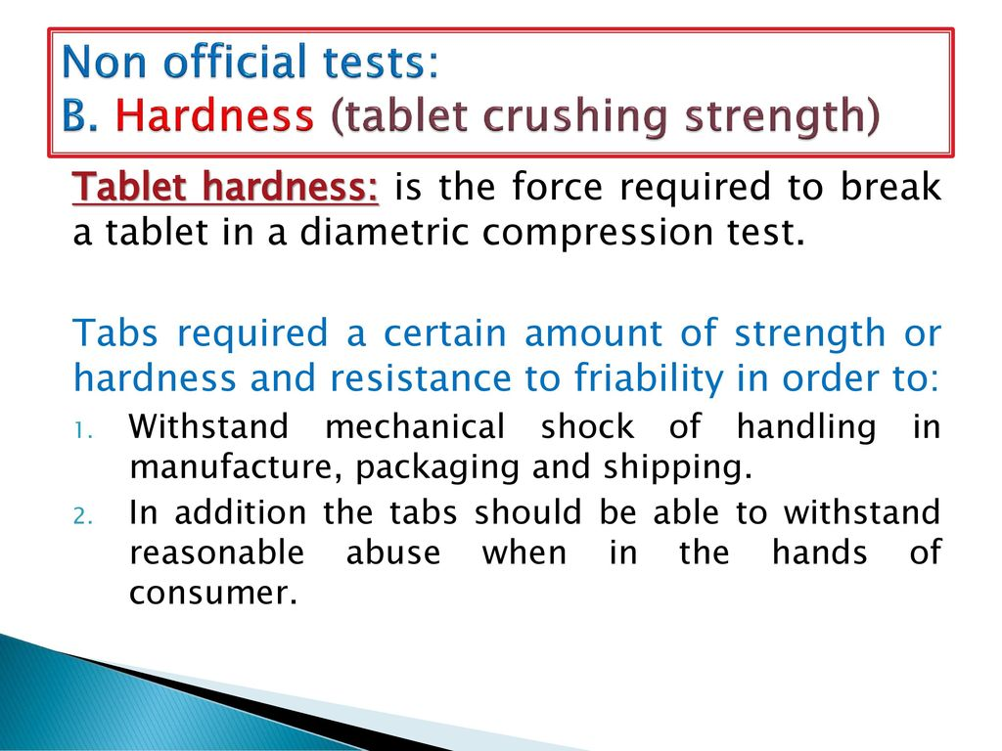

Slide 8
Non official tests
An apparent relationship between hardness and disintegration and more significantly to drug dissolution rate is present
Monitoring tablet hardness is therefore important for products that possess potential bioavailability problems, or sensitive to altered dissolution profile as a function of compression force used

Slide 9
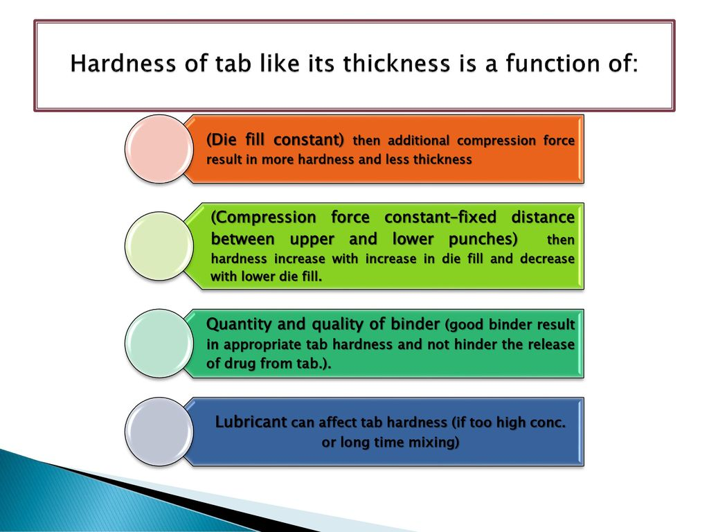
Non official tests? Why?

Slide 10
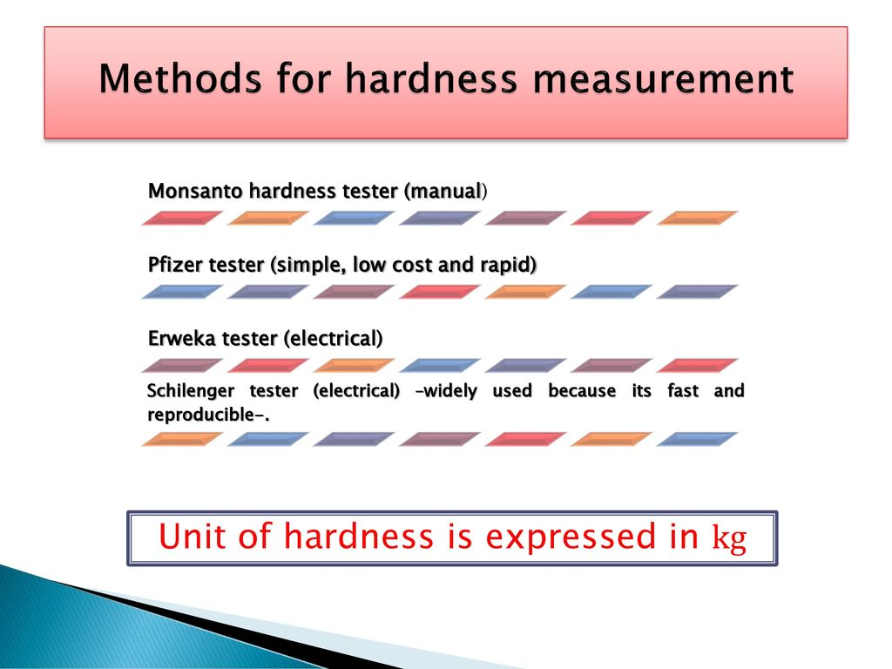

Slide 11
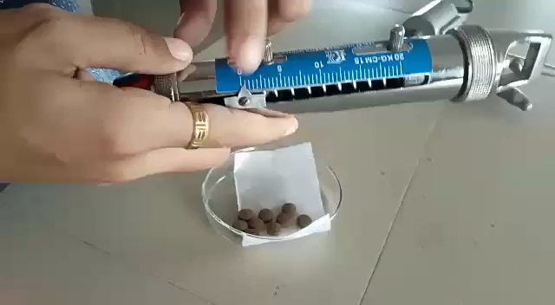

Slide 12
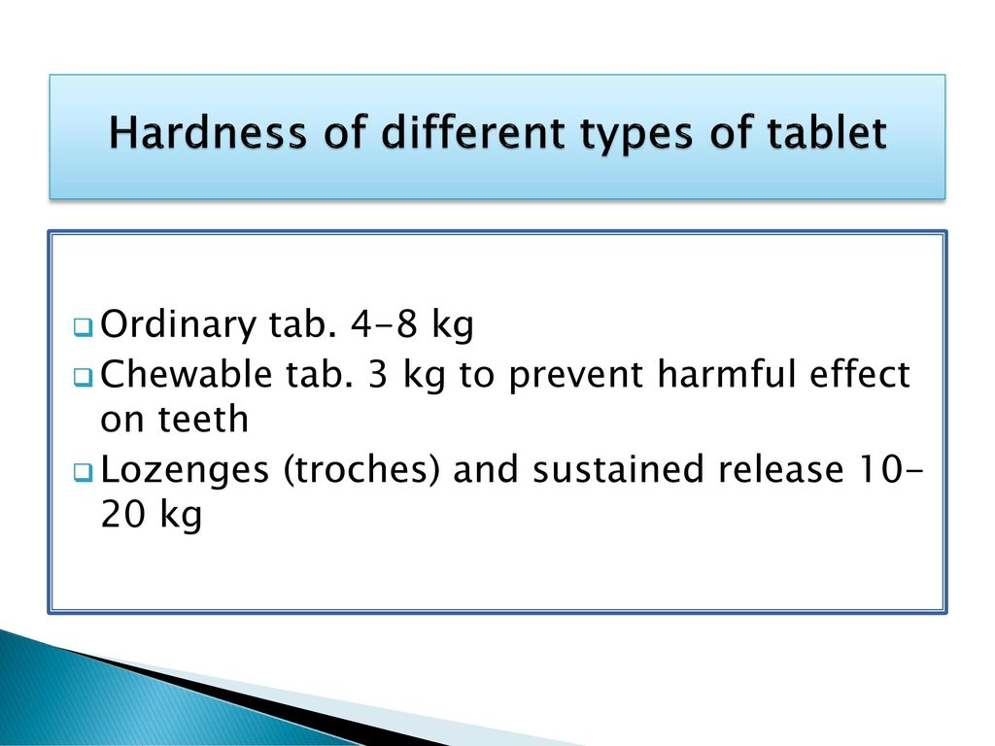

Slide 13
Non official tests
Tablet hardness is not an absolute indicator of tablet strength
Many tablets when compressed into very hard tablet tend to (cap) on attrition losing their crown portion
Therefore, another measurement of tablet strength is measured which is (Friability)

Slide 14
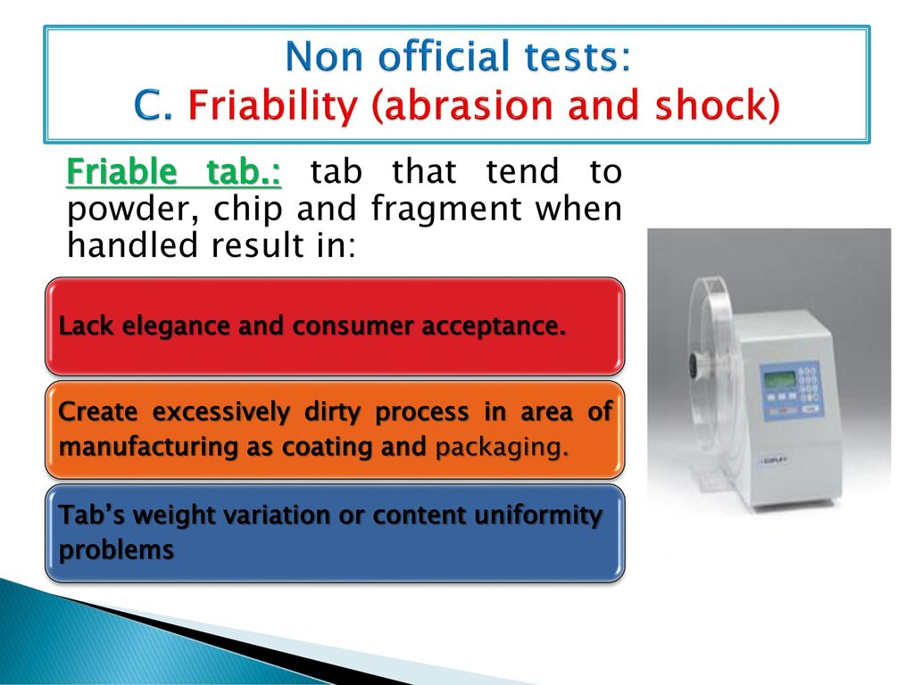
Non official tests

Slide 15
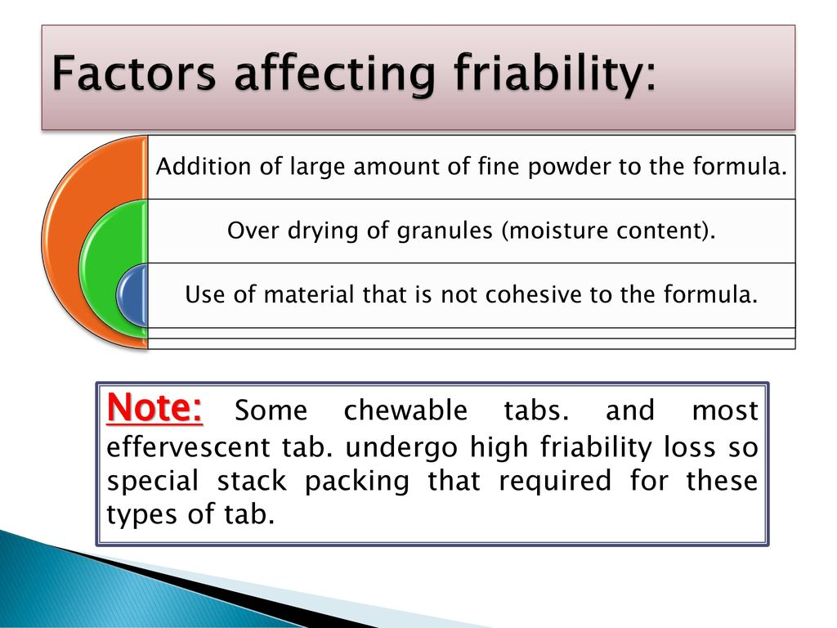

Slide 16
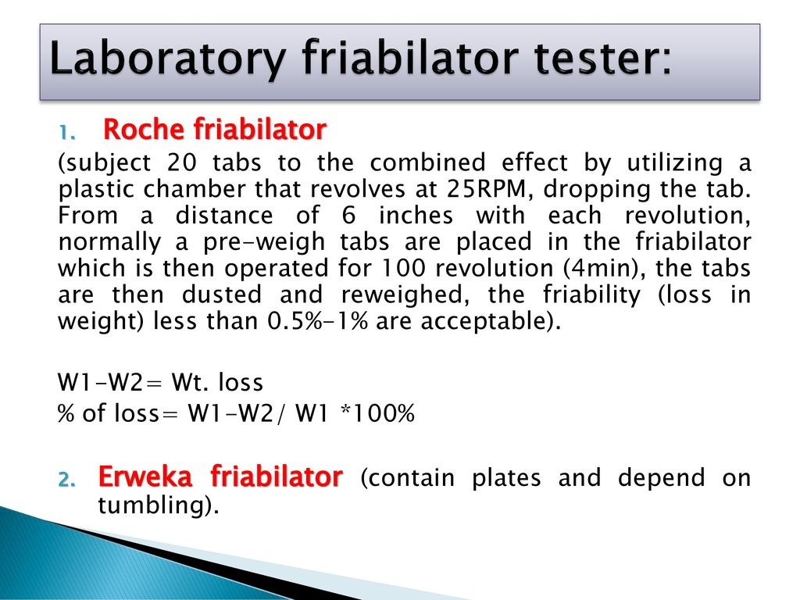

Slide 17


Slide 18
Official Tests(Drug content and release)
Physically sound tablet may not produce desired effect
To evaluate the efficacy of tablet , the uniformity of tablet need to be monitored from tablet to tablet and from batch to batch
Besides, the ability of tablet to release its content should be ensured

Slide 19
Official Tests
The uniformity of dose or dose variation between tablets is tested in two separate tests:
Uniformity of weight (weight variation)
Uniformity of active ingredient(content uniformity )

Slide 20
Official Tests(weight variation)
The weight of tablet is routinely measured to ensure that the tablet contains the proper amount of the drug.
The test for uniformity of weight is done by collecting a sample of tablets from a batch and determining their individual weight.
The average weight is then calculated ,the individual weight should not deviate from the mean more than is permitted in pharmacopeia

Slide 21
Official Tests(weight variation)
The USP weight variation test is run by weighing 20 tablets individually , calculating the average weight ,and comparing the individual tablet weights to the average.
The tablets meet the USP test if no more than 2 tablets are out side the percentage limit and if no tablet differs by more than 2 times the percentage limit

Slide 22
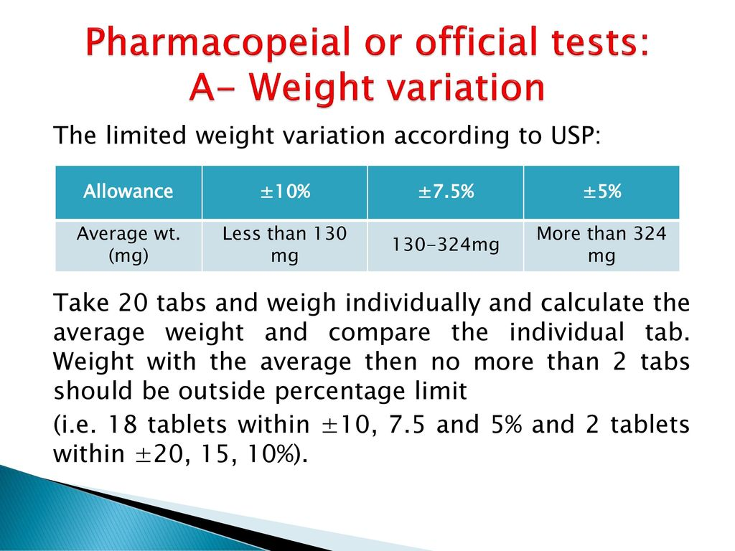
Official Tests(weight variation)

Slide 23
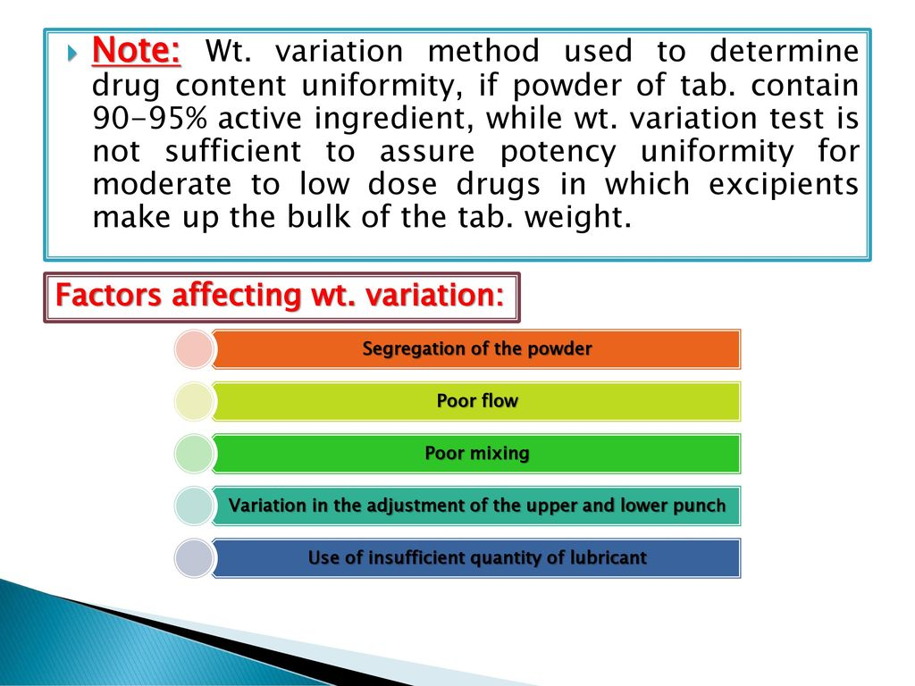
Official Tests(weight variation)

Slide 24
Official Tests(content uniformity)
The amount of drug per tablet should be evaluated from tablet to tablet and from batch to batch .
Factors such as segregation of powder mixture ,non uniform distribution due to poor mixing , tablet weight variation lead to variation in the content uniformity

Slide 25
Official Tests(content uniformity)
30 tablets are randomly selected from the batch and 10 tablets at least should be assayed individually
9 of 10 tablets must contain not less than 85% or more than 115% of the labeled drug content
The tenth tablet may not contain less than 75% or more than 125% of the labeled content

Slide 26
Official Tests(content uniformity)
If these conditions are not met the remaining 20 tablets should be assayed individually.
None may fall outside of the 85% to 115% range

Slide 27
Official Tests(Disintegration Test)
For drug to be absorbed it must be in solution ,the first step towered solution is breakdown into particles or granules in a process known as disintegration
Disintegration test measure the time required for number of tablets to rupture into particles under a set of conditions
Disintegration do not establish a correlation with in vivo behavior

Slide 28
Official Tests(Disintegration Test)
Acceptable disintegration test is not an indicator on acceptable release and uptake of the drug in vivo and obvious clinical effect
However , it is useful for assessing the importance of formulation and process variables on the biopharmaceutical properties of the tablet , and we can assume that a failed tablet in disintegration test is unlikely to be efficacious

Slide 29
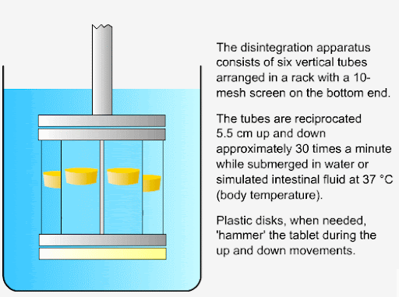
Official Tests(Disintegration Test)

Slide 30
Official Tests(Disintegration Test)
The disintegration media is usually water at 37°, in some monographs simulated gastric fluid is recommended
If 1or2 tablets fail to disintegrate, the test is repeated using 12 tablets ,of the 18 tablets tested ,16 must disintegrate within specified time

Slide 31
Official Tests(Disintegration Test)
The condition of test vary according to the type of tablet
Disintegration time are included in the individual tablet monograph
For most uncoated tablet the period is 30 minutes
It may vary for coated tablet the disintegration time may reach up to 2hours, while it is 3 minutes for sublingual tablets

Slide 32
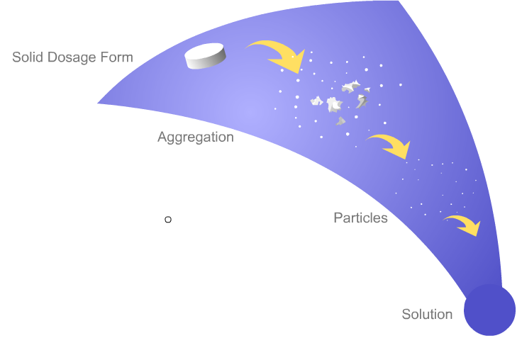
Official Tests(Dissolution Test)
Dissolution is the process where a solid is introduced into a solvent to yield a solution. Solid oral dosage forms, typically tablets and capsules, are swallowed. Then the tablet begins to disintegrate into large irregular pieces which then further de aggregate into particles. Dissolution begins when the particles are small enough to pass into solution and continues until the tablet has dissolved

Slide 33
Official Tests(Dissolution Test)
For a tablet with poorly soluble drug determination of dissolution rate is more important than measuring disintegration time
The dissolution test measure the time required for a certain percentage of drug substance in a tablet to go into solution under specified set of conditions (in-vitro release test)
The most direct assessment of drug release is in vivo bioavailability study

Slide 34
Official Tests(Dissolution Test)
Accordingly, dissolution test is extensively studied as indirect measurement of drug bioavailability especially in preliminary assessment of formulation and process factor that may influence bioavailability
In vitro-in vivo correlation is relate the correlation between in vitro dissolution and the release and the uptake of the drug in vivo

Slide 35
Official Tests(Dissolution Test)
Two objectives in the development of in vitro dissolution test:
The release drug from the product is as close as possible to 100%
The release is uniform from batch to batch
All factors affect dissolution process should be considered (solubility , temperature, composition of dissolution medium, sink condition)

Slide 36
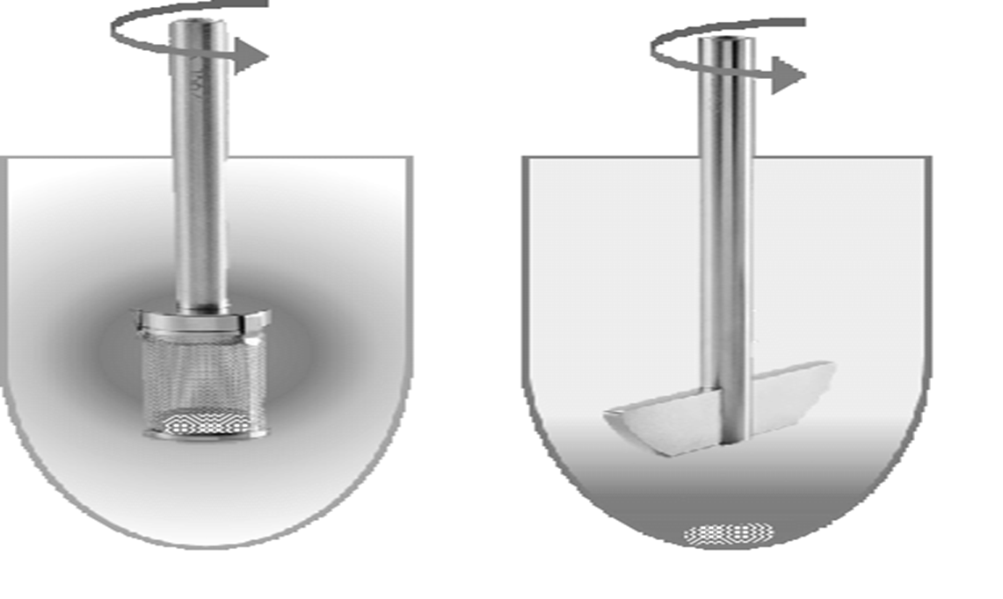
Official Tests(Dissolution Test)
Usually either of two dissolution apparatus are used to determine dissolution rate .apparatus I(basket) and apparatus II (paddle)

Slide 37
Official Tests(Dissolution Test)
The tablet are located in the apparatus chamber which contain previously added dissolution medium, pre-warmed to 37°
Then the stirrer rotated at specified speed
At stated interval the sample are withdrawn from the medium for analysis of the portion of the drug dissolved

Slide 38
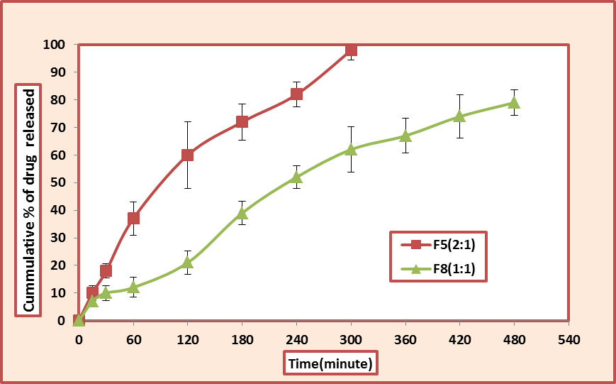

Slide 39


