Slide 1
Industrial Pharmacy/Fifth Stage
Lecturer Dr.Nawar Michael
Lecture:3

Slide 2
Types of Tablets According to Release Pattern
Most medicines administered by the oral route provide what is known as immediate-release’ drug delivery or conventional’ drug delivery.
Some limitations are associated with conventional drug delivery which are:
The concentration of drug in the plasma and hence at the site of action of the drug fluctuates over successive dosing interval
As a result of the fluctuation, the patient being over or under-medicated
For drugs with short biological half life frequent dosing are required to maintain steady state concentration within therapeutic range.

Slide 3
Types of Tablets According to Release Pattern
Modified-release drug delivery refers to the
manipulation or modification of drug release from a dosage form (e.g. tablet, pellet, capsule) with the specific aim of delivering active pharmaceutical ingredients (API) at:
1. desired rates
2. pre-determined time points, or
3. specific sites in the gastrointestinal tract.

Slide 4
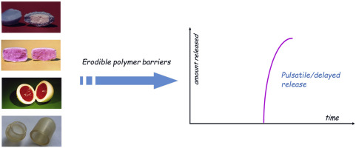
Types of Tablets According to Release Pattern
Modified-release drug delivery is a broad term which covers a variety of different approaches which are:
1-Delayed release indicates that the drug is not being released immediately after administration but at a later time as in case of enteric release and (pulsatile release ???)

Slide 5
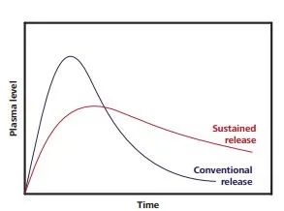
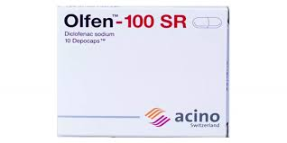
Types of Tablets According to Release Pattern
2- Sustained release, indicates an initial release of drug sufficient to provide a therapeutic dose soon after administration, and then a gradual release over extended period of time

Slide 6
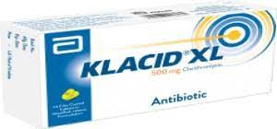
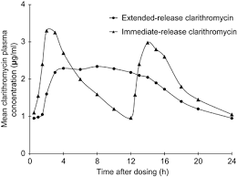
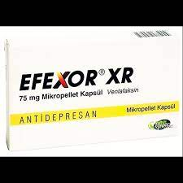
Types of Tablets According to Release Pattern
3- Extended Release [ER, XR, XL], refers to a dosage form release drug slowly , so that plasma concentration are maintained at a therapeutic level for a prolonged period of time ,which allows twofold reduction in dosing frequency and increasing patient compliance

Slide 7
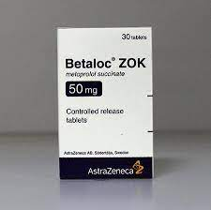
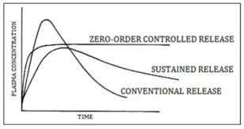
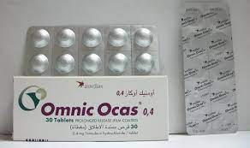
Types of Tablets According to Release Pattern
4- controlled release ,in this type the drug release from a dosage form will be at a constant rate and provide plasma concentration that remain invariant with time

Slide 8
Factors to be considered in formulation modified release dosage forms
The physicochemical properties of drug to be formulated(candidate or not)
Choice of the dosage form, modified-release formulation can be designed as a single-entity (usually a tablet) which can often be manufactured using conventional techniques such as compaction and film coating
Or it can be formulated as Multiple-unit systems? (e.g. pellets or granules filled into a hard capsule shell or compressed into tablets)

Slide 9
Matrix formulation or coated formulation?
The release of an active pharmaceutical ingredient can be modified by two main methods:
Firstly, the release modifying ingredients can be incorporated throughout the matrix of the dosage form wherein the whole dosage form encompasses the modified-release element
The second option is the application of a modified-release coating to a dosage form, wherein the drug is usually contained in the core and is released through, or via the dissolution of, the MR coat
Osmotic pump system? Gastric-retentive system?

Slide 10
Matrix formulation or coated formulation?

Slide 11
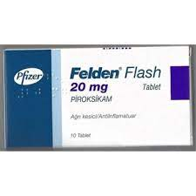
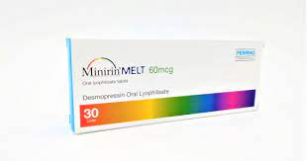
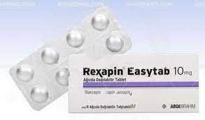
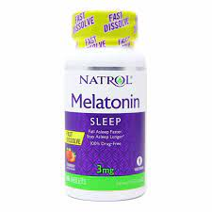
Advanced Form of Tablets
Rapidly Dissolving Tablets:
It may also called orodispersible tablet , and characterized by rapid disintegration or dissolving in the mouth within a period of less than one minute.
This type of tablets designed for children and elderly , they liquefy on the tongue and the patient swallow the liquid

Slide 12
Advanced Form of Tablets
These tablets are prepared using very water soluble excipients to wick water into the tablet for rapid disintegration.
It can be prepared by compression or lyophilization.

Slide 13
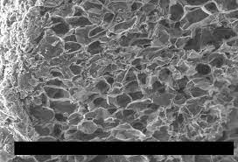
Advanced Form of Tablets
Freeze-drying or lyophilization can be utilized to prepare mouth-dissolving tablets, which are very porous in nature and which quickly disintegrate or dissolve upon contact with saliva.
This method involves incorporation of the drug in water-soluble matrix, which is then transferred to the preformed blister with peelable foil, freeze drying is then done to remove water by sublimation

Slide 14
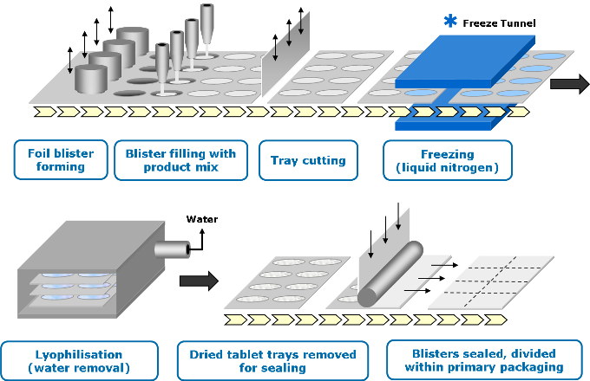
Advanced Form of Oral Tablets for Ingestion

Slide 15
Advanced Form of Tablets
Disadvantages associated with this type of tablets include taste masking difficulty, being friable , stability of the product and manufacturing cost.
Zydis Technology?

Slide 16
Tablets Preparation Techniques
Materials intended for compaction into tablets must have two characteristics:
Fluidity
Compressibility
Therefore tablet materials should be in physical form that flow smoothly and uniformly, besides being compressible.

Slide 17
Tablets Preparation Techniques
Accordingly three established based preparation techniques have been introduced which are :
Direct Compression
Compression Granulation (dry granulation)
Wet Granulation

Slide 18
Direct Compression
The processing of drug with excipients can be achieved without any need of granulation and related unit operations.
By simply mixing in a blender, formulation ingredients can be processed and compressed into tablets without any of the ingredients having to be changed.
This procedure is called direct compression and it is used in the manufacture of tablet when formulation ingredients can flow uniformly into a die cavity

Slide 19
Direct Compression
The manufacture of tablets by direct compression involves comparatively few steps and they include
1)Pre-milling of formulation ingredients (active drug substance and excipients)
2)Mixing of active drug substance with the powdered excipients (including the lubricant)
3)Compression of the mixed powders into tablets.

Slide 20
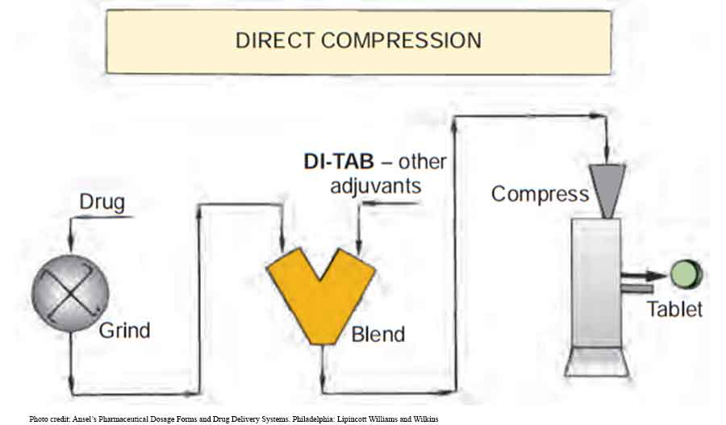

Slide 21
Direct Compression
The term direct compression was reserved for a small group of granular chemicals having all the physical characteristics that enable them to be directly compressed into tablets without an intermediate granulating step.
As most of medicinal agent have weak intermolecular attraction or covered with film of adsorbed gas that hinder compaction

Slide 22
Direct Compression
As such, direct compression was restricted for chemicals, such as potassium salts (chlorate, chloride, bromide, iodide, nitrate, and permanganate), ammonium chloride

Slide 23
Direct Compression
Today, the term direct compression is used to define the process by which tablets are compressed directly from powdered active drug substance and suitable excipients into a firm compact without employing the process of granulation

Slide 24
Direct Compression
The successful application of direct compression technique in tablet manufacture especially for low and medium dosage range of drugs can be attributed to the availability of new excipients, modified form of old excipients, and the invention and utilization of new tablet machinery

Slide 25
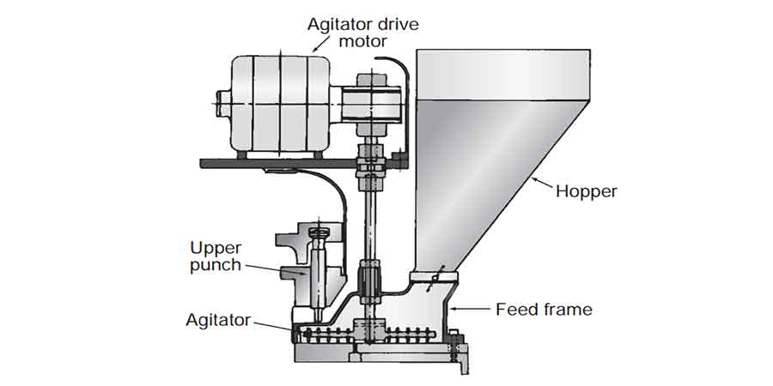
Direct Compression
Direct compression technique using induced die feeders
This involves the use of a special feeding device which prevents segregation and enhances the flow of powders from the hopper into the die cavity of a tablet machine.

Slide 26
Direct Compression
Direct compression technique using direct compression excipients
also referred to as direct compressible excipients filler/binders are inert, non-medicinal substances with good tableting properties.
Microcrystalline cellulose, spray dried lactose, are example on such excipients.

Slide 27
Advantages of Direct Compression
Direct compression method requires fewer processing steps (unit operations) and less equipment. Therefore, the method is potentially less expensive than other methods used in tablet manufacture
Tablet manufacture can be carried out without the involvement of moisture and heat. Hence, product stability is almost guaranteed

Slide 28
Advantages of Direct Compression
Some direct compressible excipients possess inherent disintegration properties e.g., microcrystalline cellulose.
Tablets produced by direct compression method generally show faster dissolution times than those prepared by wet granulation.
Changes in dissolution profile are less likely to occur in tablets manufactured by direct compression (if stored for a long time) than in those prepared by wet granulation

Slide 29
Advantages of Direct Compression
Because direct compression excipients have a relatively high binding capacity, the pressure required to manufacture the desired hardness is, in general, less with direct compression vehicles than with conventional granulations, resulting in both higher production rates and longer machine life.

Slide 30
Drawbacks of Direct Compression Technology
High-dose drugs may present problems with direct compression if it is not easily compressible by itself
Low-dose drugs may not be uniformly blended
Direct compression excipients are often more expensive than other tablet excipients used in other granulation methods

Slide 31
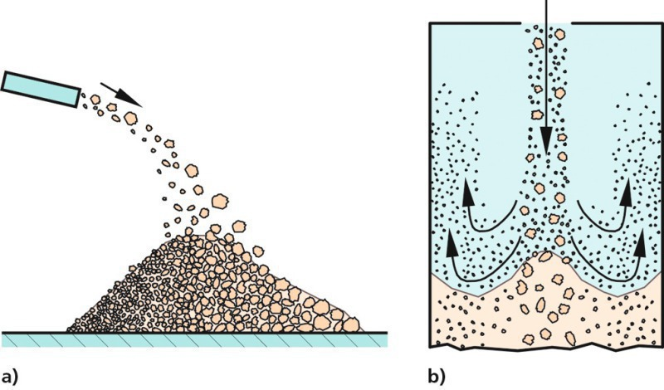
Drawbacks of Direct Compression Technology
Direct compression blends are subject to un-blending/ segregation in post-blending handling steps which lead to poor content uniformity.

Slide 32
Drawbacks of Direct Compression Technology
This arises from lack of moisture in the blends (which may give rise to static charges leading to un-blending) or variations in particle size or density of formulation ingredients. This problem can be solved by applying the concept of ordered blending?? and/or use of excipients of narrow particle size ranges

Slide 33
Drawbacks of Direct Compression Technology
In some instances, direct compression excipients may interact with the drug substance. A good example of such reaction is that which occurs between amine compounds and spray-dried lactose and this results in a yellow discoloration of the tablets.

Slide 34
Drawbacks of Direct Compression Technology
Coloring of tablets is difficult to achieve when the colorant in dry particulate form.
Tablet defects such as sticking, capping and lamination are usually pronounced in tablets manufactured by direct compression method

Slide 35


