Slide 1
Industrial Pharmacy/Fifth Stage
Lecturer Dr.Nawar Michael
Lec:4

Slide 2
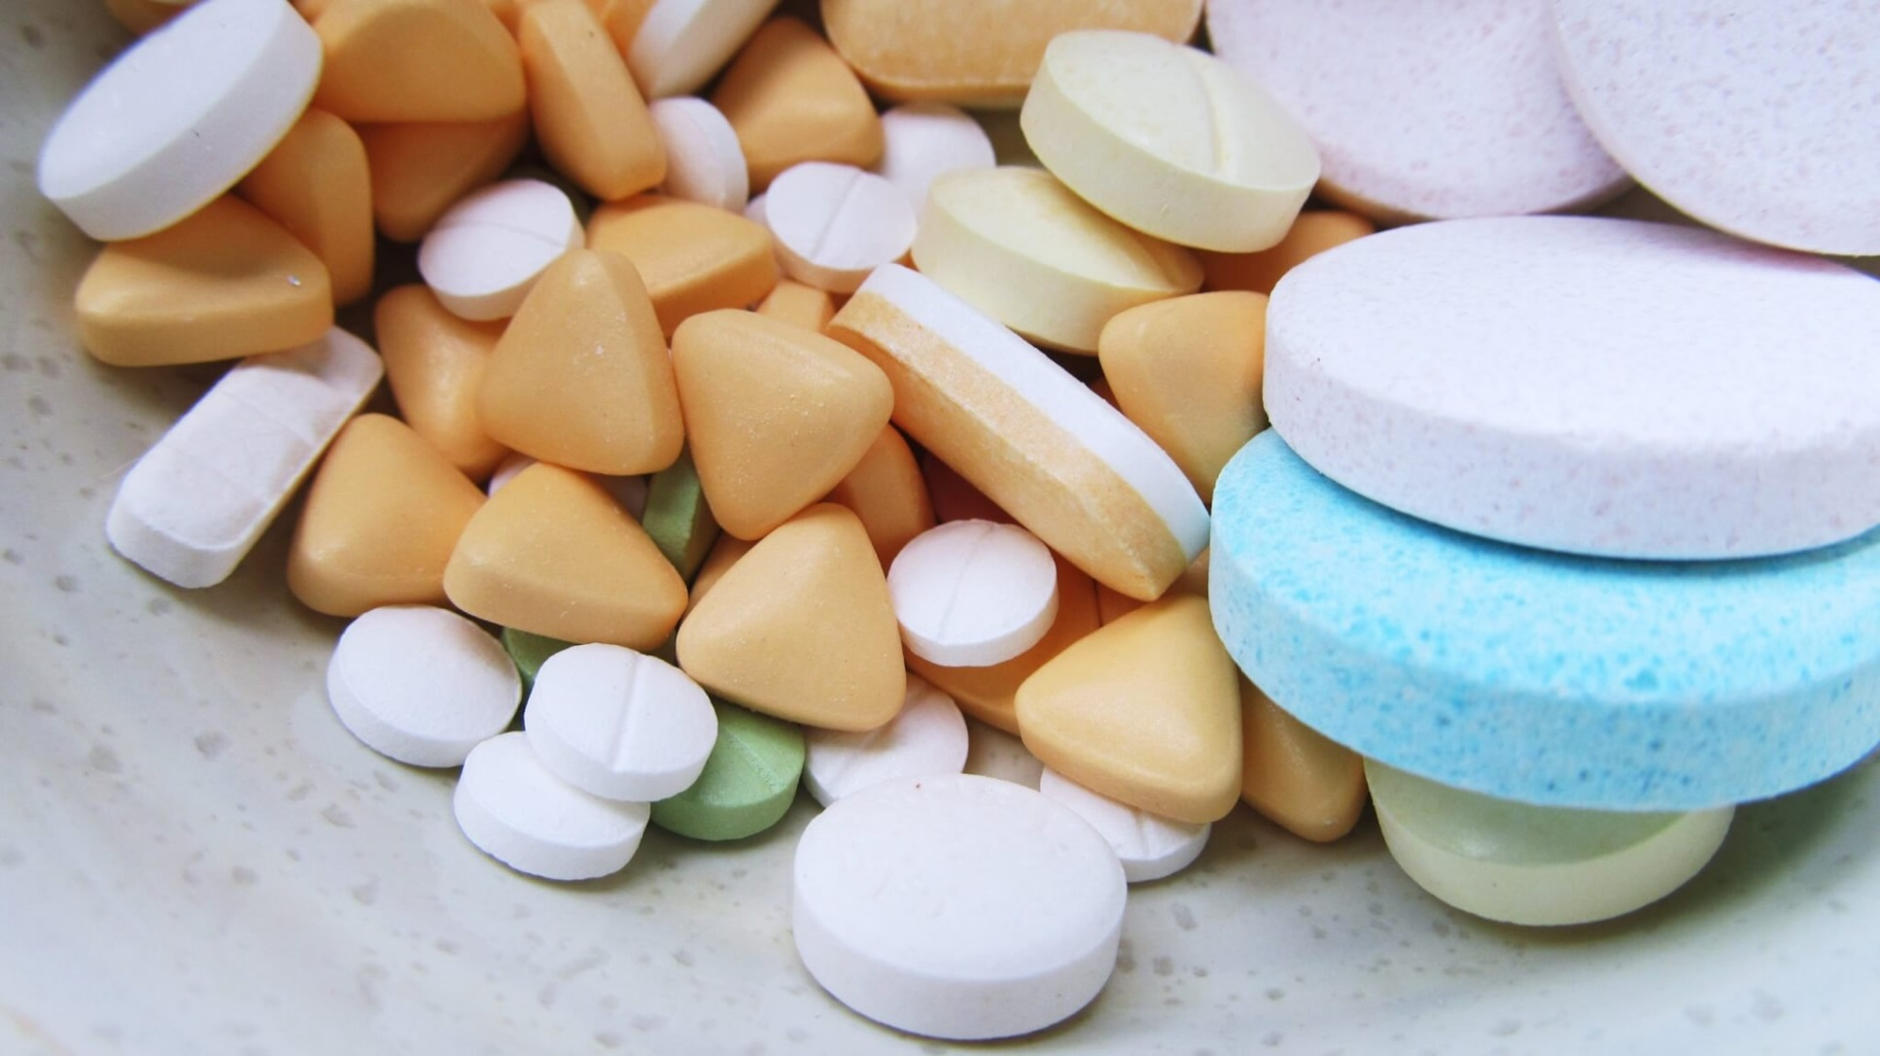
Oral Solid Dosage Forms(Tablets)

Slide 3
Tablets Preparation Techniques
Granulation: is a process where the primary powder particles are made to adhere to form large multi-particle entities
Tablet materials should be in a physical form having the essential tableting properties
Granulation is a process of forming sphere like or regular shaped aggregates called granules

Slide 4
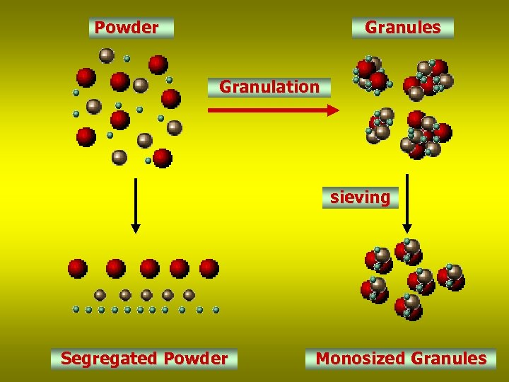

Slide 5
Tablets Preparation Techniques
Rationale Behind Granulation
1)Increase bulk density
2)Improve the flowability
3)Improve mixing homogeneity
4)Improve compressibility of the powder
5) Affect dissolution process of hydrophobic drugs

Slide 6
Tablets Preparation Techniques
Dry Granulation
In dry granulation, the powder mixture is compacted into large pieces and subsequently broken down or sized into granules
It also called pre-compression or double compression

Slide 7
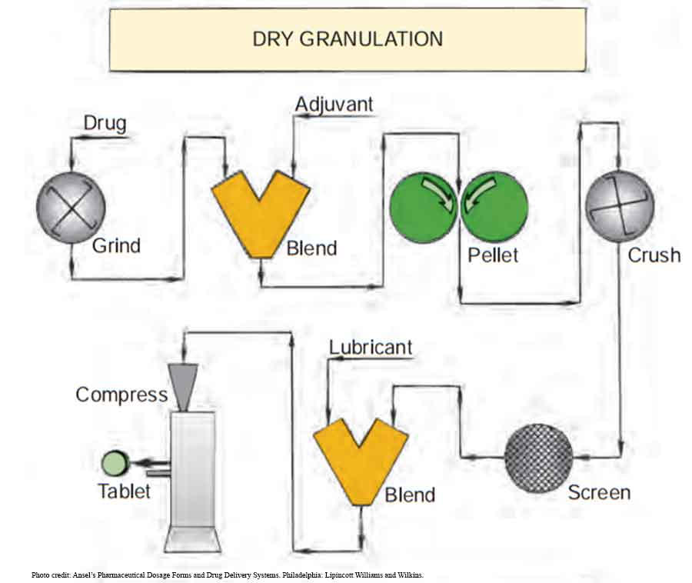

Slide 8
Tablets Preparation Techniques
For this method the drug or the diluent must have cohesive properties, and it is applicable for substances degraded by elevated temperature or sensitive to moisture
Two methods have been introduced to achieve dry granulation:
1-Slugging
2-Roller Compaction

Slide 9
Tablets Preparation Techniques
1-Slugging:
After weighing and mixing the ingredient the powder mixture is slugged or compressed into large flat tablets of about 1 inch in diameter
The slugs are broken up by hand or by a mill and pass through a screen of suitable size
The pressure used to produce the slugs is usually less than that used in the final compression.

Slide 10
Tablets Preparation Techniques
When a single slugging is not sufficient to confer the required granular properties to the mixture, it can be screened and slugged again.
Slugging is a method to increase compression time.
The more compression cause strengthening the bonds holding the tablet together.

Slide 11
Tablets Preparation Techniques
2- Roller Compactor:
On large scale production, granulation can be achieved by pressing powders between two rollers at 1-6 tons of pressure
Roller compactor can produce as much as 500 kg per hour of compacted materials (ribbon-like)which can be broken up, sized , lubricated and compressed into tablets

Slide 12
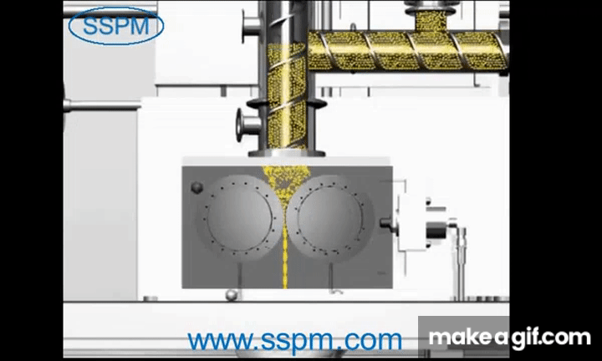

Slide 13
Tablets Preparation Techniques
Advantages of dry granulation
Disadvantages of dry granulation
Less equipment
Eliminate addition of moisture and using of heat
The process can be done with conventional excipients
Fast disintegration may be attained
Require specialized heavy duty equipment
The process generate considerable dust
Excessive pressure which require to obtain cohesive mass and the use of lubricant twice may prolonged dissolution time

Slide 14
Tablets Preparation Techniques
Wet Granulation:
The most widely used and most general method of tablet preparation, Its popularity is due to the greater probability that the granulation will meet all the physical requirements for the compression of good tablets.
Its chief disadvantages are the number of separate steps involved, as well as the time and labor necessary to carry out the procedure, especially on a large scale

Slide 15
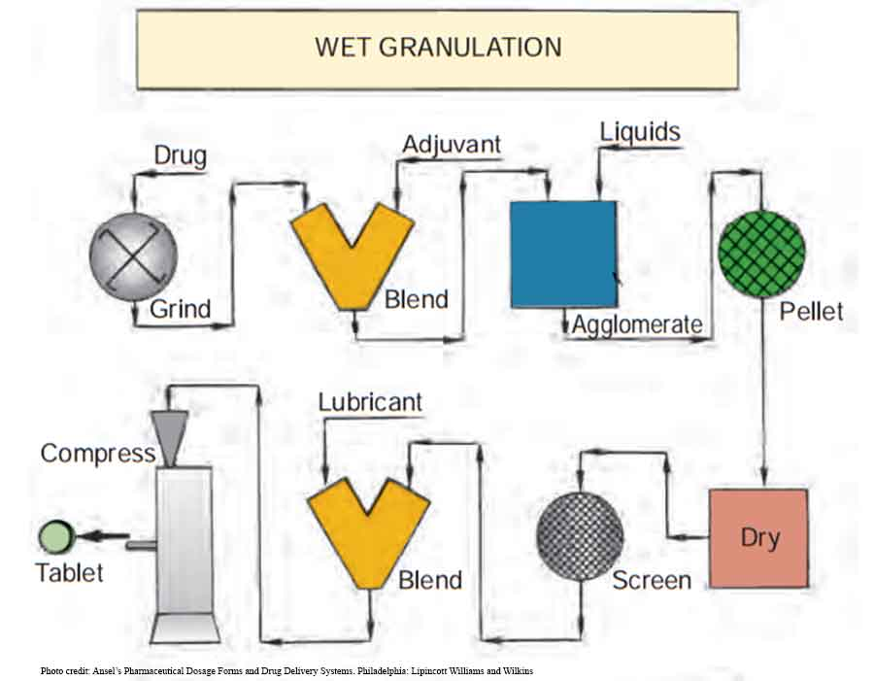
Tablets Preparation Techniques
The steps in the wet method are weighing, mixing, granulation, screening the damp mass, drying, dry screening, lubrication, and compression.

Slide 16
Tablets Preparation Techniques
The powder binding together by adhesive granulating liquid, instead of compaction
Granulating liquid contain solvent that must be volatile to be removed(water, ethanol)
The granulating liquid may used alone or it may contain dissolve adhesive(binder) to ensure particle adhesion once the granules is dry and maintain the integrity of tablet after compression.

Slide 17
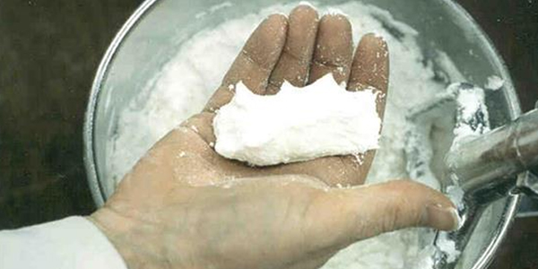
Tablets Preparation Techniques
The powder mass is wetted with the binding solution until the mass has the consistency of damp snow (ball test)

Slide 18
Tablets Preparation Techniques
The mass should be merely moist rather than wet or pasty,
If it is over wetted it will dry slowly and form hard aggregate which convert into powder by subsequent dry milling, or it may be hard and require extra-pressure for compression
If it is not wetted sufficiently, the resulting granules will be soft breaking down during lubrication and being difficult to compress

Slide 19
Tablets Preparation Techniques
The wet screening process involve converting the moist mass into coarse, granular, aggregates of suitable size by passing through hammer mill or screen of suitable mesh size
In drying, it is preferable to maintain residual amount of moisture in the granules to maintain the binder in hydrated state also the presence of moisture reduce the electrostatic charges around the particles.

Slide 20
Tablets Preparation Techniques
After drying, the granulation is reduced in particle size by passing it through a smaller-mesh screen.
Following dry screening, the granule size tends to be more uniform and ready for compression but the lubricant should be added before that.
Melt granulation???

Slide 21
New Granulation Techniques
Fluid-Bed Granulation
The concept was to spray a granulating solution onto the suspended particles, which then would be dried rapidly in the suspending air.
The main benefit from this system is the rapid granulation and drying of a batch.

Slide 22
New Granulation Techniques
Many scientist consider this technique an extension to the wet granulation.
In this method, particles of an inert material or the active drug are suspended in a vertical column with a rising air stream; while the particles are suspended
the common granulating materials in solution are sprayed into the column, there is a gradual particle buildup under a controlled set of conditions resulting in a powder granulation that is ready for compression after the addition of the lubricant.

Slide 23
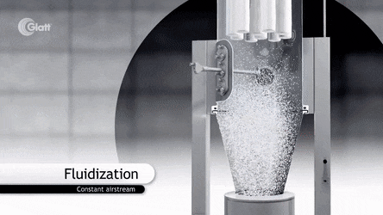

Slide 24
Extrusion/spheronization
Extrusion/ spheronization is a multi-step process used to make uniformly sized spherical particles
It is primarily used as a method to produce multi-particulates for controlled drug release applications.
The major advantage over other methods of producing drug-loaded spheres or pellets is the ability to incorporate high levels of active ingredients without producing excessively large particles (i.e. minimal excipients are necessary).

Slide 25
The main steps of the process are:
dry mixing of ingredients to achieve a homogeneous powder dispersion
wet massing to produce a sufficiently plastic wet mass
extrusion to form rod-shaped particles of uniform diameter
spheronization to round off these rods into
spherical particles
drying to achieve the desired final moisture content
screening (optional) to achieve the desired narrow size distribution.

Slide 26
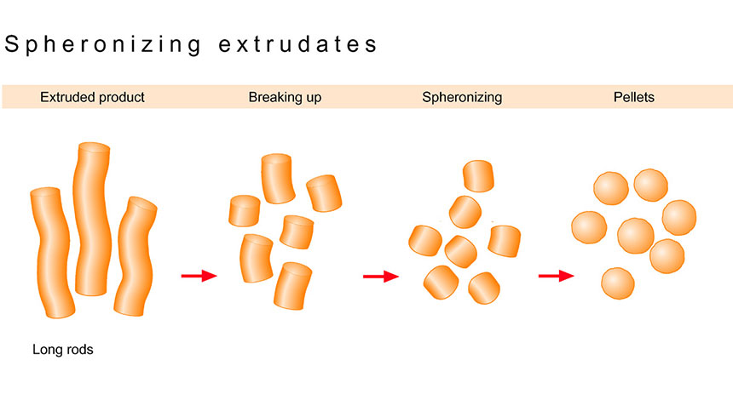

Slide 27


Slide 28
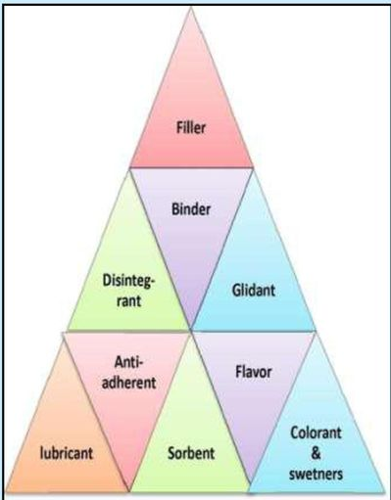
Tablet Excipients
In addition to the active or therapeutic ingredient, tablets contain a number of inert materials, known as additives or excipients

Slide 29
Tablet Excipients
Although the term inert has been applied to these added materials, it has become apparent that there is an important relationship between the properties of the excipients and the dosage forms containing them .
Preformulation studies demonstrate their influence on stability, bioavailability, and the processes by which the dosage forms are prepared

Slide 30
Tablet Excipients
They may be classified according to the role
they play in the finished tablet:
1) The first group contains those that help to impart satisfactory processing and compression
characteristics to the formulation, these include diluents, binders, glidants, and lubricants

Slide 31
Tablet Excipients
2)The second group of added substances helps to give additional desirable physical characteristics to the finished tablet. Included in this group are disintegrants, colors, flavors, and sweetening agents

Slide 32
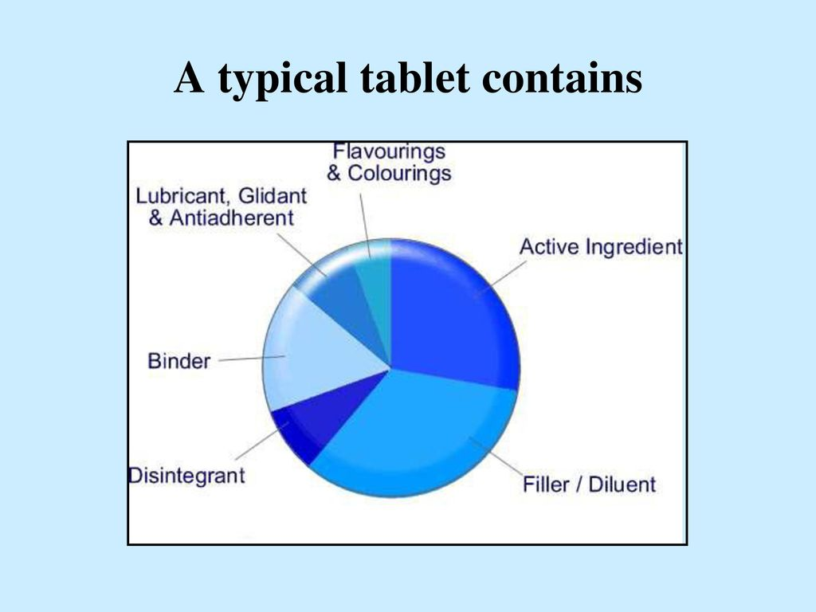

Slide 33
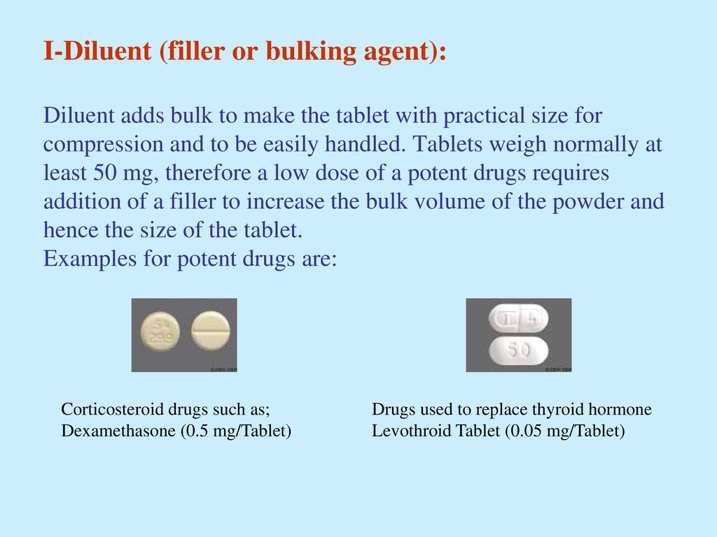
Tablet Excipients

Slide 34
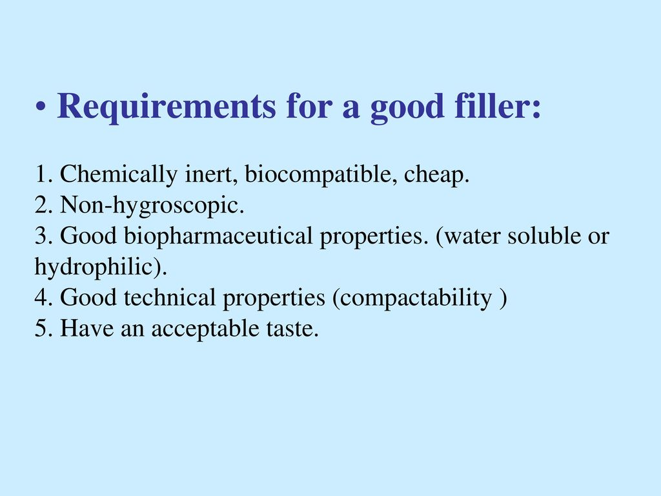

Slide 35
Tablet Excipients
Diluent is not necessary if the dose of drug is high
One or more diluents may be used in the same tablet preparation
Selection of diluents depends on the experience of the manufacturer as well as its cost and compatibility with the other tablet ingredients

Slide 36
Tablet Excipients
Calcium salts used as diluents when combined with tetracycline interfere with the drug absorption from GIT(due to formation of non absorbable complex)
When drug substances have low water solubility , it is recommended to use water soluble diluent to avoid possible bioavailability problem.

Slide 37
Tablet Excipients
Highly adsorbent substances such as bentonite and kaolin should be avoided to use as diluent with drugs used clinically in small dosage , because these drugs may adsorbed after administration.
Combination of amine bases with lactose or amine salts results in tablet discoloration on aging

Slide 38
Diluents Classification
Generally speaking diluents can be categorized into three main groups:
Carbohydrate fillers
Celluloses fillers
Inorganic salts fillers

Slide 39
Carbohydrate fillers
Lactose is still the most widely used diluent in tablet formulation, as it has no reaction with most drugs whether used in hydrous or anhydrous form
Anhydrous lactose has the advantage over lactose that it does not undergo Maillard reaction which lead to browning and discoloration with certain drugs

Slide 40
Carbohydrate fillers
In general , lactose formulations show good release rates, their granulations are readily dried , and the tablet disintegration times are not strongly sensitive to variations in tablet hardness.
Besides , lactose is one of the cheapest diluent

Slide 41
Carbohydrate fillers
Spray dried lactose???
Widely used in direct compression due to its compressibility and good flow properties
It also subject to darkening in the presence of excess moisture , amines
The process of brown discoloration is accelerated in the presence of alkaline condition

Slide 42
Carbohydrate fillers
Other sugars or sugar alcohol such as glucose , sucrose , sorbitol, mannitol have bee used as alternative to lactose, especially in lozenges and chewable tablets due to their pleasant taste
Mannitol is expensive have slow solubility ,non hygroscopic , but have poor flow properties, while sorbitol the optical isomer is cheap

Slide 43
Celluloses fillers
The most common type is microcrystalline cellulose(Avicel) direct compressible excipient
Two tablet grades are present PH101(powder)and PH102(granules)
The flow properties are good and the compressibility is excellent and have a unique property of being disintegrants, expensive

Slide 44
Celluloses fillers
It is usually combined with other diluent and not used alone in high concentration
Avicel also can be used in wet granulation in concentration of about 5-15% shown beneficial and aid in the granulation and drying process

Slide 45
Inorganic salts fillers
Calcium hydrogen phosphate dihydrate (Emcompress), it is inorganic substance insoluble in water and non hygroscopic but it is hydrophilic
It can improve the flowability and compressibility of the mixture
It is slightly alkaline and may be incompatible with drug sensitive to alkaline condition

Slide 46


