Slide 1
Industrial Pharmacy/Fifth Stage
Lecturer Dr.Nawar Michael
Lecture:6

Slide 2
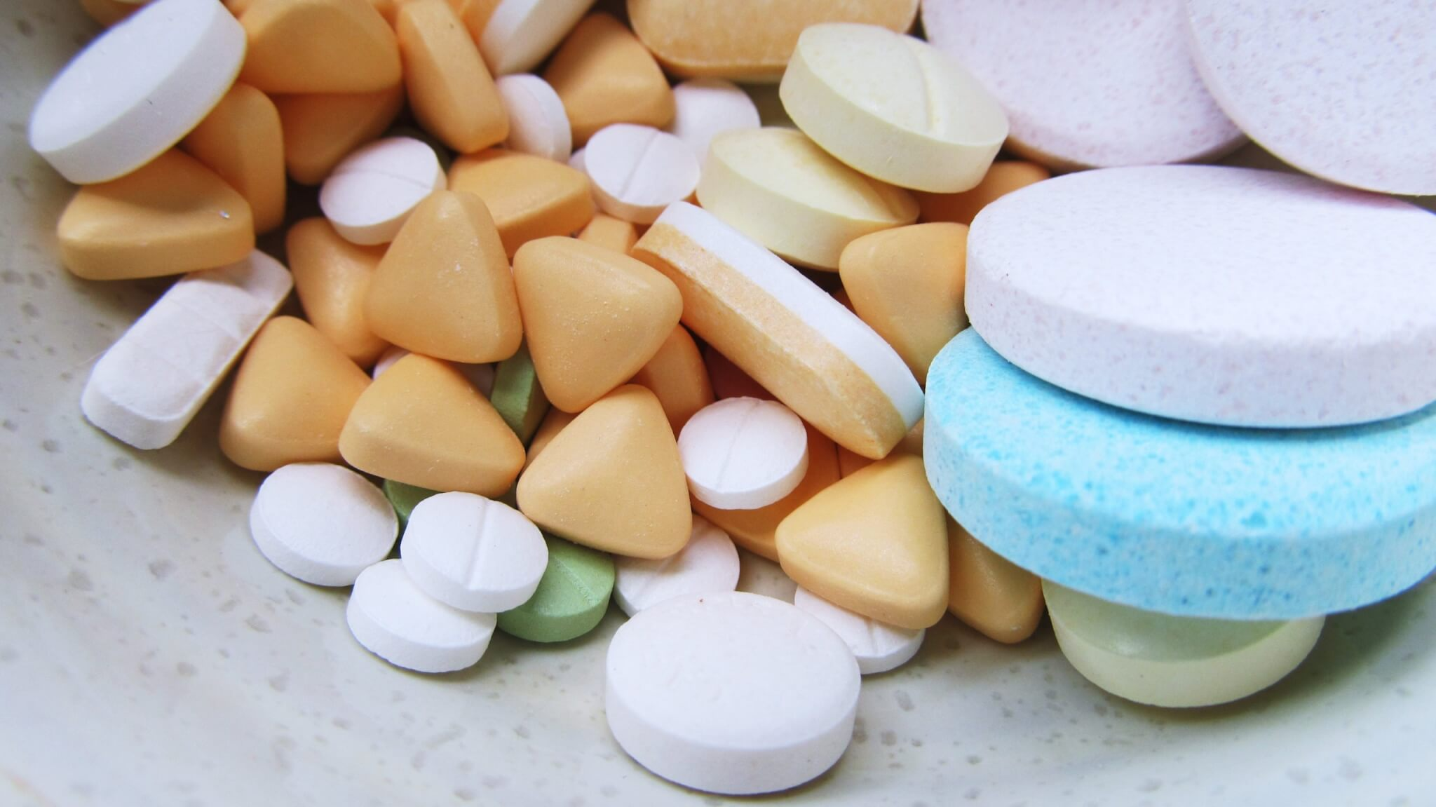
Oral Solid Dosage Forms(Tablets)

Slide 3
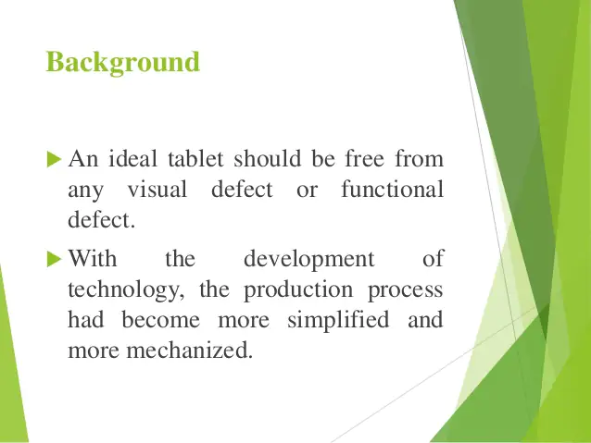
Tablet Processing Problems and its Remedies

Slide 4
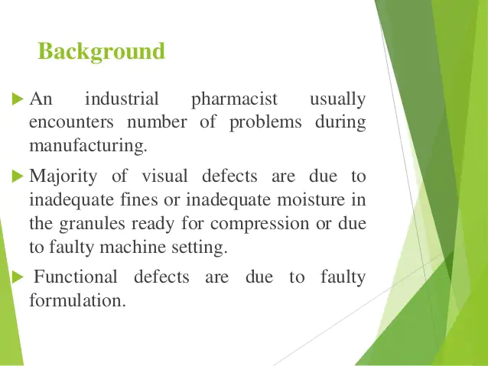
Tablet Processing Problems and its Remedies

Slide 5
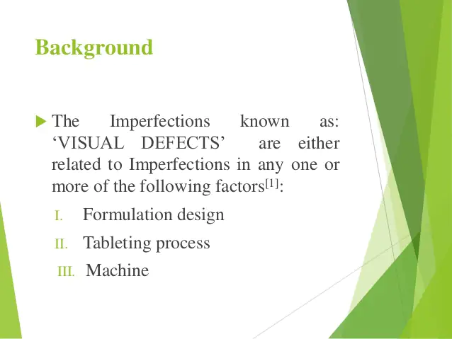
Tablet Processing Problems and its Remedies

Slide 6
Tablet Processing Problems and its Remedies
We can classify the problems into the following types:
Defects related to tableting process (capping , lamination, cracking)
Defects related to excipients(sticking , picking , chipping, binding)
Defects related to more than one factor(mottling)
Defects related to machine(double impression)

Slide 7
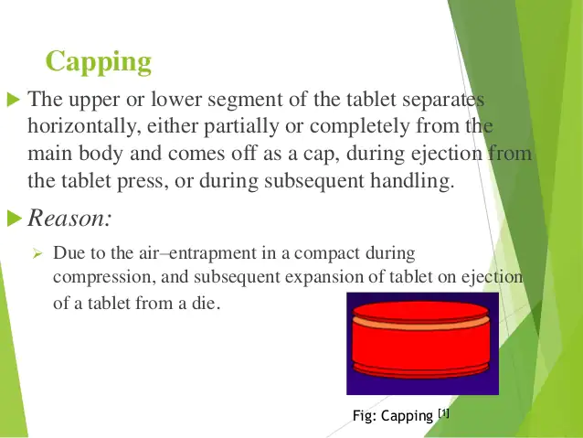
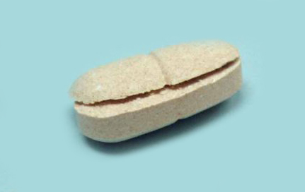
Tablet Processing Problems and its Remedies

Slide 8
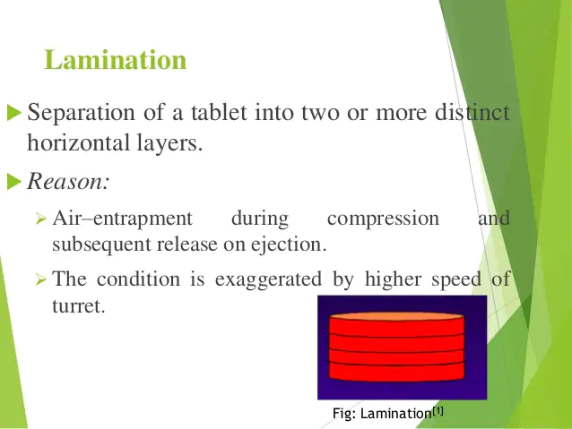
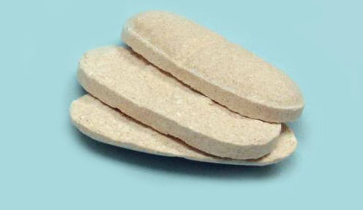
Tablet Processing Problems and its Remedies

Slide 9
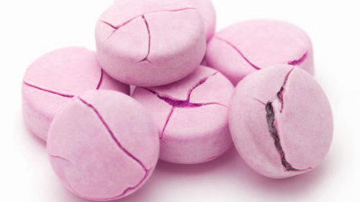
Tablet Processing Problems and its Remedies
Cracking: Small, fine cracks observed on the upper and lower central surface of tablets, or very rarely on the sidewall are referred to as cracking.

Slide 10
Tablet Processing Problems and its Remedies
These processing problems may occur immediately after compression or hours or even days later
Friability test is the quickest way to reveal such problems
These processing problems in the past have been attributed to the air entrapment

Slide 11
Tablet Processing Problems and its Remedies
During compression process, the air is entrapped among the particles or granules and does not escape until the compression pressure is released
Recently, it is postulated that these problems is resulted from deformational properties of the formulation during and immediately after compression and can be solved by slowing decompression.

Slide 12
Tablet Processing Problems and its Remedies
Certain percentage of moisture is essential for good compression
A granulation that is too dry tend to cap or laminate for lack of cohesion
Capping and lamination may encountered in direct compression, as it may contain fine particulate or powder materials with poor compression properties.

Slide 13
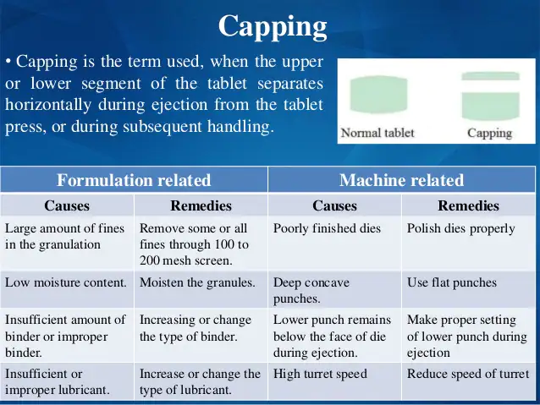
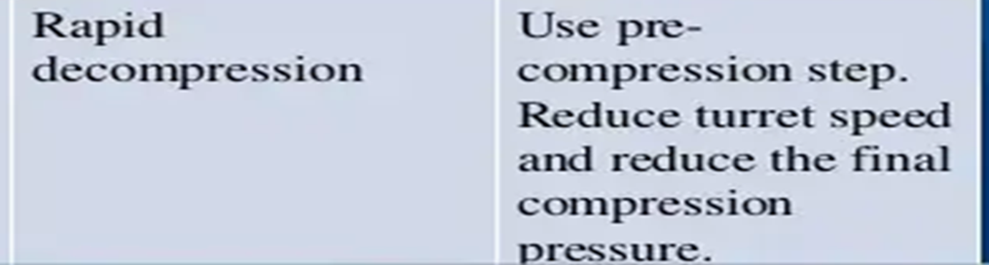
Tablet Processing Problems and its Remedies

Slide 14
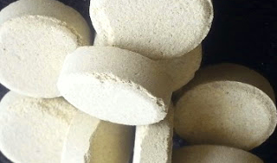
Excipient related problems
Chipping: Chipping is the breaking of tablet edges during the press process or during the subsequent handling.

Slide 15
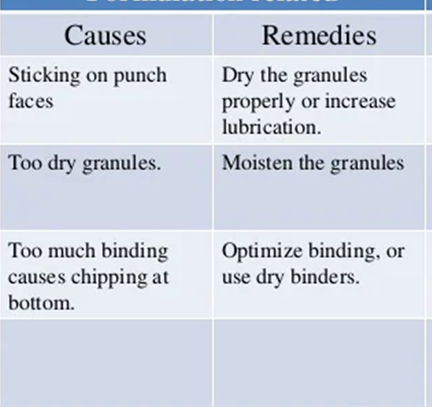
Excipient related problems
It is due to very dry granules or sticking on punch faces or too much binding.

Slide 16
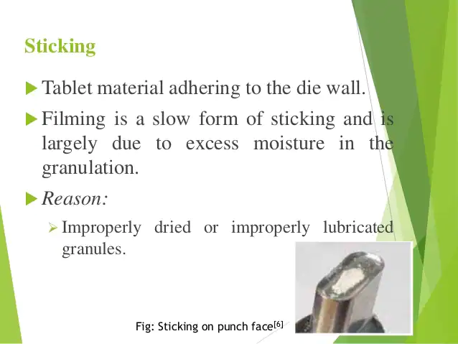
Excipient related problems

Slide 17
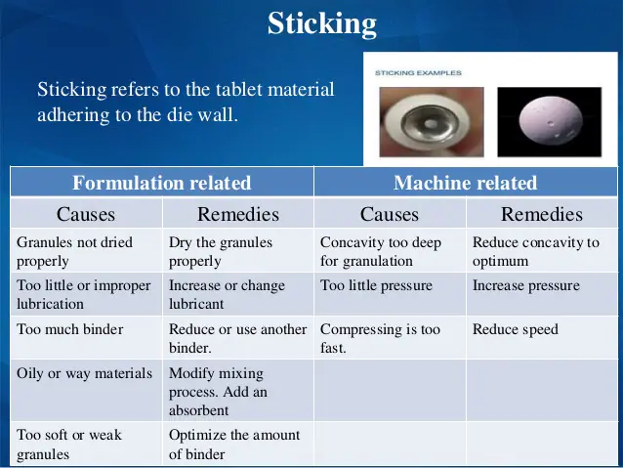
Excipient related problems

Slide 18
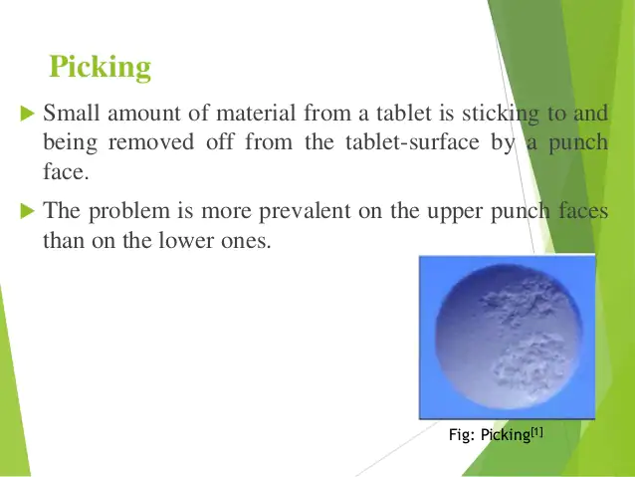
Excipient related problems

Slide 19
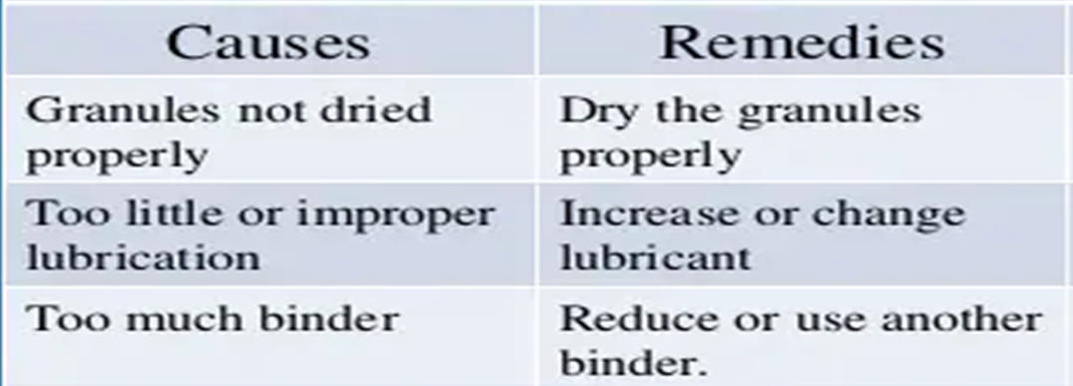
Excipient related problems
It is due to improper drying or improper lubricant or too much binder or rough punch face.

Slide 20
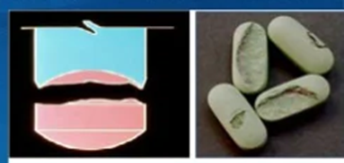
Excipient related problems
Binding: is the condition where a tablet adheres, tear in the die or a film is formed on the die area and hindered the ejection of the tablet.
It is due to excessive binder or too moist granules or improper lubricant or rough die

Slide 21
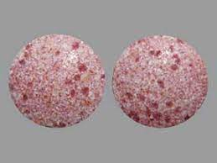
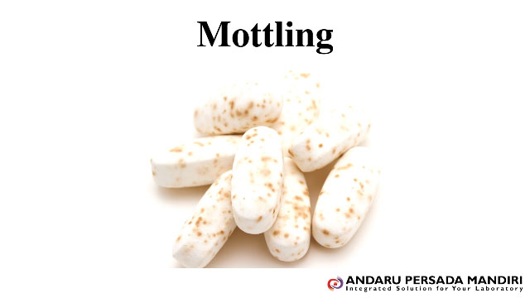
Tablet Problems and its Remedies
Mottling: is an unequal distribution of color on a tablet, with the appearance of light and dark areas on it.
It is due to improper mixing or using a colored drug along with colorless/ white excipients.

Slide 22
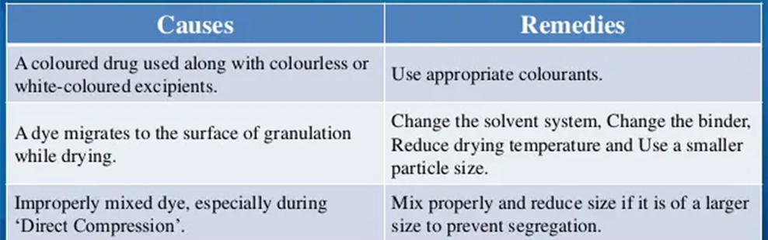
Tablet Problems and its Remedies

Slide 23
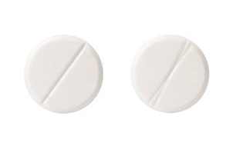
Machine-related problems
Double Impression: is machine related problem where a monogram or engraving shape or break line appears twice on the tablet surface.
It is due to the free rotation of the punches having some engraving on their faces.

Slide 24
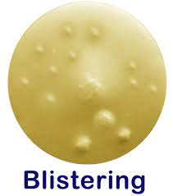
Problems for Tablet Coating
Blistering: it is local detachment of film from the substrate forming blister .
This problem occurs due to entrapment of gases in or underneath the film as a result of overheating either during spraying or at the end of the coating run which directly affect the strength ,elasticity and adhesion of the film.
It can be solved by using mild drying condition

Slide 25
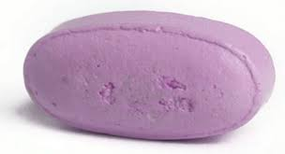
Problems for Tablet Coating
Cratering: it is defect of film coating whereby volcanic-like craters appears on the tablet surface.
It is occurred when the coating solution penetrates the surface of the tablet, and due to inefficient drying
It can be solved by optimizing drying condition and increasing the viscosity of the coating solution

Slide 26
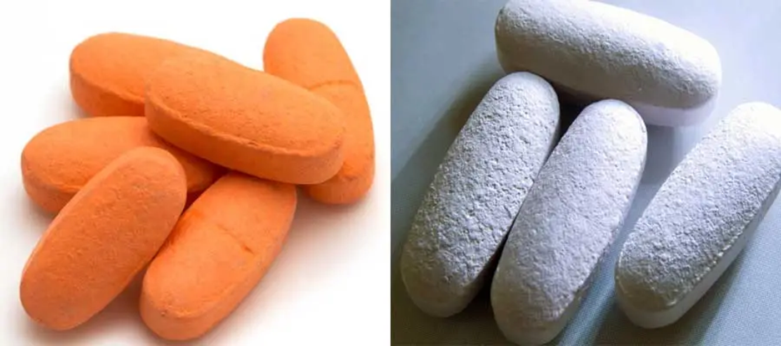
Problems for Tablet Coating
Orange Peel/Roughness:
It is surface defect resulting in the film being rough and nonglossy, appearance is similar to that of an orange peel .

Slide 27
Problems for Tablet Coating
It is caused due to inadequate spreading of the coating solution before drying which is direct result of rapid drying and high viscosity of coating solution
It can be solved by using mild drying condition and/or decreasing the viscosity of the solution.

