Slide 1
Industrial Pharmacy/Fifth Stage
Lecturer Dr.Nawar Michael
Lec:5

Slide 2
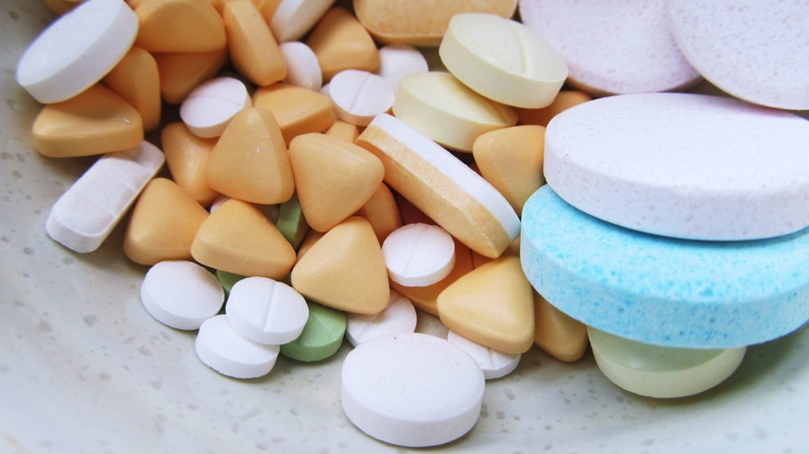
Oral Solid Dosage Forms(Tablets)

Slide 3
Binders
Agents used to impart cohesive qualities to the powdered material are referred to as binders or granulators.
They promote formation of cohesive compact and ensures the tablet remaining intact after compression, as well as improving the free-flowing qualities by the formulation of granules of desired hardness and size

Slide 4
Binders
Based on the other ingredients in the formulation and the method of preparation binders can be added as:
1)As dry powder which is mixed with other ingredients before granulation
2)As dry powder which is mixed with other ingredients before compaction
3)As a solution which is used as granulating liquid

Slide 5
Binders
The most commonly used binders include starch, gelatin, and sugars such as sucrose, glucose, and lactose
Natural and synthetic gums that have been used include acacia, sodium alginate, PVP
Other agents that may be considered binders under certain circumstances are polyethylene glycol, ethyl cellulose, waxes, water, and alcohol

Slide 6
Binders
The quantity of binder used has considerable influence on the characteristics of the compressed tablets.
The use of too much binder or too strong a binder will make a hard tablet that will not disintegrate easily and will cause excessive wear of punches and dies
Materials that have no cohesive qualities of their own will require a stronger binder than those with these qualities

Slide 7
Binders
The same amount of binder in solution will be more effective than if it were dispersed in a dry form and moistened with the solvent.
The direct-compression method for preparing tablets requires a material that is not only free-flowing but also sufficiently cohesive to act as a binder such as microcrystalline cellulose(dry binder)

Slide 8
Binders
Alcohol and water are not binders in the true sense of the word, but because of their solvent action they change the powdered material to granules, and the residual moisture retained enables the materials to adhere together when compressed
Acacia and tragacanth are employed in solution in range of 10-25% alone or in combination they are more effective in solution form, contamination with bacteria is the major disadvantage

Slide 9
Binders
GELATIN SOLUTION—Gelatin generally is used as a 10–20% solution; gelatin solutions should be prepared freshly as needed and used while warm or they will solidify
STARCH PASTE—Cornstarch is used widely as a binder.
The concentration may vary from 10% to 20%. It usually is prepared as it is to be used, by dispersing cornstarch in sufficient cold purified water to make a suspension and warming in a water bath with continuous stirring until a translucent paste forms

Slide 10
Binders
Sucrose solution 50-74%, these sugar solution are capable of producing hard . Unless the sugar solution are highly concentrated , bacterial proliferation is problem
Modified natural polymer, such as Cellulose derivative (methylcellulose ,HPC and HPMC) Used in direct compression in dry form and the aqueous solution have adhesive properties.

Slide 11
Binders
HPMC used as alcoholic solution to provide anhydrous condition.
Ethyl cellulose alcoholic solution also used to provide retardation to disintegration and dissolution.
Polyvinyl pyrroloidine synthetic polymer used as aqueous or alcoholic binding solution. It has some capabilities of dry binder.

Slide 12
Binders
It will be noted that binder solutions usually are made up to weight rather than volume.
This is to enable the formulator to determine the weight of the solids that have been added to the tablet granulation in the binding solution

Slide 13
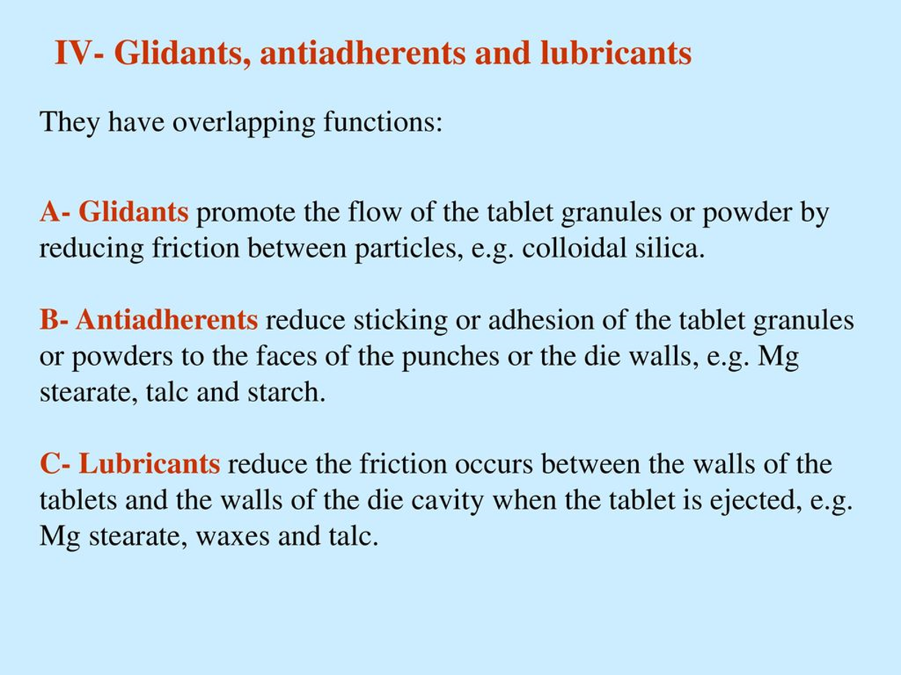
Glidants , antiadhereants, lubricants

Slide 14
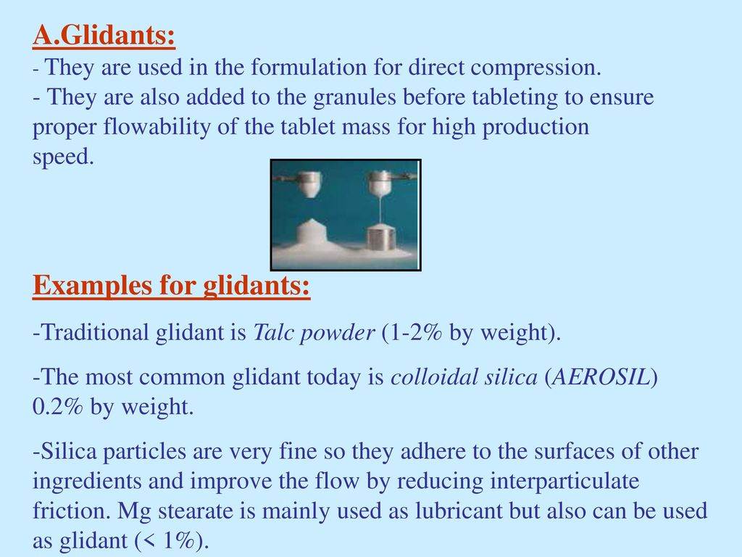

Slide 15
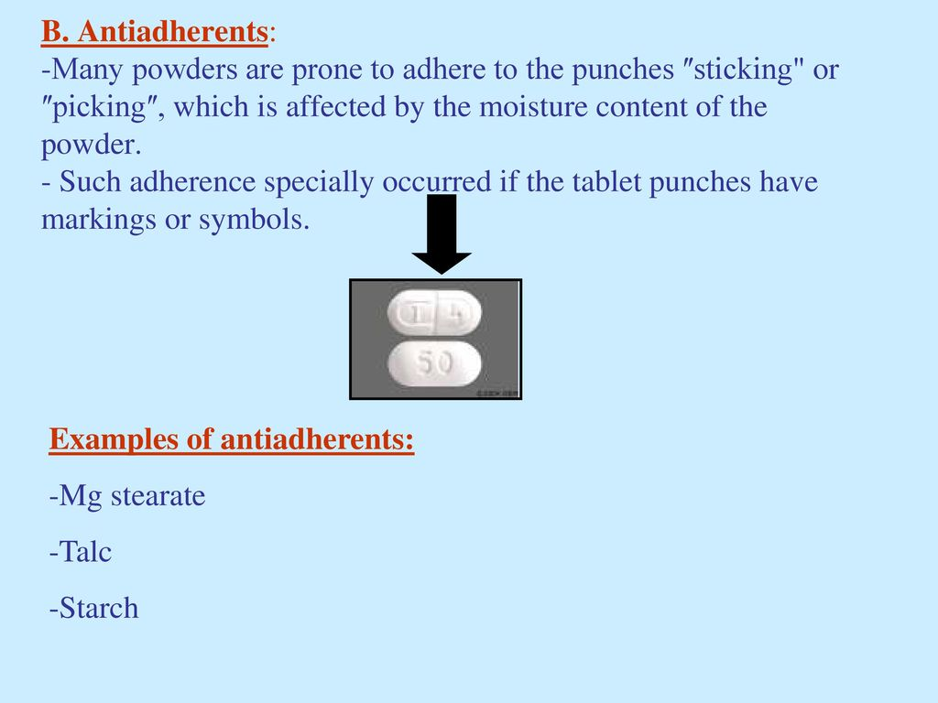

Slide 16
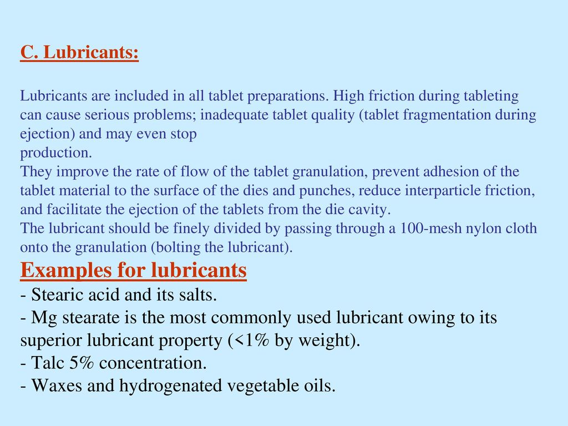

Slide 17
Problems due to lubricant
Reduce tablet strength as it interfere with bonding between particles during compression
Retard disintegration and dissolution
Incompatibility problems between alkaline salts and certain acidic drugs

Slide 18
Such problems are function of lubricant amount therefore it is used with minimum concentration 1% or less
The way in which lubricant added to mixture should also be considered (the addition should be sequentially rather than simultaneously

Slide 19
The total mixing time and mixing intensity is also important
All these negative effects are related with hydrophobic lubricants ,therefore more hydrophilic molecules have been suggested as alternative such surface active agent and polyethylene glycol

Slide 20
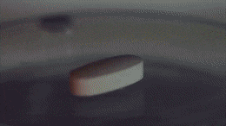
Disintegrants
Is a substance, or a mixture of substances, added to a tablet to facilitate its break up or disintegration after administration.

Slide 21
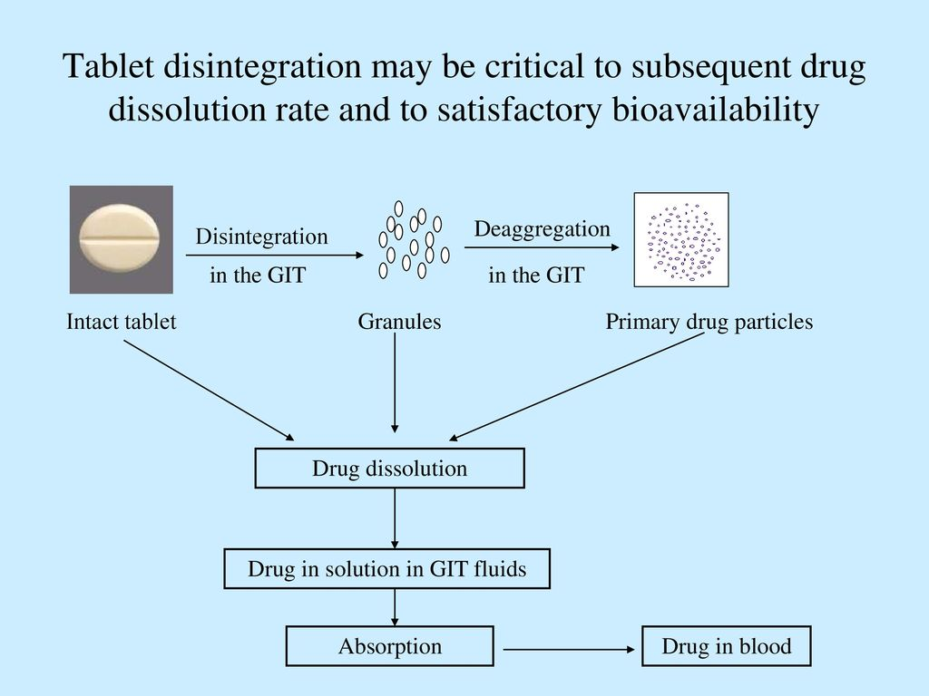

Slide 22
Mechanism of action of disintegrants
Disintegrants that facilitate water uptake , through pores of tablets with consequent tablet breaking into fragments, surface active agent act by such mechanism, also penetration can occur through capillary action
Disintegrants that will rupture the tablets caused by swelling of disintegrants particles upon water sorption

Slide 23
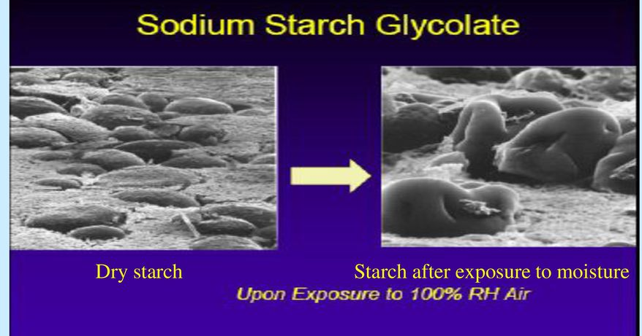

Slide 24
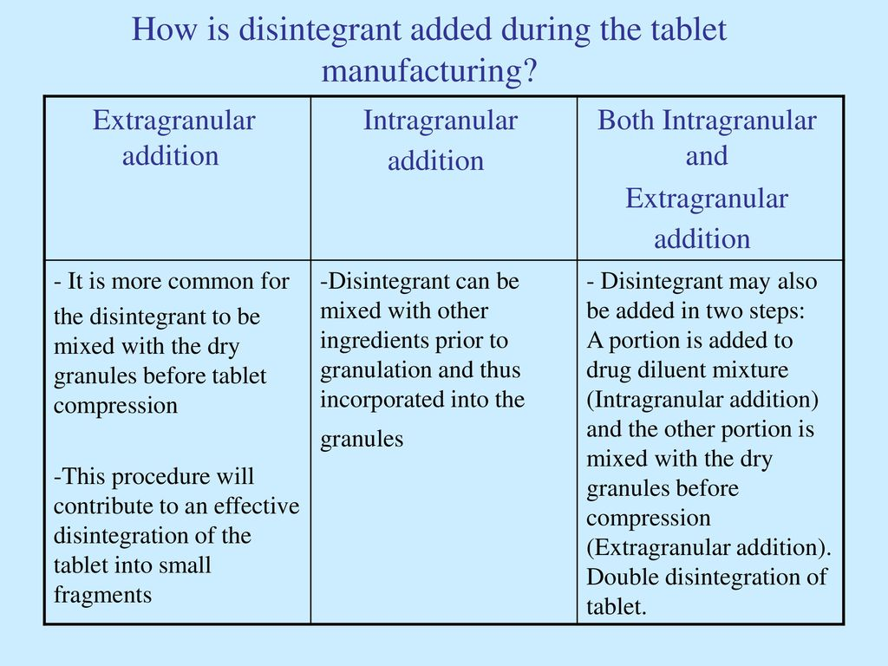

Slide 25
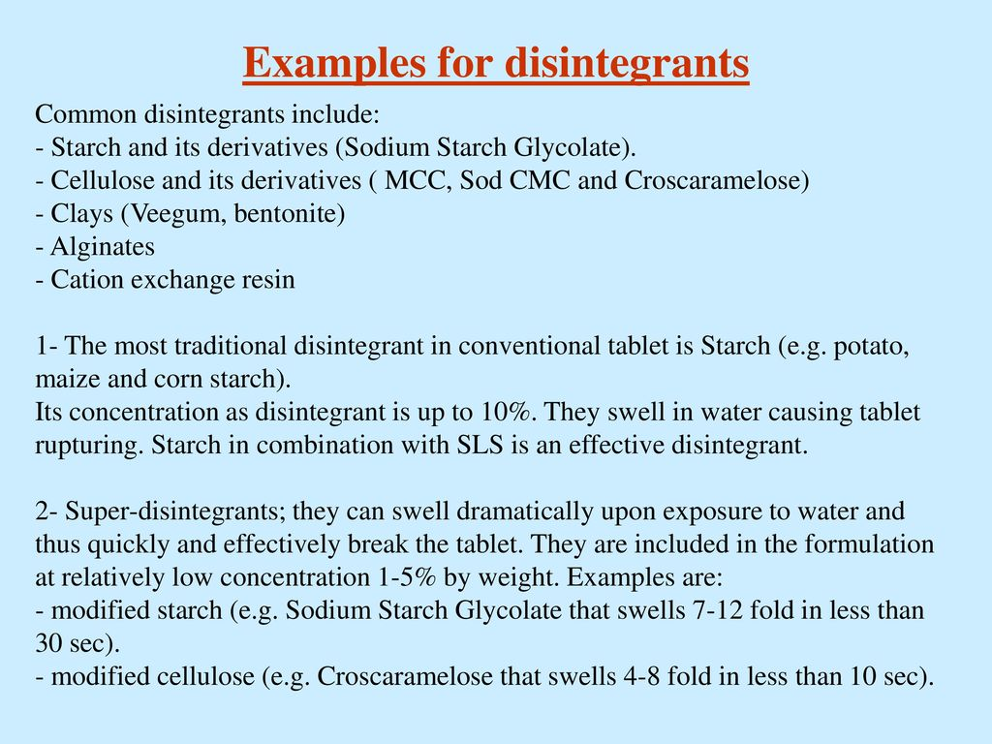

Slide 26
Other factors than the presence of disintegrants can affect significantly the disintegration time of compressed tablets:
1-The binder
2-Tablet hardness
3-Lubricant.

Slide 27
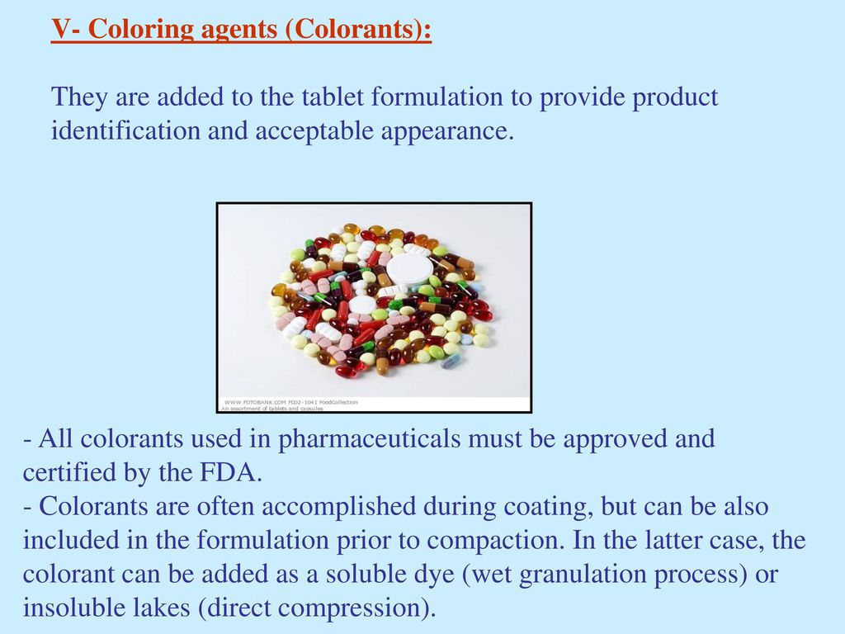

Slide 28
When wet granulation is employed , care should be taken to prevent color migration during drying.
Also the formulation should be checked for resistance to color change on exposure to light ,artificial light source are available to stimulate ultraviolet spectrum of sun light

Slide 29
Flavoring agents
Flavoring agent are incorporated into formulation to give the tablet a more pleasant taste or to mask an unpleasant one
Generally, water-soluble flavors have poor stability; hence, flavor oils or dry powders usually are used.
Flavor oils may be added to tablet granulations in solvents, or emulsified in aqueous granulating agents.
Usually, the maximum amount of oil that can be added to a granulation without influencing its tablet characteristics is 0.5%-0.75%

Slide 30
Artificial sweeteners
like flavors, are usually used only with chewable tablets or tablets dissolve in the mouth.
Some sweetness may come from the diluent (e.g., mannitol, lactose);
agents, such as saccharin and aspartame, can also be added.

Slide 31


