Slide 1
Urinary System
By
Assist. Prof. Dr. Eatelaf A. Al-Mutheffer

Slide 2
Surgical anatomy
Urinary system is composed of :
Two kidneys
Two ureters
One urinary bladder
One urethra; that is short in female, while is subdivided in male into:
a. Prostatic urethra
b. Membranous urethra
c. Penile urethra.

Slide 3
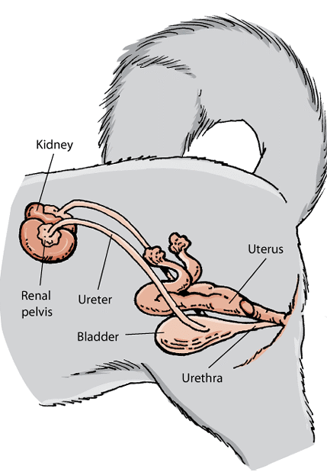
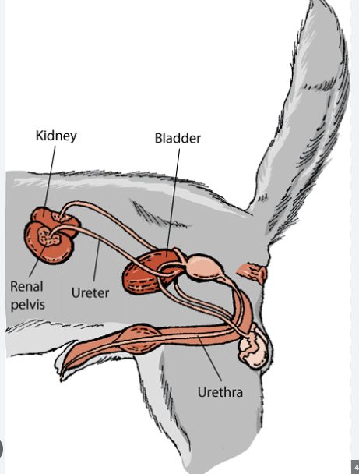

Slide 4
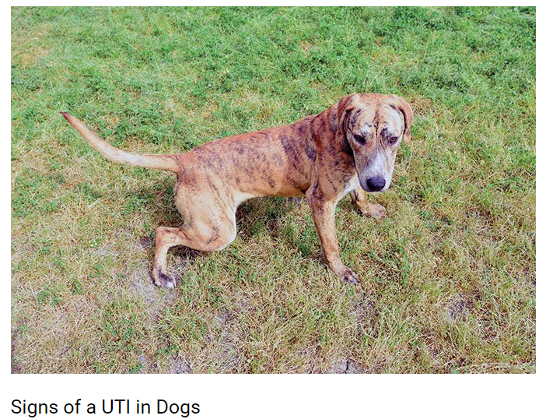
Symptoms of Urinary Tract Infections In Dogs
The sooner recognizing symptoms, the earlier the treatment
Frequent urination: especially in small amounts, is one of the most common symptoms of UTIs in dogs.
Difficulty urinating: dog strain or even whimper while urinating.

Slide 5
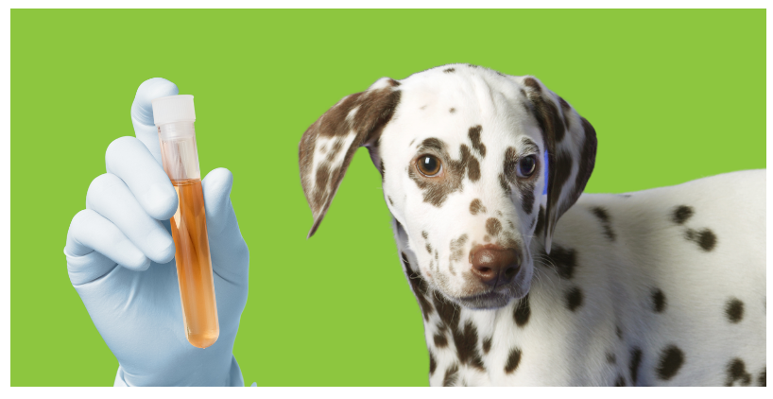
Symptoms of Urinary Tract Infections In Dogs
Blood in urine: Urine is clear and yellow in color, so cloudy or bloody urine is a sign of UTIs. Blood in urine can also be caused by more serious medical conditions.
Increased thirst:
Foul-smelling urine: urine may smell differently because of the bacteria in the urinary tract
Frequently wanting to go outside
Accidents: Adult dogs typically don't urinate inside, so indoor accidents could be a warning sign of UTI.

Slide 6
Diagnosis of the urinary system defects

Slide 7
Blood tests
Urinalysis
Urine culture: To detect and identify specific bacteria and yeast and to determine the best antibiotic for treating a UTI
4. Diagnostic imaging:
a. Radiography
b. Ultrasound
c. CT scan
d. MRI
4. Biopsy
Advance way to diagnose urinary system defects

Slide 8
TEST NAME | PURPOSE OF TEST
Complete Blood Count (CBC) | To evaluate a patient for sepsis, a severe reaction to infection
Blood Culture | To assess if a UTI has spread to the blood
Urinalysis: A group of physical, chemical, and microscopic tests on a sample of urine | To evaluate the health of the kidneys and evaluate for sepsis ‘’Creatinine, Electrolytes, Lactate’’
Urodynamic testing | Tests how well the bladder, sphincters, and urethra are storing and releasing urine

Slide 9
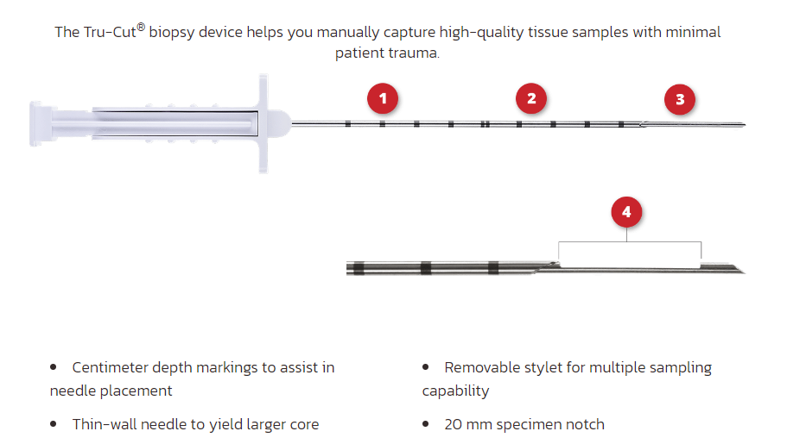
Clinical Pathological Examination
Very important
Complete blood count.
Biochemistry and coagulation panels.
Urinalysis.
Urine culture.
Renal Biopsy by:
a. Ultrasound-guided percutaneous biopsy.
b. Laparoscopic-guided biopsy.
c. Needle biopsy-TruCut device

Slide 10
Radiography:
Measurements related to the vertebral bodies are not to be considered accurate.
Normal kidneys may be larger or smaller than the lengths suggested.
Abnormality should be suspected in the dog if a kidney is less than 2.5 or more than 3.5 times the length of the second lumbar vertebra.
Normal kidneys have a smooth regular outline.
Normal appearance of kidney does not always mean they are indeed normal.

Slide 11
AFFECTION OF KIDNEY

Slide 12
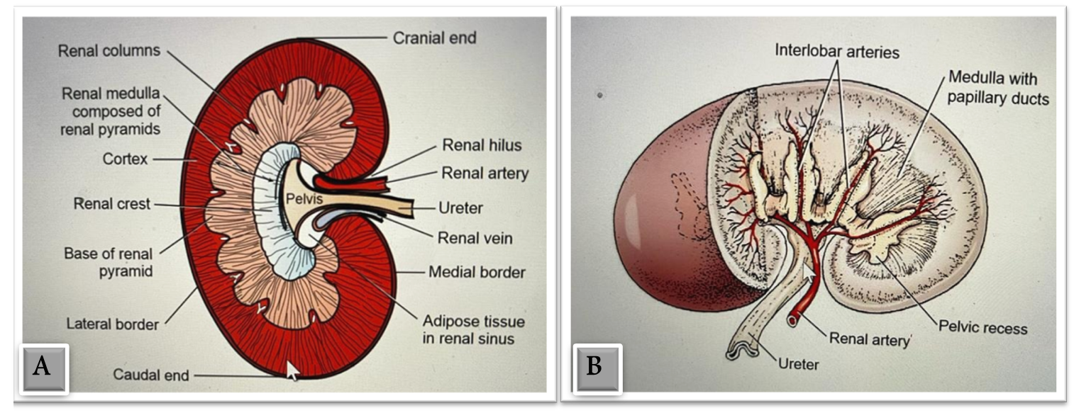
Surgical anatomy of the kidney
These images were taken from Veterinary surgery-small animal by Tobias, 2012.

Slide 13
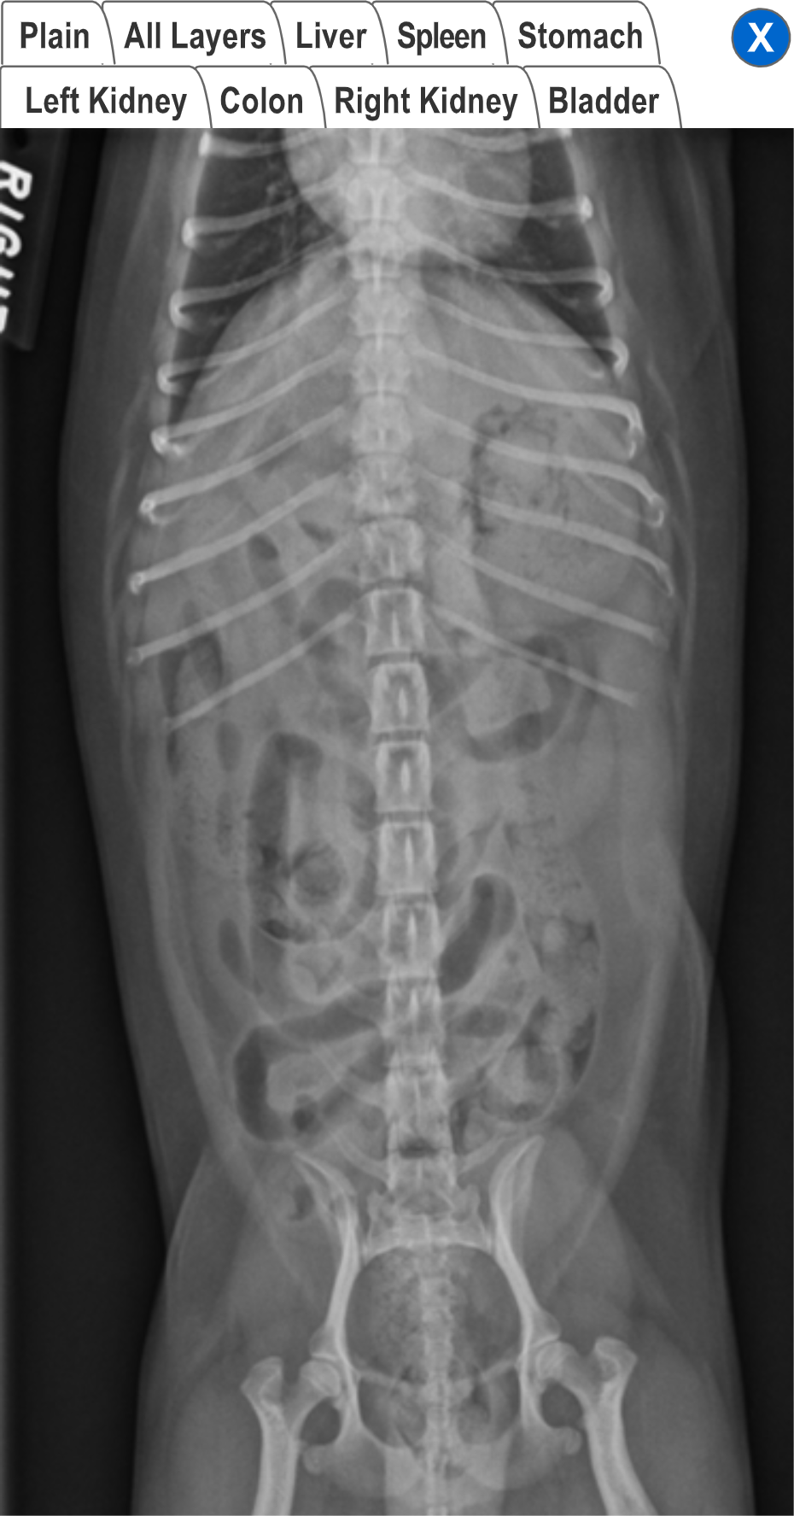
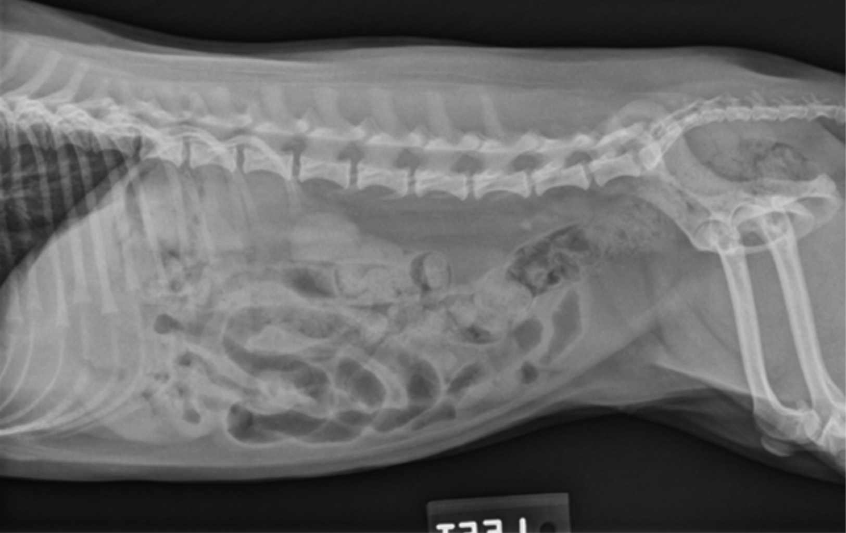
A
A) Shows the lateral view plain radiograph of the abdomen.
B
B) shows the ventrodorsal view of the that abdomen.

Slide 14
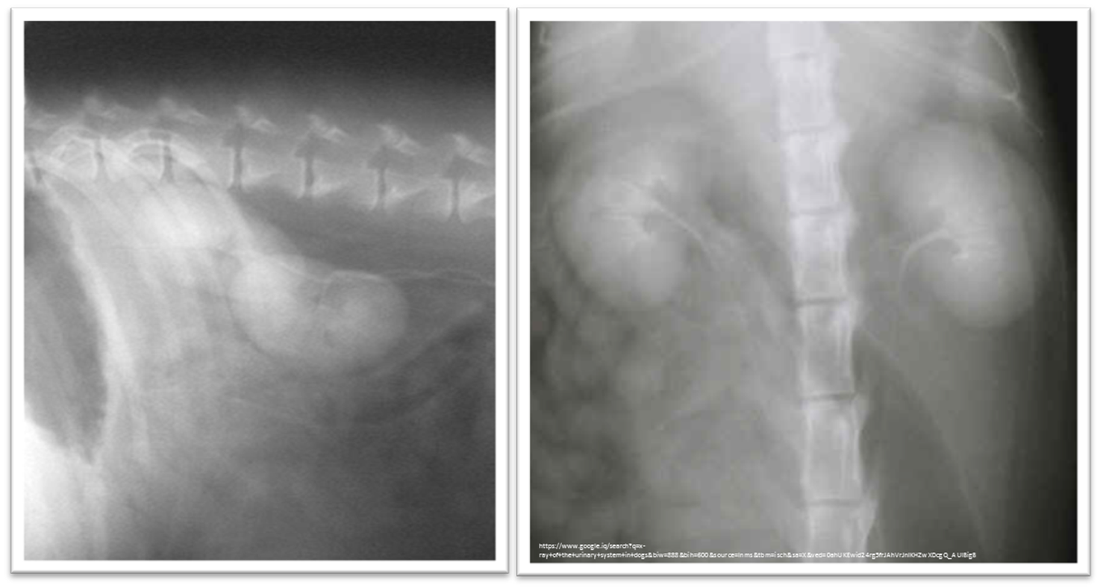
Radiological anatomy
(A) Lateral and (B) Ventro-dorsal views with Positive contrast agent (iodine compound –the iohexol) radiograph of the urinary system
A
B

Slide 15
Functional Unit of the Kidney
The basic functional unit of the kidney is the nephron
Dogs have an estimated 500,000 nephrons per kidney.
The nephron consists of the renal corpuscle and the renal tubules, which end at the collecting duct.
The renal corpuscle, which is found only in the renal cortex, is composed of the glomerulus and the glomerular capsule (also referred to as Bowman’s capsule).
The glomerulus is a tuft of capillaries enclosed within the glomerular capsule. Between the glomerulus and the afferent arterioles is a group of cells called the macula densa, these cells help maintain autoregulation of renal blood flow.

Slide 16
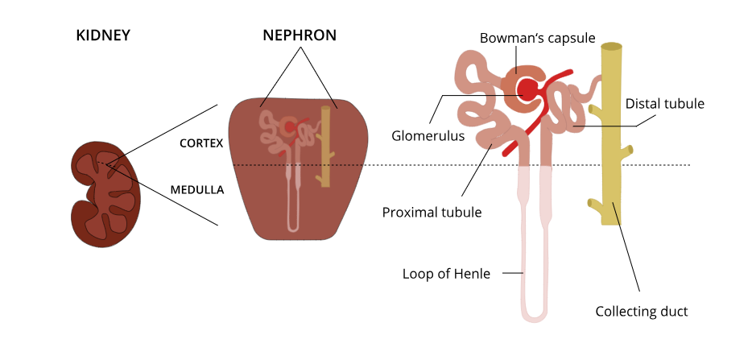
Functional Unit of the Kidney

Slide 17
Urine Formation and concentration
Normal urine production 20 - 45 mL/kg/d.
Urine begins as a filtrate that is created as water and small particles move through the filtration slits.
The creation of dilute urine requires the resorption of solutes from the filtrate, while the formation of concentrated urine requires the resorption of water from the filtrate.
These processes are accomplished in the various portions of the nephron. And controlled by Three hormones

Slide 18
The three hormones that is a chemical produced in the brain control the kidneys are:
Aldosterone, Antidiuretic hormone (ADH), and Atrial natriuretic factor.
Very important
Aldosterone: It stimulates the reabsorption of water and sodium and excretion of sodium and potassium ions.
Antidiuretic hormone (ADH): It stimulates the reabsorption of water from the distal tubules. A high ADH level causes the body to produce less urine. A low level results in greater urine production.
Atrial natriuretic factor ANF
is called the hormone of the heart. It is a protein-based hormone, secreted and released by the cardiac muscle cells. The synthesized hormones are released into the atrium in counter to the high blood pressure through the heart muscle cells

Slide 19
Special considerations of surgical urinary Affection
Premedicated: anticholinergic (i.e., atropine or glycopyrrolate), If the animal has minimal renal compromise, a thiobarbiturate, propofol as mask can be used for induction.
Ketamine should be avoided in cats with renal compromise.
If a dog is severely depressed, hydromorphone plus diazepam may allow intubation.
Urine output should be monitored during and after surgery.
Drug doses/ frequency should be altered as required by the degree of renal compromise
Patients with renal and heart failure require close monitoring during anesthesia

Slide 20
Special considerations of surgical urinary Affection
Antibiotics
The antibiotics are considered based on urine culture and susceptibility testing.
Potentially nephrotoxic antibiotics (aminoglycosides, tetracycline [except doxycycline], and sulfonamides) should be avoided, if possible.
Penicillins and cephalosporins are highly concentrated in urine.
Drug doses or dosing frequency should be altered as required by the degree of renal compromise.

Slide 21
Healing of the Upper Urinary Tract
When vascular injury is minimal, connective tissue and collagen rapidly repair renal parenchymal wounds.
Inflammation and infarction occur with parenchymal ischemia secondary to compression, electrocoagulation, vascular transection, or inflammation and delay wound healing.
Intraparenchymal hemorrhage increases the amount of fibrosis and renal damage, resulting in obliteration of local nephrons and dilatation and obstruction of renal tubules in the area of the hematoma.
Use of transparenchymal horizontal mattress sutures to stop hemorrhage, however, causes parenchymal necrosis, fibrosis, scarring, and atrophy.
Healing is more rapid when intraparenchymal vessels are individually ligated.

Slide 22
Materials and special instruments
Absorbable suture material, such as polyglactin 910 (Vicryl), polyglycolic acid (Dexon), polydioxanone (PDS), polyglyconate (Maxon), or poliglecaprone 25 (Monocryl) should be used in the kidney, ureter, and bladder.
Non-absorbable suture material should be avoided because it may promote calculus formation and infection.
The use of pediatric or ophthalmic instruments facilitates surgery of the ureter. These instruments tend to be smaller and more delicate and may cause less tissue trauma than larger instruments

Slide 23
ABNORMALITIES OF THE KIDNEY
Developmental Anomalies:
Renal Agenesis
Renal Ectopia -The kidneys normally “ascend” from the pelvic region to the level of the thoraco- lumbar junction. Ectopic kidneys are usually found within the pelvic area, although they may be found anywhere along the normal path of ascension or even in the thorax. Ectopic kidneys should function normally and may be found incidentally during routine abdominal imaging or exploratory surgery.
Fused Kidney -The fused kidney is often shaped more like a horseshoe rather than the more typical bean shape. Most fused kidneys function normally.
Polycystic Kidney Disease

Slide 24
ABNORMALITIES OF THE KIDNEY
Renal calculi (nephroliths or renoliths):
Causes & Pathophysiology:
over saturation of urine with calculogenic substances.
Plasma concentrations of calculogenic substances may be increased by a variety of causes such as
Organ dysfunction
Neoplasia (e.g., hypercalcemia secondary to parathyroid tumors or paraneoplastic syndrome)
Increased calcium intake
Drugs
Increased intestinal absorption
Impaired renal reabsorption
Excessive skeletal mobilization.
NOTE: Most feline calculi are composed of calcium salts (calcium oxalates, calcium phosphates)

Slide 25
Clinical Findings
Absent or nonspecific (e.g., vomiting, lethargy, anorexia) or may be associated with underlying diseases (e.g., encephalopathy or poor body condition.
Renomegaly, nonpainful hematuria, pyelonephritis, primary renal failure, and nonspecific abdominal pain (renal colic).
Changes on blood work are usually mild or absent unless obstruction, pyelonephritis.
NOTE: Abnormalities on urinalysis may include hematuria, pyuria, bacteriuria, or crystalluria.

Slide 26
Kidney surgery termology
1. Nephrectomy: is an excision of the kidney
2. Nephrotomy: is a surgical incision into the kidney.
3. Nephrostomy: is creation of a permanent fistula leading into the pelvis of the kidney; temporary nephrostomy tubes .
4. Nephropyelostomy Tube Placement is occasionally used to divert urine when obstructive uropathy occurs or when the proximal ureter has been avulsed from the kidney.

Slide 27
Causes of renal calculi & pathogenesis
Very important
Increased mineral salt concentration in the urine (can result from diet or urinary tract infection).
Increased water reabsorption by the kidneys
Changes in urine pH (can result from diet or urinary tract infection).
Urinary tract infection – bacteria produce urease, an enzyme that breaks down urea in dog urine resulting in a more alkaline urine pH.
Long term use of diuretics
Dehydration
Genetic predisposition - breeds include (but are not limited to) the bichon fries, lhasa apso, miniature schnauzer, and Yorkshire terrier.

Slide 28


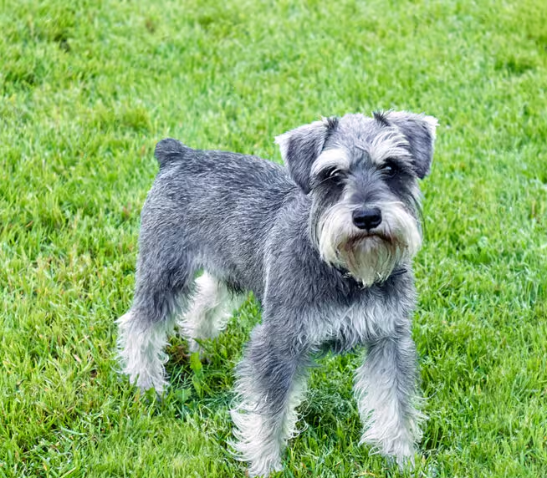

bichon fries lhasa apso miniature schnauzer Yorkshire terrier.

Slide 29
Indications
Very important
Surgery for Renal problem is recommended in:
Unresponsive pyelonephritis.
Perinephric abscesses or cysts.
Unilateral renal neoplasia.
Severe renal trauma.
Ureteral conditions that cause severe and irresolvable hydronephrosis.
Non-respond to treatment renal calculi.
Why only unilateral but not bilateral
What is hydronephrosis ?

Slide 30
Calculi types
Very important
Uric acid
Calcium oxalate
Struvite (magnesium ammonium phosphate)
Cystine
Calcium phosphate

Slide 31
Diagnosis of the Renal Calculi
Blood Examination- usually mild or absent unless obstruction, pyelonephritis.
Abnormalities on urinalysis may include hematuria, pyuria, bacteriuria, or crystalluria.
Urine cultures-often have no growth.
Diagnositic imaging technique-
a. X-ray
b. Ultrasonography
c. CT scan
d. MRI

Slide 32
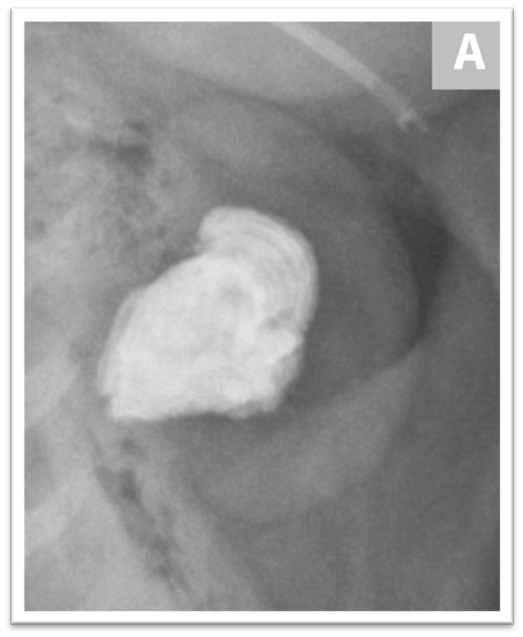
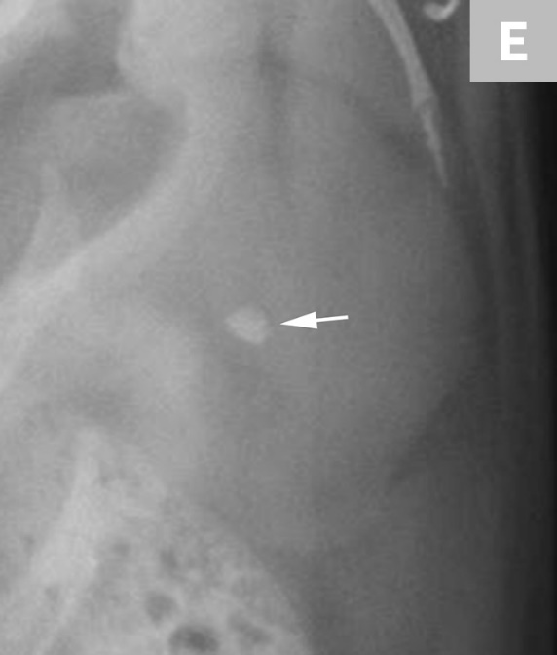
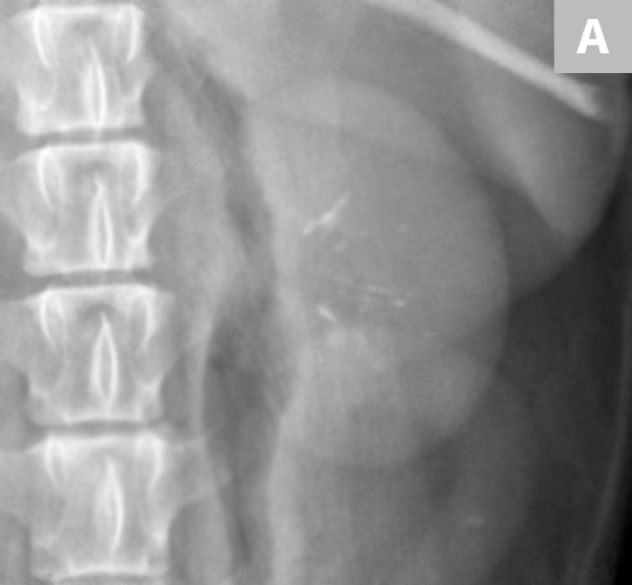
B
C
Close-up ventro-dorsal view radiograph of the left kidney with a large renal calculus in a clinically normal canine patient.
Close-up ventro-dorsal view radiograph of the left kidney in a different dog with a small renal calculus located within the region of the renal pelvis (arrow).
Close-up ventro-dorsal view radiograph of the left kidney in a dog with well-defined, linear regions of mineralization localized to renal diverticula.
These images are reused with permission from ‘Imaging of Calculi of the Urinary System’ by Dr. Daniel VanderHart, DVM, DACVR, Feb 2017, Clinician’s Brief.com.

Slide 33
Treatment of Renal Calculi
Dietary Adjustment: To adjust the PH to normal-These diets are normally low in protein, phosphorus and magnesium. A proper diet can result in stone dissolution within 2-12 weeks, in some situations
Medication-to dissolve the stone if it did not cause obstruction. Like Ursodiol.
ESWL: Extracorporeal shock wave lithotripsy has the advantage of removing stones without invasive surgery. High-energy sound waves break up the stones into small enough pieces to be flushed from the urinary tract
Surgery- usually with calcium oxalate.

Slide 34
Urinary Bladder and Urethra

Slide 35
Anatomy of The Urinary Bladder and Urethra
The bladder is a muscular sac a temporary storage reservoir for urine
- lies within the peritoneal cavity and is attached to the abdominal wall via loose, double-layer peritoneal ligaments.
The histological layers of the UB are urothelium, lamina propria, muscularis propria, and serosa
The mucosa of the urinary bladder (urothelium) is lined by a multilayered transitional epithelium
The urothelium's most superficial layer comprises dome-shaped umbrella cells whose shape becomes flat in a distended bladder
-The ventral median ligament, which can be cut before cystotomy, is a very thin structure connecting the bladder to the linea alba and pelvic symphysis.
In fetuses, this ligament contains the urachus. The lateral ligaments of the bladder attach to the pelvic walls and contain fat along with the distal portion of the ureter and umbilical artery on each side.
The lateral ligaments should be identified and avoided during dissection around the bladder to prevent iatrogenic damage to the ureters.

Slide 36
The urethra is a muscular tube that connects the urinary bladder to the outside
It is short in female, while is subdivided in male into:
a. Prostatic
b. Membranous
c. Penile urethra.

Slide 37
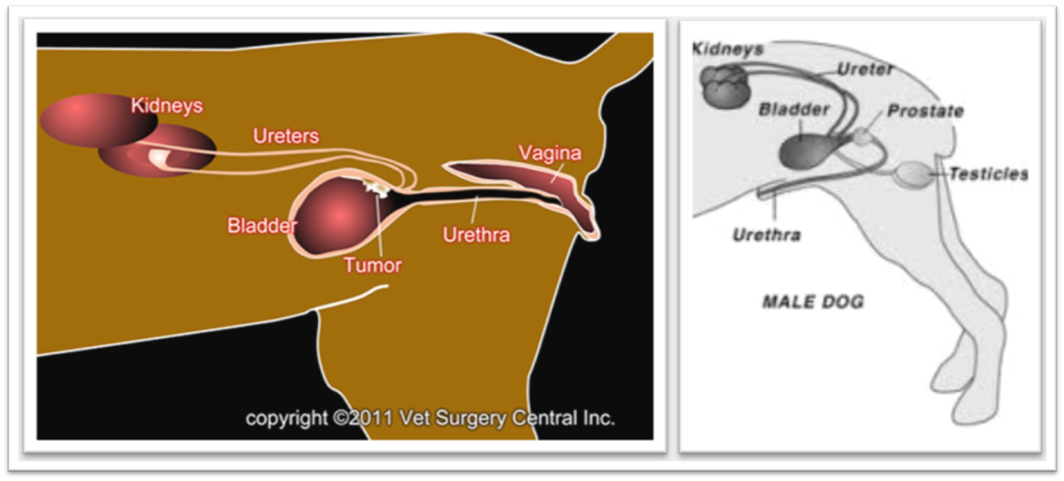
Surgical anatomy
A: Represents a female urinary system; while, B: Shows male urinary system

Slide 38
URINARY BLADDER AND URTHRAL AFFECTIONS

Slide 39
Congenital Abnormalities
The most frequently reported congenital bladder abnormalities in dogs and cats are vesicourachal diverticulae, urachus, bladder hypoplasia and genitourinary dysplasia in cats.
Other rare congenital anomalies include trigone diverticulae, bladder agenesis, bladder exstrophy, urachal cyst, urinary bladder duplication, and colocystic fistula.
Congenital bladder abnormalities are easily diagnosed by positive-contrast cystography, although overdistension of the bladder must be avoided because this could obscure small vesicourachal diverticulae
Hypospadias is a relatively rare developmental anomaly that results from failure of fusion of the urogenital folds, leading to incomplete formation of the urethra
Epispadias is failure of fusion of the dorsal urethra

Slide 40
2. Acquired abnormalities
Urinary bladder or urethral rupture
Urinary bladder or urethral calculi
Urinary bladder or urethral neoplasm
Urethral stricture
Urethral obstruction
Urethral Prolapse
NOTE : Canine Urethral Prolapse is a health condition characterized by extrusion of the tail end segment of the urethra through the external urethral opening.

Slide 41
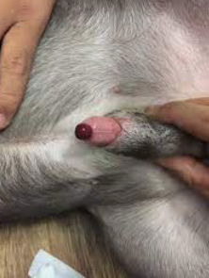
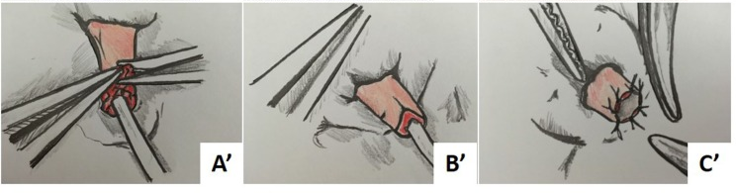

Slide 42
Diagnostic Techniques

Slide 43
A. Cystocentesis
Very important
Cystocentesis (obtaining urine directly from the urinary bladder by inserting a needle through the body wall) is common and considered the ideal method for obtaining urine for urinalysis and culture and susceptibility testing
The most accurate method of obtaining urine for bacterial culture and cytologic evaluation.
It is useful to decompress a distended, obstructed bladder that cannot be catheterized to help stabilize an animal before further investigation and treatment.
It is performed easily and safely in most dogs and cats with a 22- or 24-gauge needle and a syringe.

Slide 44
Urine analysis
Investigation and treatment of concurrent urinary tract infection before or after bladder surgery are important to reduce the risk of complications and maximize the likelihood of a successful outcome.
Transitional cells are a normal finding, but neoplastic cells may also be identified on cytology.
The pH, crystal type, and presence of urinary tract infection may help guide the prediction of calculi type.

Slide 45
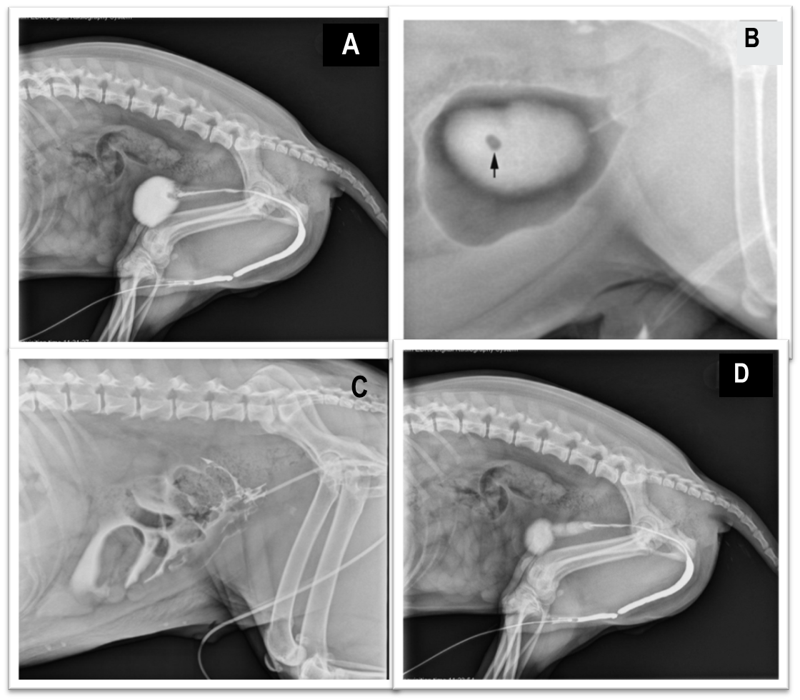
A Positive (A, C and D) and double contrast agent (B) radiological images of the urinary system.
These images are reused with permission from ‘Imaging of Calculi of the Urinary System’ by Dr. Daniel VanderHart, DVM, DACVR, Feb 2017, Clinician’s Brief.com.

Slide 46
C. Catheter Biopsy
Tissue from bladder and urethral masses is easy to obtain noninvasively by applying suction using a syringe via a urinary catheter that has been advanced to lie at the level of the mass.
Using ultrasound guidance is recommended because it will verify the position of the mass next to the catheter tip, and the ultrasound transducer can be used to carefully push the bladder mass against the catheter tip.

Slide 47
D. Blood and urine examination
Ex.
CBC (Complete Blood Count)
Creatinine (which is a waste product produced by the muscles, gets filtered out by the kidneys. creatinine in the blood can be a sign of impaired kidney function
Uric acid is a normal waste product formed during the breakdown of chemicals called purines. Purines come from cells when they die. Purines are also found in many foods and beverages

Slide 48
Urinary bladder caculi

Slide 49
Bladder Calculi Urolithiasis is common in dogs and cats, with one prospective study in cats identifying uroliths in 21% of those presenting with clinical signs of lower urinary tract disease.
Urolithiasis often involves one or more sites in the urinary tract, but the bladder is the most common location for the occurrence and removal of calculi.

Slide 50
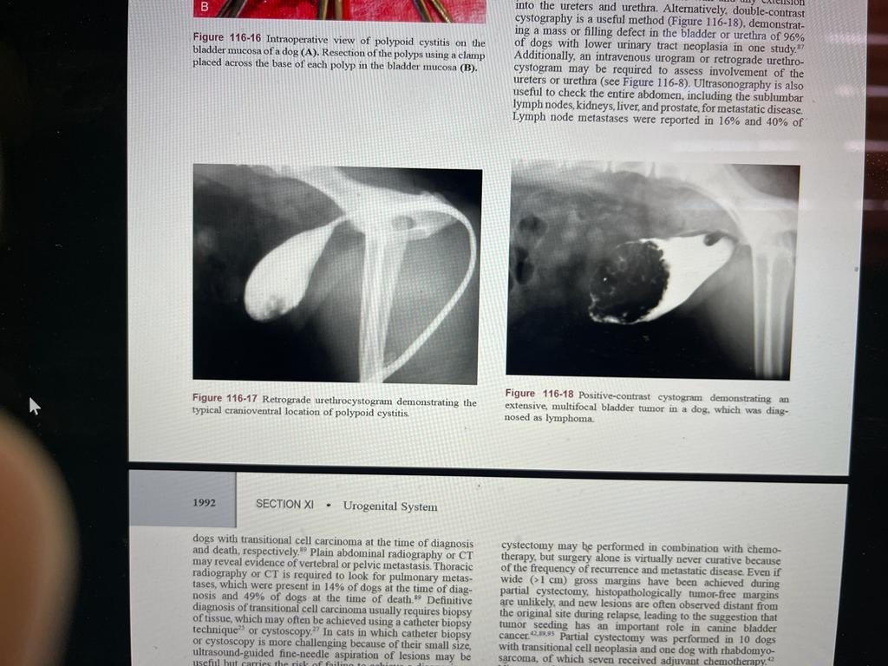
Polypoid Cystitis: a rare lesion of the bladder mucosa characterized by inflammation, epithelial proliferation, and development of a polypoid mass without histopathologic evidence of neoplasm.
Cystic neoplasia a cancer within the urinary bladder
A
B
This figure shows A) Polypoid Cystitis after giving contrast agents, while, B) shows the Cystic neoplasia. These images were taken from Tobias 2012.

Slide 51
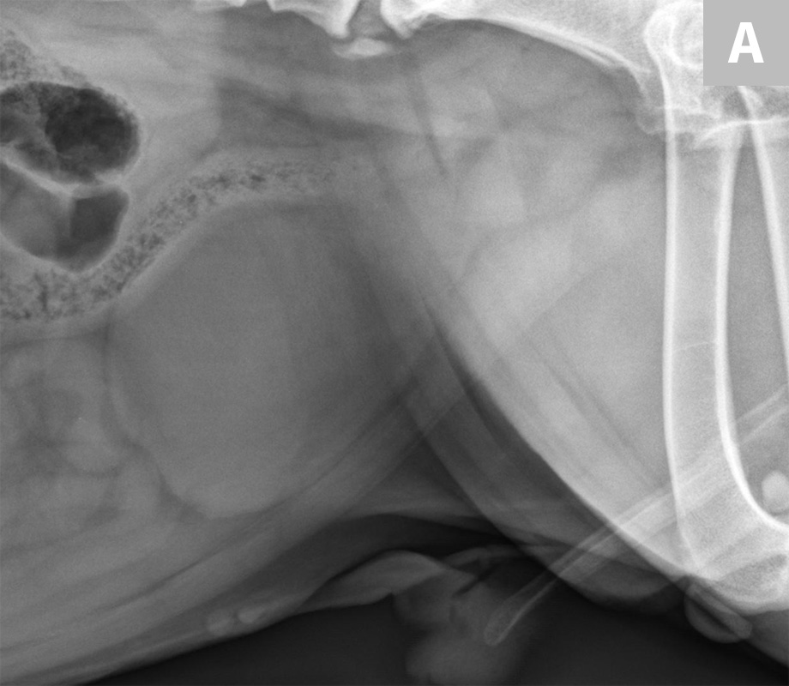
Lateral radiograph of a bulldog presented for recurrent hematuria The study was negative for mineral opaque urinary bladder calculi.
These Images Are Reused With Permission From ‘The Veterinary Radiology Website (http://www.veterinaryradiology.net/5049/8-year-old-springer-spaniel/) by Allison Zwingenberger

Slide 52
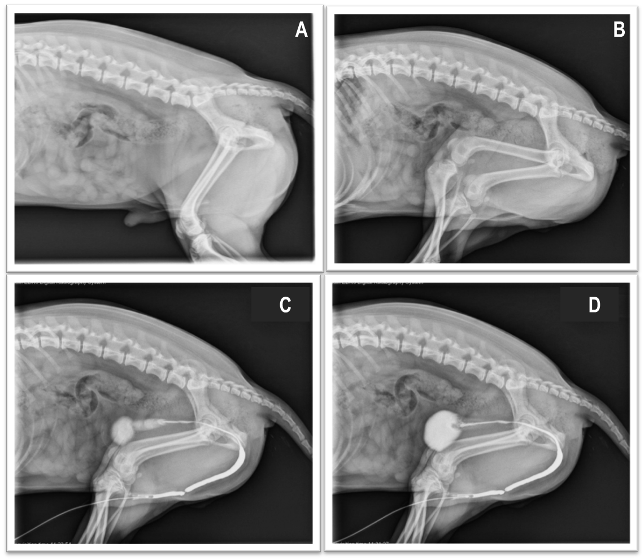
A&B: Plain Lateral abdominal radiograph of a dog. C&D: Lateral abdominal radiograph with contrast agent showing the urethral stricture.
These images are reused with permission from ‘Imaging of Calculi of the Urinary System’ by Dr. Daniel VanderHart, DVM, DACVR, Feb 2017, Clinician’s Brief.com

Slide 53
Thank you
Any Question?

