Slide 1


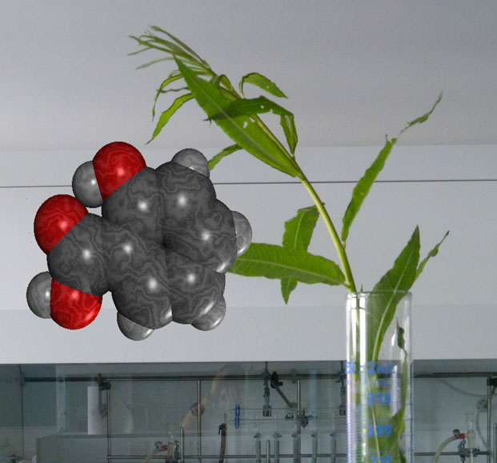
2023 - 2024
Salicylates

Slide 2
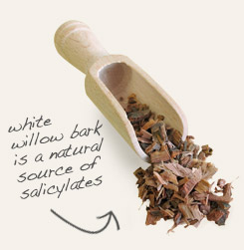
Historically,
salicylates were among the 1st of the NSAIDs that are recognized as analgesics.
The parent cpd. Salicylic acid has been known since 1839 and it is found as free form, salts & esters.
Salicylic acid (from Latin salix , willow tree, from the bark of which the substance used to be obtained) is an beta- or ortho-hydroxybenzoic acid.

Slide 3
Salicylates have been introduced for a variety of purposes such as:
1- Preservative for food and pharmaceuticals.
They have strong antiseptic and germicidal properties.
2- Local treatment of warts, corns and athlete's feet.
They have good escharotic and keratolytic properties.
3- Internally, (although seldom taken in the free state).
They show good anti-inflammatory , antipyretic and
analgesic activities characteristics of their many
commonly used salts and derivatives.

Slide 4
Derivatives of S.A. were introduced in an attempt to:
1- Minimize the gastric symptoms
Gastric disturbances , hemorrhage , irritation.(Pka=2.97).
2- Minimize the undesirable taste
3- Prepare suitable dosage forms
4- Improve the physicochemical properties
Types of S.A. derivatives:
Type I:
Represents those that are formed by modifying the carboxyl group
of S.A. , ( e.g. salts, esters or amides ) .
Type II:
Represents those that are derived by substitution on –OH group of
S.A.

Slide 5
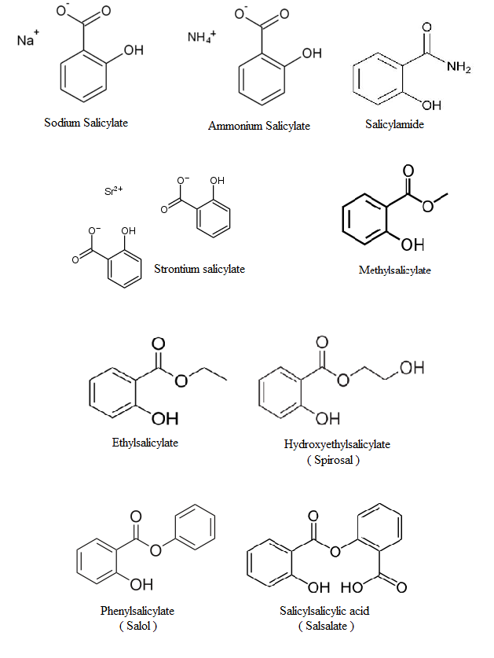
Examples (Type I derivatives):

Slide 6
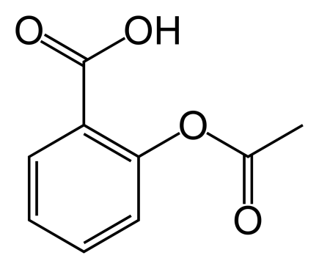
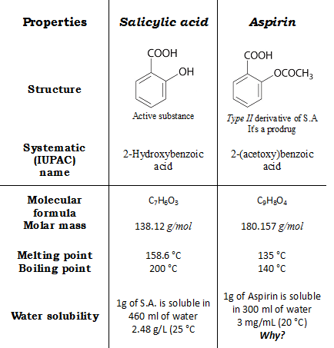
Example ( Type II derivative) :
Aspirin, C₉H₈O₄, Acetyl salicylic acid.
Differences between S.A and aspirin :

Slide 7
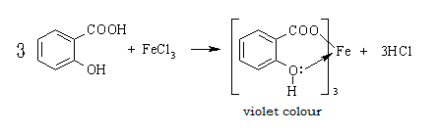
Given orally | Externally Not given orally Why? | Route of administration
S.A. contains phenolic - OH group and it is ortho to the carboxyl group. It forms a violet colored complex when reacted with FeCl3.
FeCl₃ is used to detect the presence of phenol compounds in organic synthesis e.g.: examining purity of the synthesized aspirin.

Slide 8
Preparation of S.A.:
1- Kolbe reaction ( industrial method ).
2- Oxidation of salicylaldehyde.
3- Alkaline hydrolysis of ester.
1-Kolbe reaction :(electrophilic aromatic substitution)
It is a carboxylation chemical reaction that proceeds
by heating sodium phenolate ( the sodium salt of
phenol ) with CO2 under pressure (100 atm , 125 °C),
then treating the product with sulfuric acid .
The final product is an aromatic hydroxy acid which
is known as salicylic acid (the precursor to aspirin).
The mechanism of the reaction:
The Kolbe – Schmitt reaction proceeds via the nucleophile addition
of a phenolate to carbon dioxide to give the salicylate.
The final step is the reaction of the salicylate with acid to form the
desired salicylic acid.

Slide 10
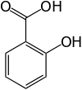

Some p-hydroxybenzoic acid is formed ( in small quantities ) as well, the separation of the two isomers can be carried out by steam distillation, the (ortho isomer being more volatile (sublimes at 76). (Why?
Compound Structure
Compound name | o-hydroxybenzoic acid (S.A.) | p-hydroxybenzoic acid
Molecular formula | C₇H₆O₃ | C₇H₆O₃
Molecular weight | 138.121 g/mol | 138.121 g/mol
Appearance | colorless to white crystals | white crystalline
Melting point | 159 °C | 214.5 °C

Slide 11
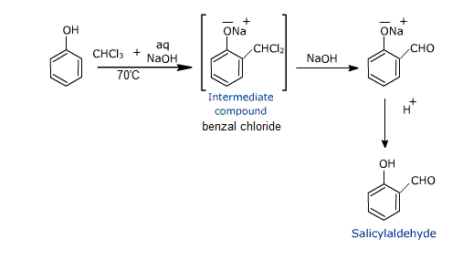
2- Oxidation of salicylaldehyde:
On treating phenol with chloroform in presence of sodium hydroxide
an aldehyde group , a - CHO group, is introduced at ortho position of
benzene ring . This reaction is known as Reimer – Tiemann
reaction. This results in the formation of o – hydroxybenzaldehyde (salicylaldehyde) and p – hydroxybenzaldehyde .
The ortho isomer being the major product.

Slide 12
Mechanism of the reaction:
Reimer Tiemann reaction is an electrophilic substitution reaction. The first step is the generation of electrophile.
Dichlorocarbene contains a sextet of electrons & thus is a strong electrophile.

Slide 13




3- Alkaline hydrolysis of ester:
An ester is hydrolyzed either by aqueous base ( Saponification ) or by aqueous acid, to yield a carboxylic acid plus an alcohol.
Mechanism of Saponification:
Nucleophilic addition of OH ⁻ ion to the ester carbonyl group
gives the usual tetrahedral alkoxide intermediate.
Elimination of alkoxide ion, (RO-), then generate the carboxylic
acid.
Alkoxide ion abstracts the acidic proton from the carboxylic acid & yields a carboxylate ion.
Protonation of the carboxylate ion by the addition of aqueous
mineral acid in a separate step then gives the free carboxylic acid.

Slide 14
Mechanism of Base-catalyzed ester hydrolysis
( Saponification )

Slide 15
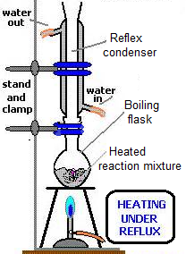
Name of Experiment: Alkaline Hydrolysis of Ester.
Aim of experiment: Preparation of Salicylic Acid by Alkaline
hydrolysis of Methylsalicylate.
Procedure:
1- Put 2.1 ml of
Methylsalicylate in
250 ml boiling flask
with few boiling chips.
2- Add 25ml of 20% aq. NaOH solution
& mix ; at this point a white ppt.
appears which will re-dissolve again
by heating .
3- Reflex for 15 – 20 min.

Slide 16
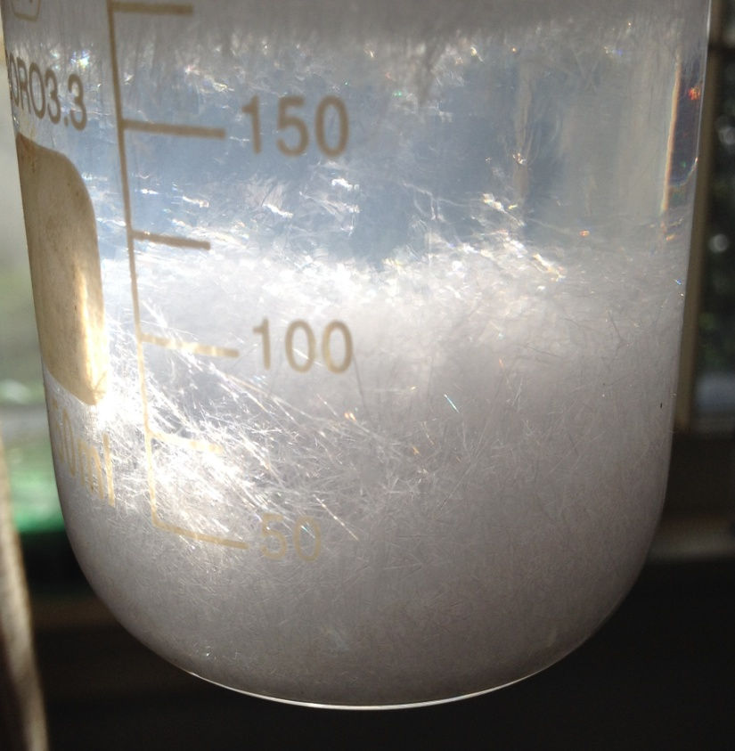

4- Stop reflex, cool & transfer the mixture to a beaker.
5- Add 35 ml of dil. H₂SO₄ to get the acid ( S.A. ppt. ).
6- Further cooling is required then filter & collect the ppt.
7- Recrystalize S.A. from the
minimum amount of hot water
The white solid that is formed immediately ( before reflex )
when methylsalicylate was introduced to the aqueous solution
of NaOH is the Na salt
of methylsalicylate that
will disappear by
boiling ( redissolve ).

Slide 17
Safety and Health Notifications
Salicylic acid:
Eye hazards(severe irritation), Skin hazards(mild irritation), danger, and it has been listed as experimental teratogen.
Salicylic acid upon heating converts to phenyl salicylate with further heating it gives xanthone.
At the boiling point =200-230, it slowly decomposes or degrades to phenol and CO2.
With log P= 2.25, using high concentration ointment of salicylic acid will lead to absorption to blood stream across the skin.

Slide 18
Safety and Health Notifications
Methyl salicylate:
Harmful, use with warning. It is potentially deadly especially for young children who may accidently ingest preparations containing methyl salicylate. Also excessive application of topical muscle pain-relief products can be toxic and fatal due to accumulation of salicylate in blood plasma or serum.

Slide 19
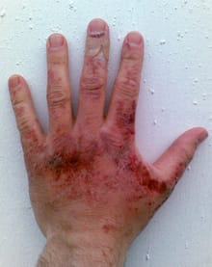
Safety and Health Notifications
NaOH:
Caustic soda and danger. It can readily decompose proteins and lipids via amide and ester hydrolysis with consequently chemical burns and may induce blindness if contact with eyes. The alkali spills on skin is first aided with irrigation with large quantities of water continued for at least 10-15 min.

